Slide 1
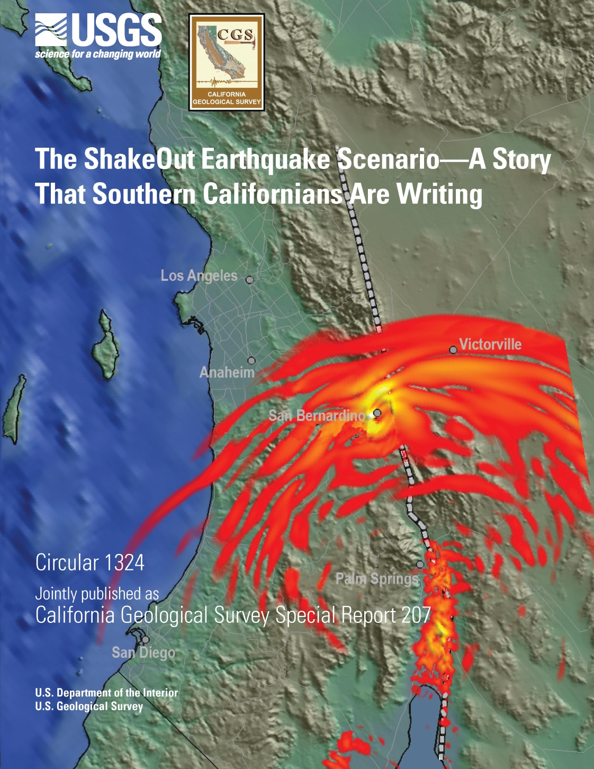
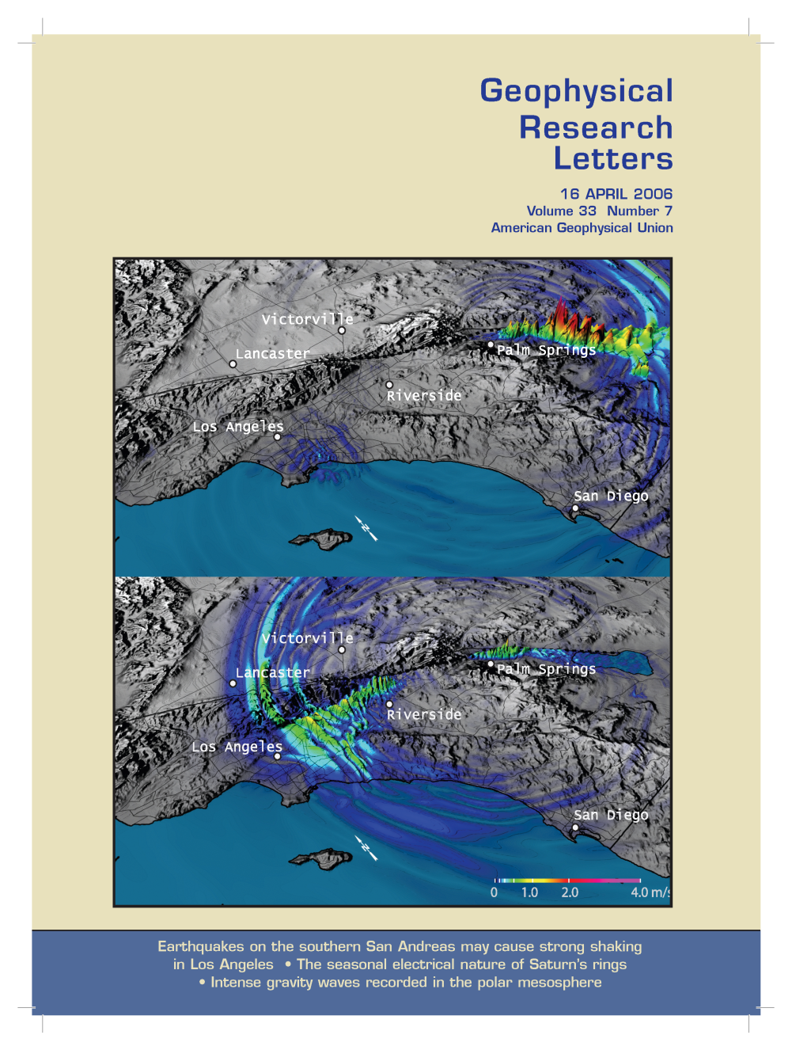
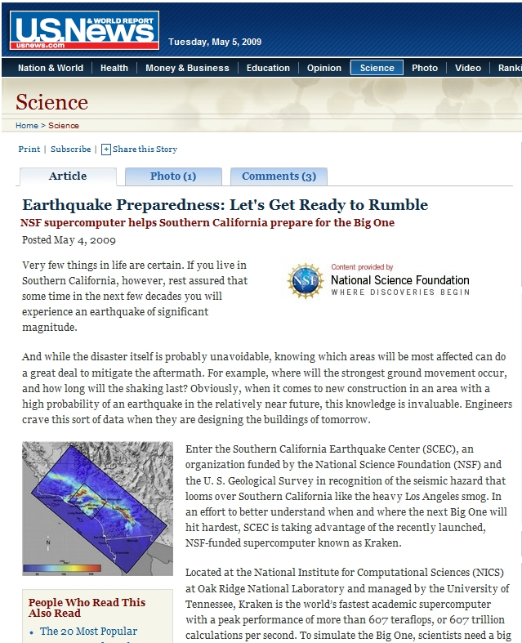
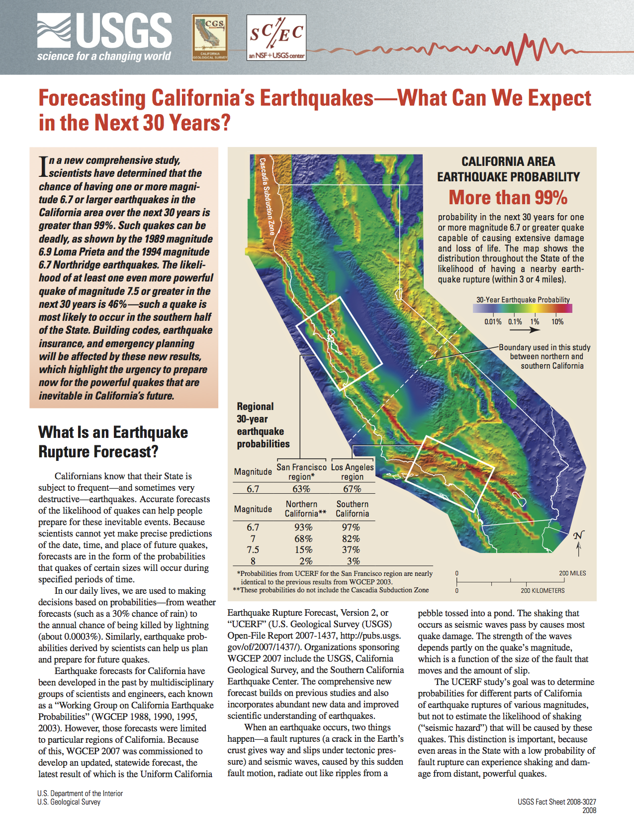

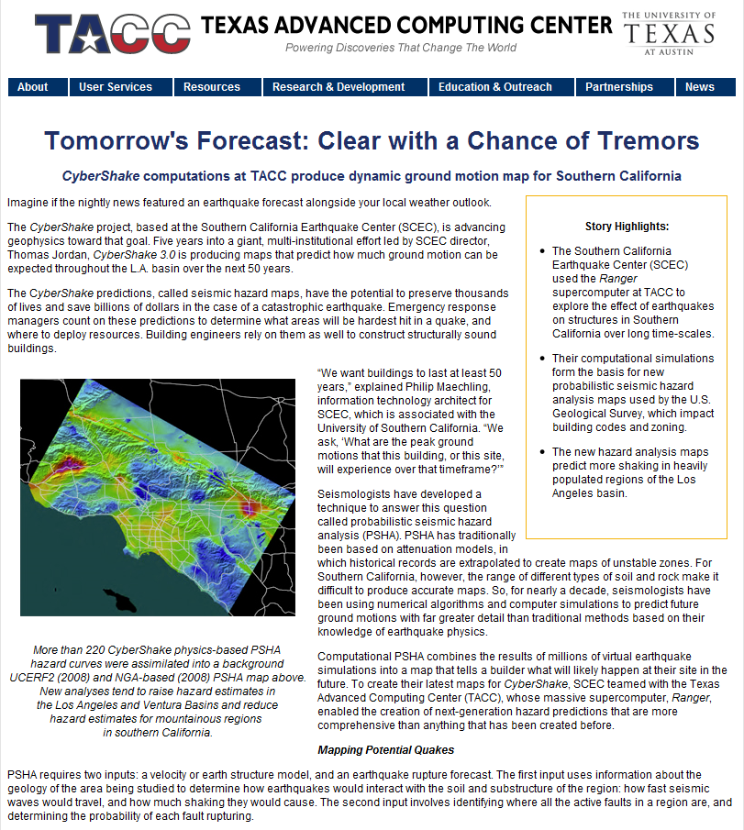
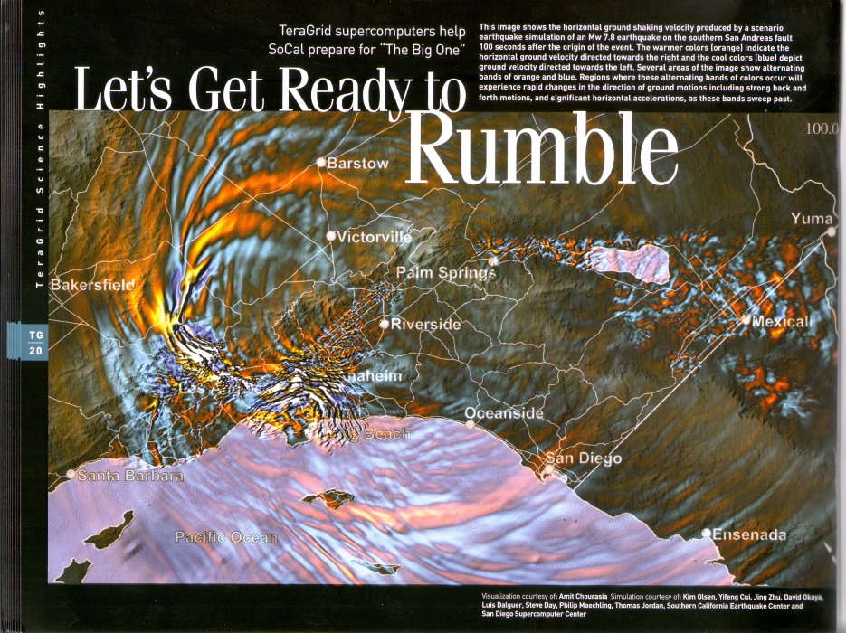
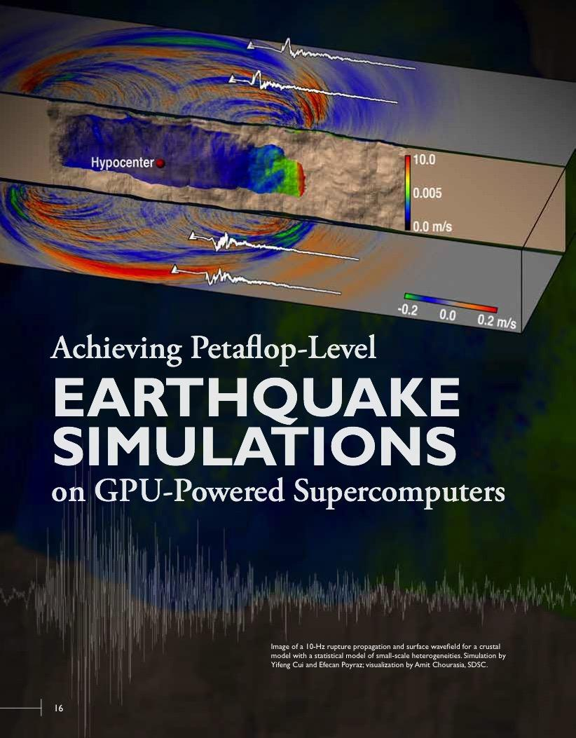


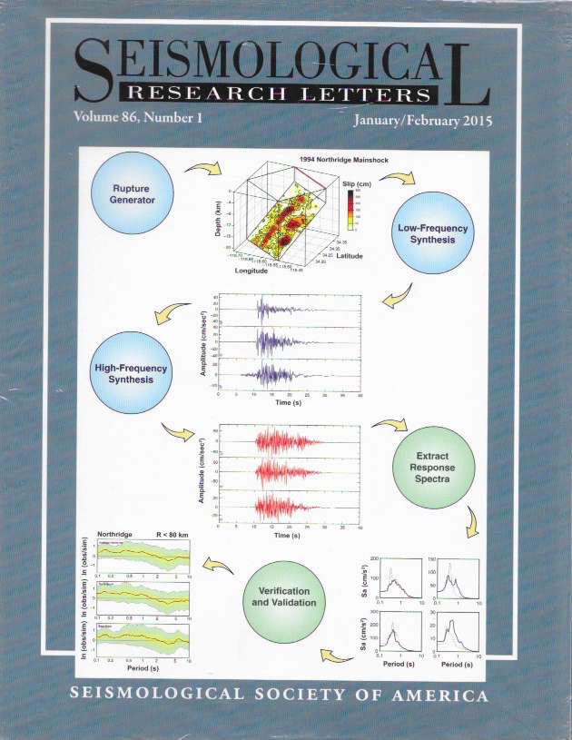


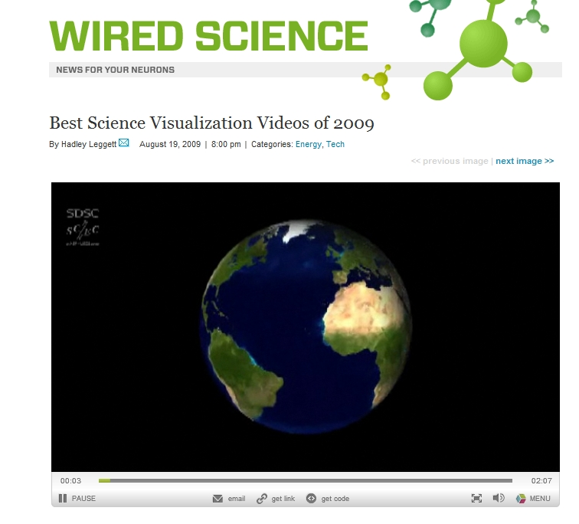
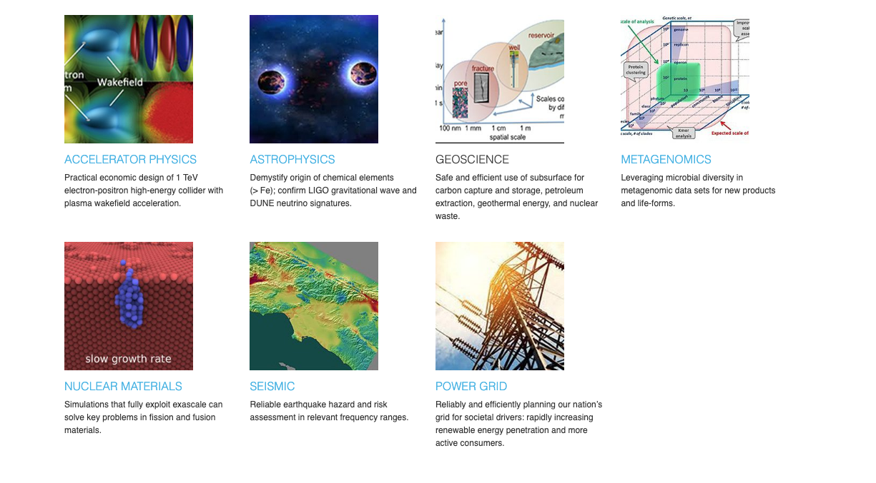
Examples of SCEC’s Research Computing Science Communications

Slide 2
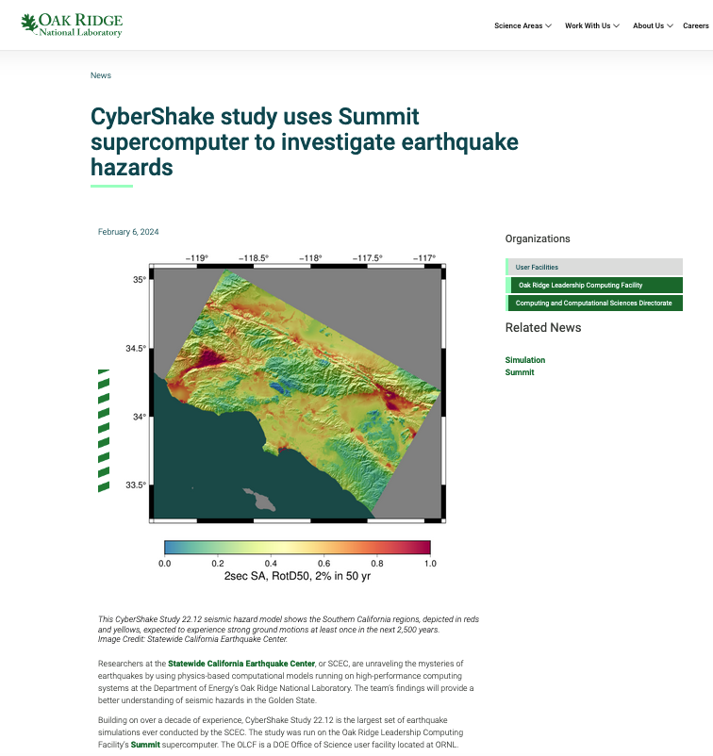
DOE Oak Ridge Leadership Computing Facility (OLCF) article about SCEC’s CyberShake v22.12 probabilistic seismic hazard research which used the OLCF Summit supercomputer to calculate both low-frequency and broadband PSHA hazard models for southern California (2024)

Slide 3
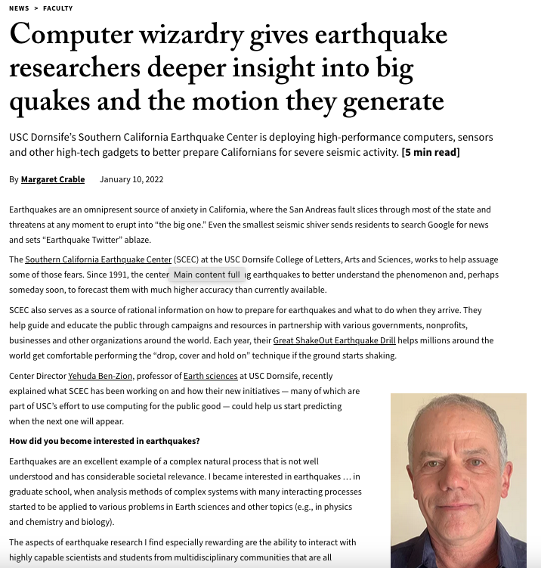
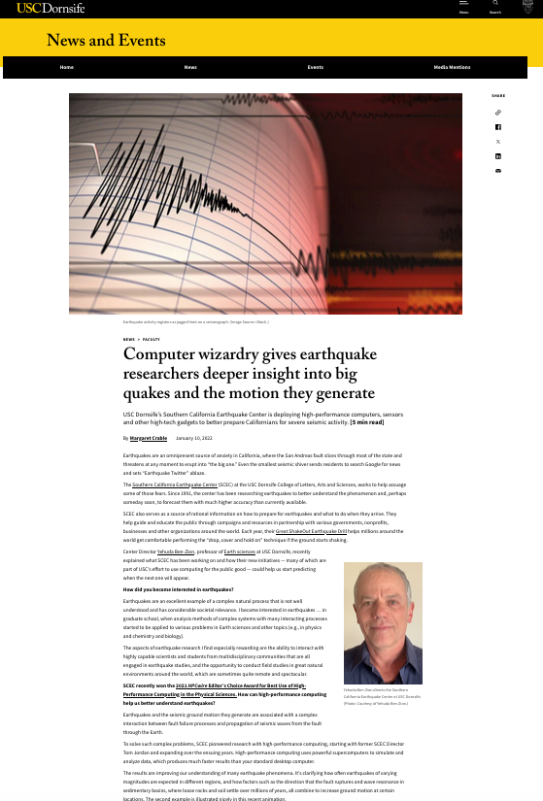
USC Dornsife article describes research activities at SCEC (2022)

Slide 4
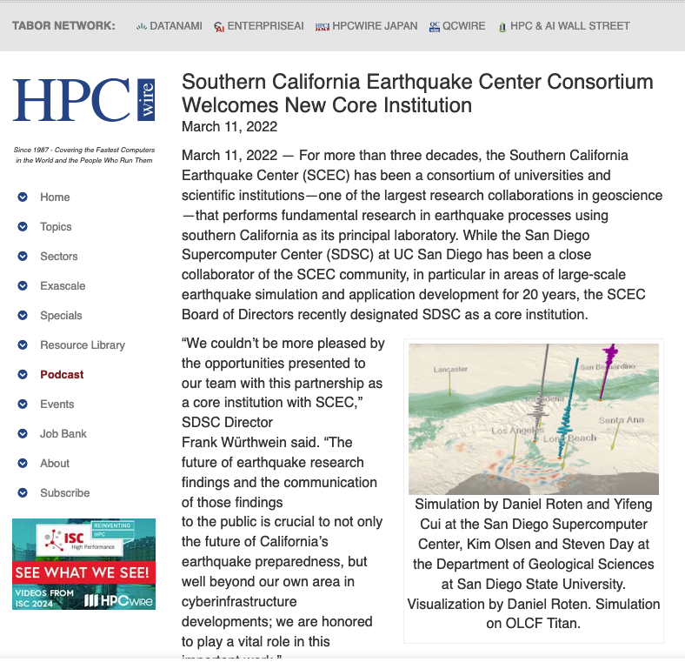
SCEC collaboration with San Diego Supercomputer Center in the HPC Press (2022)

Slide 5
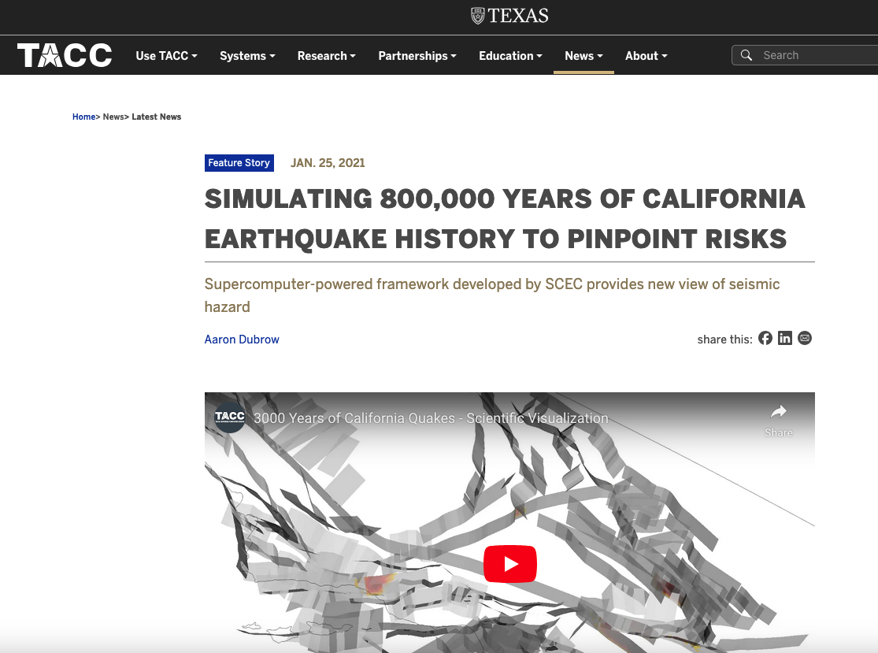
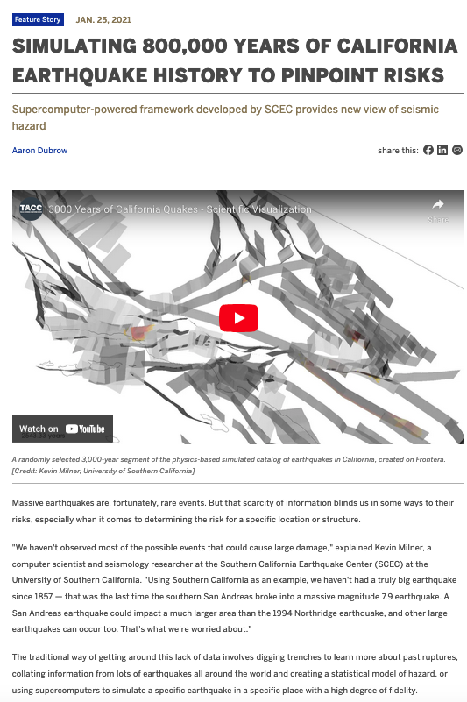
SCEC RSQSim On TACC Systems (2021)

Slide 6
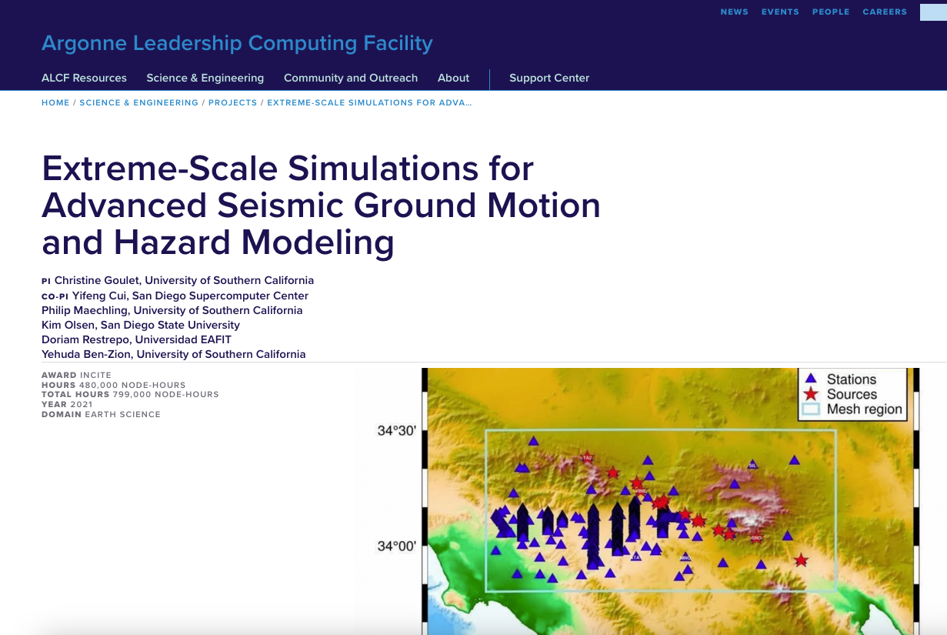
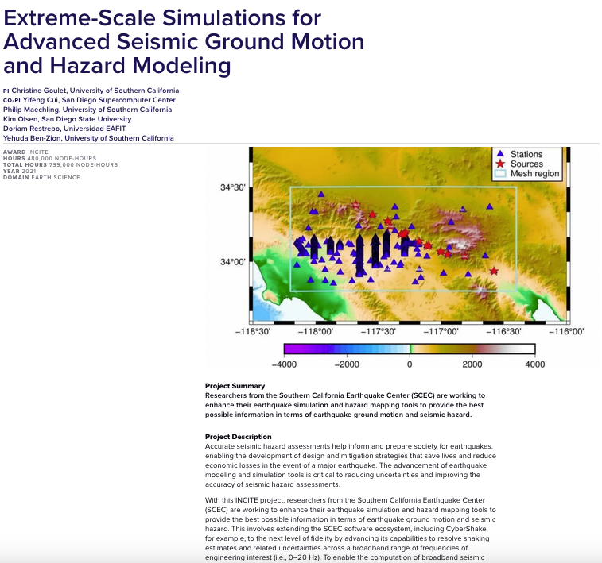
Argonne National Laboratory Leadership Computing Facility research computing (2021)

Slide 7
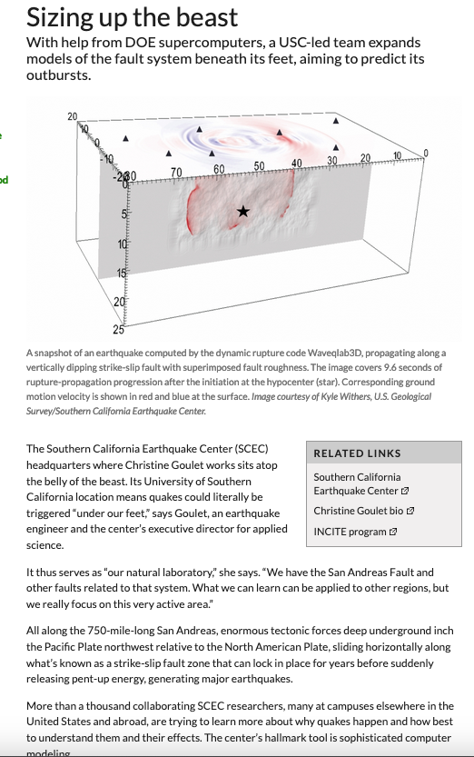
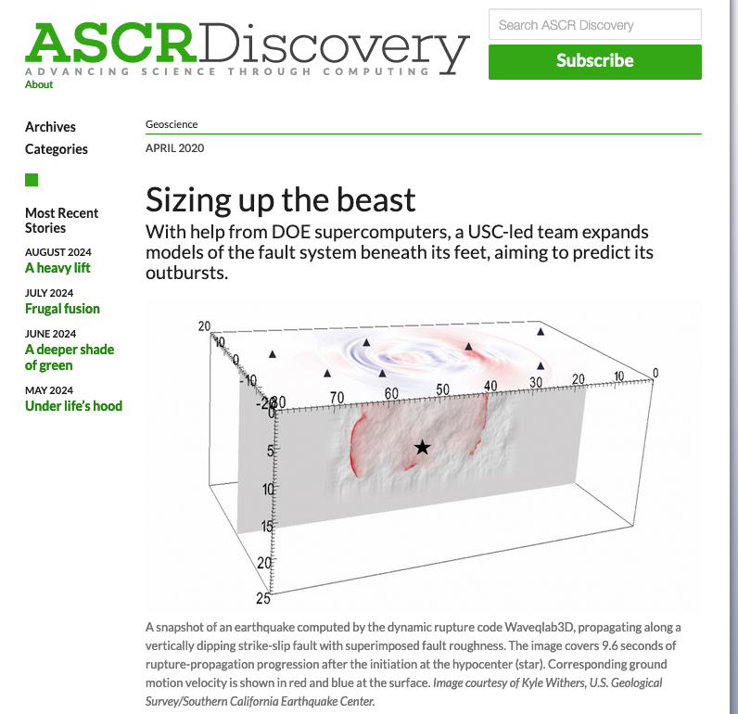
DOE ASCR article about the impact of SCEC computational research on dynamic rupture models (2020)

Slide 8
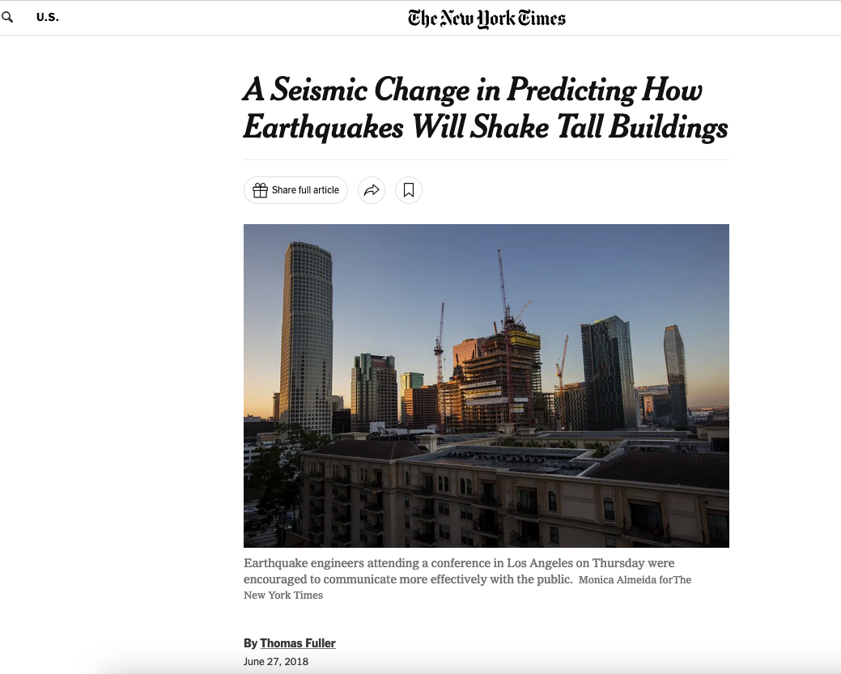
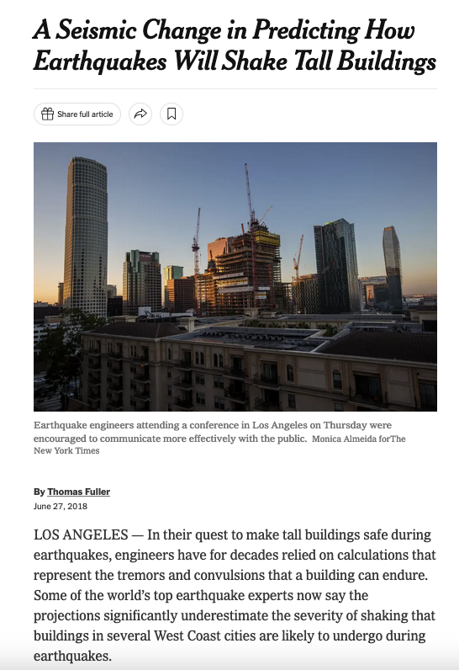
NY Times article about the impact of SCEC computational research on hazard and risk estimates (2018)

Slide 9
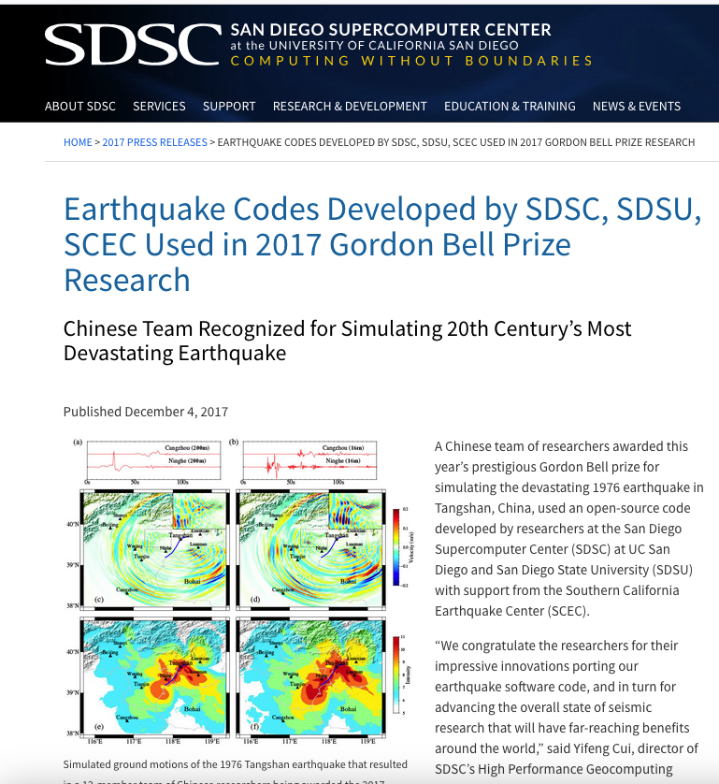
SDSU,SDSC,SCEC codes used in Gordon Bell prize simulations (2017)

Slide 10
DOE Exascale Computing Project target research applications included SCEC CyberShake research (2017)

Slide 11

SCEC’s large-scale computational research computing projects require collaborations between geoscientists and computer scientists, supercomputer resource providers, and vendors. (Cray 2018)

Slide 12
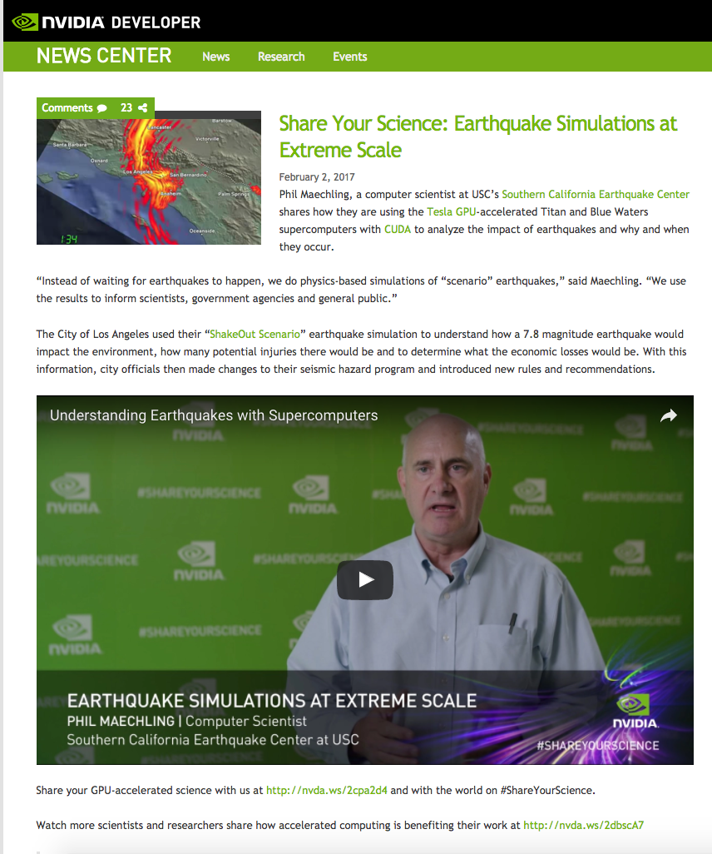
SCEC’s large-scale computational research computing projects require collaborations between geoscientists and computer scientists, supercomputer resource providers, and vendors. (NVIDIA Interview 2017)

Slide 13
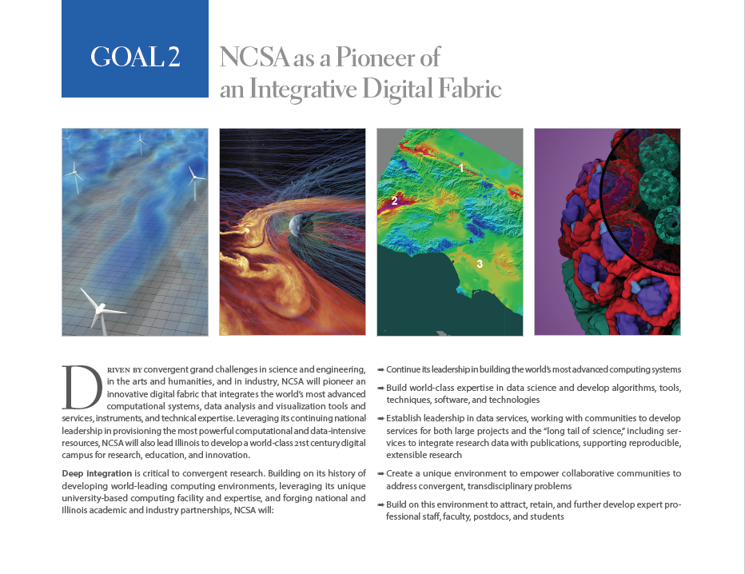
SCEC research as exemplar in NCAS 2020 Planning

Slide 14


Slide 15

SCEC Broadband Platform Software Publication and Cover in SRL (Jan 2015)

Slide 16
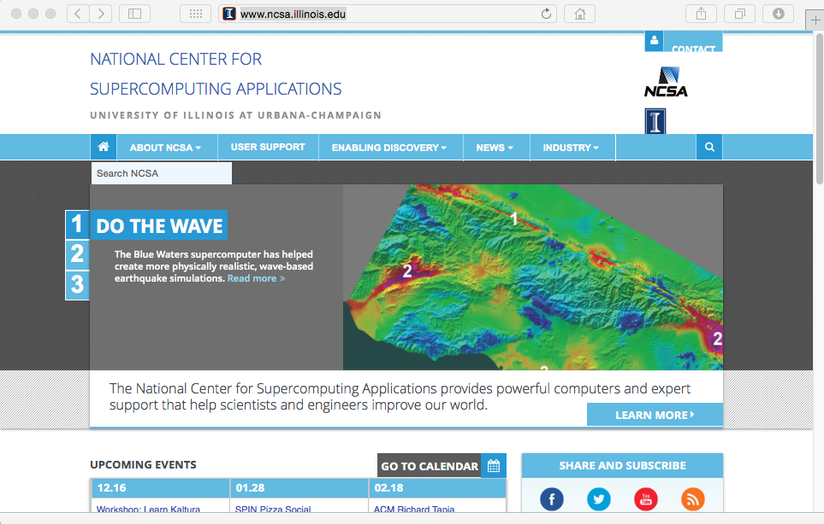
NCSA Website
Jan 2015

Slide 17
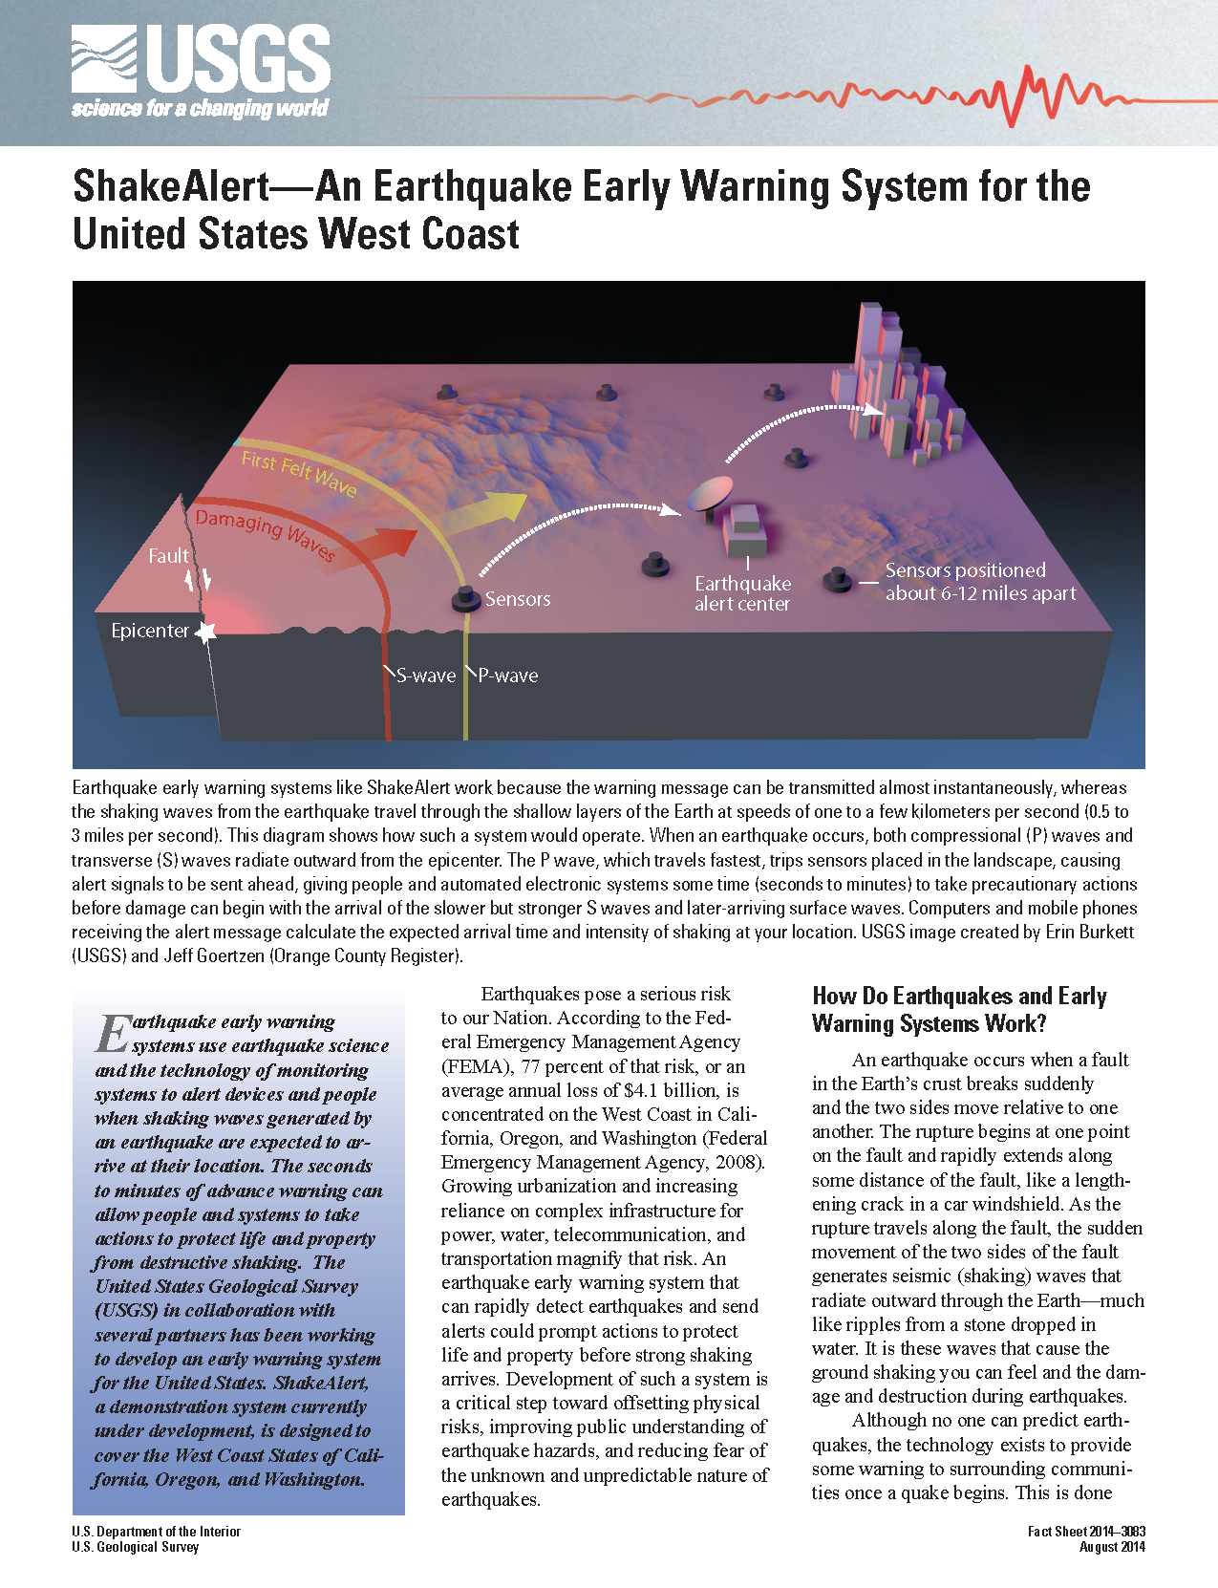
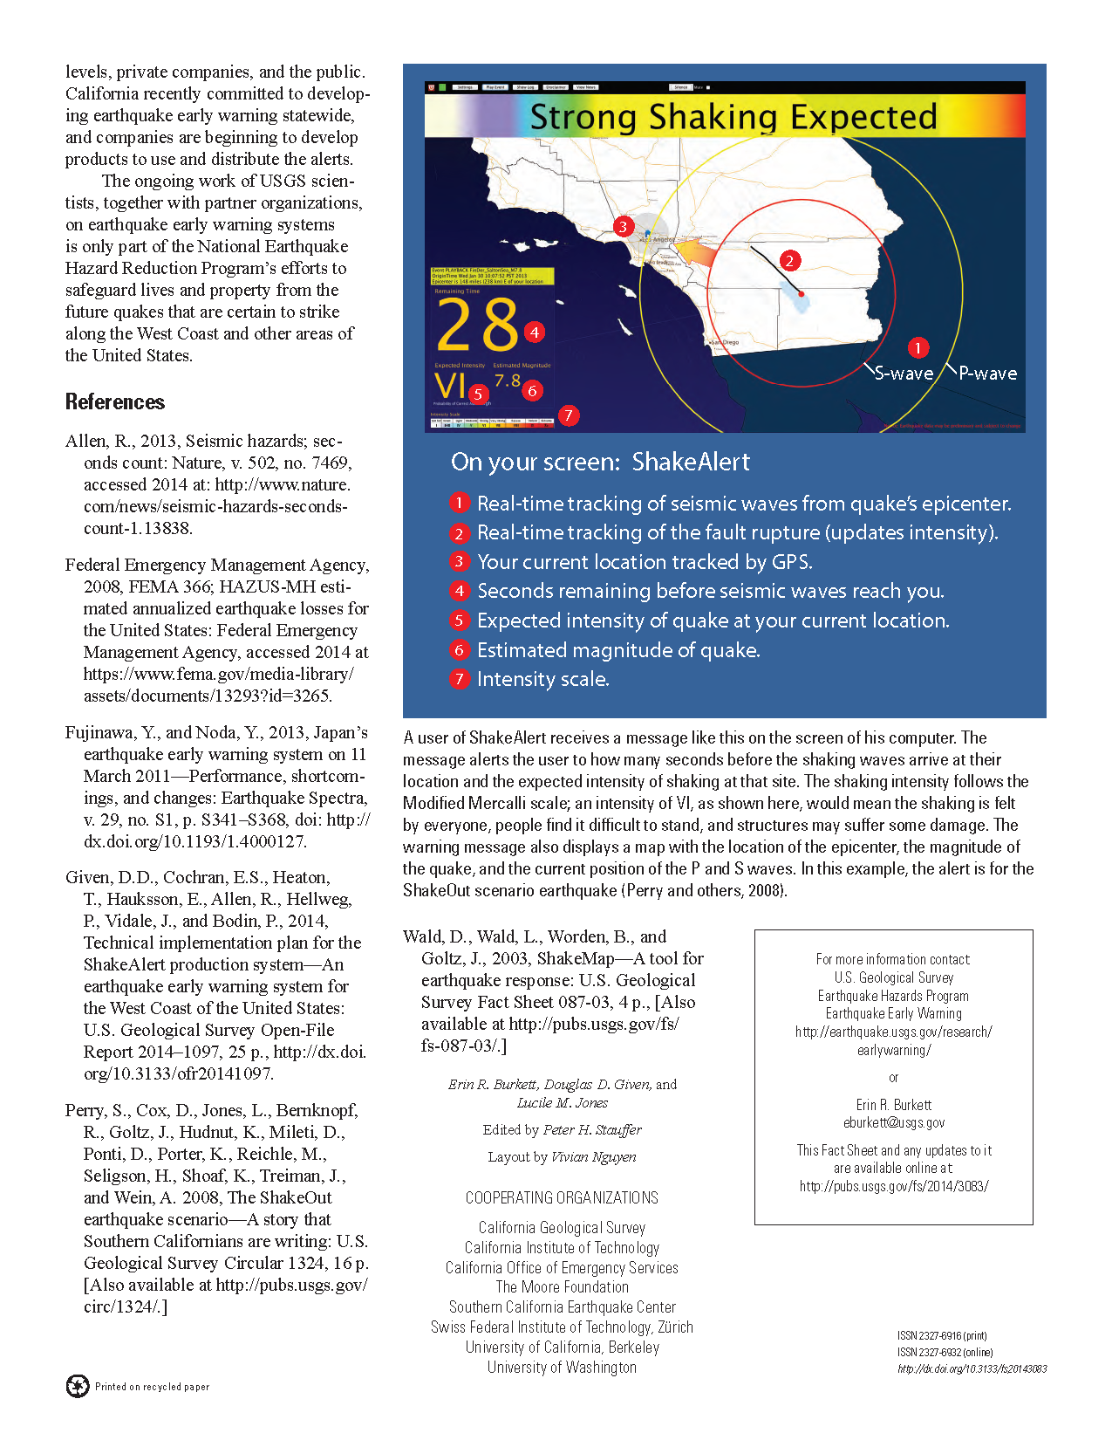
Developed testing center for ShakeAlert methods prior to public distribution of earthquake early warnings (2013)

Slide 18
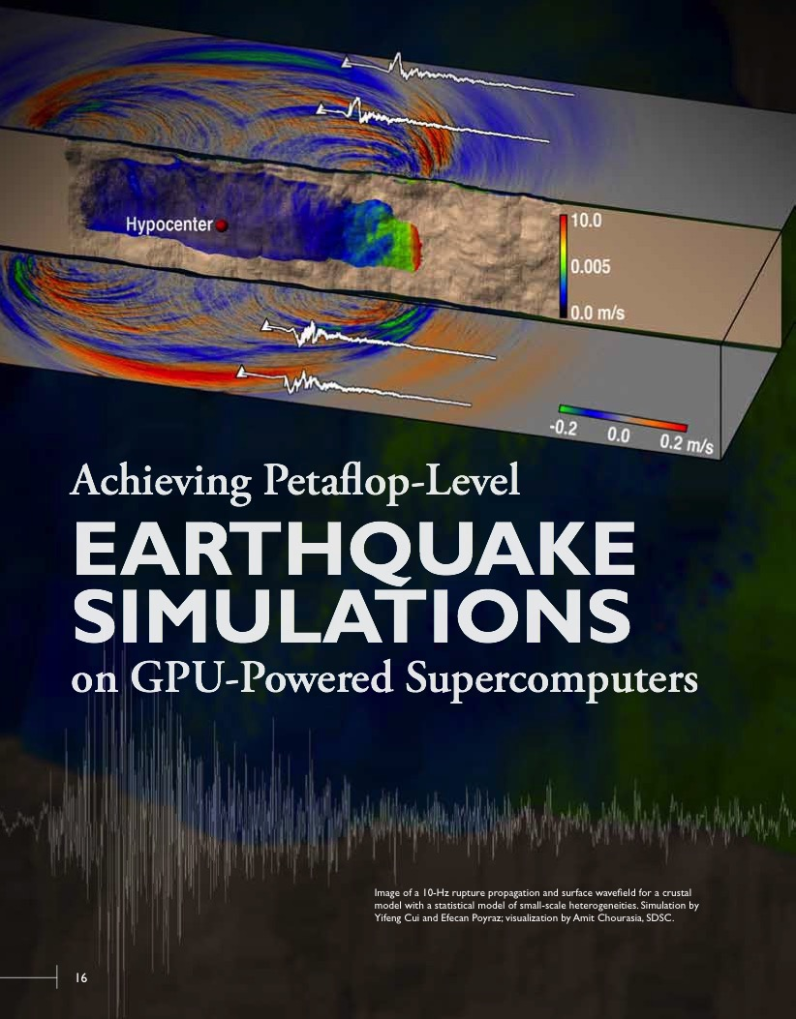
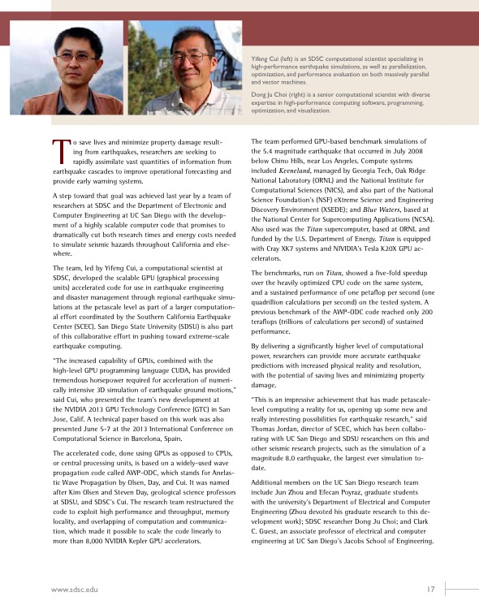

SDSC Science Highlights about SCEC - 2013

Slide 19
SDSC Science Highlights about SCEC - 2013

Slide 20
Cray SC’13 Case Study about SCEC - November 2013

Slide 21
California State Department of Water Resources Use of Broadband Platform Usage - October 2013

Slide 22
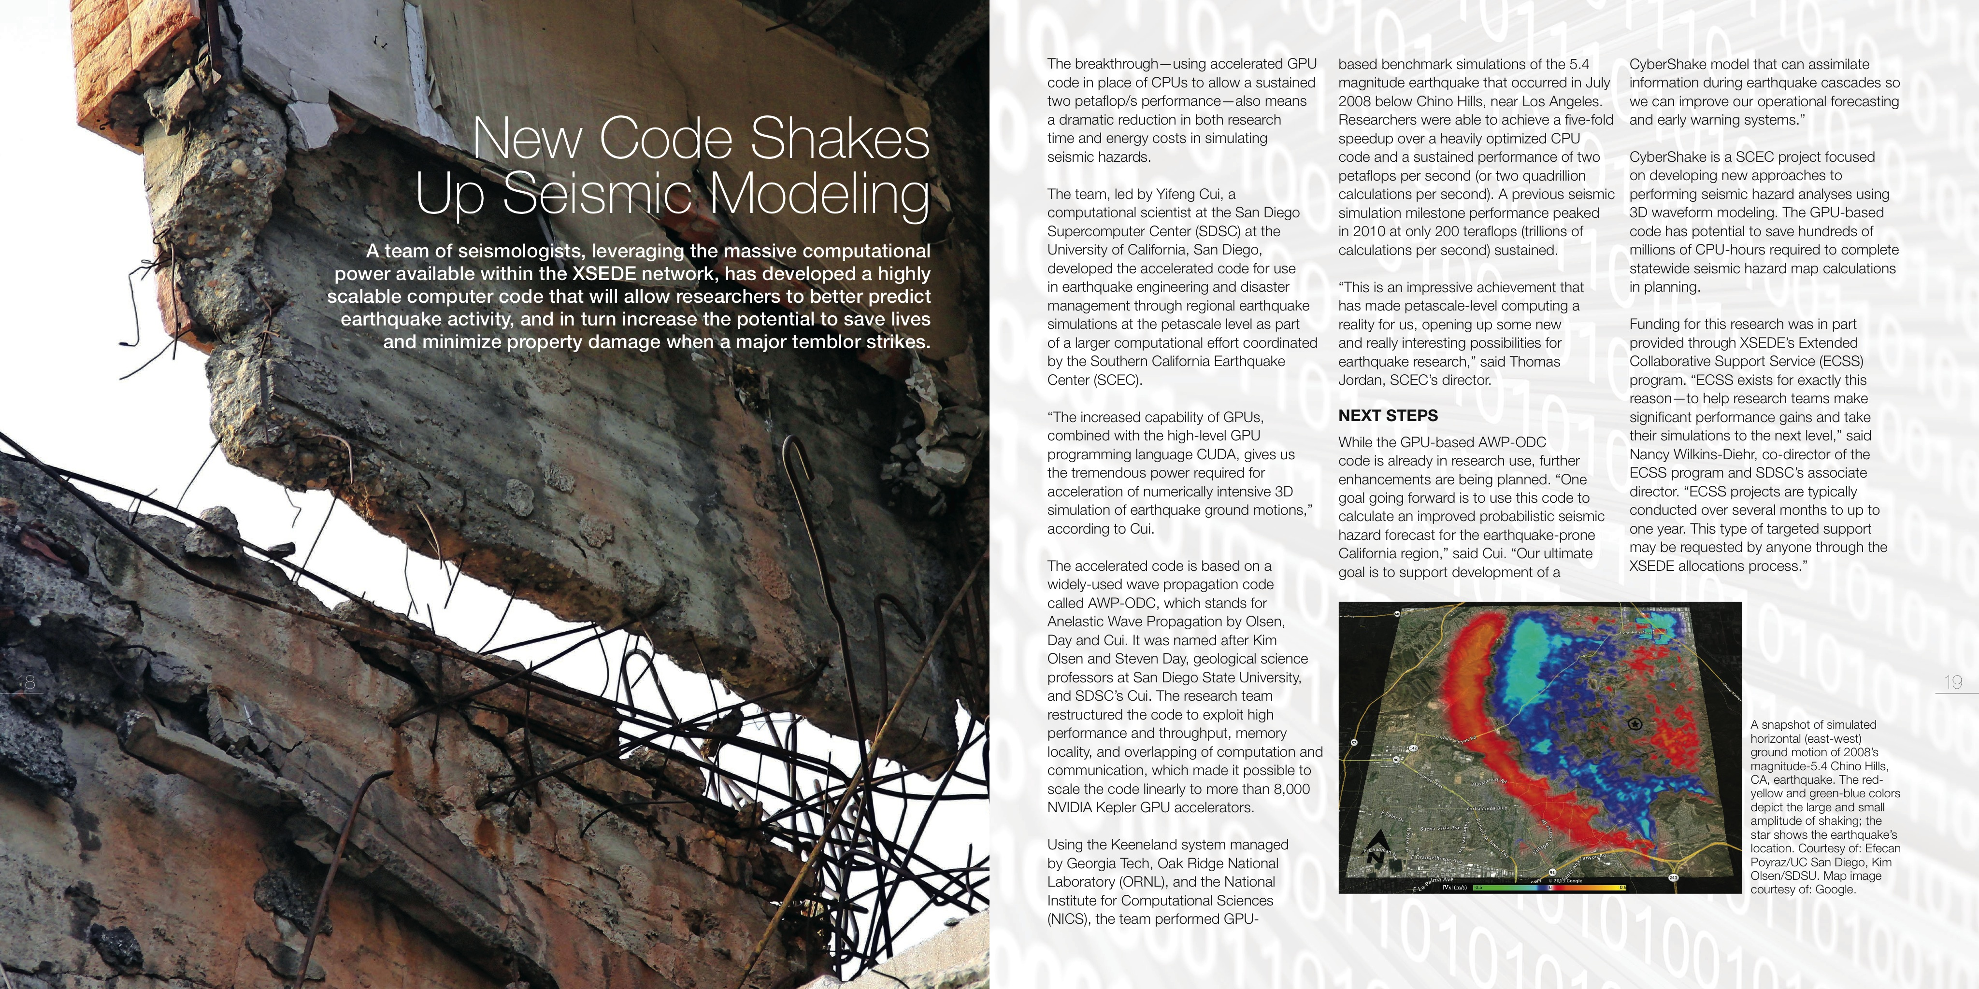
NSF XSEDE Highlight about SCEC HPC Software - July 2013

Slide 23
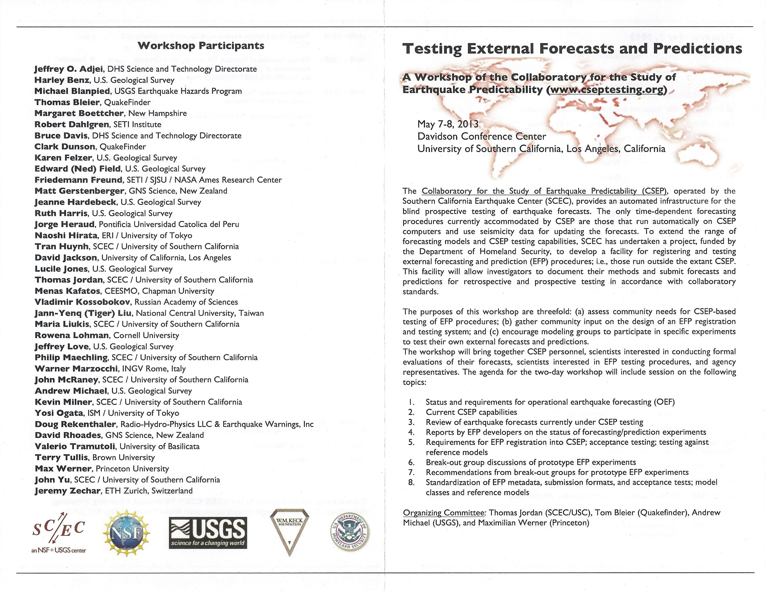
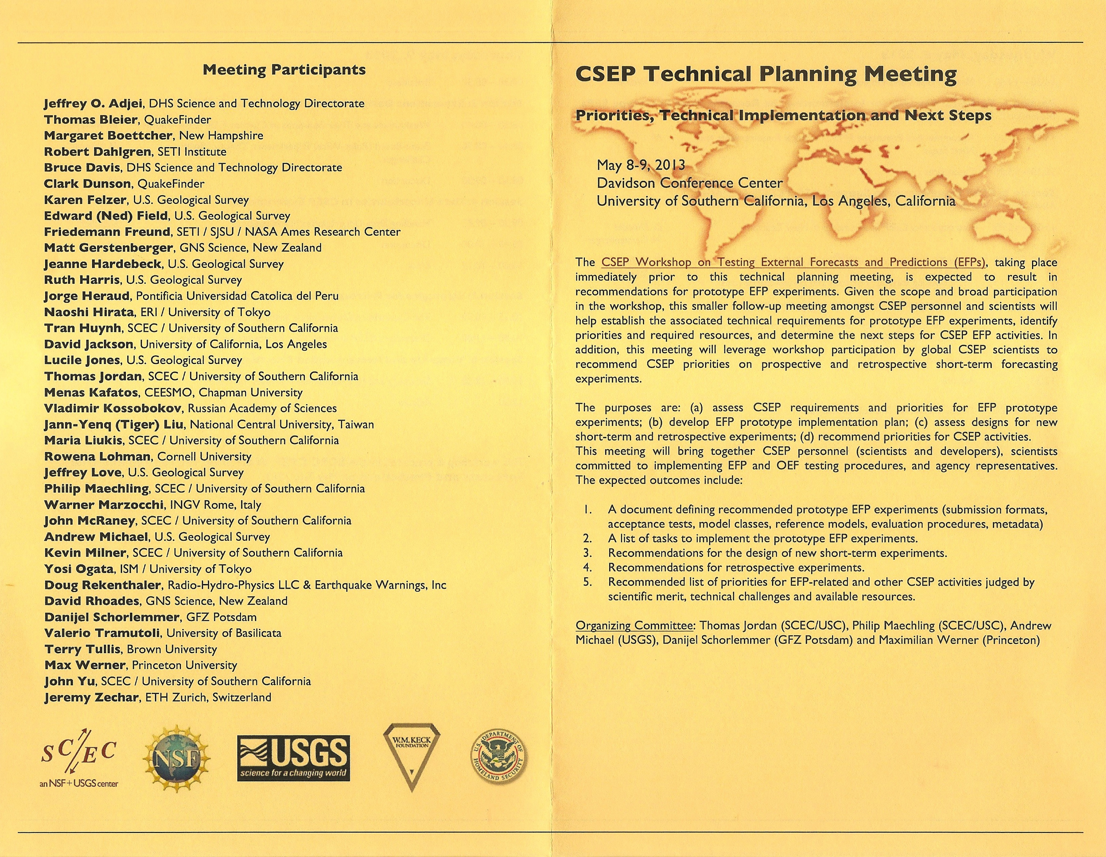
International Earthquake Forecasting Meetings –
May 2013

Slide 24
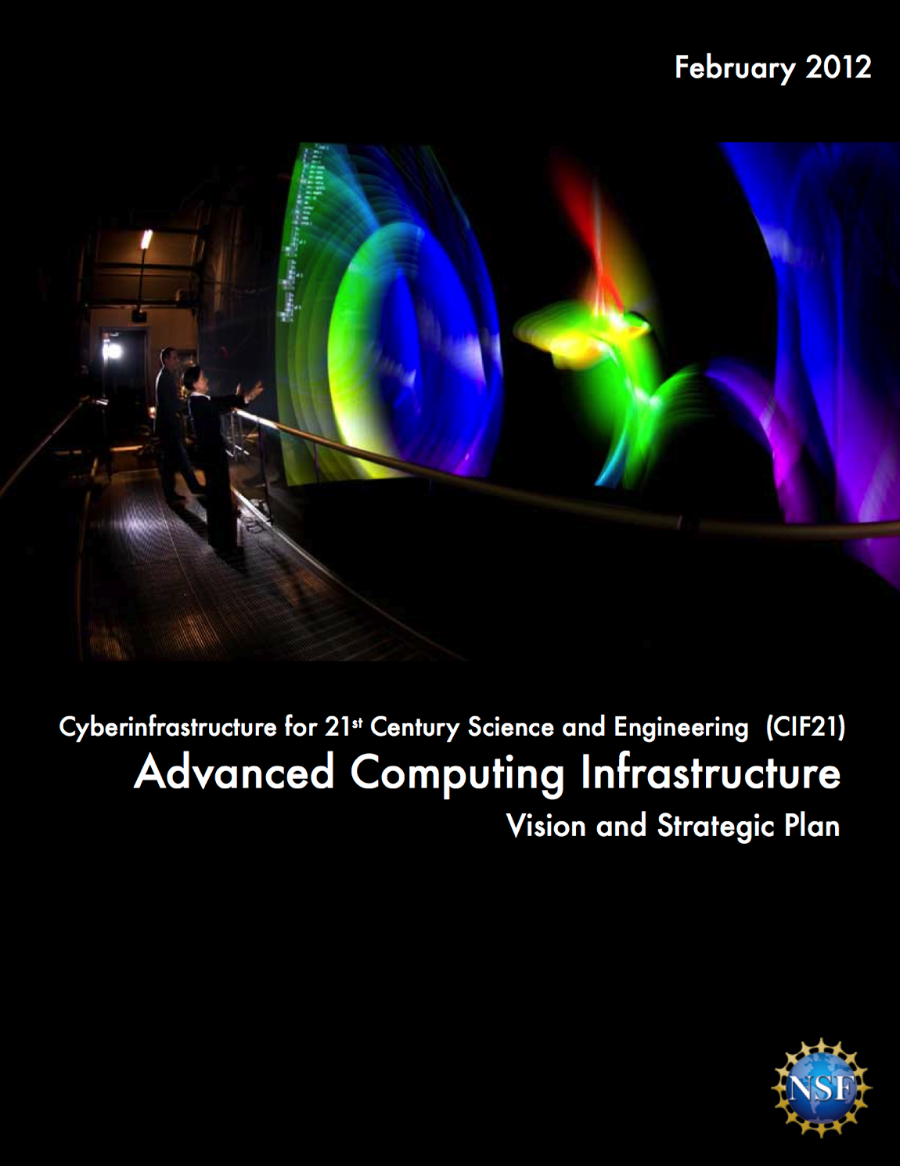
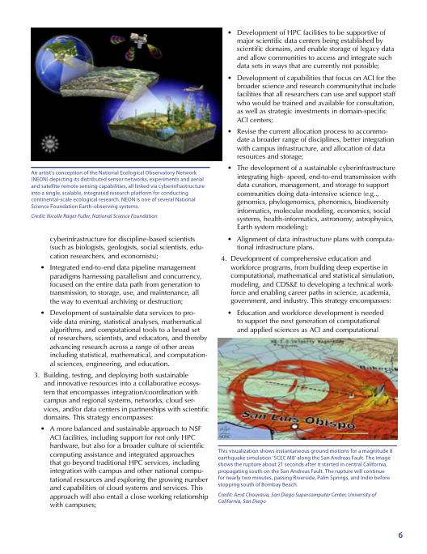
NSF Advanced Computing Infrastructure - February 2012

Slide 25
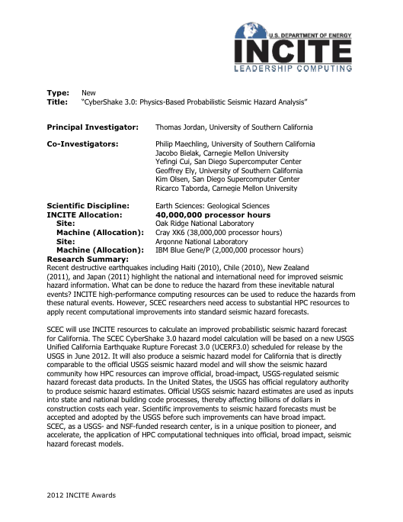
DOE INCITE Allocation – January 2012
40 Million CPU Hours (ALCF and ORNL)

Slide 26
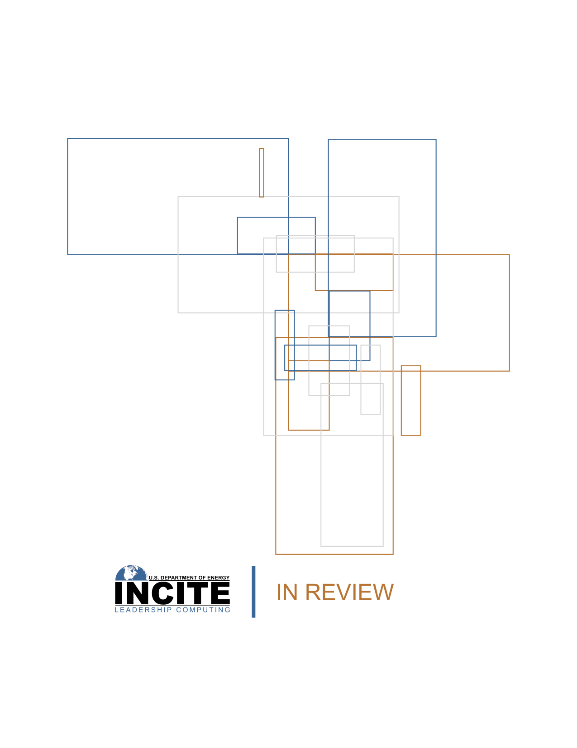
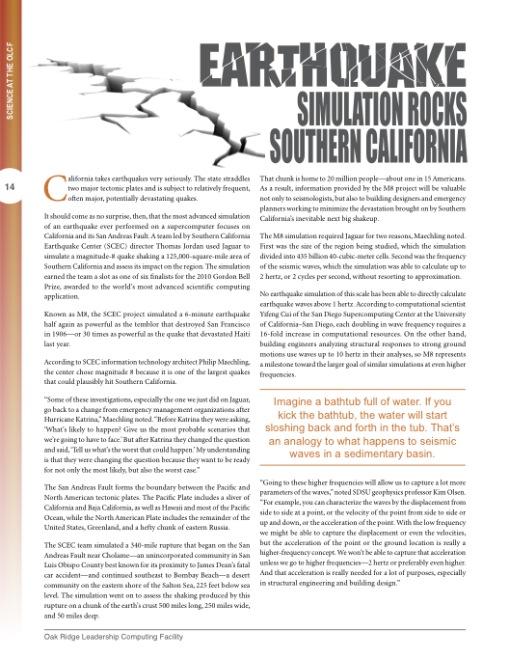
DOE INCITE Review - June 2011

Slide 27
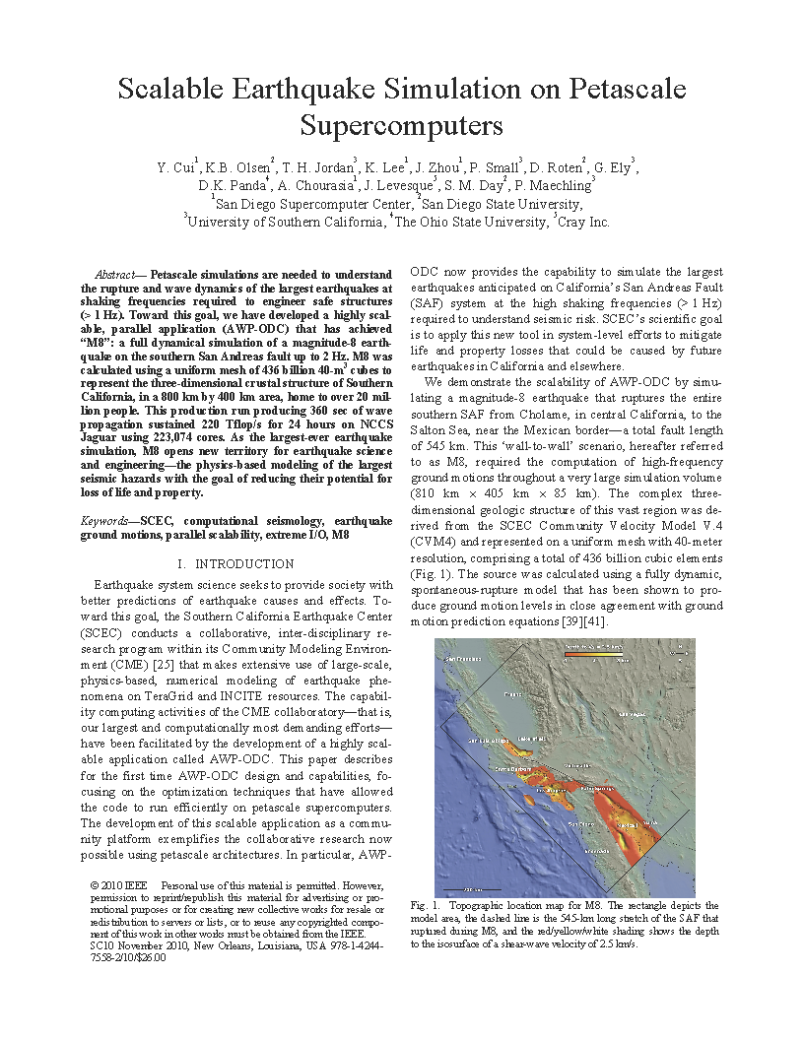
M8 Simulation
SC10 Gordon Bell HPC Award Finalist (Nov 2010)

Slide 28
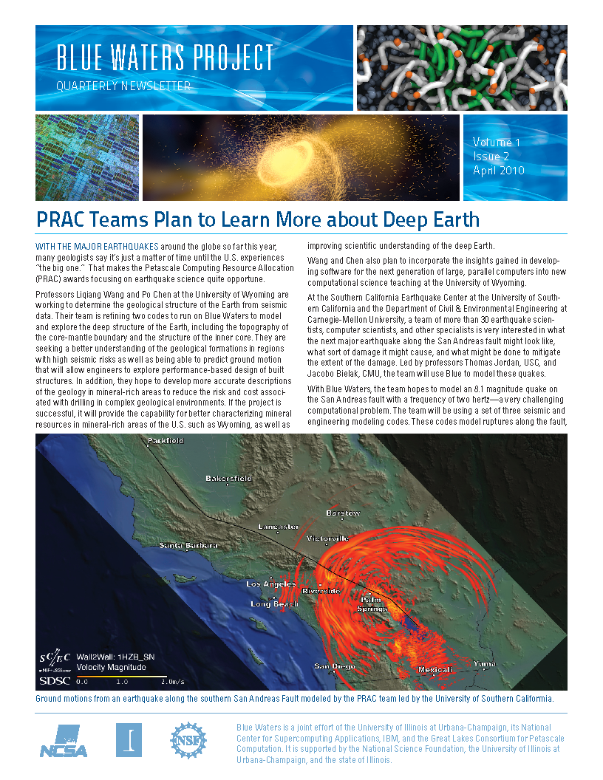
NCSA article on SCEC/CME (May 2010)

Slide 29
TACC article on CyberShake (Feb 2010)

Slide 30
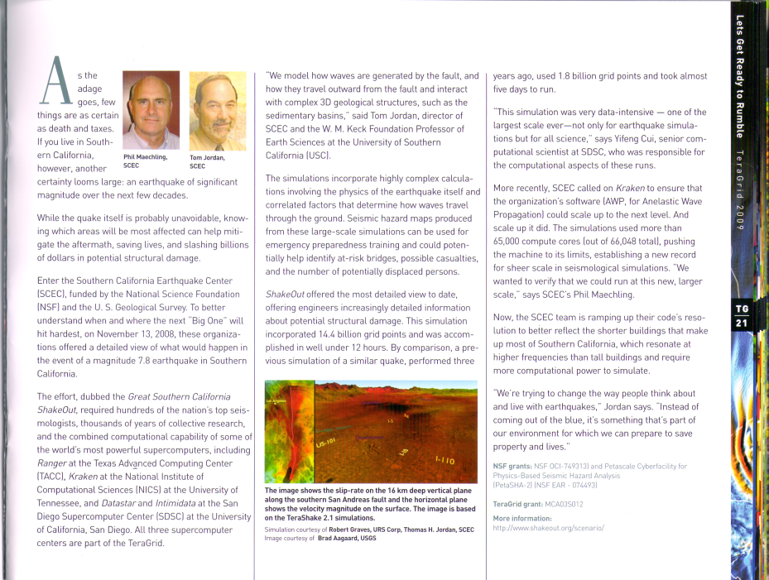

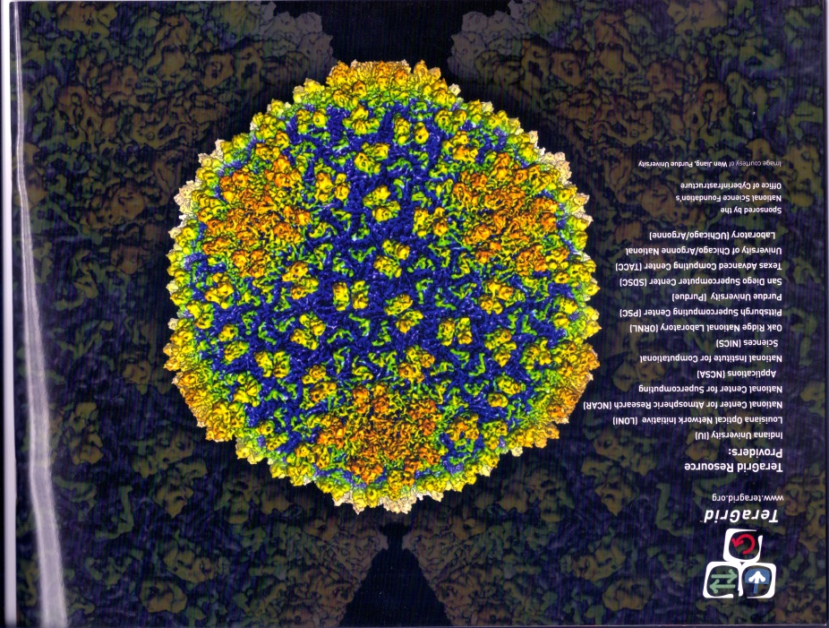
TeraGrid Highlights 2009 describes SCEC’s use of NSF’s Track 2B computer Kraken at the National Institute for Computational Science (NICS) Kraken at Oak Ridge National Laboratory.

Slide 31
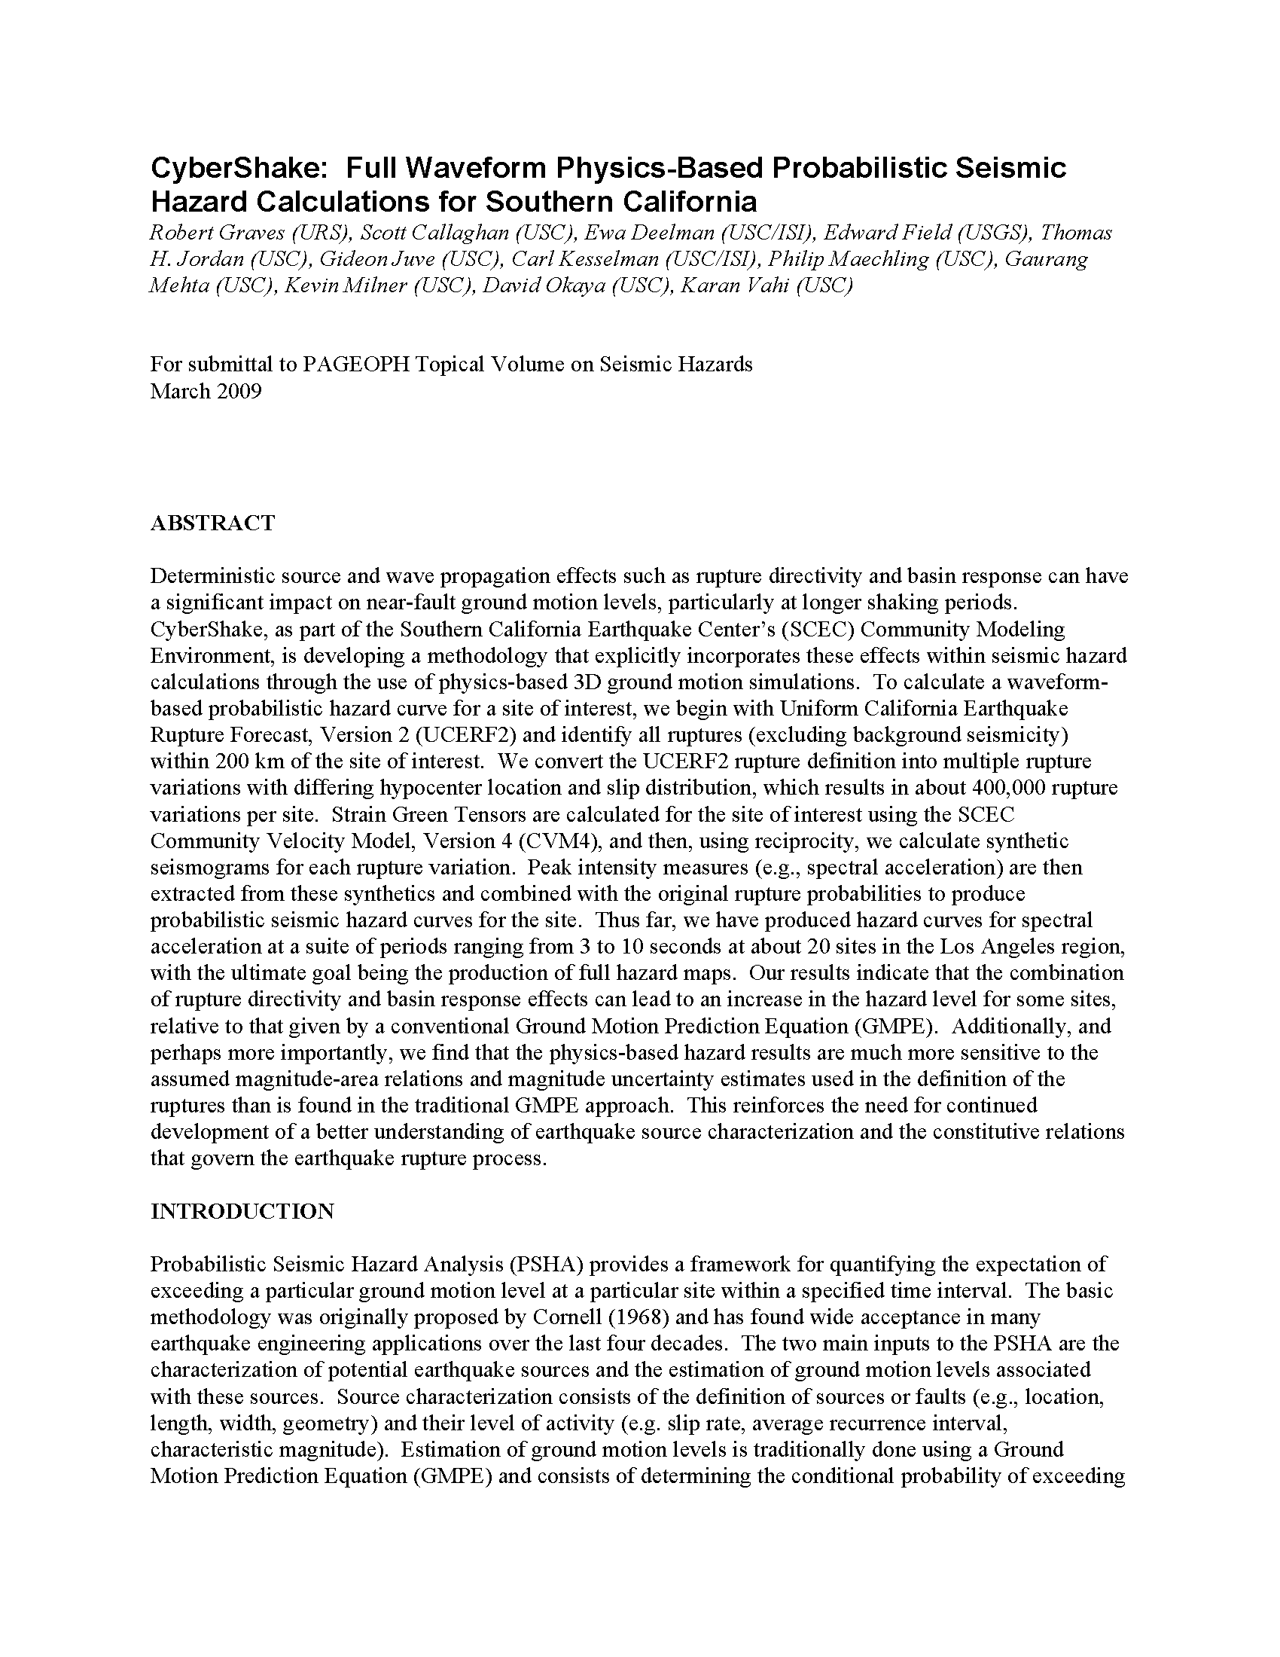
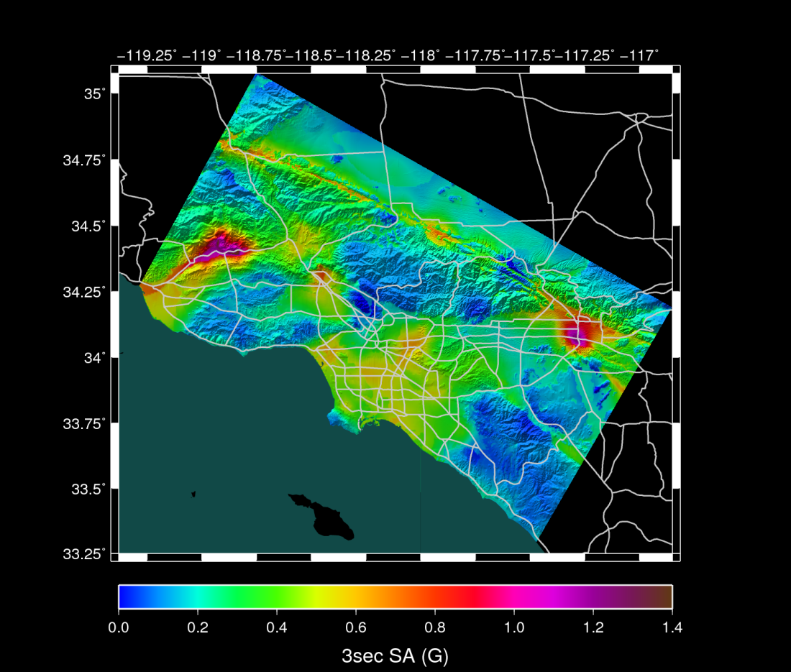
CyberShake 1.0 PSHA Hazard Map (2009)

Slide 32
SciDAC Best Scientific Visualization Award on Wired.com (2009)

Slide 33
Earthquake System Science Outreach Material in U.S. News and World Report (2009)

Slide 34
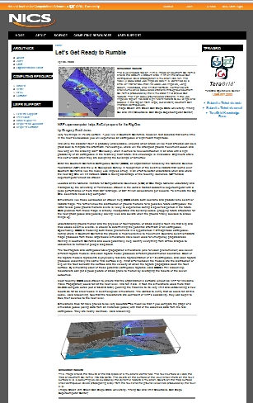
Science impact article about SCEC High Performance Computing (HPC) research from National Institute for Computational Science (NICS) (2009)

Slide 35
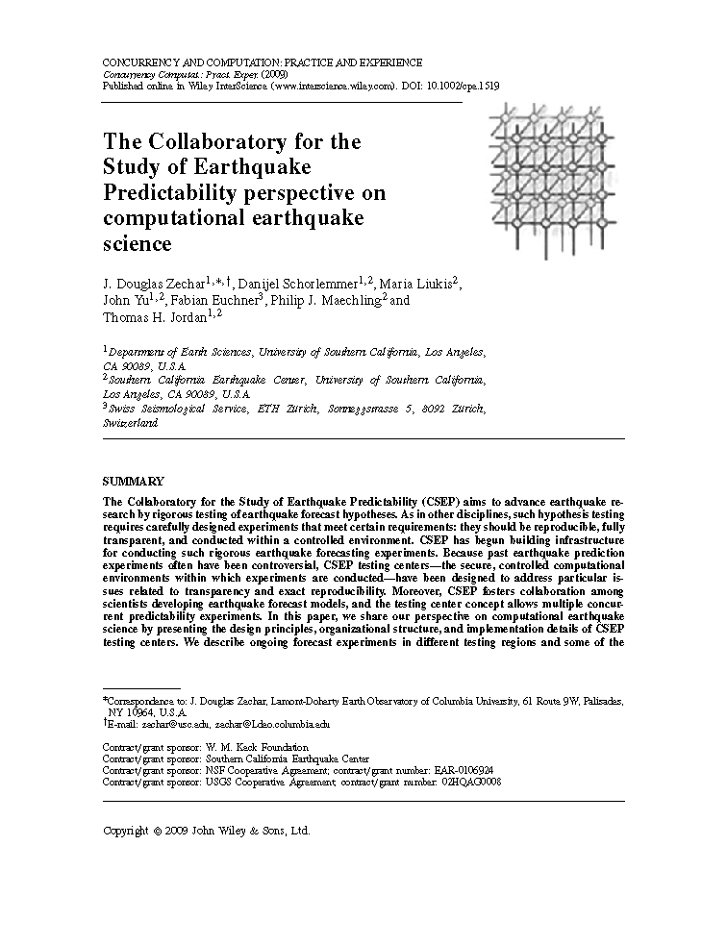
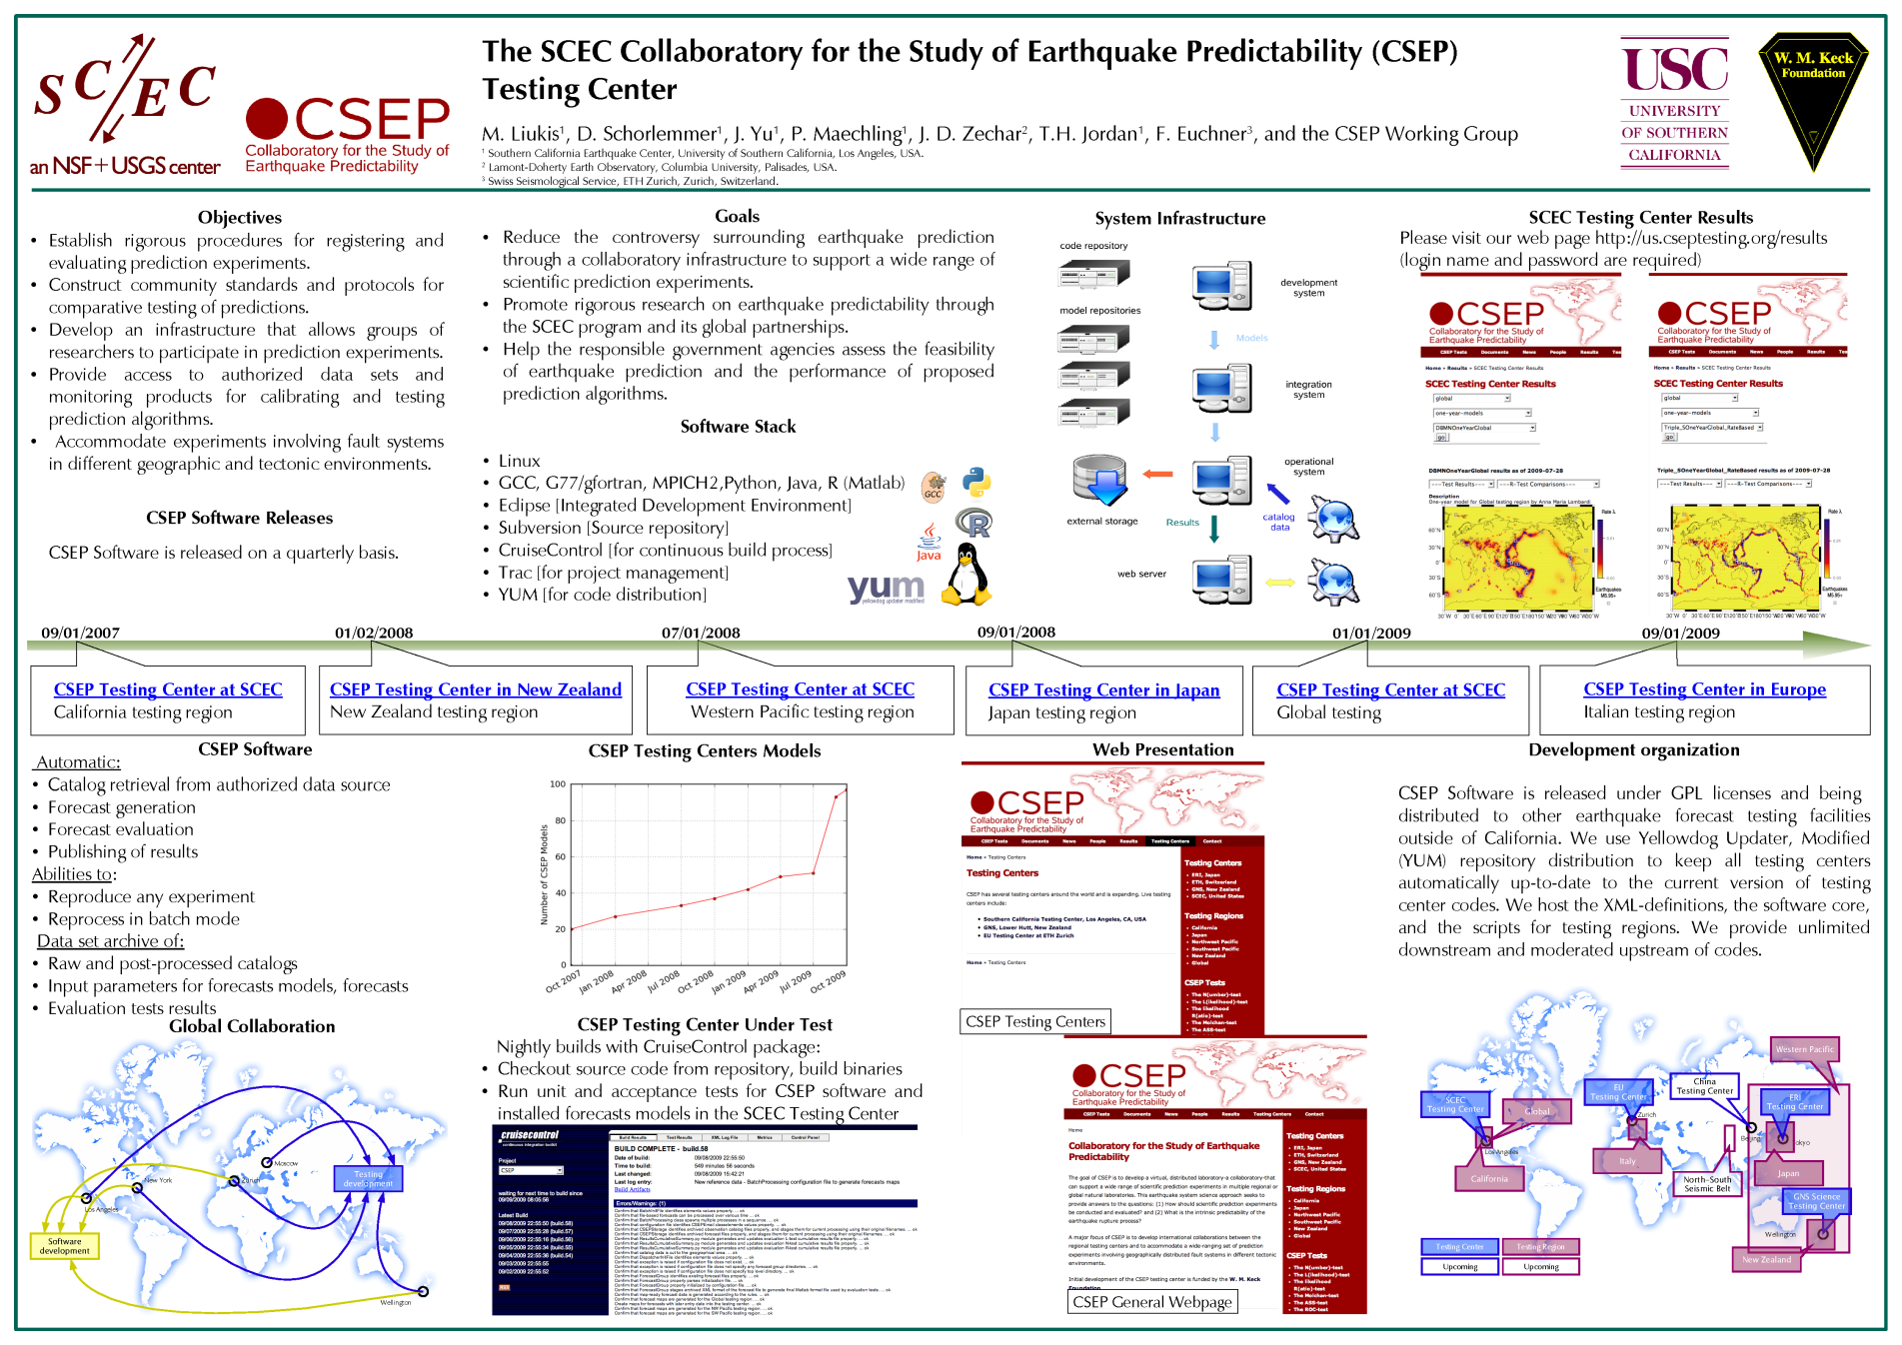
Operational CSEP Testing Center at SCEC (2009)

Slide 36
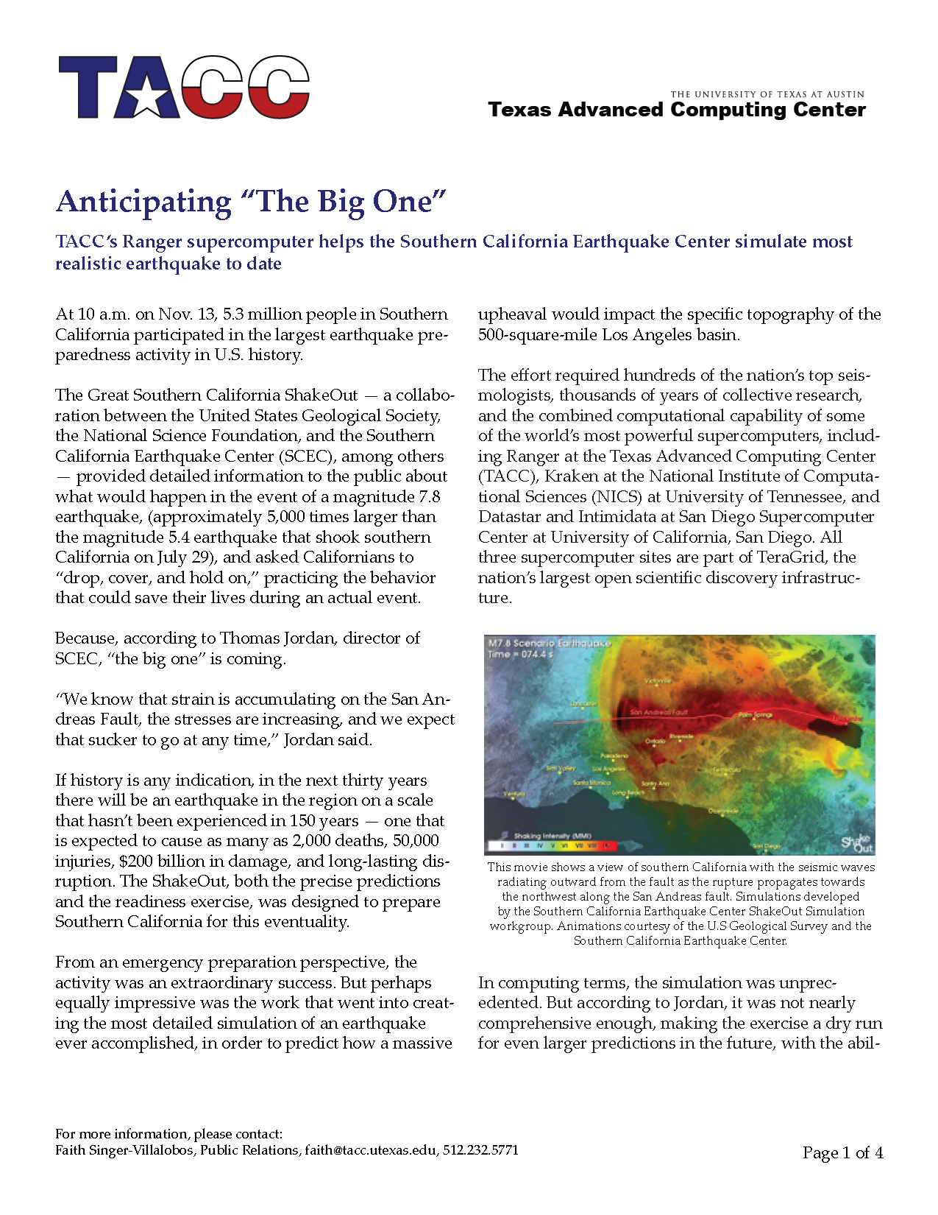
Science impact article about SCEC High Performance Computing (HPC) research from Texas Advanced Computing Center (TACC) (2009)

Slide 37

Department of Energy (DOE) INCITE Allocation Award (2008)

Slide 38
SCEC/CME research makes significant contributions to the Great Southern California ShakeOut (2008)
Selection of collaborative research objectives and coordination of research activities.

Slide 39
UCERF2, produced using OpenSHA, released by USGS (2008)

Slide 40

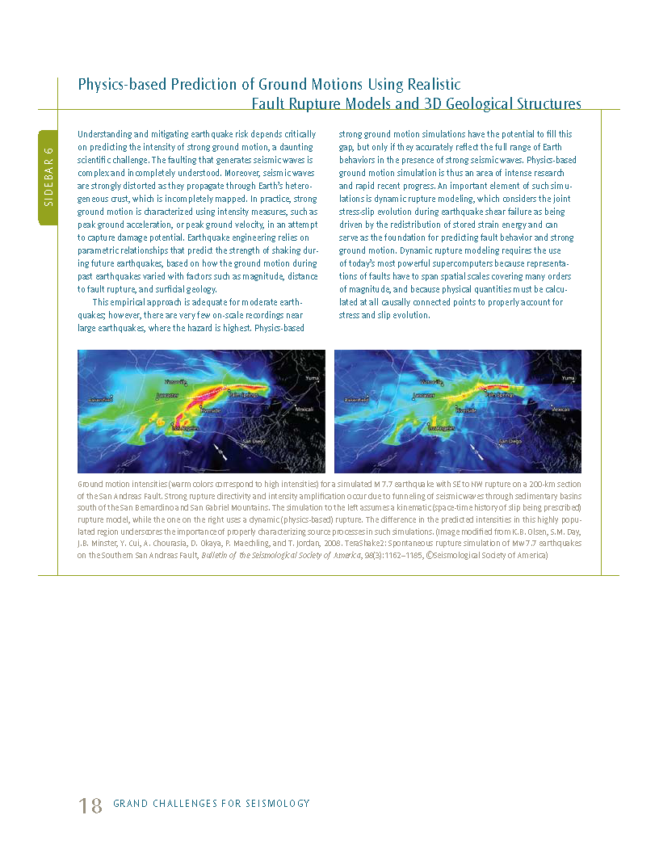
Seismological Grand Challenges in Understanding Earth’s Dynamic System (2008) – Discussion of TeraShake 2 Simulation Results

Slide 41
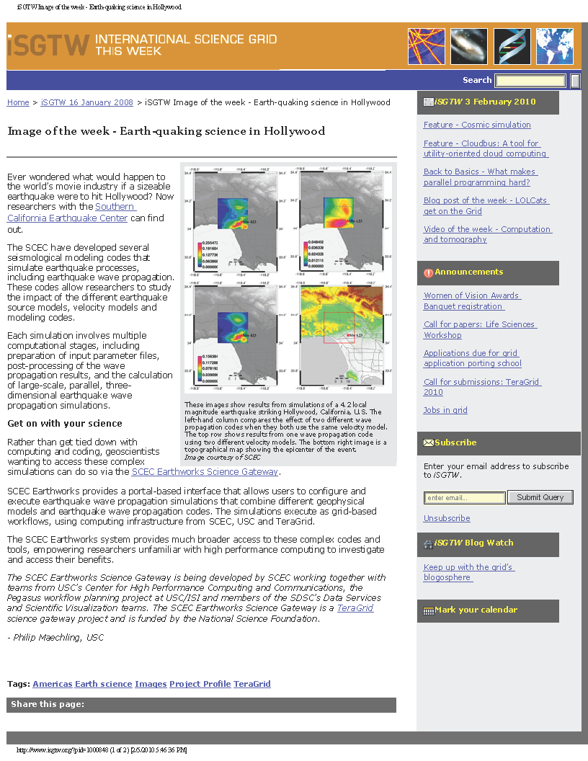
iSGTW online Image of the week (2008)
Earth-quaking science in Hollywood, international Science Grid this Week, January 2008, http://www.isgtw.org/?pid=1000848

Slide 42

Plenary Talk at TeraGrid 07
National Science Foundation Supercomputer Conference (2007)

Slide 43



SCEC/CME in NSF Office of Cyberinfrastructure (OCI) Vision Document (2007)

Slide 44



SCEC Broadband Platform Development (2007)

Slide 45



Visualization of Scientific Simulation Results(2007)

Slide 46



SCEC/CME in National Science Board Report on Transformative Research at National Science Foundation (NSF) (2007)

Slide 47


Feature - Pegasus invites new communities to saddle up, international Science Grid this Week, iSGTW online, September 2007, http://www.isgtw.org/?pid=1000664

Slide 48
iSGTW online Feature (2007) - Pegasus invites new communities to saddle up

Slide 49



ISI Leads $13.8 Million E-Science Effort to Tame Terabyte Torrents, ISI News, http://www.isi.edu/news/news.php?story=165

Slide 50
ISI News (2007) – ISI Leads $13.8 Million E-Science Effort to Tame Terabyte Torrents

Slide 51


SCEC/CME in NSF Strategic Plan (2006)

Slide 52


SCEC/CME in NSF Computational
Solid Earth Sciences Plan (2006)

Slide 53


W. M. Keck Foundation Grant for Collaboratory for the Study of Earthquake Predictability (2006)

Slide 54
Foster and Kesselman - IEEE Computer (2006)

Slide 55


SDSC 2006 Calendar with SCEC Broadband Wave Propagation Imagery

Slide 56




National Center for Supercomputer Applications (NCSA) article on SCEC Research (2006)

Slide 57
Los Angeles Times Coverage of SCEC TeraShake High Performance Computing Simulation Research (2006)

Slide 58
Discovery of the TeraShake Wave Guide Effect (2006)

Slide 59


Design and development of SCEC Community Modeling Environment (2005)
HPC modeling environment including HPC, grid-computing, workflows, data management, knowledge management.

Slide 60


SCEC Community Modeling Environment Peer-reviewed Mid-term ITR Project Review (2005)

Slide 61


SDSC 2005 Calendar with SCEC Earthquake Wave Propagation Imagery

Slide 62



Application of Grid Computing and Distributed Object Computing to Seismic Hazard Research (2004)
Establish grid computing capabilities within the SCEC research community
Scale existing seismic hazard processing onto hundreds of processors

Slide 63


SDSC 2004 Calendar with SCEC Dynamic Rupture Imagery

Slide 64



San Diego Supercomputer Center (SDSC) article on SCEC Research (2004)

Slide 65

Publication of SCEC CME System Design and Development for Seismological Society of America audience (2003)

Slide 66


Proposal to NSF Information Technology Research (ITR) Program from PI: Thomas H. Jordan for collaborative development of a research computing system (SCEC Community Modeling Environment) to improve seismic hazard information for California. (2000)

