Slide 1

The SCEC Broadband Platform
Open-Source Software for Strong Ground Motion Simulation and Validation
Fabio Silva

Slide 2

Outline
Broadband Platform Overview
  Validation and scenario simulations
  Supported simulation regions
  Simulation methods
  Simulation inputs and outputs
Current Developments
  Support for multi-segment ruptures
  FAS validation
Next Generation Concepts
  GF generation within BBP
  Modular version of BBP

Slide 3
Broadband Platform Overview
The SCEC Broadband Platform…
  provides a collection of open-source scientific software
    software from seven research groups in BBP 19.4
  calculates broadband ground motions at user-specified locations
    Historical and scenario earthquakes
  integrates complex scientific modules
    Rupture generation
    Seismogram synthesis
    Site effects calculations
    Post-processing
    Visualization
  supports common inputs and output data products for all simulation methods
  features a simple command-line interface for interactive and/or scripting use
  runs on Linux computers with GNU compilers and open-source libraries
  is available on GitHub!

Slide 4
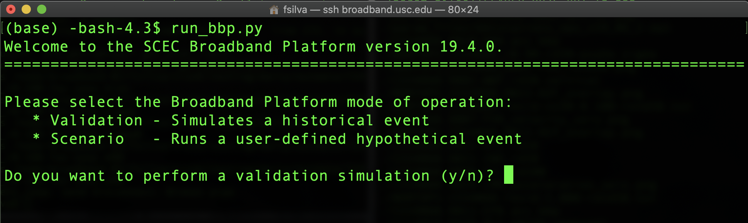
Choosing a Simulation Mode
Validation
Scenario
OR

Slide 5
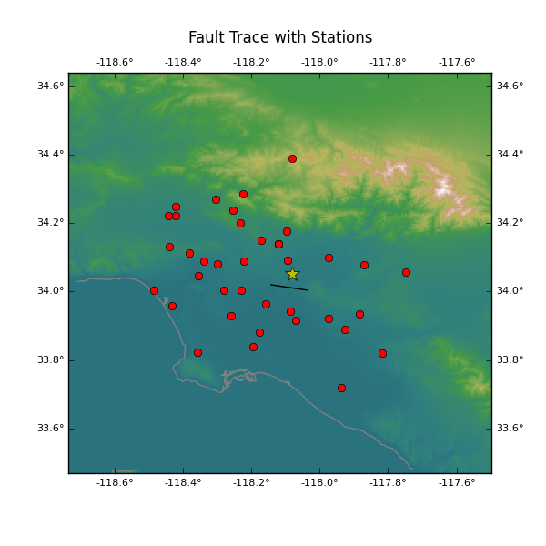
Validation Simulations
Validation simulations
  “validates” simulation methods against recorded data
  Uses historical event source description
  Includes locations where recorded data is available
User inputs
  Validation event
  Simulation method
  Validation metrics
BBP outputs
  Velocity and acceleration timeseries
  Per-station timeseries and PSA comparisons
  Goodness-of-Fit Plot
  Other validation metrics
Whittier Narrows (1987)

Slide 6
Validation Events
California
  Alum Rock Mw 5.45
  Chino Hills Mw 5.39
  Hector Mine Mw 7.13
  Landers Mw Mw 7.22
  Loma Prieta Mw 6.94
  North Palm Springs Mw 6.12
  Northridge Mw 6.73
  Parkfield Mw 6.0
  Ridgecrest A Mw 6.47
  Ridgecrest B Mw 5.4
  Ridgecrest C Mw 7.08
  San Simeon Mw 6.6
  Whittier Narrows Mw 5.89
Japan
  Chuetsu-Oki Mw 6.69
  Iwate Mw 6.9
  Niigata Mw 6.65
  Tottori Mw 6.59
Italy
  L’Aquila Mw 6.29
Eastern North America
  Mineral Mw 5.68
  Riviere-du-Loup Mw 4.6
  Saguenay Mw 5.81
Available as single or multi-segment rupture

Slide 7
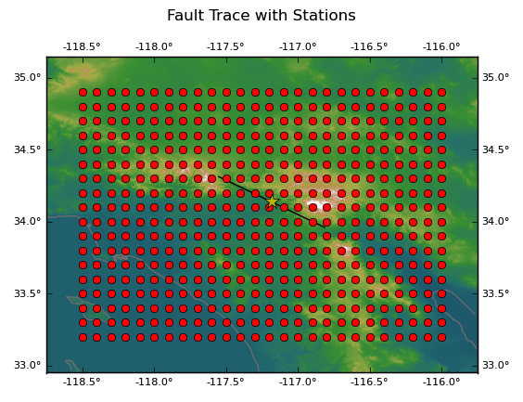
Scenario Simulations
Scenario simulations
  Used to calculate ground motions for hypothetical events
  Users specify desired source description
  Users select locations of interest
User inputs
  Simulation region
  Simulation method
  Source description
  List of stations
BBP outputs
  Velocity and acceleration timeseries
  Per-station RotD50
  Station map

Slide 8
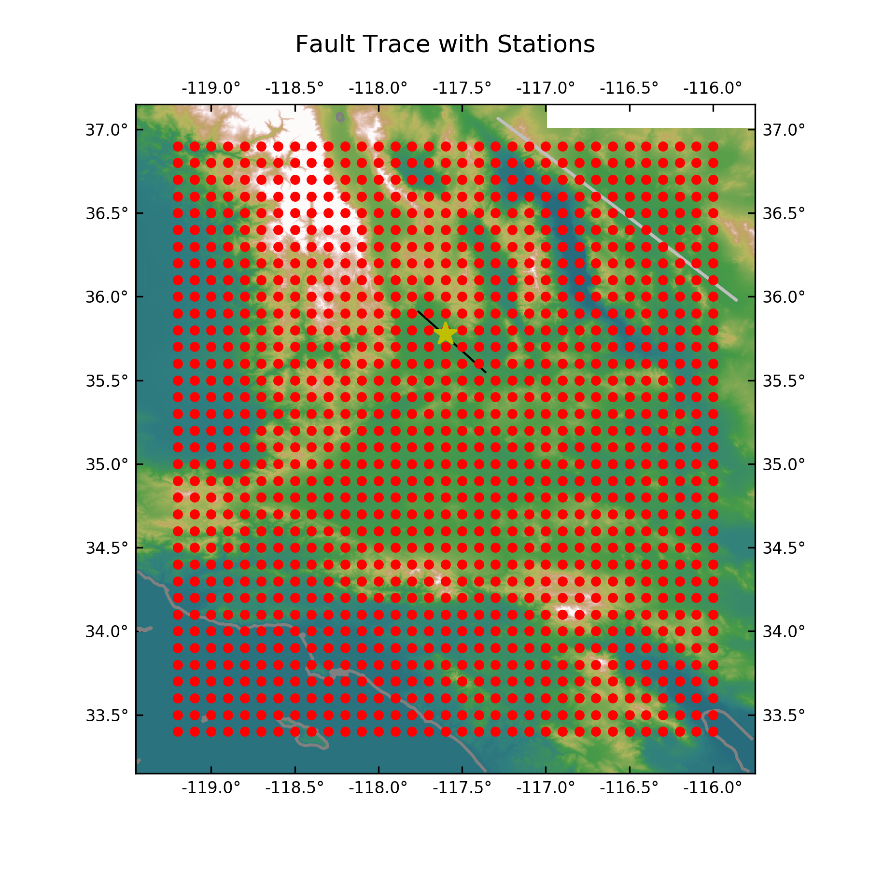
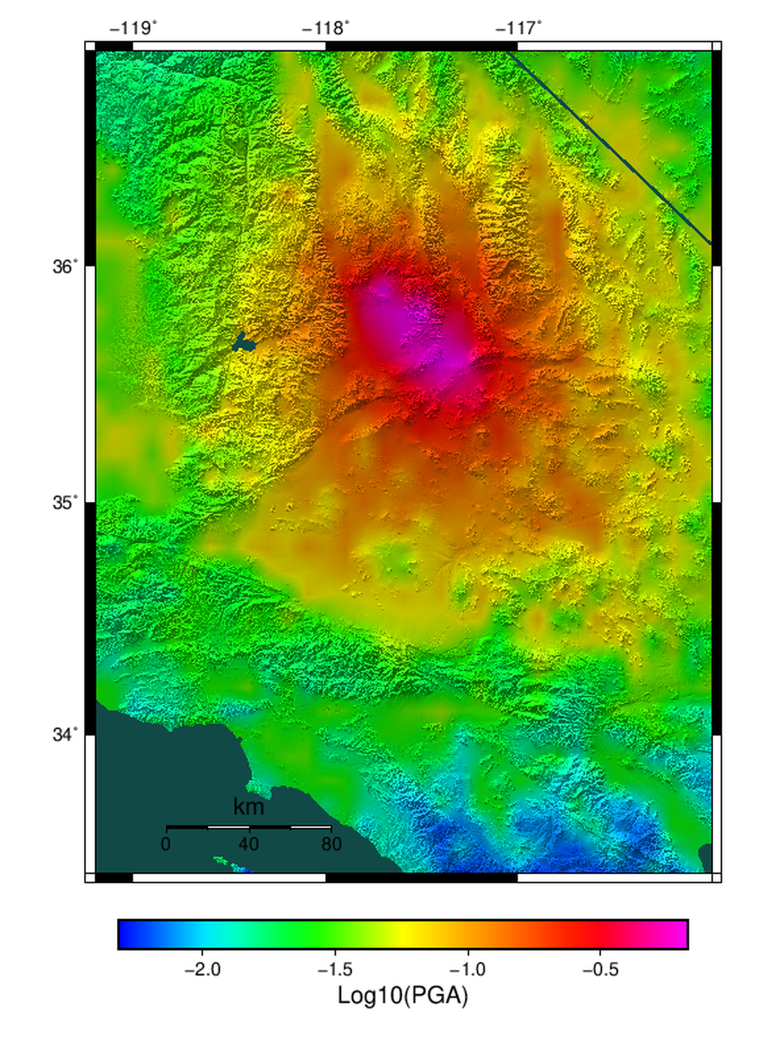
Scenario Simulations
Case Study: Creating shake intensity maps using simulated data: Ridgecrest C

Slide 9
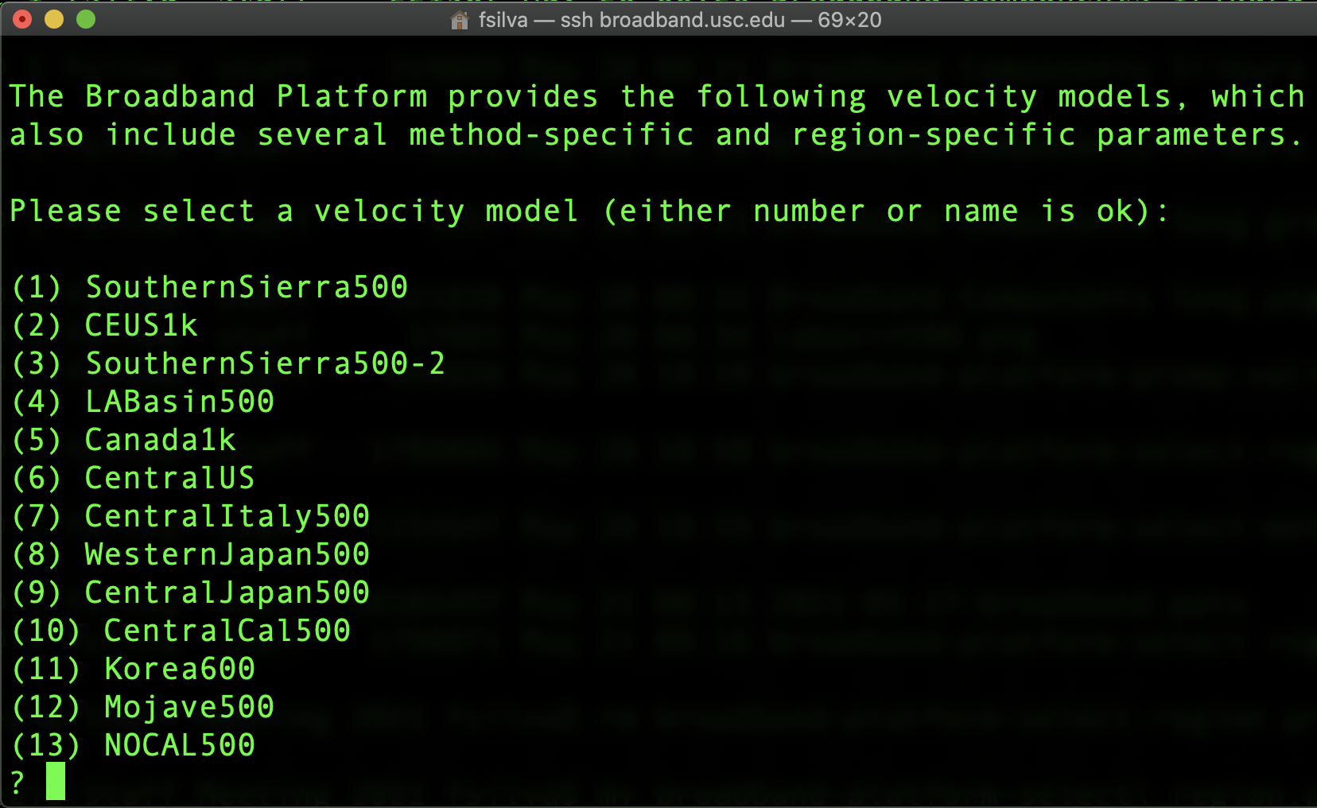
Broadband Platform Simulation Regions
  Velocity model
  Greens’ Functions
  Simulation Parameters
Broadband Platform California Regions

Slide 10
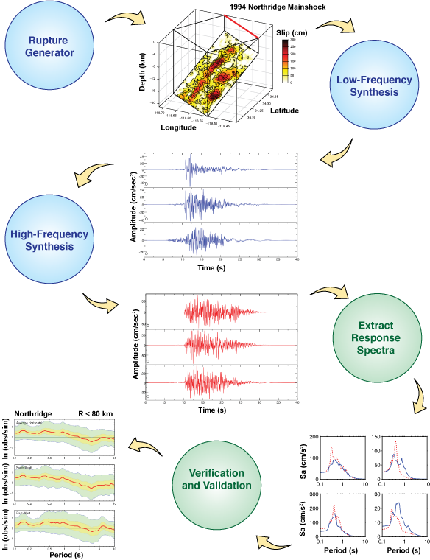
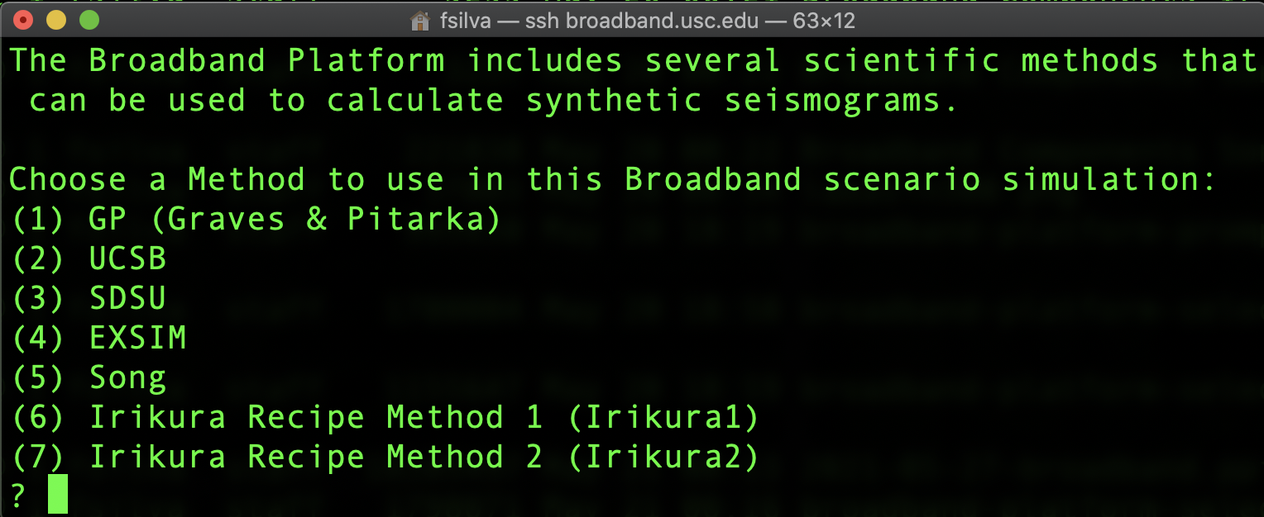
Simulation Methods
Users select one of 7 simulation methods
Also able to pick a site response module
  GP 2014 or SeismoSoil (Shi and Asimaki)

Slide 11
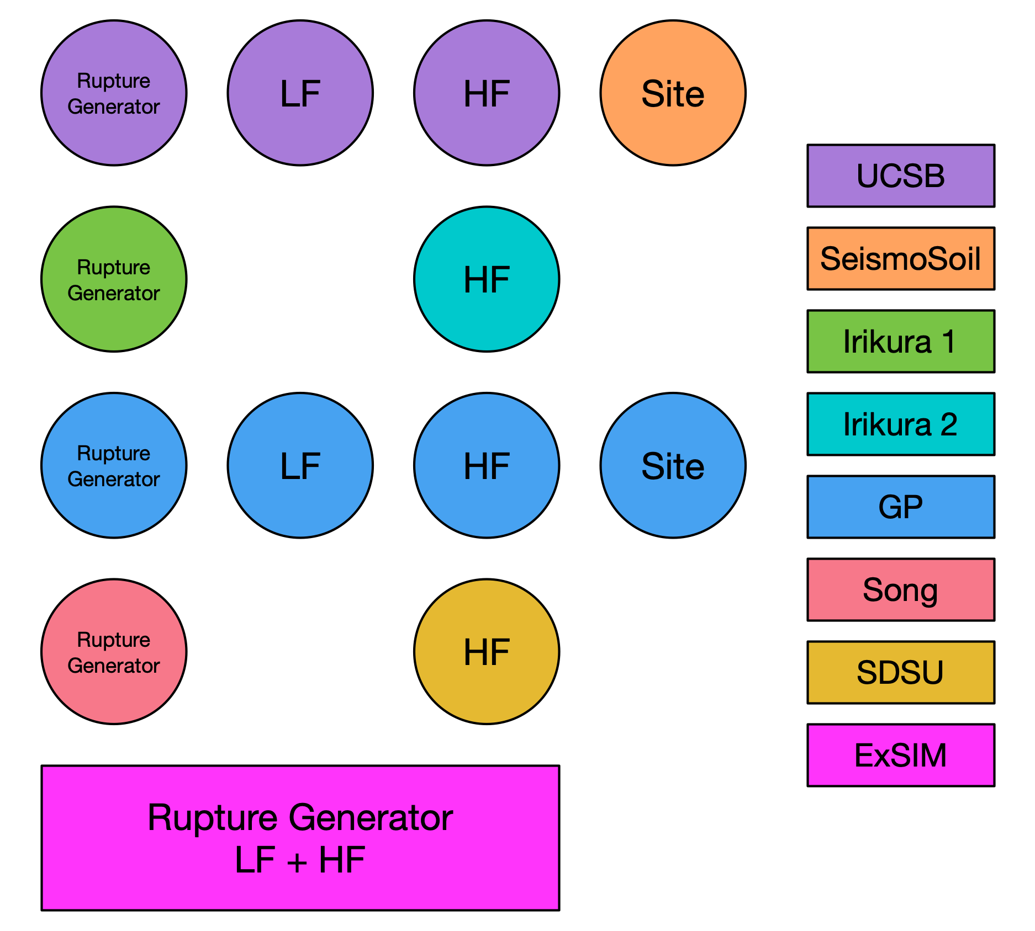
Simulation Methods
Graves and Pitarka (GP)
SDSU
UCSB
ExSIM
Irikura Recipe Method 1
Irikura Recipe Method 2
Song RMG

Slide 12
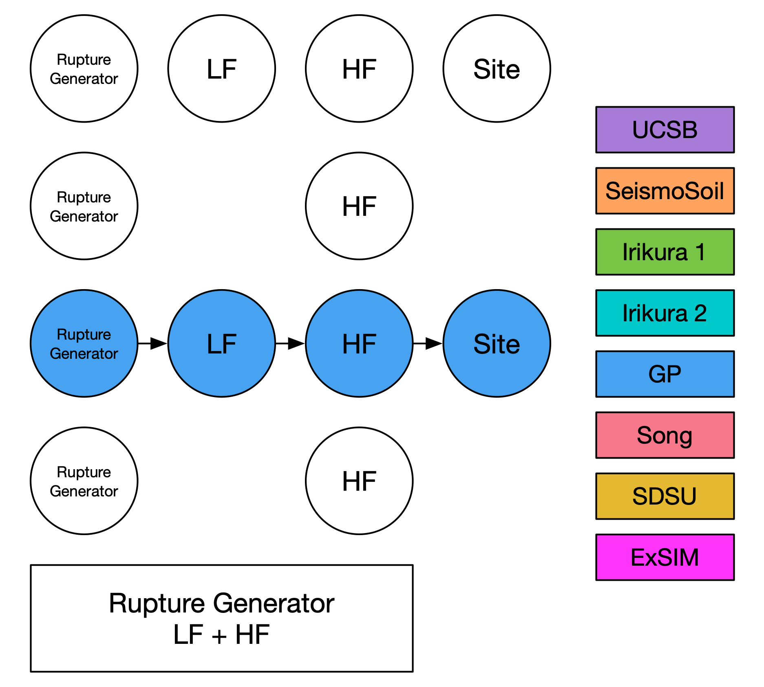
Simulation Methods
Graves and Pitarka (GP)
SDSU
UCSB
ExSIM
Irikura Recipe Method 1
Irikura Recipe Method 2
Song RMG

Slide 13
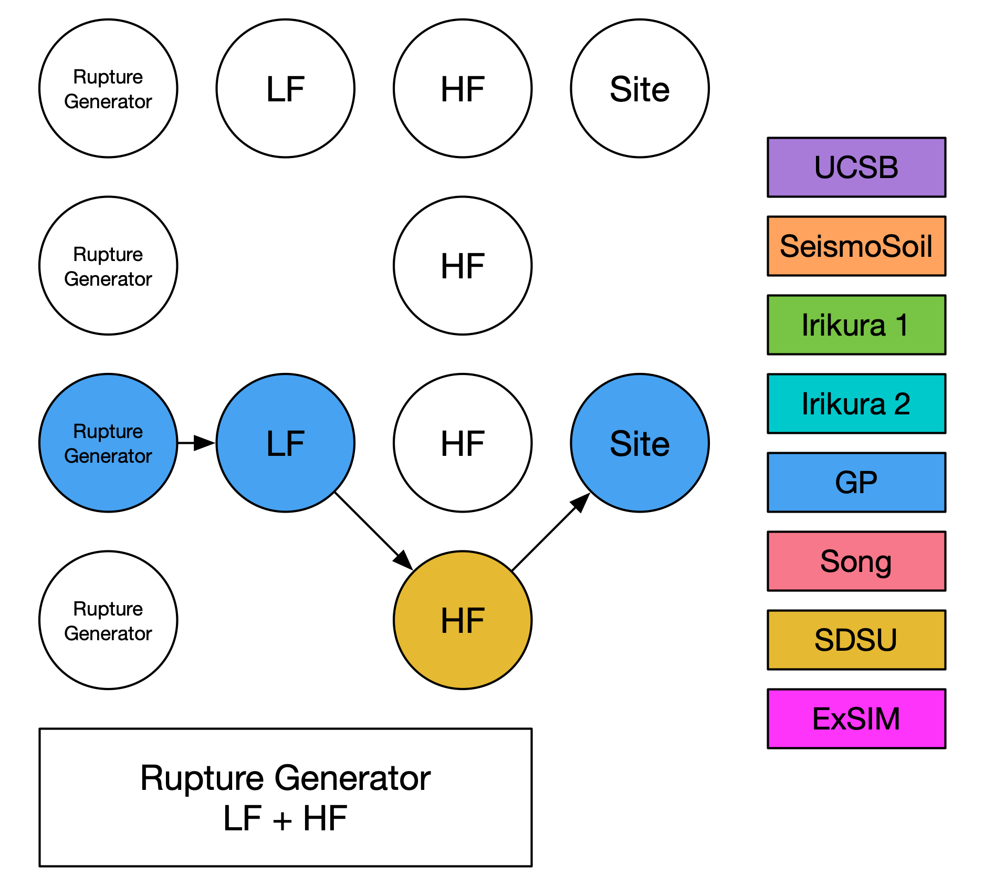
Simulation Methods
Graves and Pitarka (GP)
SDSU
UCSB
ExSIM
Irikura Recipe Method 1
Irikura Recipe Method 2
Song RMG

Slide 14
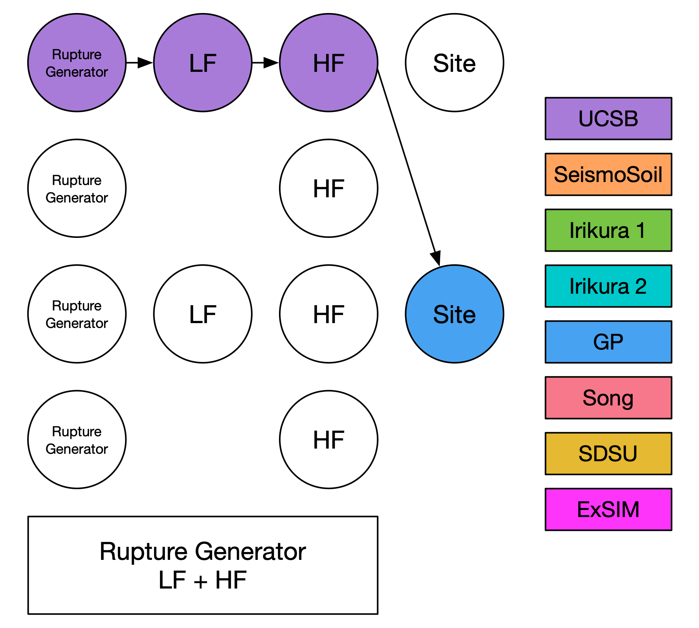
Simulation Methods
Graves and Pitarka (GP)
SDSU
UCSB
ExSIM
Irikura Recipe Method 1
Irikura Recipe Method 2
Song RMG

Slide 15
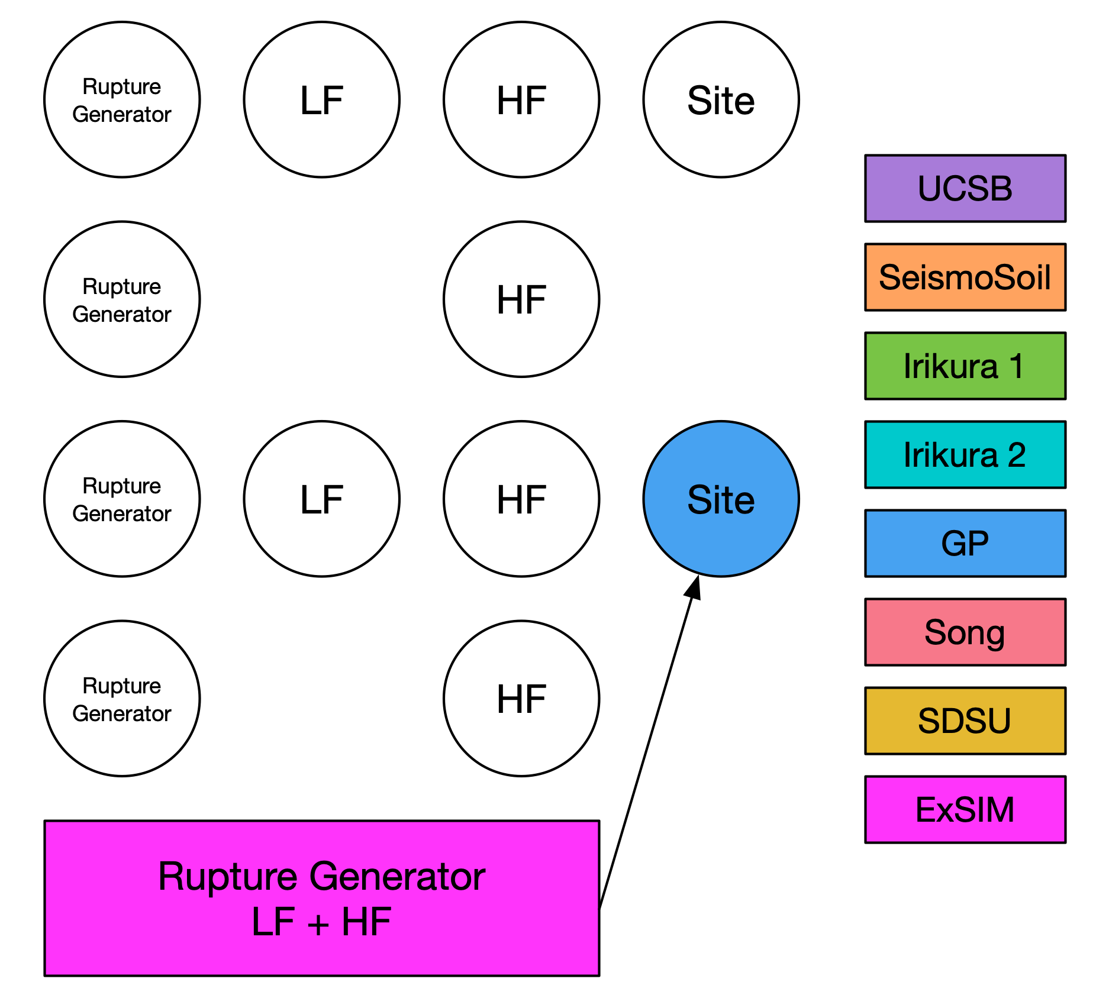
Simulation Methods
Graves and Pitarka (GP)
SDSU
UCSB
ExSIM
Irikura Recipe Method 1
Irikura Recipe Method 2
Song RMG

Slide 16
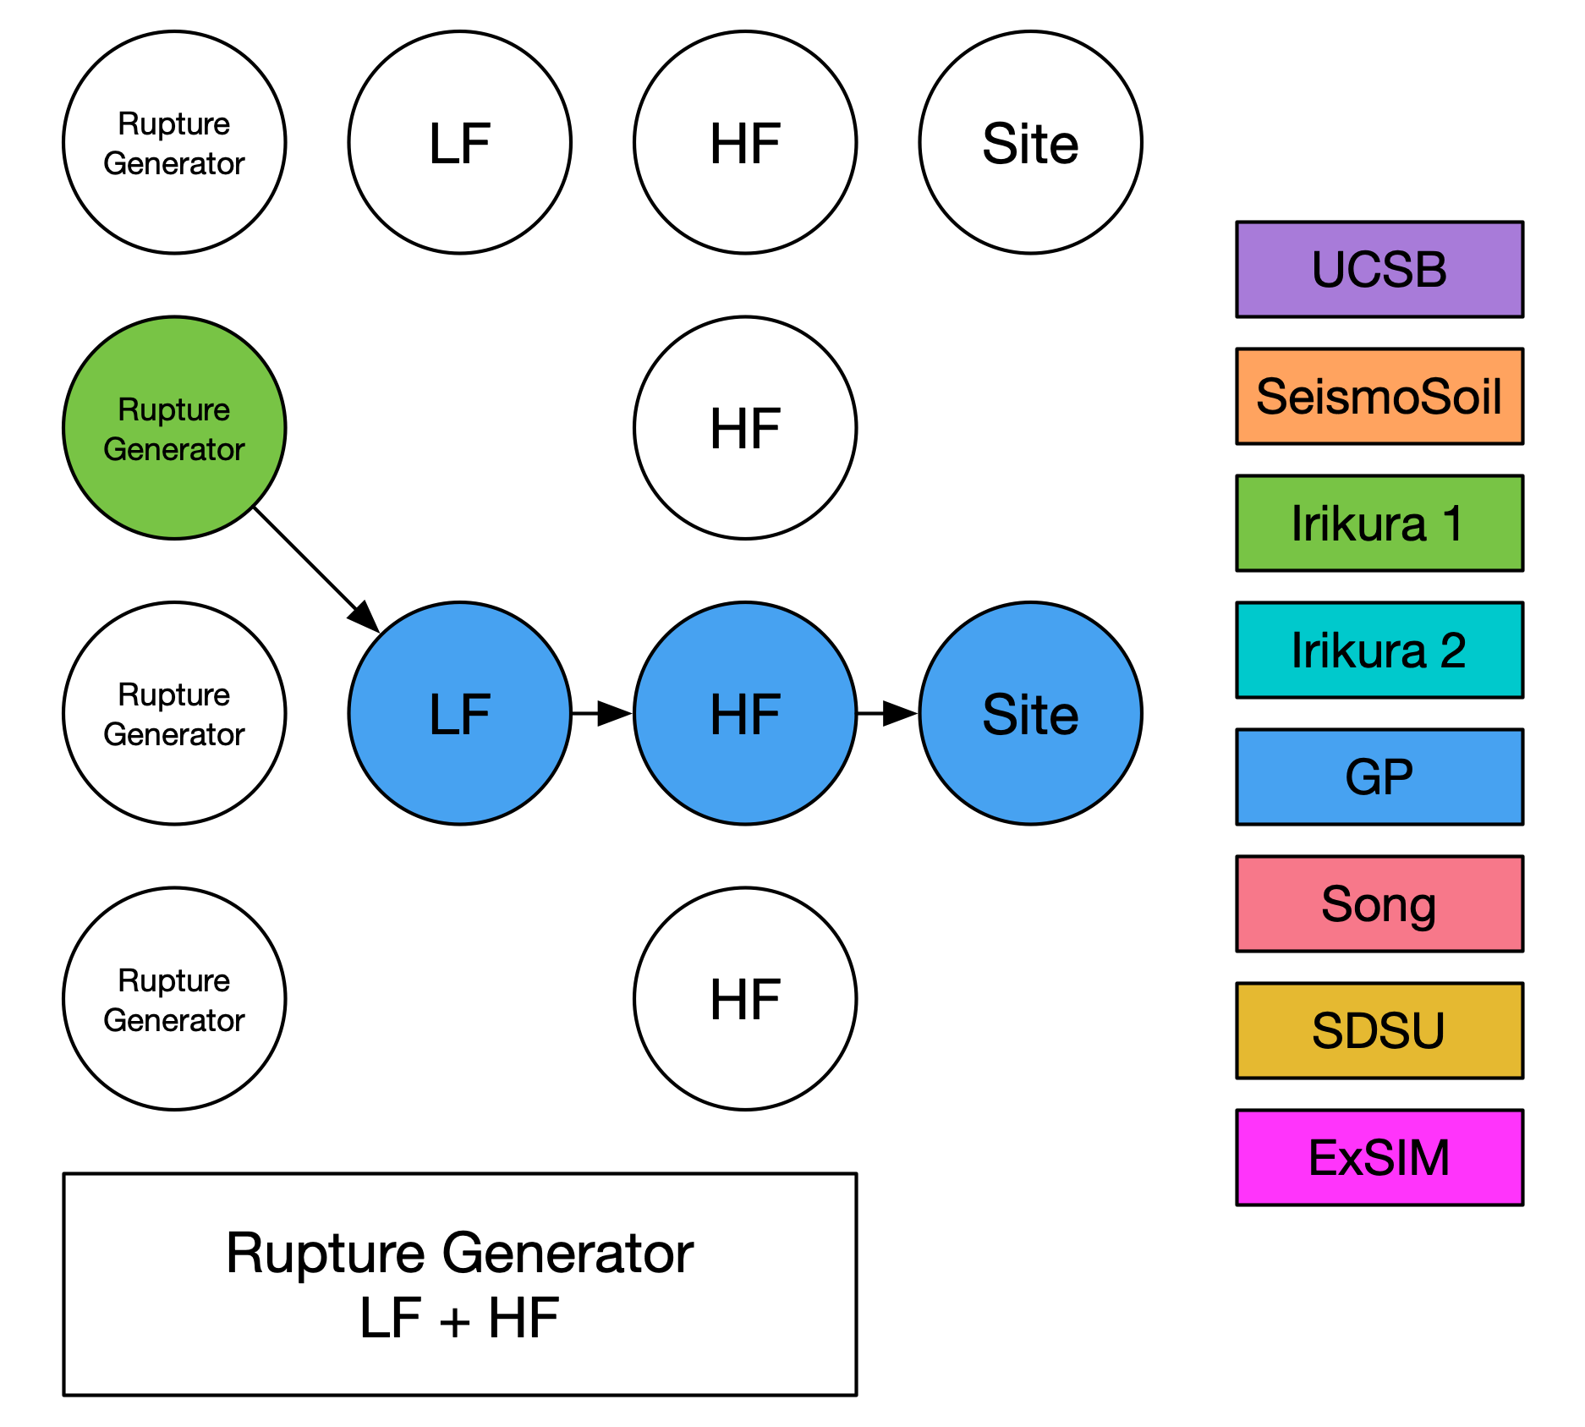
Simulation Methods
Graves and Pitarka (GP)
SDSU
UCSB
ExSIM
Irikura Recipe Method 1
Irikura Recipe Method 2
Song RMG

Slide 17
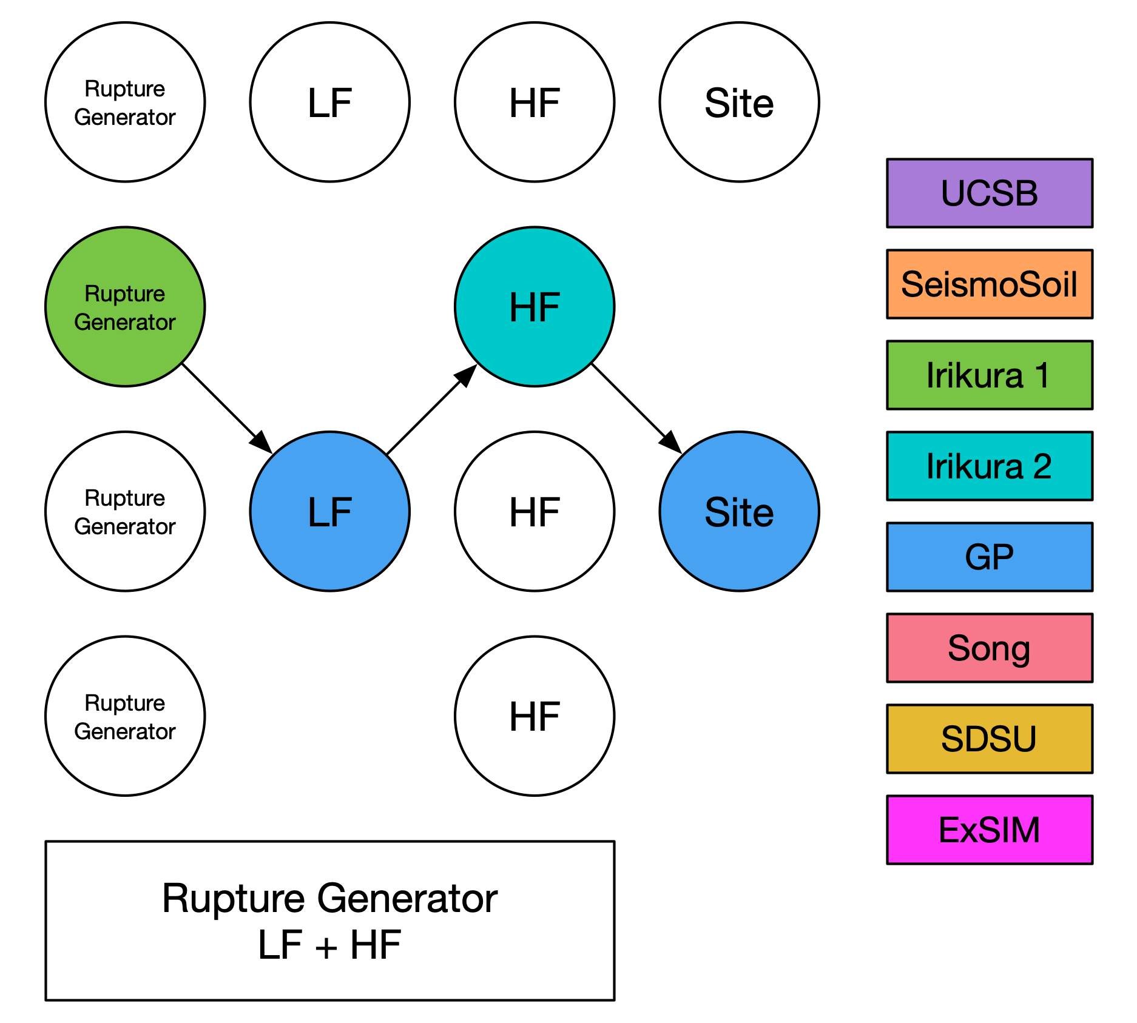
Simulation Methods
Graves and Pitarka (GP)
SDSU
UCSB
ExSIM
Irikura Recipe Method 1
Irikura Recipe Method 2
Song RMG

Slide 18
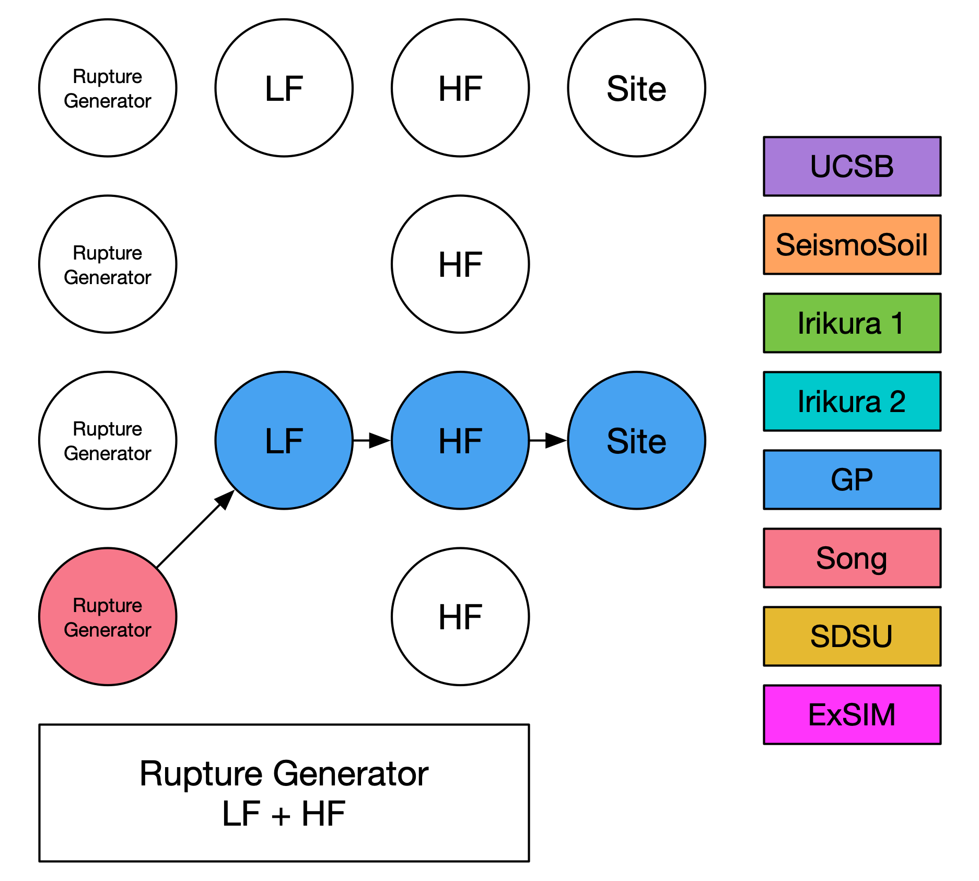
Simulation Methods
Graves and Pitarka (GP)
SDSU
UCSB
ExSIM
Irikura Recipe Method 1
Irikura Recipe Method 2
Song RMG

Slide 19
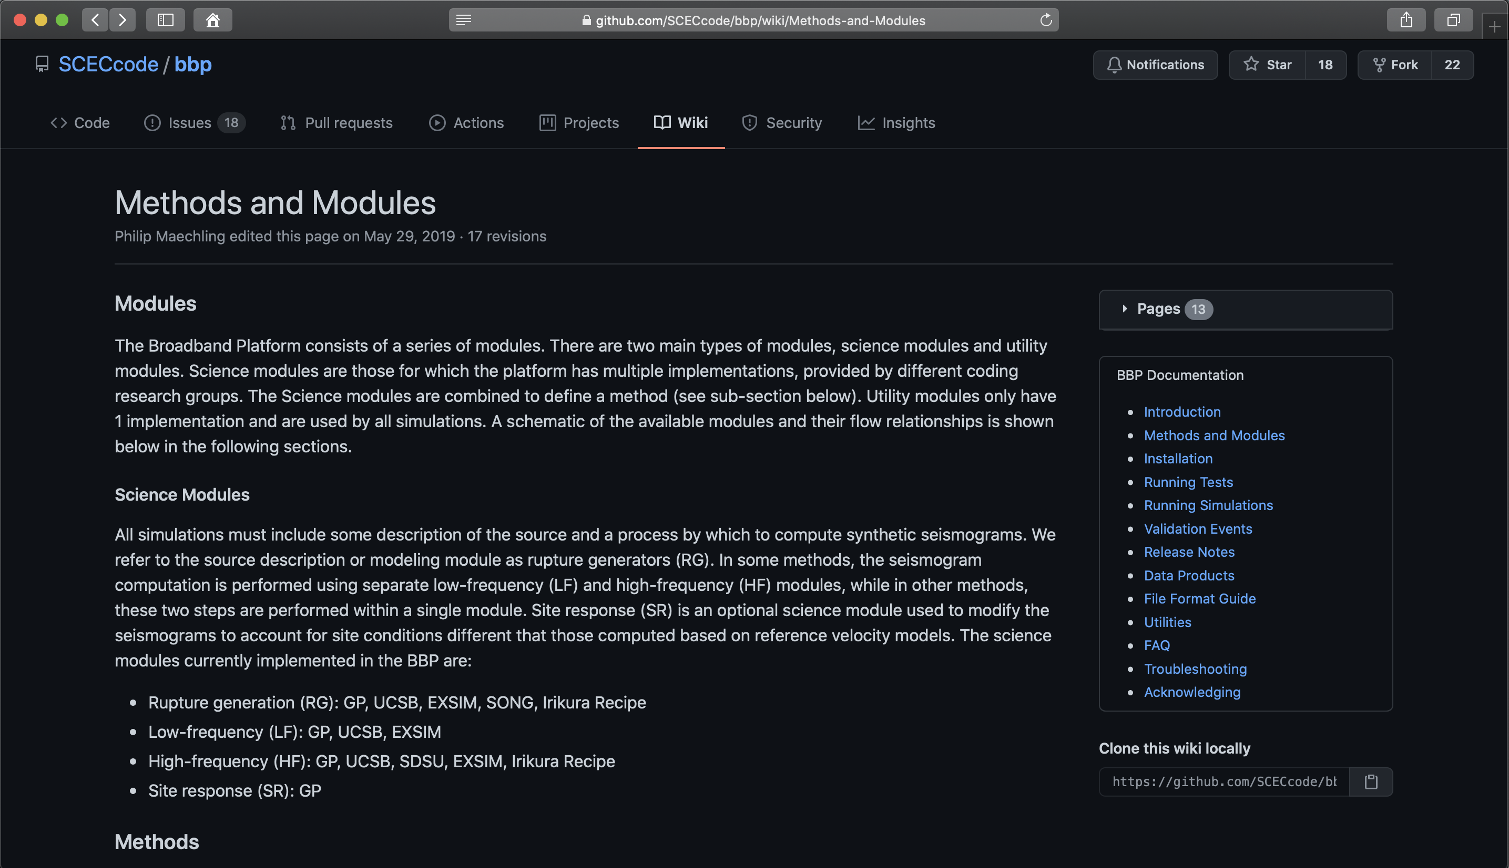
Simulation Methods
GitHub Documentation
Per model description
Modeler-provided model summary
Links to more detailed publications

Slide 20
Simulation Workflow
Based on user selections, Broadband Platform creates a simulation workflow
  Simulation and post-processing modules
Simulation inputs
  1D velocity model
  Source description
    SRC or SRF format
  Station list
    Lat/Lon
    Vs30 (for site response)
    Recorded data frequency range (for validation runs)
Post-processing inputs
  Recorded data

Slide 21
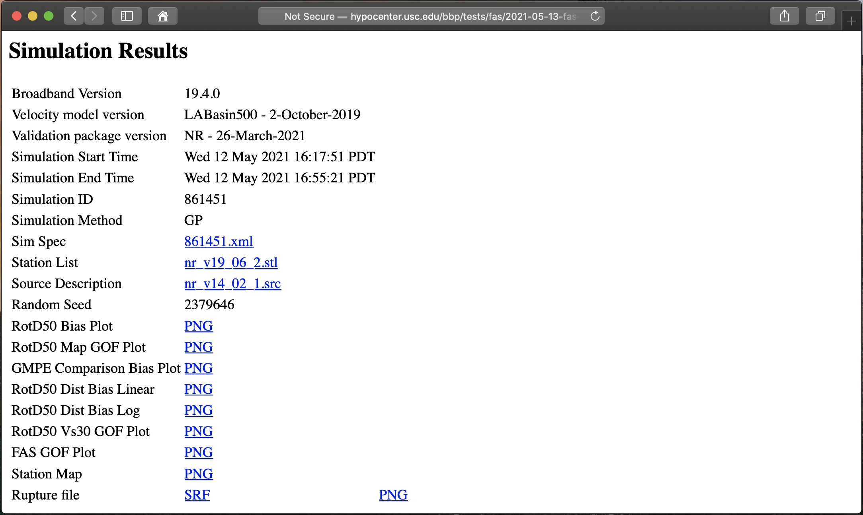
Broadband Data Products

Slide 22
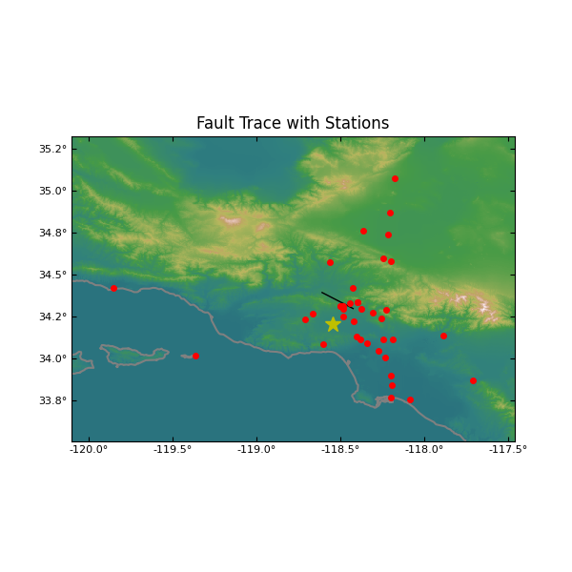
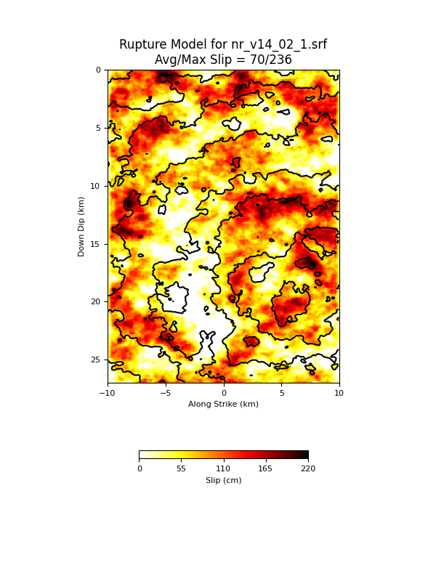
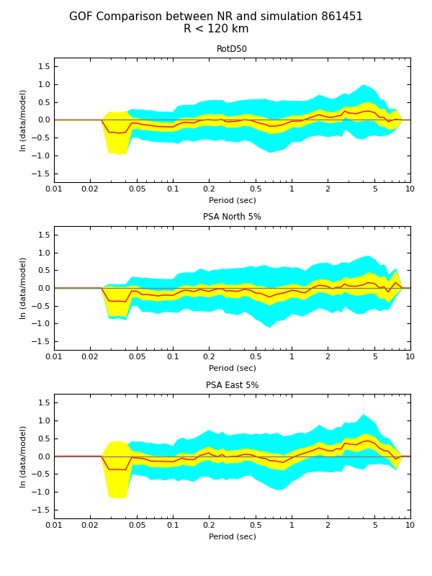
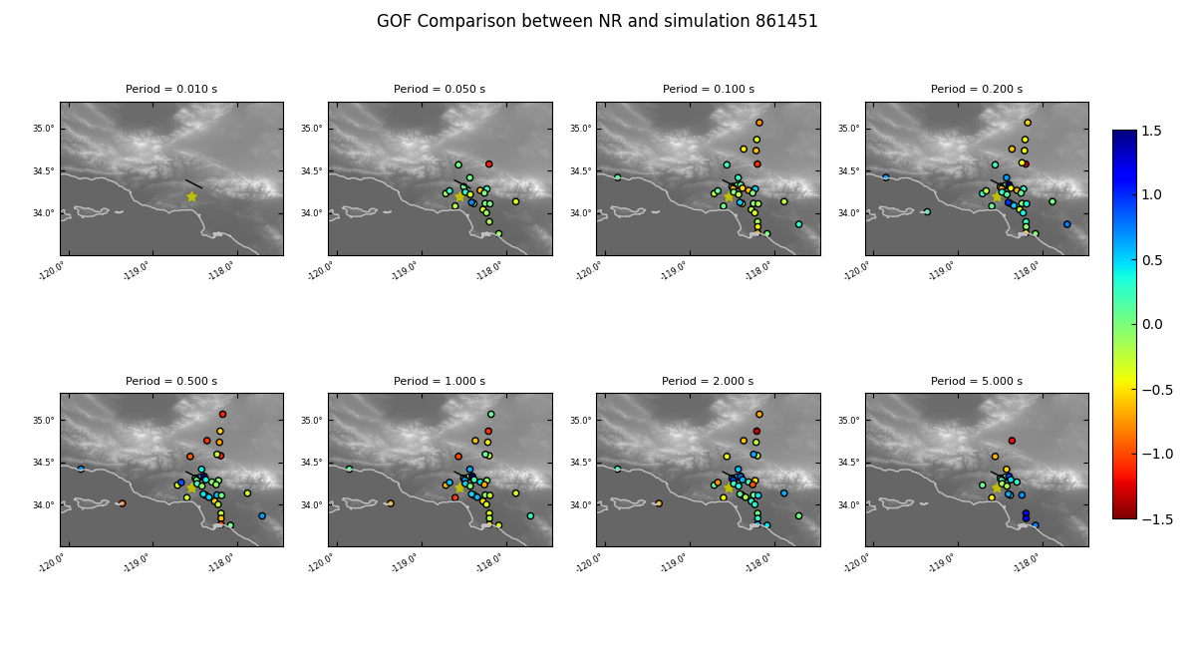
Broadband Data Products

Slide 23
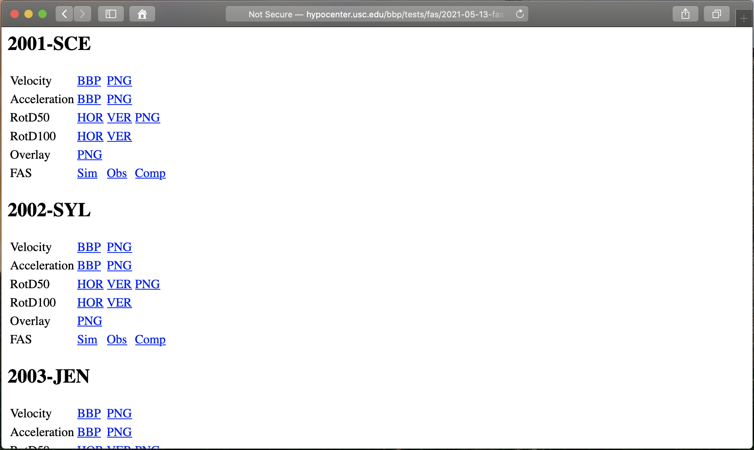
Broadband Data Products

Slide 24
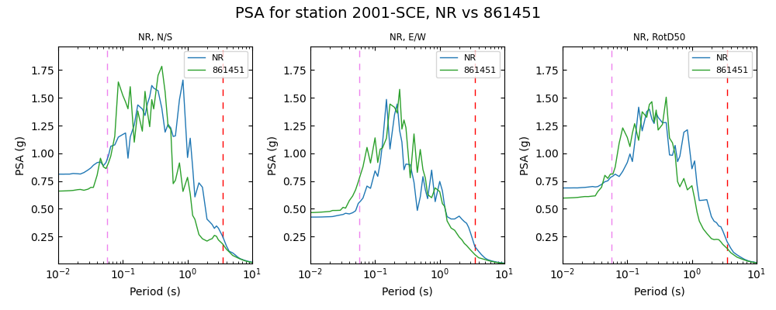
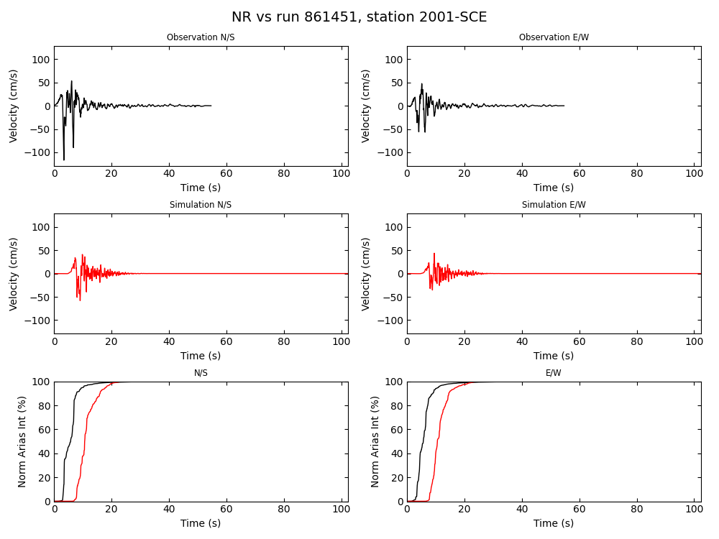
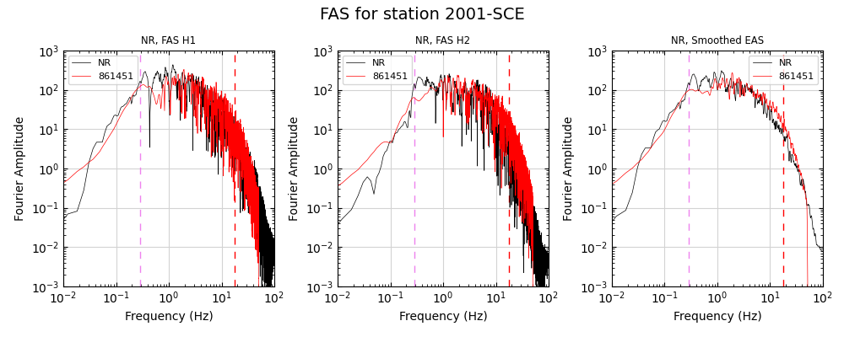
Broadband Data Products

Slide 25
Recent Developments

Slide 26
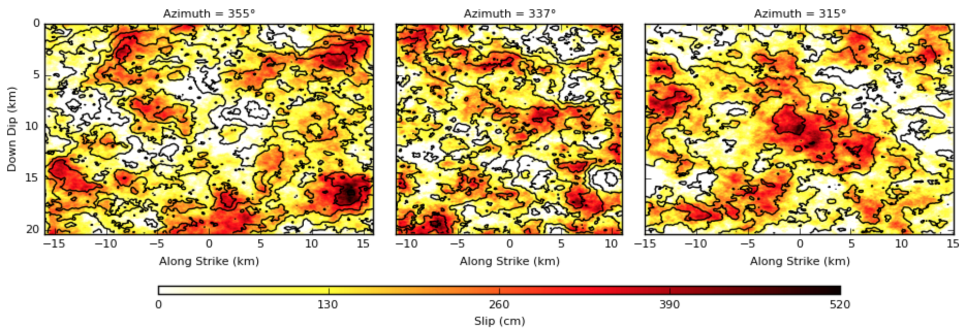
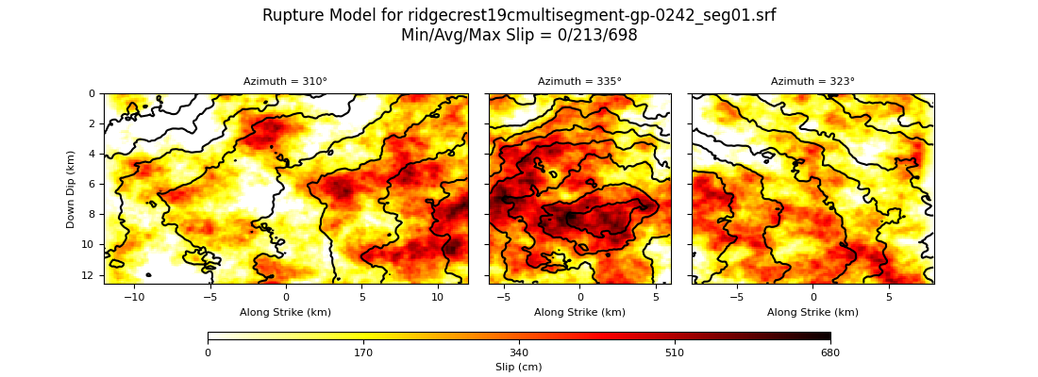
Recent Broadband Platform Development
M7.22 Landers (1992)
3-plane SRF plot
M7.08 Ridgecrest C (2019)
3-plane SRF plot
Support for multi-segment ruptures in almost all methods

Slide 27
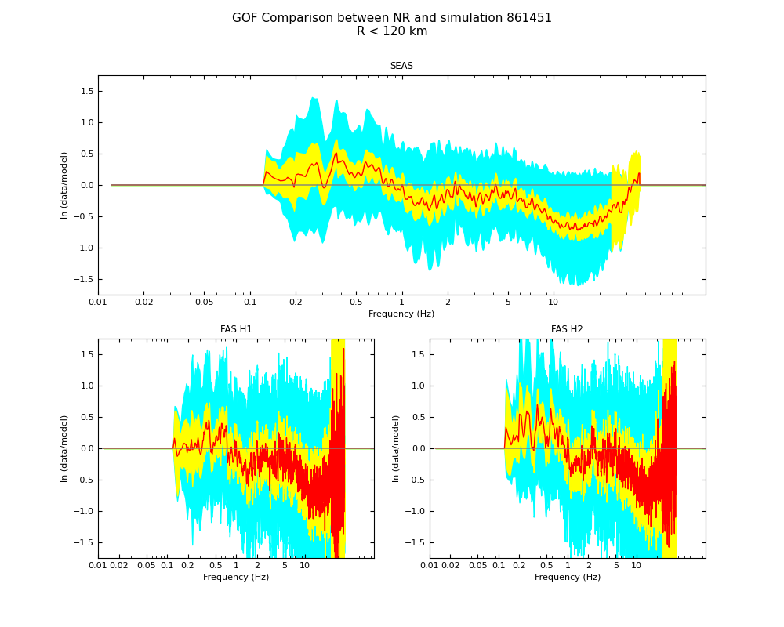
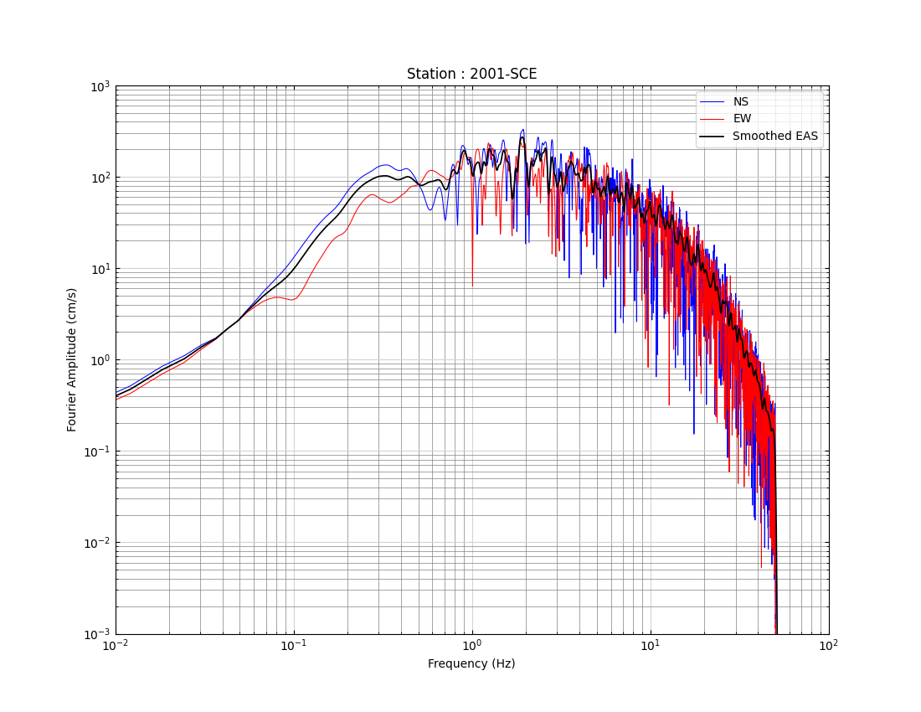
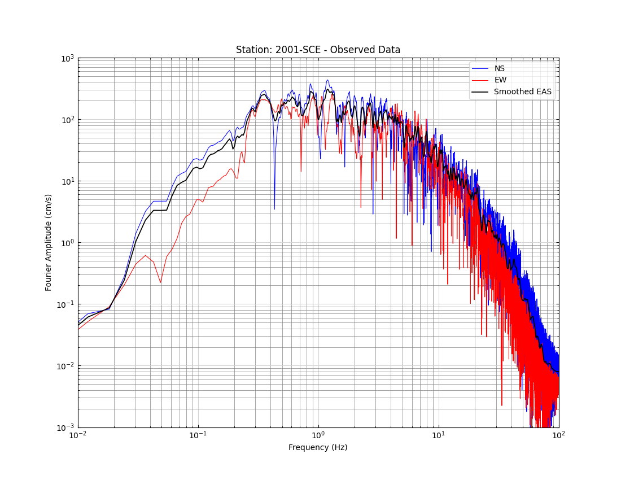
Recent Broadband Platform Development
FAS Goodness-of-Fit between simulation and data

Slide 28
Recent Broadband Platform Development
Graves and Pitarka (GP)
SDSU
UCSB
ExSIM
Irikura Recipe Method 1
Irikura Recipe Method 2
Song RMG

Slide 29
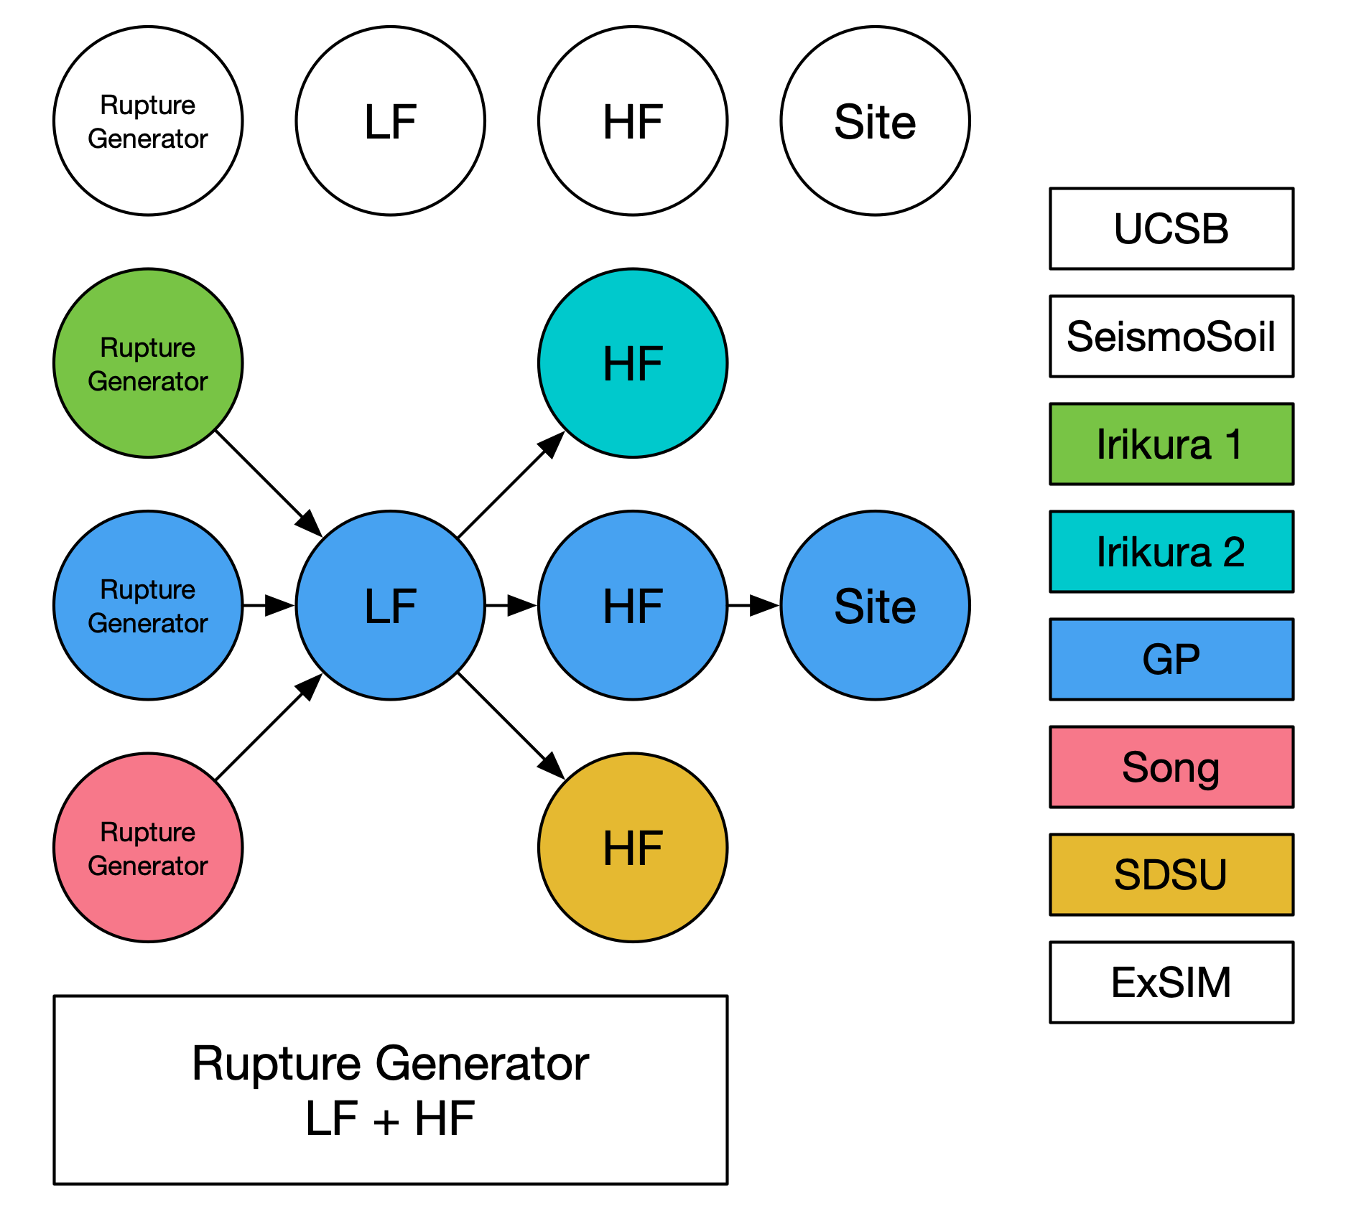
Recent Broadband Platform Development
Graves and Pitarka (GP)
SDSU
UCSB
ExSIM
Irikura Recipe Method 1
Irikura Recipe Method 2
Song RMG

Slide 30
Recent Broadband Platform Development
Graves and Pitarka (GP)
SDSU
UCSB
ExSIM
Irikura Recipe Method 1
Irikura Recipe Method 2
Song RMG
10x
faster

Slide 31
Future Developments

Slide 32
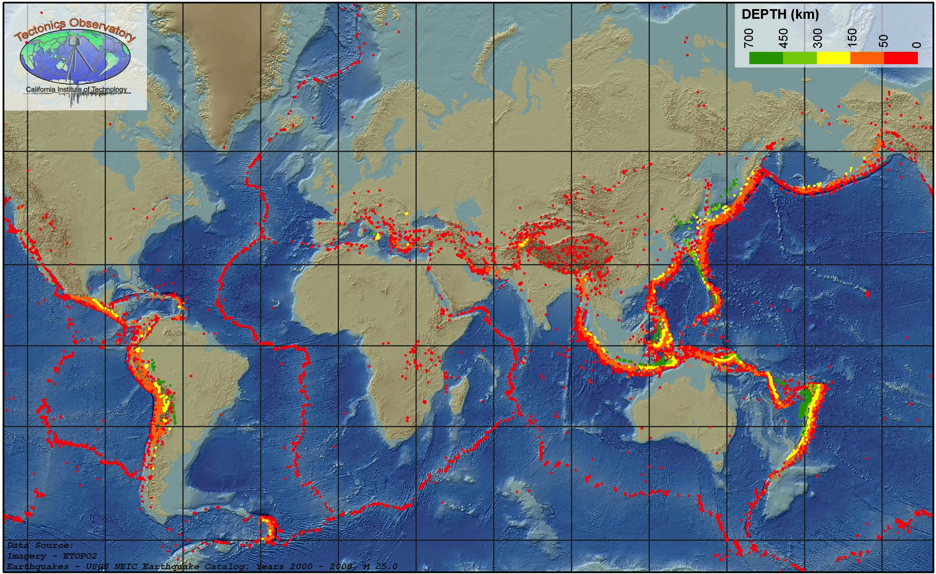
Future: User Generated Simulation Regions
Users would like to run BBP in other regions
  Costa Rica, India, China, Turkey, Iran, Taiwan, …
  User-provided velocity model
BBP supplies
  Codes to generate GFs
  Tool to create configuration file
BUT
Documentation is needed
  Region and method-specific parameters
GFs can be large
  Creates issues with distribution
Seismicity Map 2000-2008, Caltech Tectonics Observatory

Slide 33
Future: Modular Version of the Broadband Platform
Broadband Platform includes many useful tools
  Seismogram handling, post-processing, plotting, …
Most modules include a well-defined interface
  Set of input and output files
  Well-documented file formats
Enable use outside of Broadband Platform
  Separate and better package these codes
  Update codes to remove dependencies on the BBP
  Export API that allows
    Command-line use for easy scripting
    Python interface to facilitate integration against other codes

Slide 34
Thanks!
https://github.com/SCECcode/bbp

