Slide 1
Broadband Platform Data Products
November 2021
SCEC Research Computing Group
November 4, 2021

Slide 2
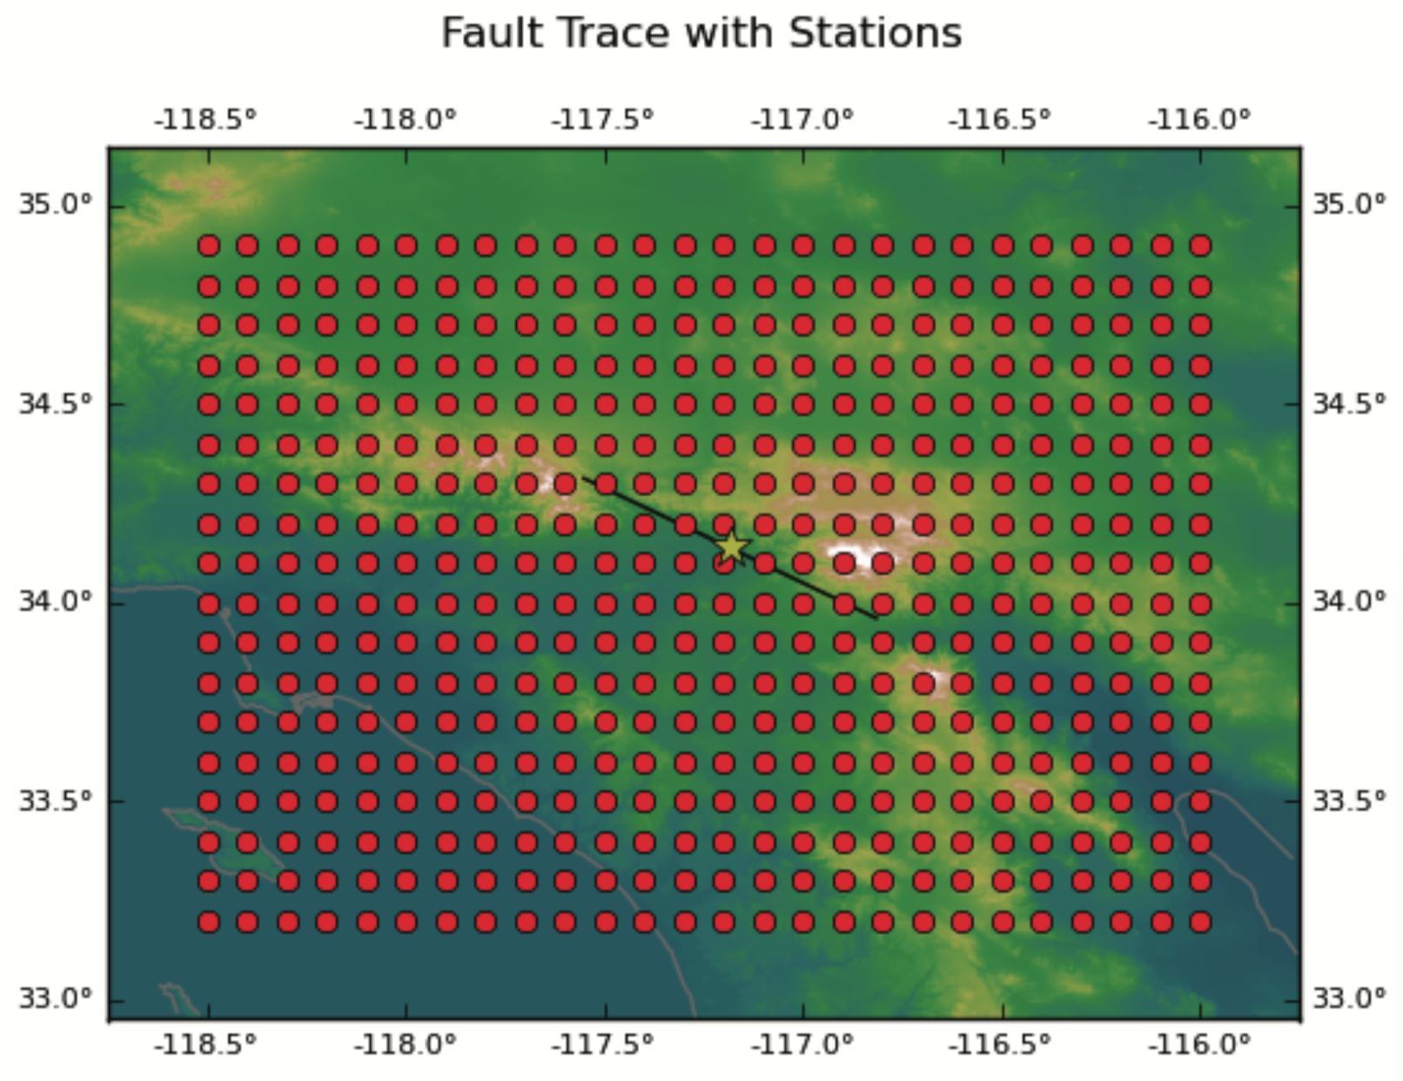
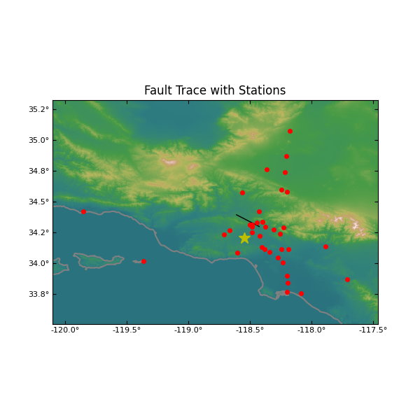
Station Map
Inputs
SRC or SRF file
Station list
Outputs
PNG plot

Slide 3
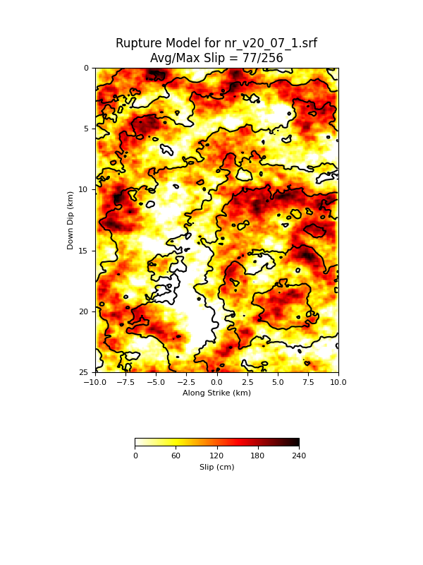
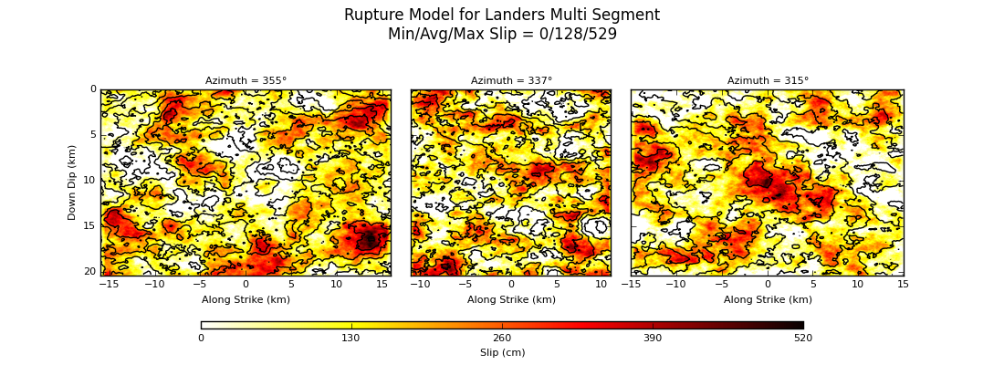
Slip Distribution Plot
Inputs
SRF file (single or multi-segment)
Outputs
PNG plot

Slide 4
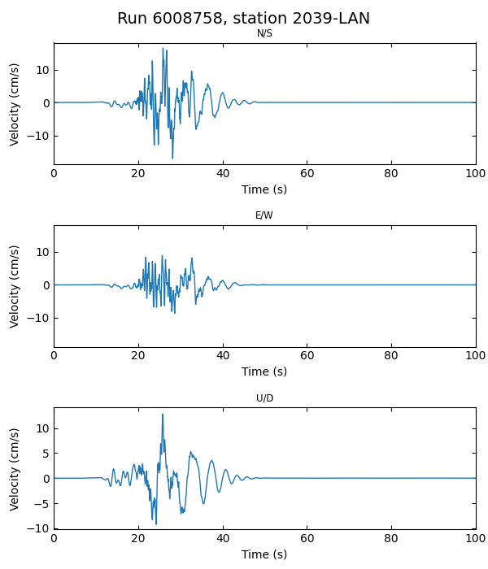
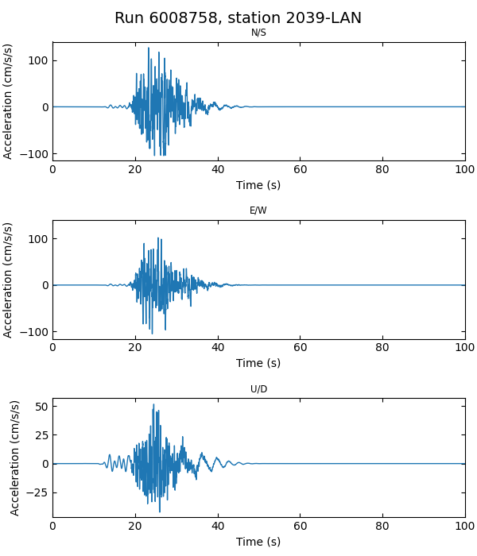
Plot Seismograms
Inputs
Station list
SRC file
Vel/Acc Seismograms
Plot vel (Y/N)
Plot acc (Y/N)
Outputs
3 comp velocity seismograms
3 comp acceleration seismograms

Slide 5
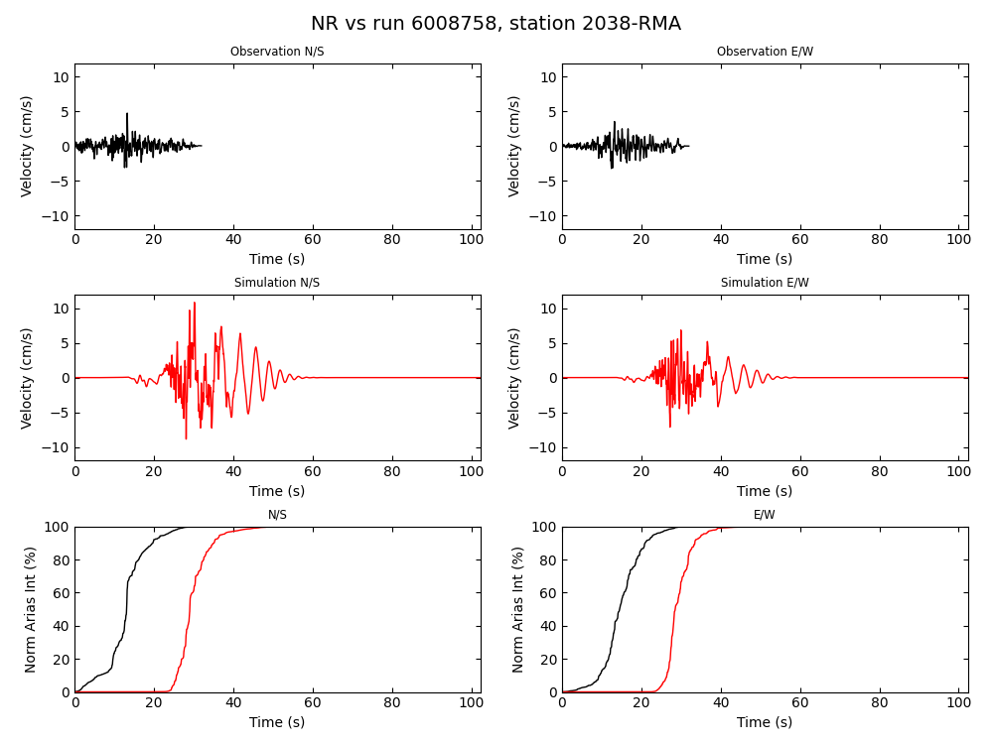
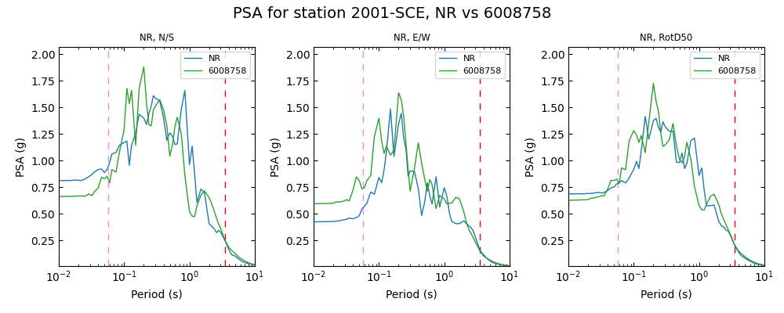
Comparison Plots
Inputs
Station list
Vel synthetic seismograms
Vel/Acc data
Outputs
N/S and E/W
Timeseries comparison
Normalized Arias intensity

Slide 6
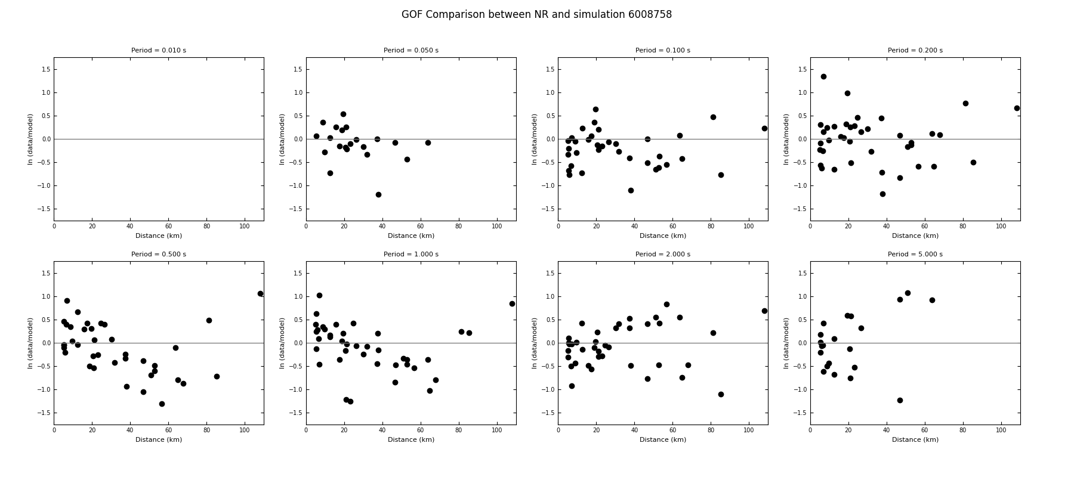
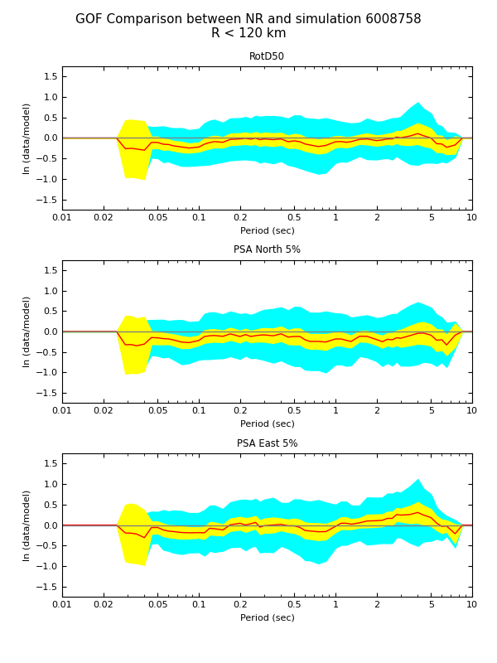
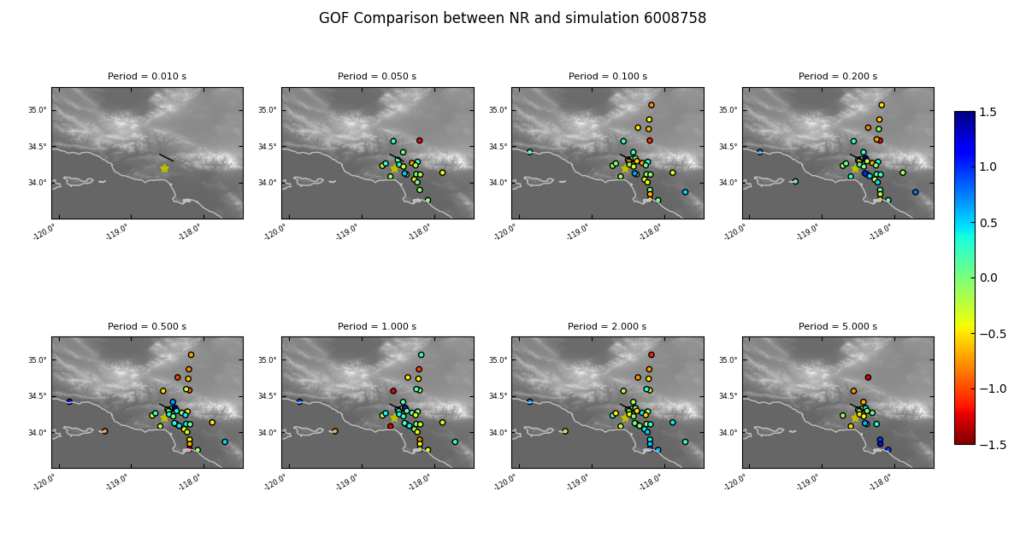
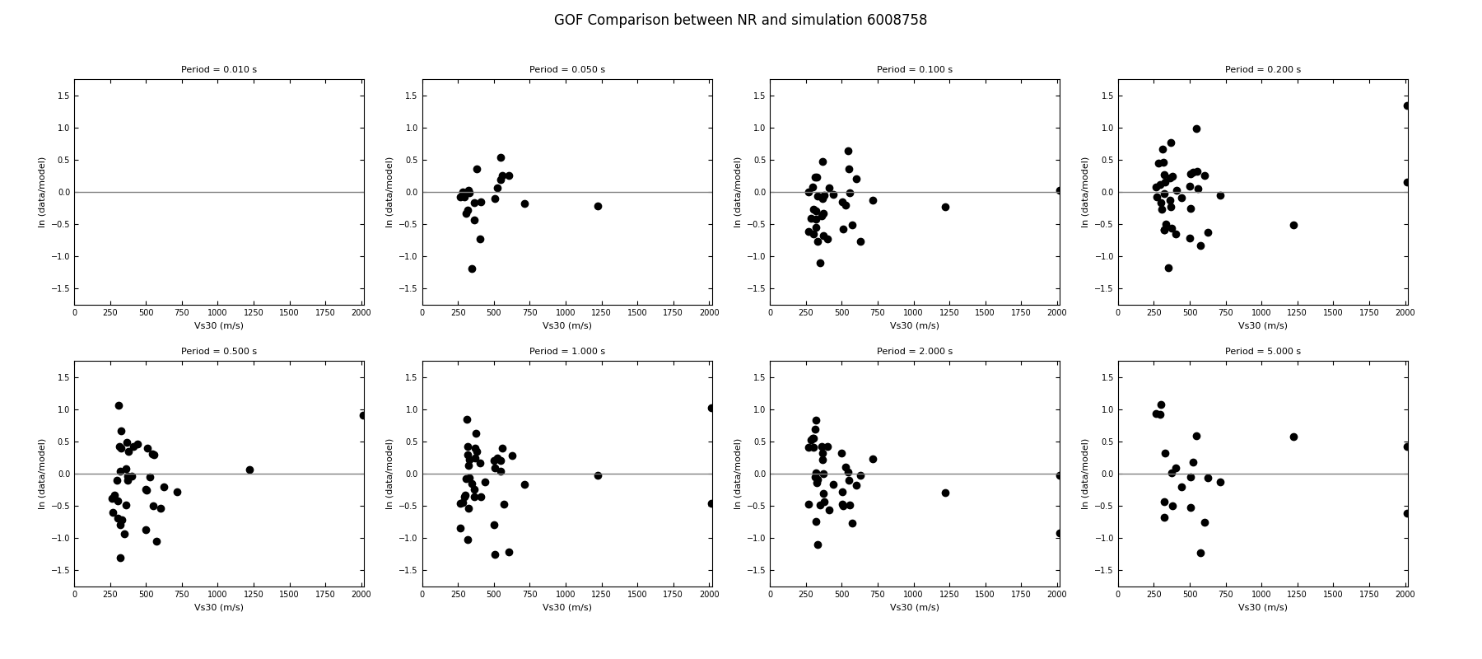
GP GoF
Inputs
Station list
SRC file
RotD50 files
Obs and synthetic
Outputs
PSA GoF plot
PSA GoF plot (distance)
PSA GoF plot (map)
PSA GoF plot (Vs30)

Slide 7
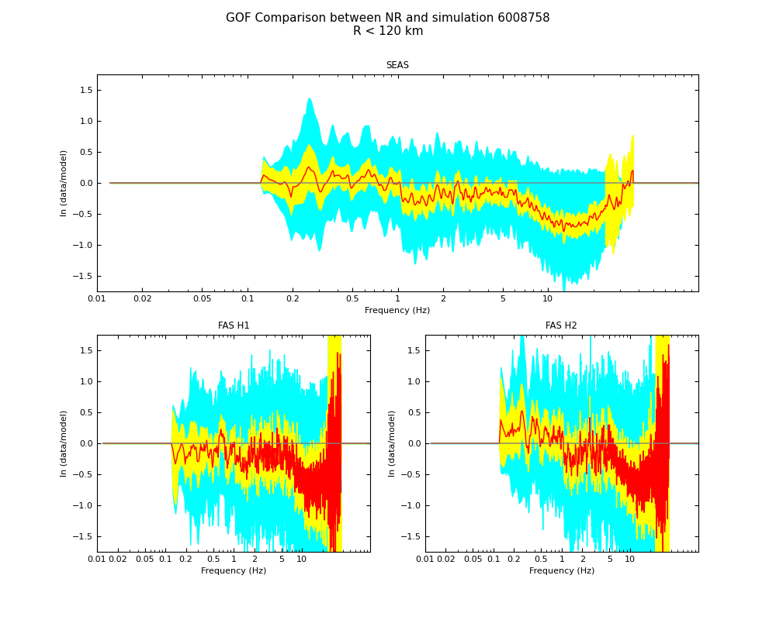
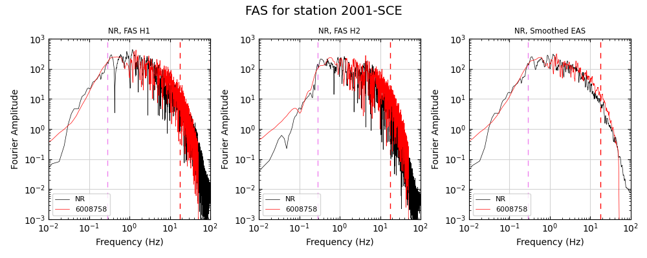
FAS GoF
Inputs
Station list
Acc seismograms (data and synthetics)
Outputs
Per station comparison plots
Horizontal components
Smoothed EAS
Combined FAS GoF plot

Slide 8
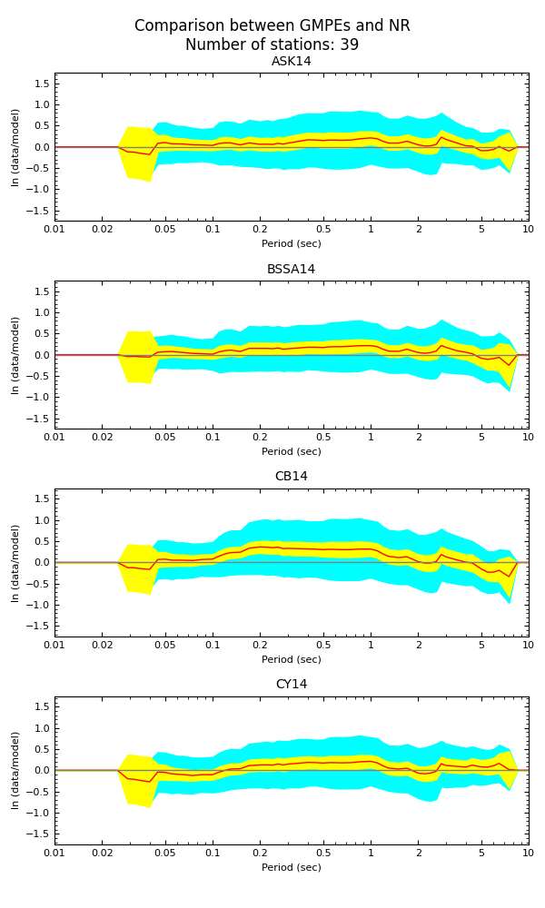
GMPE Comparison
Inputs
Station list
SRC file
RotD50 observations
Outputs
PNG plot
ASK14
BSSA14
CB14
CY14

Slide 9
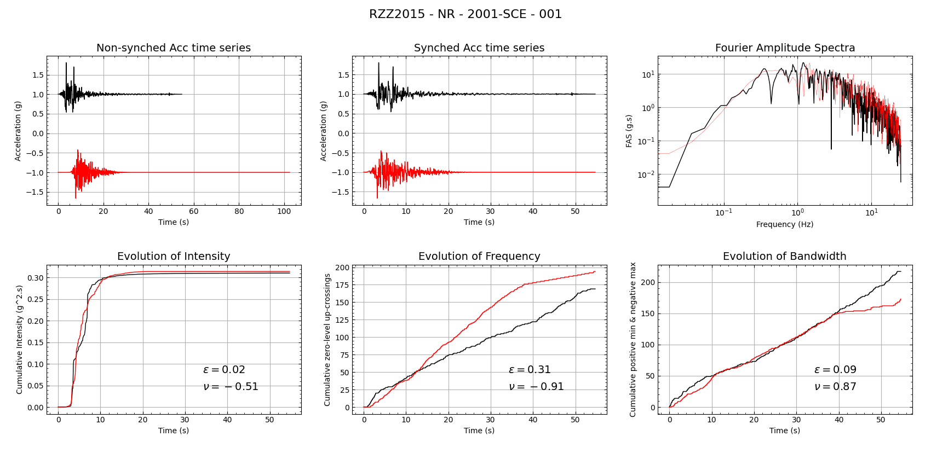
RZZ 2015
Inputs
Station list
Acc (obs and synthetic)
Outputs
Rezaeian-Zhong-Zareian 2015 validation metrics
Per station plots
Combined table with metrics

Slide 10
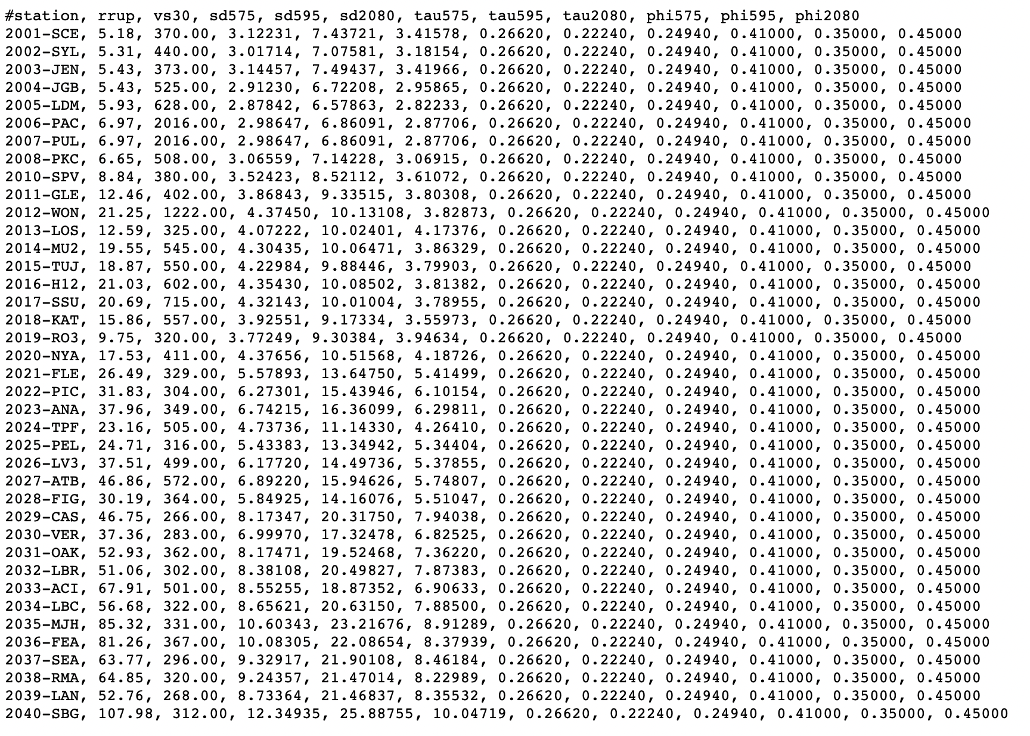
Afshari and Stewart (2016) GMPE
Inputs
Station list
SRC file
Outputs
Table with per-station duration GMPE

Slide 11
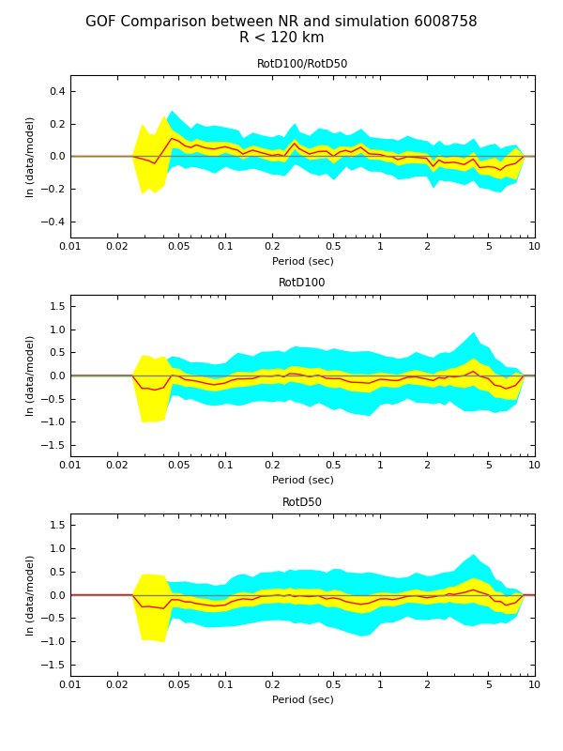
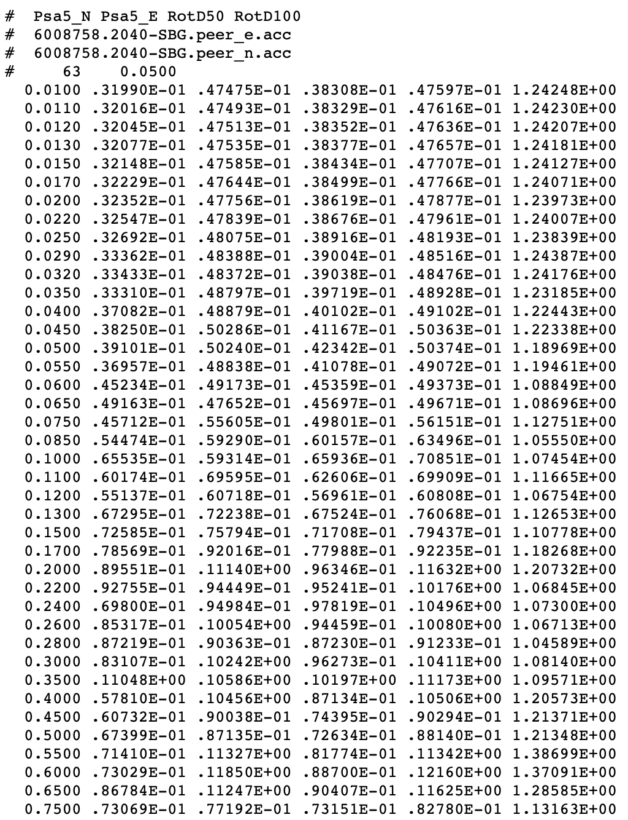
Baker RotD100
Inputs
Station list
Velocity/Acceleration Seismograms (obs and synthetic)
SRC file
Outputs
RotD100 files (per station)
RotD50
RotD100
RotD100/RotD50
RotD100/RotD50 GoF plot

Slide 12
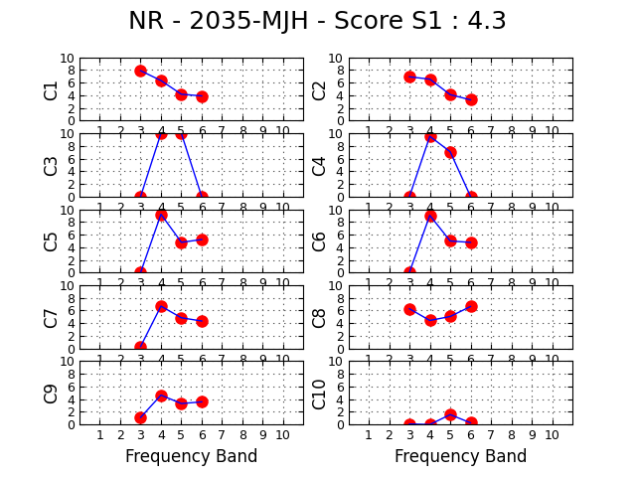
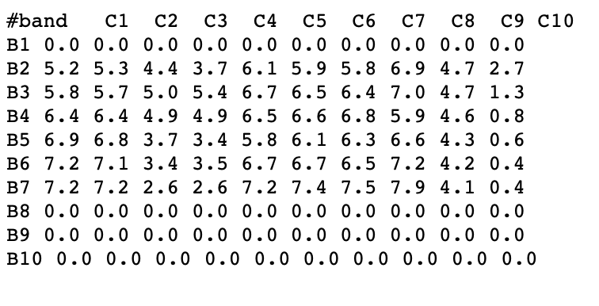
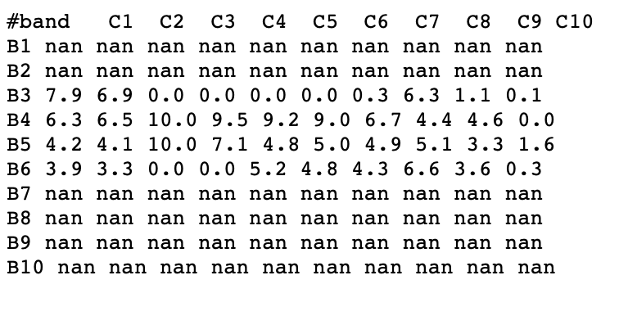
Anderson GoF
Inputs
Station list
Acc timeseries (obs and synthetic)
RotD50 (obs and synthetic)
Outputs
C1-C10 plots (per station)
C1-C10 table (per station)
Combined table

Slide 13
BBP Utilities
arias_duration
Input: peer acceleration file (1 comp)
Output: arias intensity file (1 comp)
bbp_formatter
peer2bbp
Input: 3 PEER files (N/E/Z)
Output: 3 component BBP file
bbp2peer
Input: 3-component BBP file
Output: 3 PEER files (N/E/Z)
exsim2bbp
Input: 3 ExSIM files (N/E/Z)
Output: 3-component BBP file

