Slide 1

Scientific and Software Advancements in the Broadband Platform 22.4.0
Fabio Silva

Slide 2

Outline
Broadband Platform 22.4.0
  What’s new?
    Validation events
    Method updates
    Performance improvements
    FAS validation
  Validation and release process
  Updates to installation
  Licensing changes
  GitHub CI testing

Slide 3
What’s New? Validation Events
California
  Alum Rock Mw 5.45
  Chino Hills Mw 5.39
  Hector Mine Mw 7.13
  Landers Mw Mw 7.22*
  Loma Prieta Mw 6.94
  North Palm Springs Mw 6.12
  Northridge Mw 6.73
  Parkfield Mw 6.0
  Ridgecrest A Mw 6.47
  Ridgecrest B Mw 5.4
  Ridgecrest C Mw 7.08*
  San Simeon Mw 6.6*
  Whittier Narrows Mw 5.89
Japan
  Chuetsu-Oki Mw 6.69
  Iwate Mw 6.9
  Niigata Mw 6.65
  Tottori Mw 6.59
Italy
  L’Aquila Mw 6.29
Eastern North America
  Mineral Mw 5.68
  Riviere-du-Loup Mw 4.6
  Saguenay Mw 5.81
*Available as single or multi-segment ruptures
Blue Indicates partial validation data set.

Slide 4
What’s Included? Validation Events
Validation Event data sets include:
1D seismic velocity model for region
One (or more) fault geometry definitions
One (or more) source descriptions for the earthquake
Selection of “well recorded” observed ground motion seismograms
Identification of frequency response for instrument recording each observed ground motion.

Slide 5
What’s New? Simulation Regions
BBP 19.4 California Regions
BBP 22.4 California Regions

Slide 6
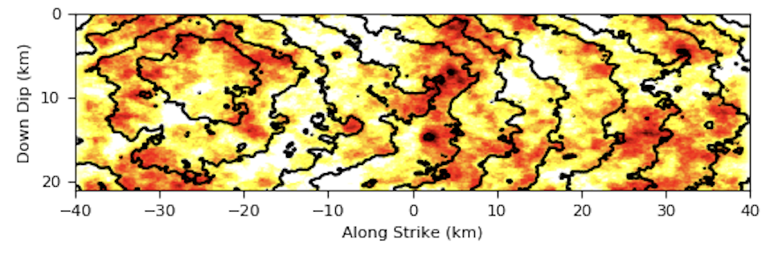
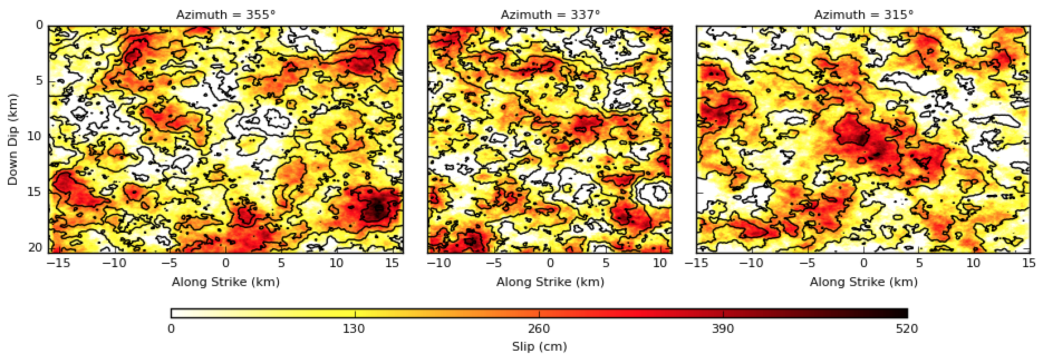
What’s New? Multi-Segment Rupture Support
M7.22 Landers (1992)
single-plane SRF plot
M7.22 Landers (1992)
3-plane SRF plot

Slide 7
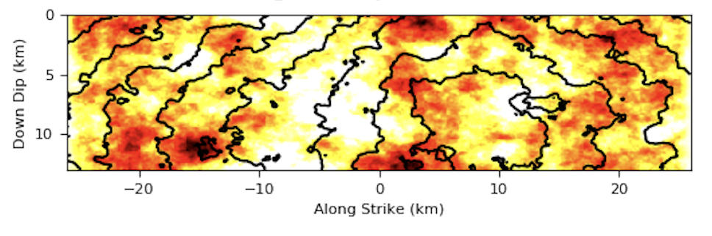
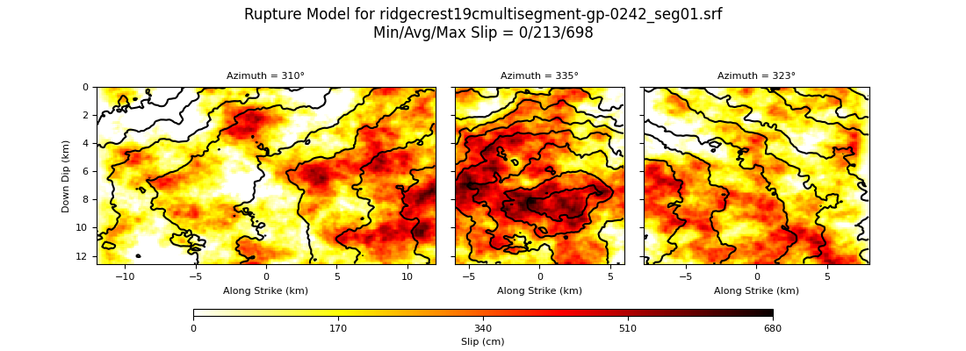
What’s New? Multi-Segment Rupture Support
M7.08 Ridgecrest C (2019)
single-plane SRF plot
M7.08 Ridgecrest C (2019)
3-plane SRF plot

Slide 8
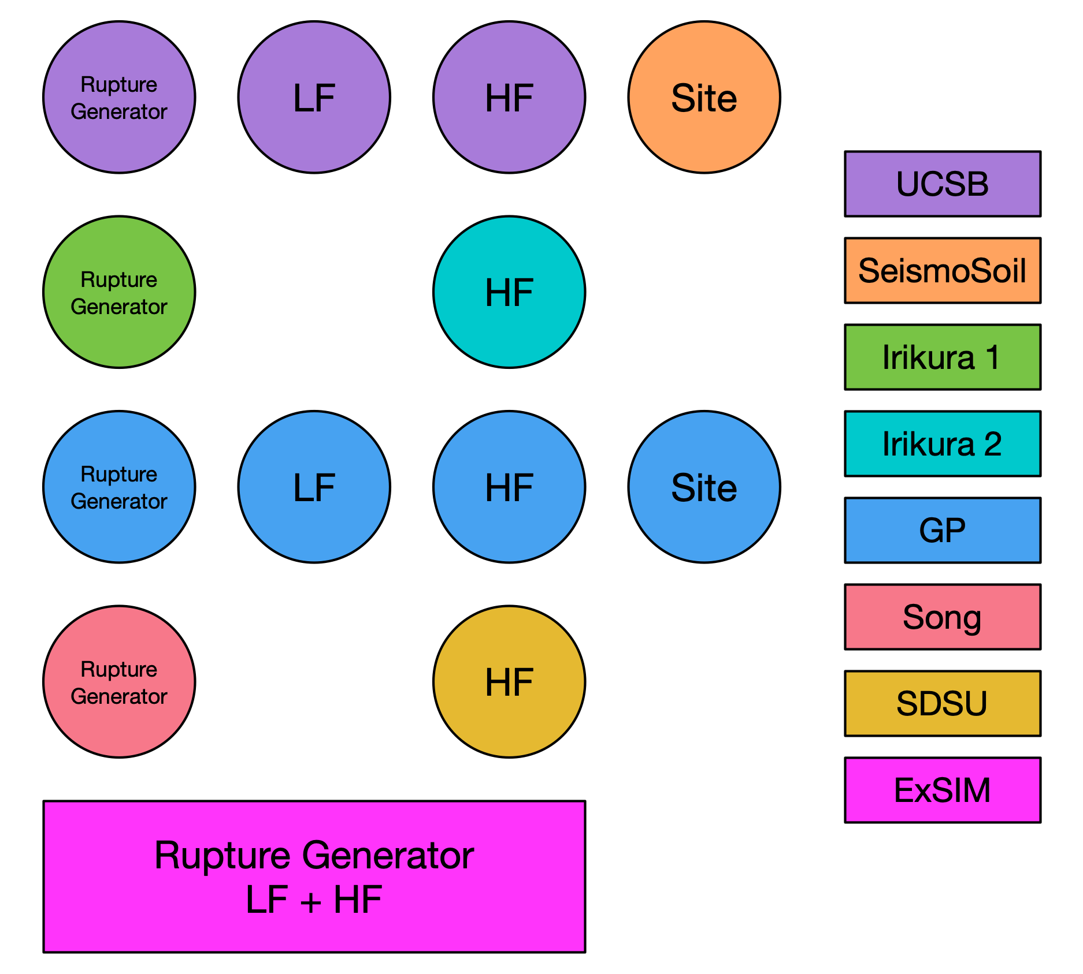
Broadband Platform Science Modules
Graves and Pitarka (GP)
SDSU
UCSB
ExSIM
Irikura Recipe Method 1
Irikura Recipe Method 2
Song RMG

Slide 9
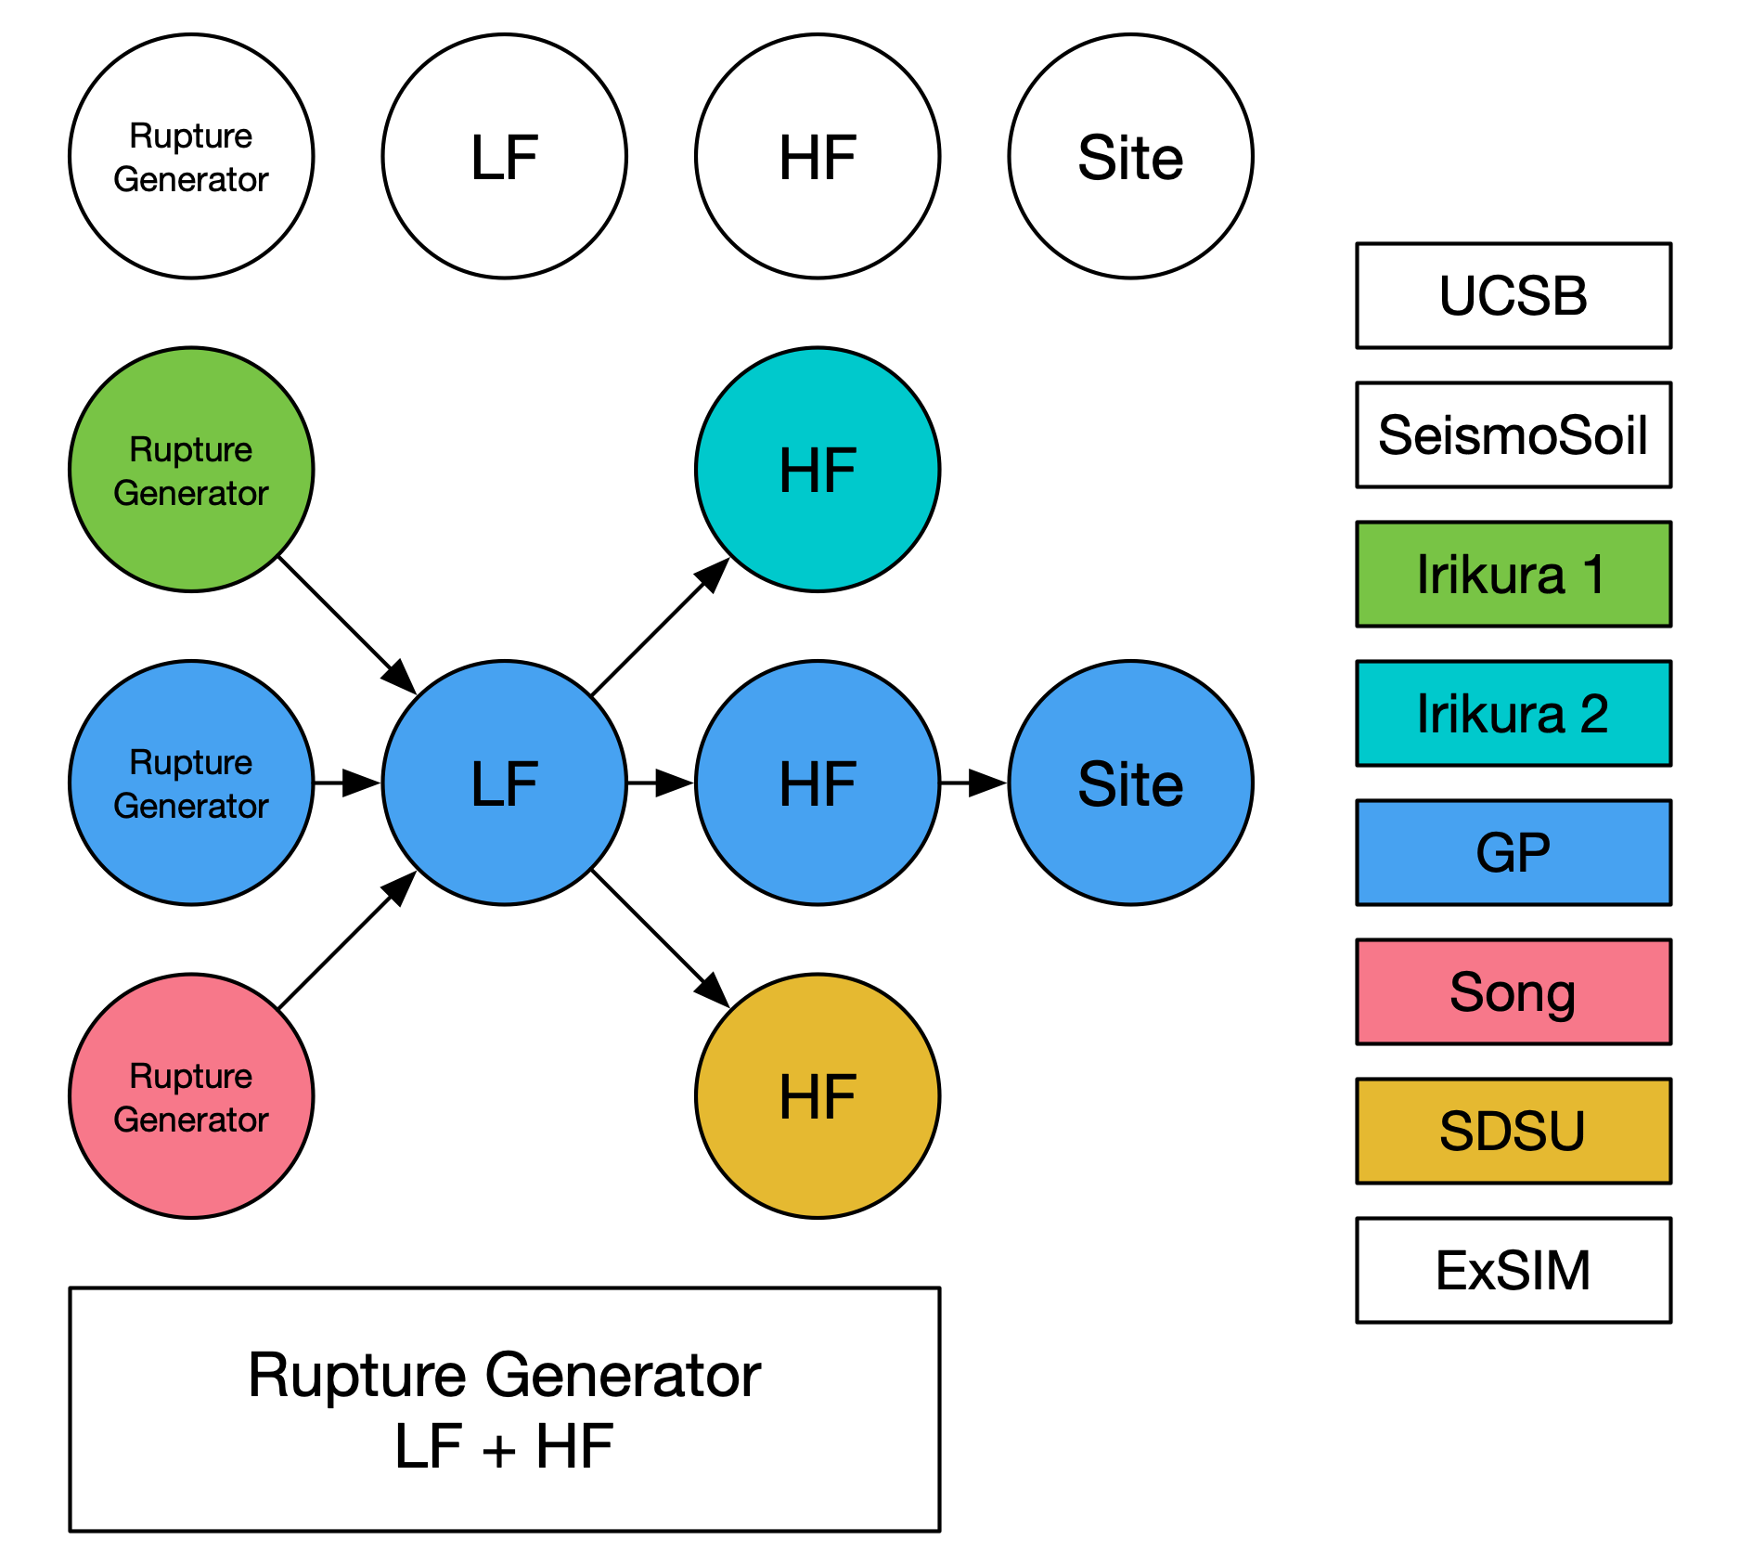
Broadband Platform Science Modules
GP - jbsim
  LF wave propagation
  Used by 5 simulation methods

Slide 10
Performance Comparison 19.8 vs 22.4 using GP LF
Huge Improvement!!!
Mw 5.89 Whittier Narrows
  Speed-up = 3.5
Mw 6.73 Northridge
  Speed-up = 5.9
Mw 7.22 Landers
  Speed-up = 12.2

Slide 11
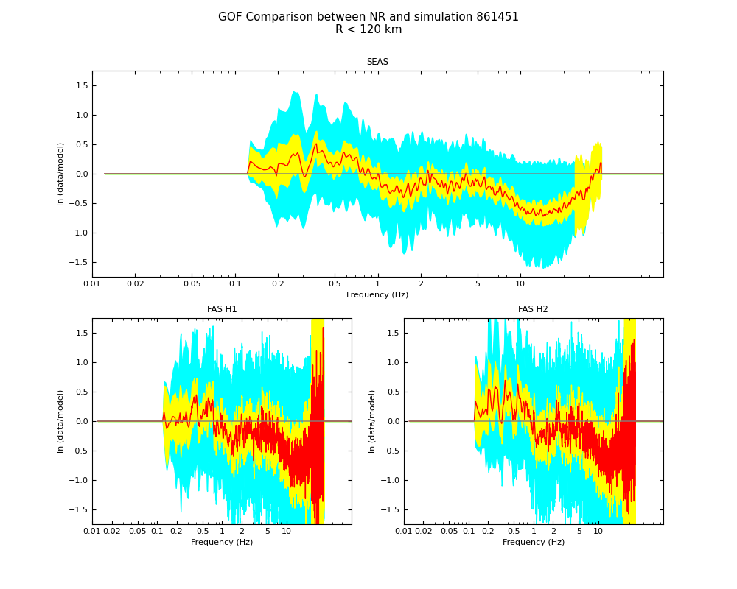
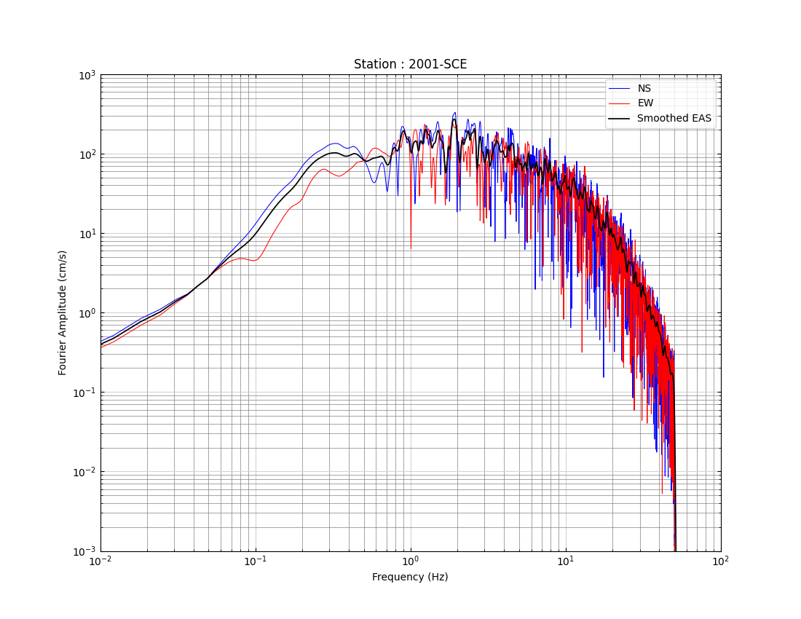
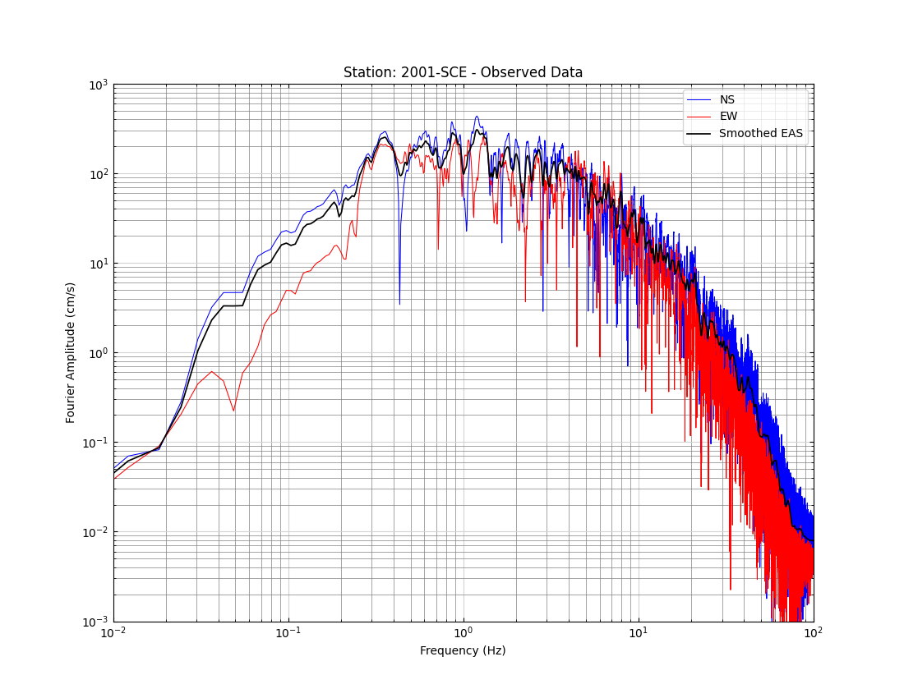
What’s New? FAS Validation
FAS Goodness-of-Fit between simulation and data

Slide 12
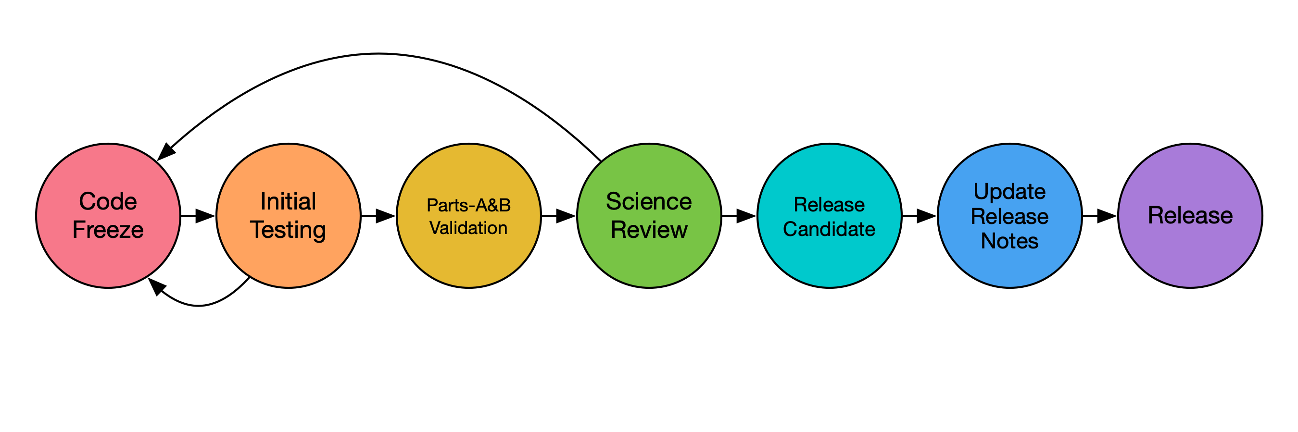
BBP Validation and Release Process
Extensive validation before a BBP release
Code freeze for science modules
  Science codes
  Parameters and configuration files
Initial checks before running full set of validation runs on USC’s computing cluster
Science Review with entire group
  Share results
Try release candidate on different computing environments
GitHub Wiki updates
  Simulation models documentation
  FAQ / release notes
Release

Slide 13
BBP Validation Part-A
  Alum Rock Mw 5.45
  Chino Hills Mw 5.39
  Hector Mine Mw 7.13
  Landers Mw Mw 7.22
  Loma Prieta Mw 6.94
  North Palm Springs Mw 6.12
  Northridge Mw 6.73
  Parkfield Mw 6.0
  Ridgecrest A Mw 6.47
  Ridgecrest B Mw 5.4
  Ridgecrest C Mw 7.08
  San Simeon Mw 6.6
  Whittier Narrows Mw 5.89
  Chuetsu-Oki Mw 6.69
  Iwate Mw 6.9
  Niigata Mw 6.65
  Tottori Mw 6.59
  Graves and Pitarka (GP)
  SDSU
  UCSB
  ExSIM
  Irikura Recipe Method 1
  Irikura Recipe Method 2
  Song RMG
  64 Realizations
  Part-A Validation 2.9TB

Slide 14
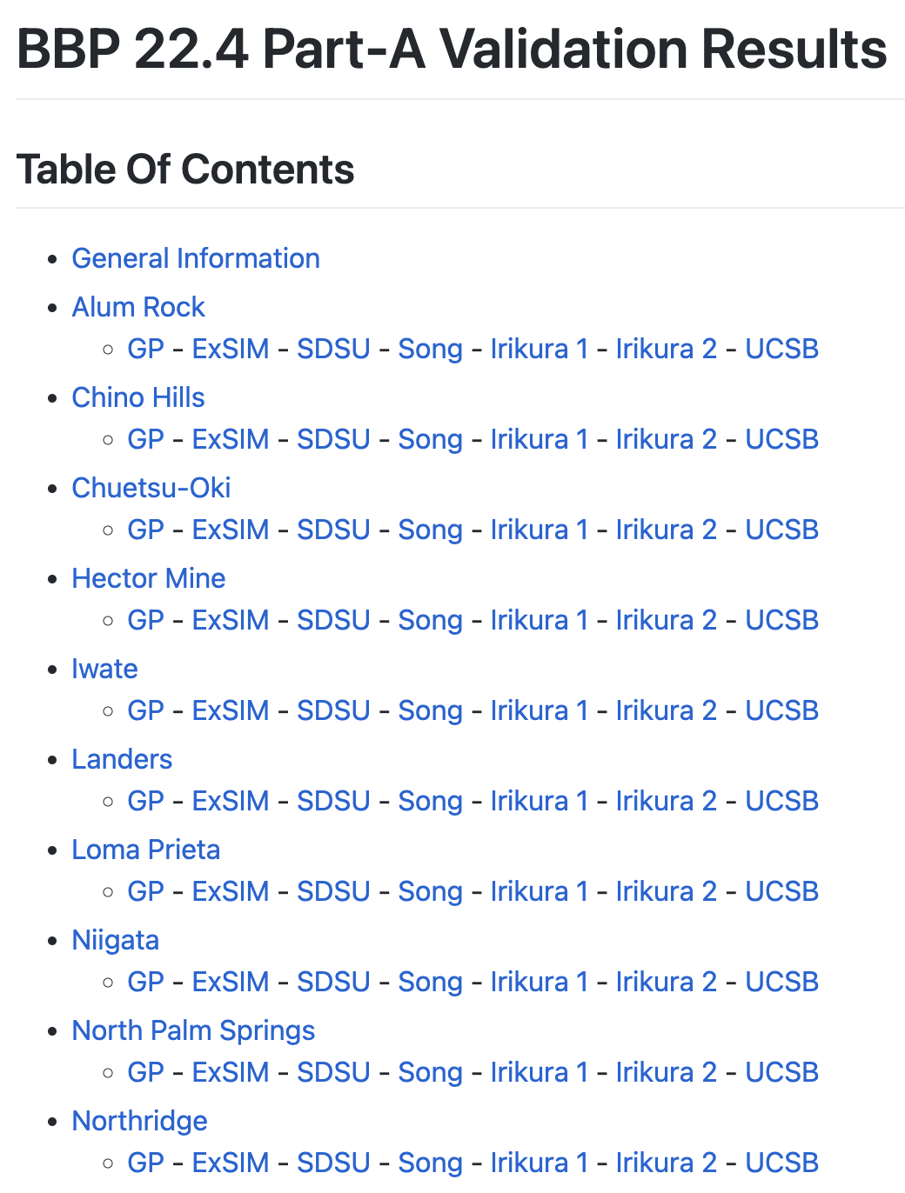
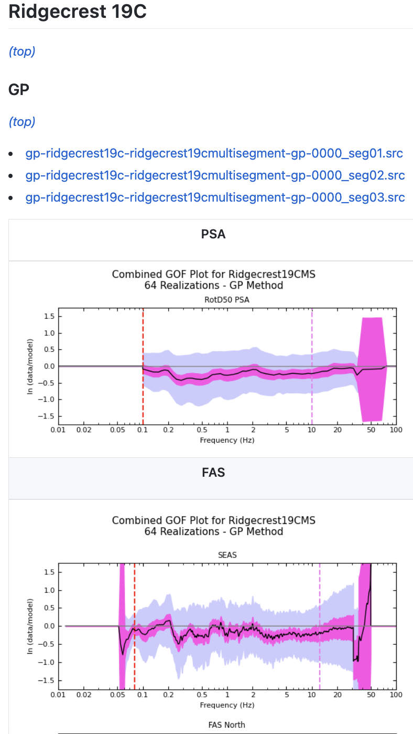
BBP Validation Part-A Data Products
  PSA GoF
    Period
    Map
    Distance
    Vs30
  FAS GoF
  Convergence plots
  ~ 80MB of plots/metadata

Slide 15
BBP Validation Part-B
  Mw 5.5 Reverse 20km SoCal
  Mw 5.5 Reverse 50km SoCal
  Mw 5.5 Reverse 20km NoCal
  Mw 5.5 Reverse 50km NoCal
  Mw 6.2 Strike-Slip 20km SoCal
  Mw 6.2 Strike-Slip 50km SoCal
  Mw 6.2 Strike-Slip 20km NoCal
  Mw 6.2 Strike-Slip 50km NoCal
  Mw 6.6 Reverse 20km SoCal
  Mw 6.6 Reverse 50km SoCal
  Mw 6.6 Reverse 20km NoCal
  Mw 6.6 Reverse 50km NoCal
  Mw 6.6 Strike-Slip 20km SoCal
  Mw 6.6 Strike-Slip 50km SoCal
  Mw 6.6 Strike-Slip 20km NoCal
  Mw 6.6 Strike-Slip 50km NoCal
  Graves and Pitarka (GP)
  SDSU
  UCSB
  ExSIM
  Irikura Recipe Method 1
  Irikura Recipe Method 2
  Song RMG
  64 Realizations
  Part-B Validation 920GB

Slide 16
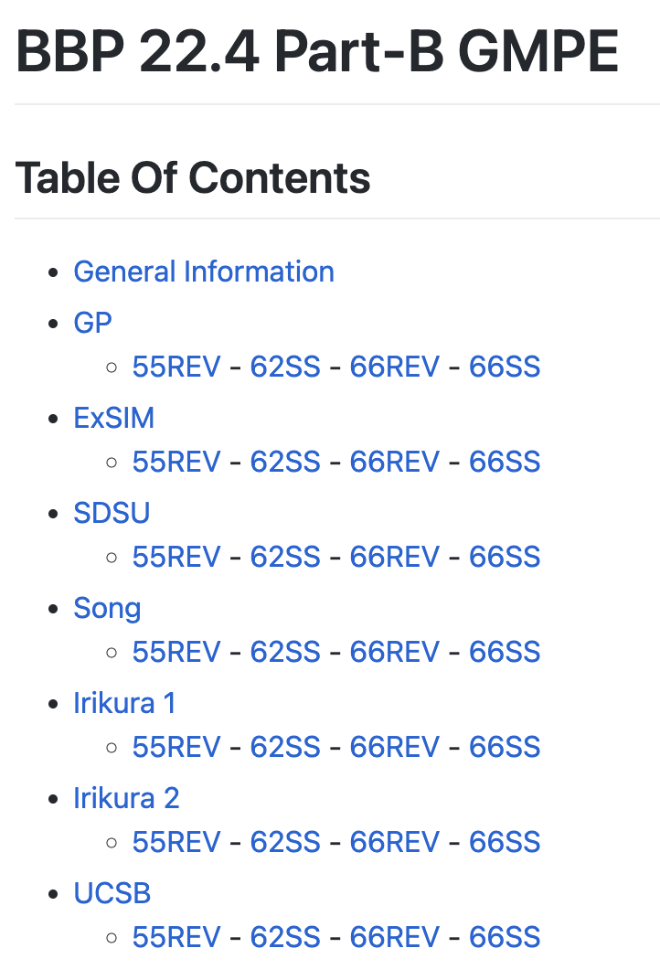
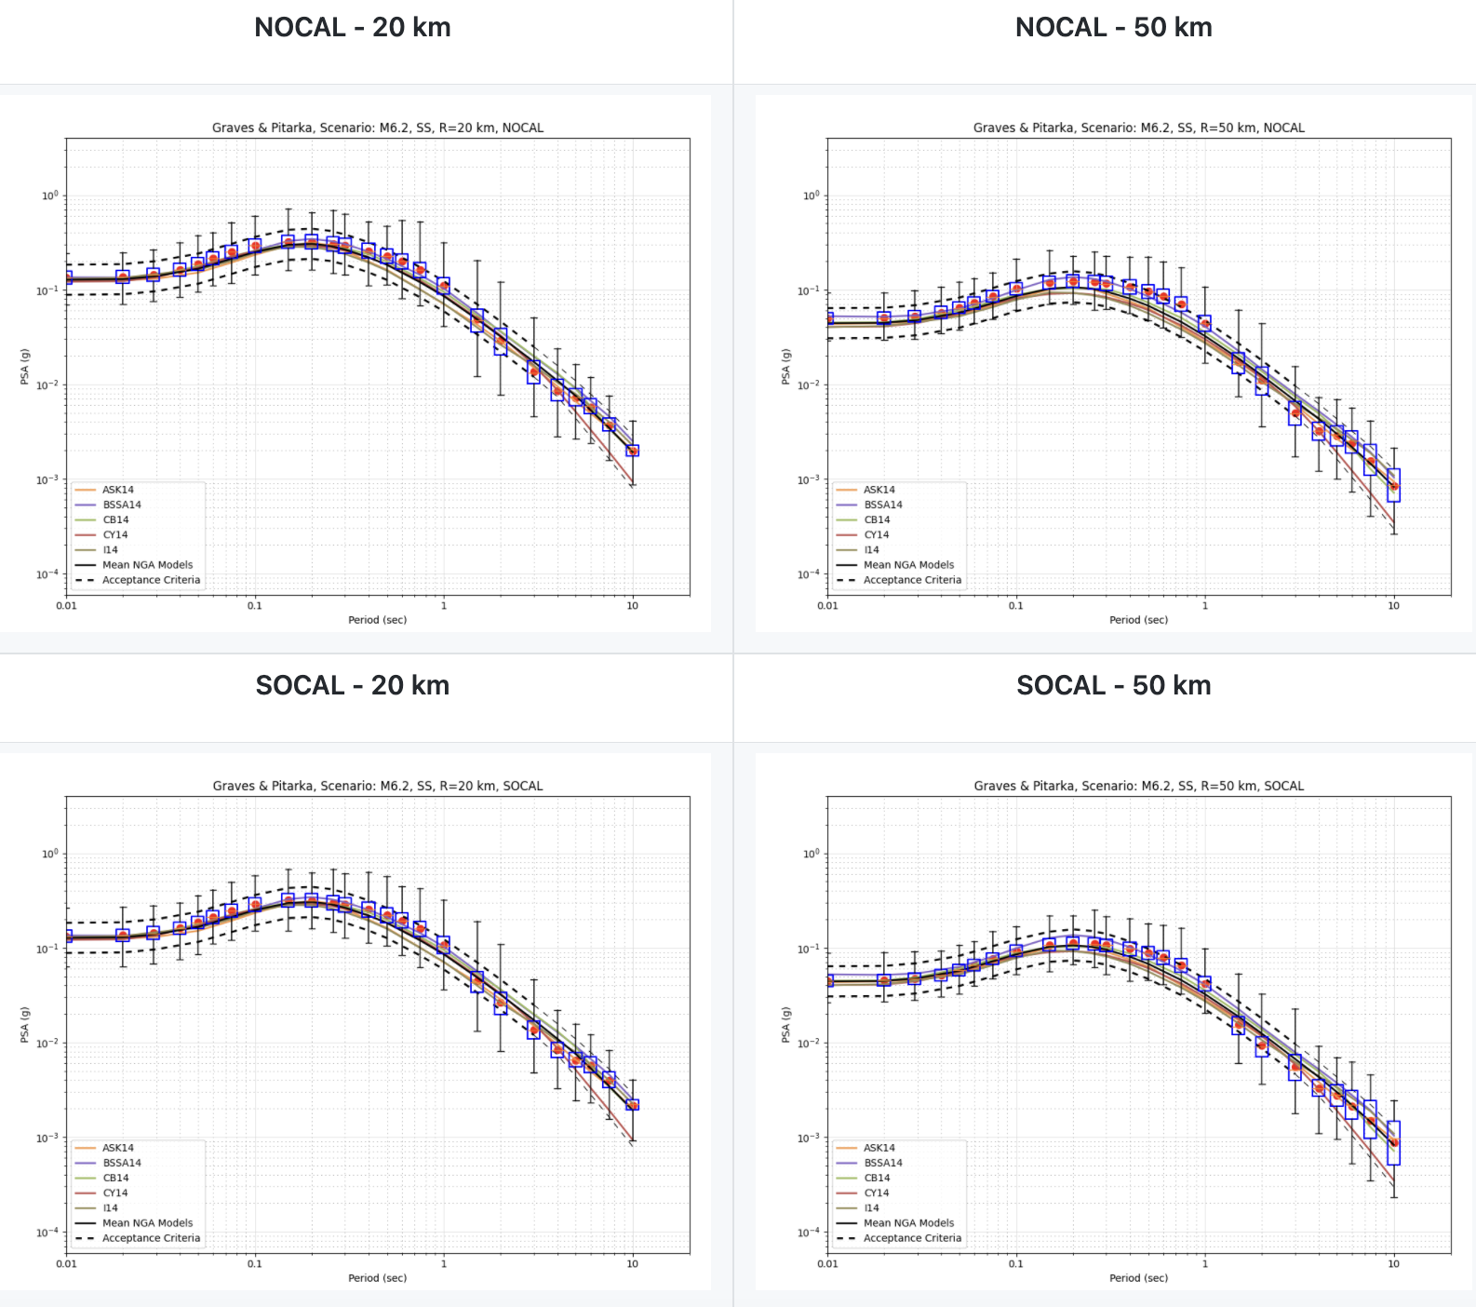
BBP Validation Part-B Data Products
PSA comparison against NGA-West 2 GMPEs
~20MB of plots and metadata

Slide 17
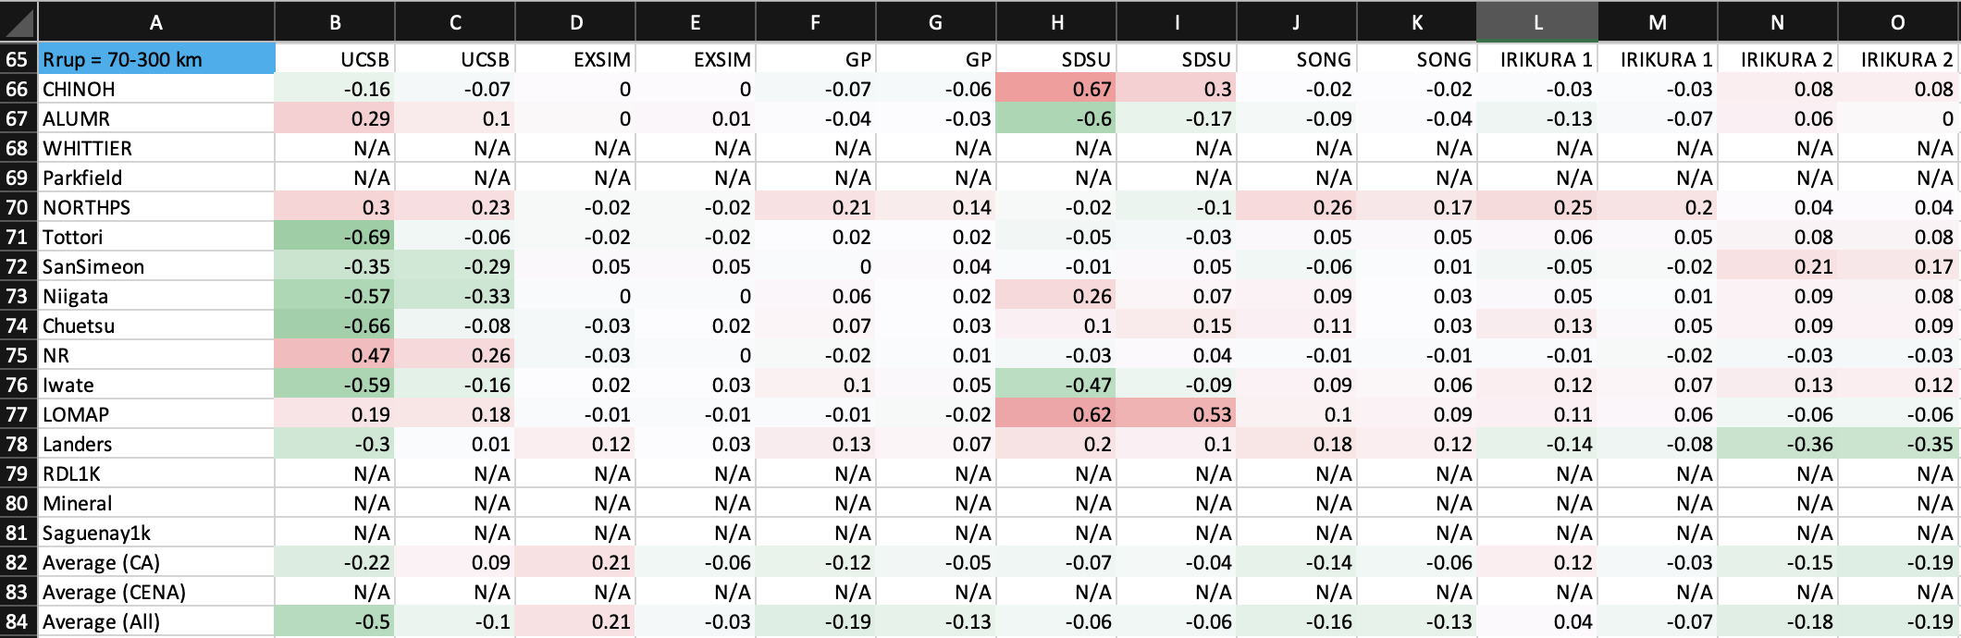
BBP Validation Summary
  Super table
    Aggregates results from all Part-A events by period and distance ranges
    Compares current Broadband Platform release against previous ones
    Helpful for identifying trends

Slide 18
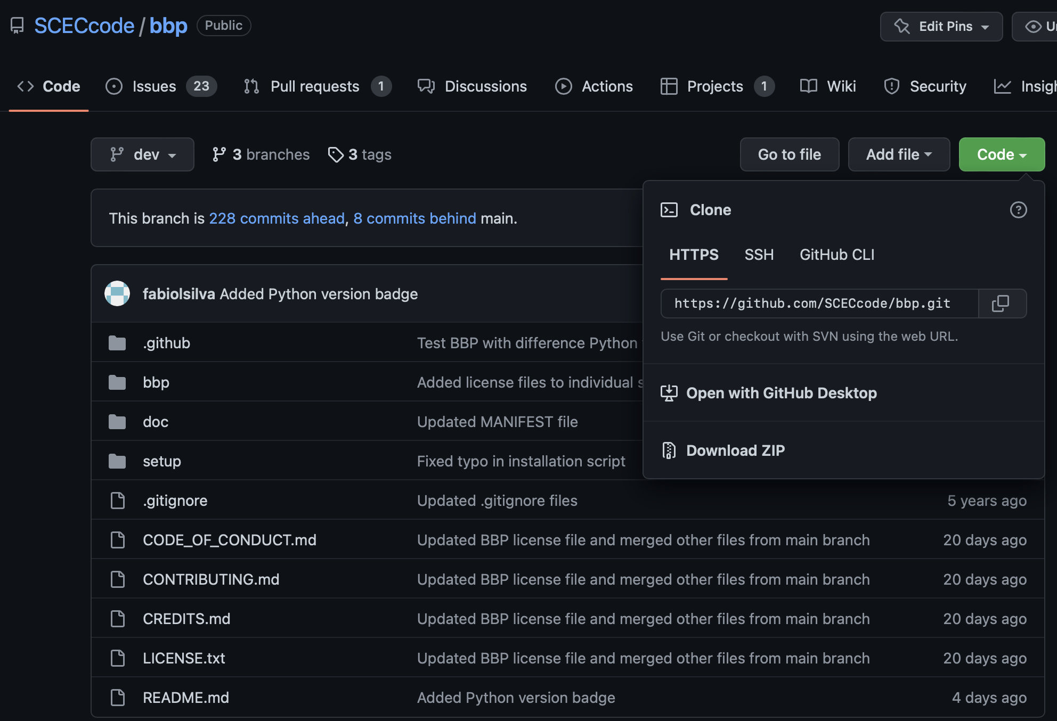
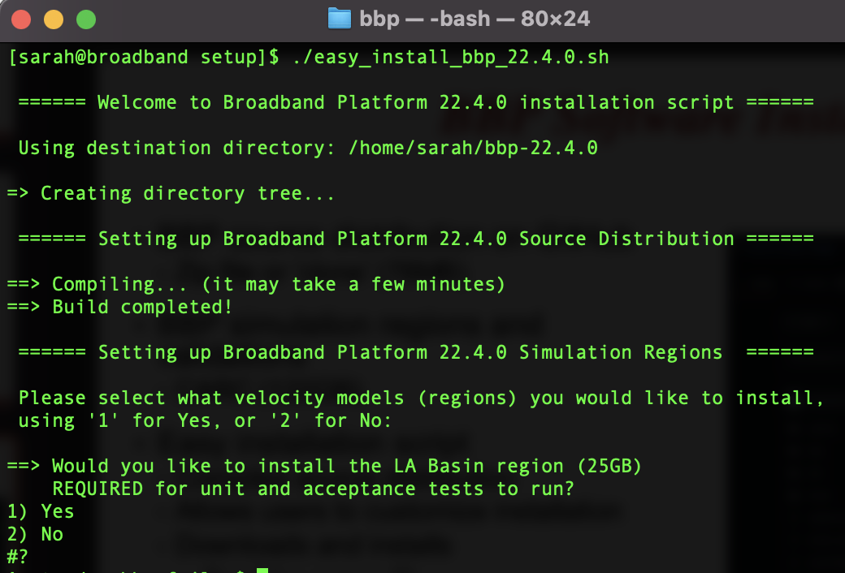
BBP Software Installation
BBP source distribution on GitHub
  Zip file or ‘clone’ (78MB)
BBP simulation regions and validations
  CARC (122GB)
Easy installation script
  Compiles source distribution
  Allows users to customize installation
  Downloads and installs
    Simulation regions (7)
    Validation events (21)
  Outputs user configuration

Slide 19
BBP Software License Update
USC Stevens Research Center recommends using BSD-3 software license
  Permissive, allows original developers and others to re-distribute software, change it, and use in commercial products in the future if they like
  Includes disclaimer saying we are not responsible for any problems resulting from use of the software
USC listed as copyright owner for Broadband Platform framework and most Python post-processing modules
Science codes show primary development organization as copyright holder
Modules developed by USGS researchers use MIT license as requested
  https://www.usgs.gov/products/software/software-management/distribution-usgs-code
Presented to BBP group in May 2022
  Received feedback and approval from each group

Slide 20
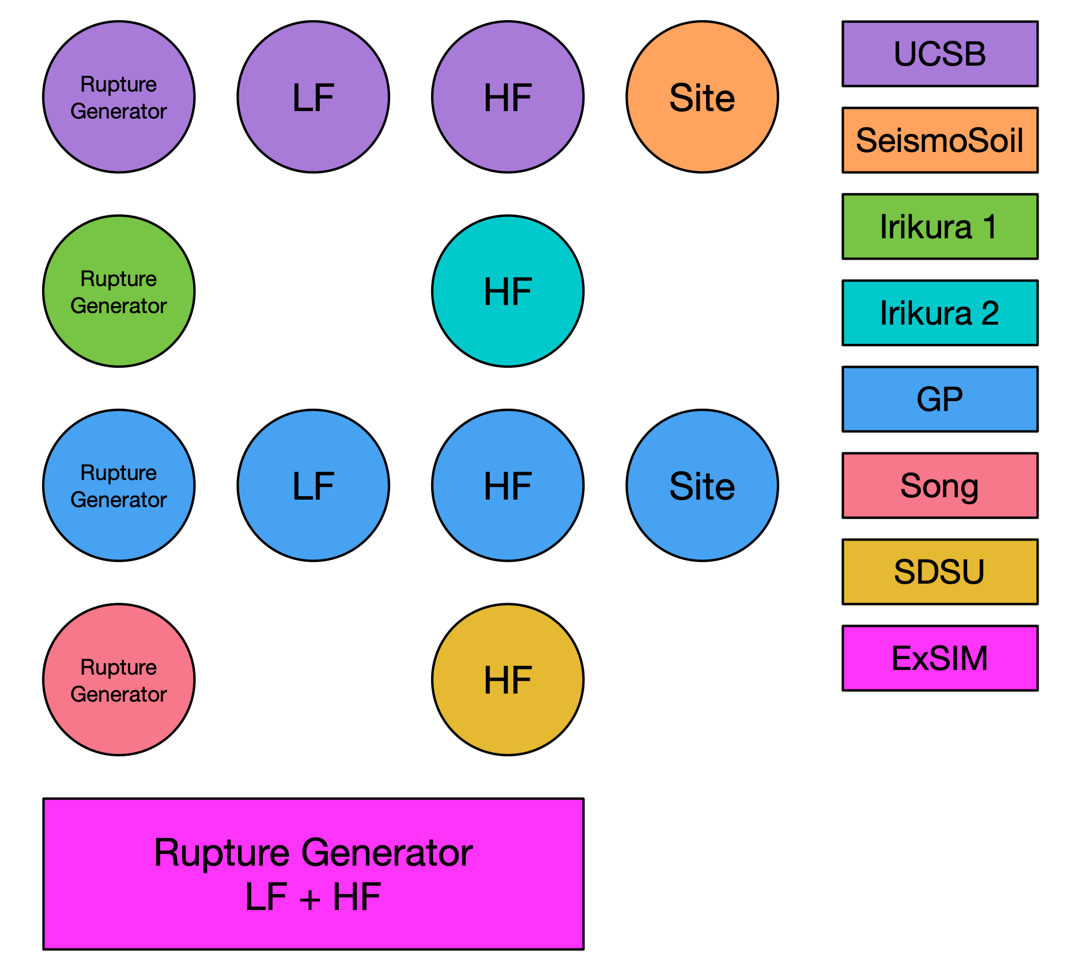
License - Simulation Methods
Graves and Pitarka (GP)
SDSU
UCSB
ExSIM
Irikura Recipe Method 1
Irikura Recipe Method 2
Song RMG

Slide 21
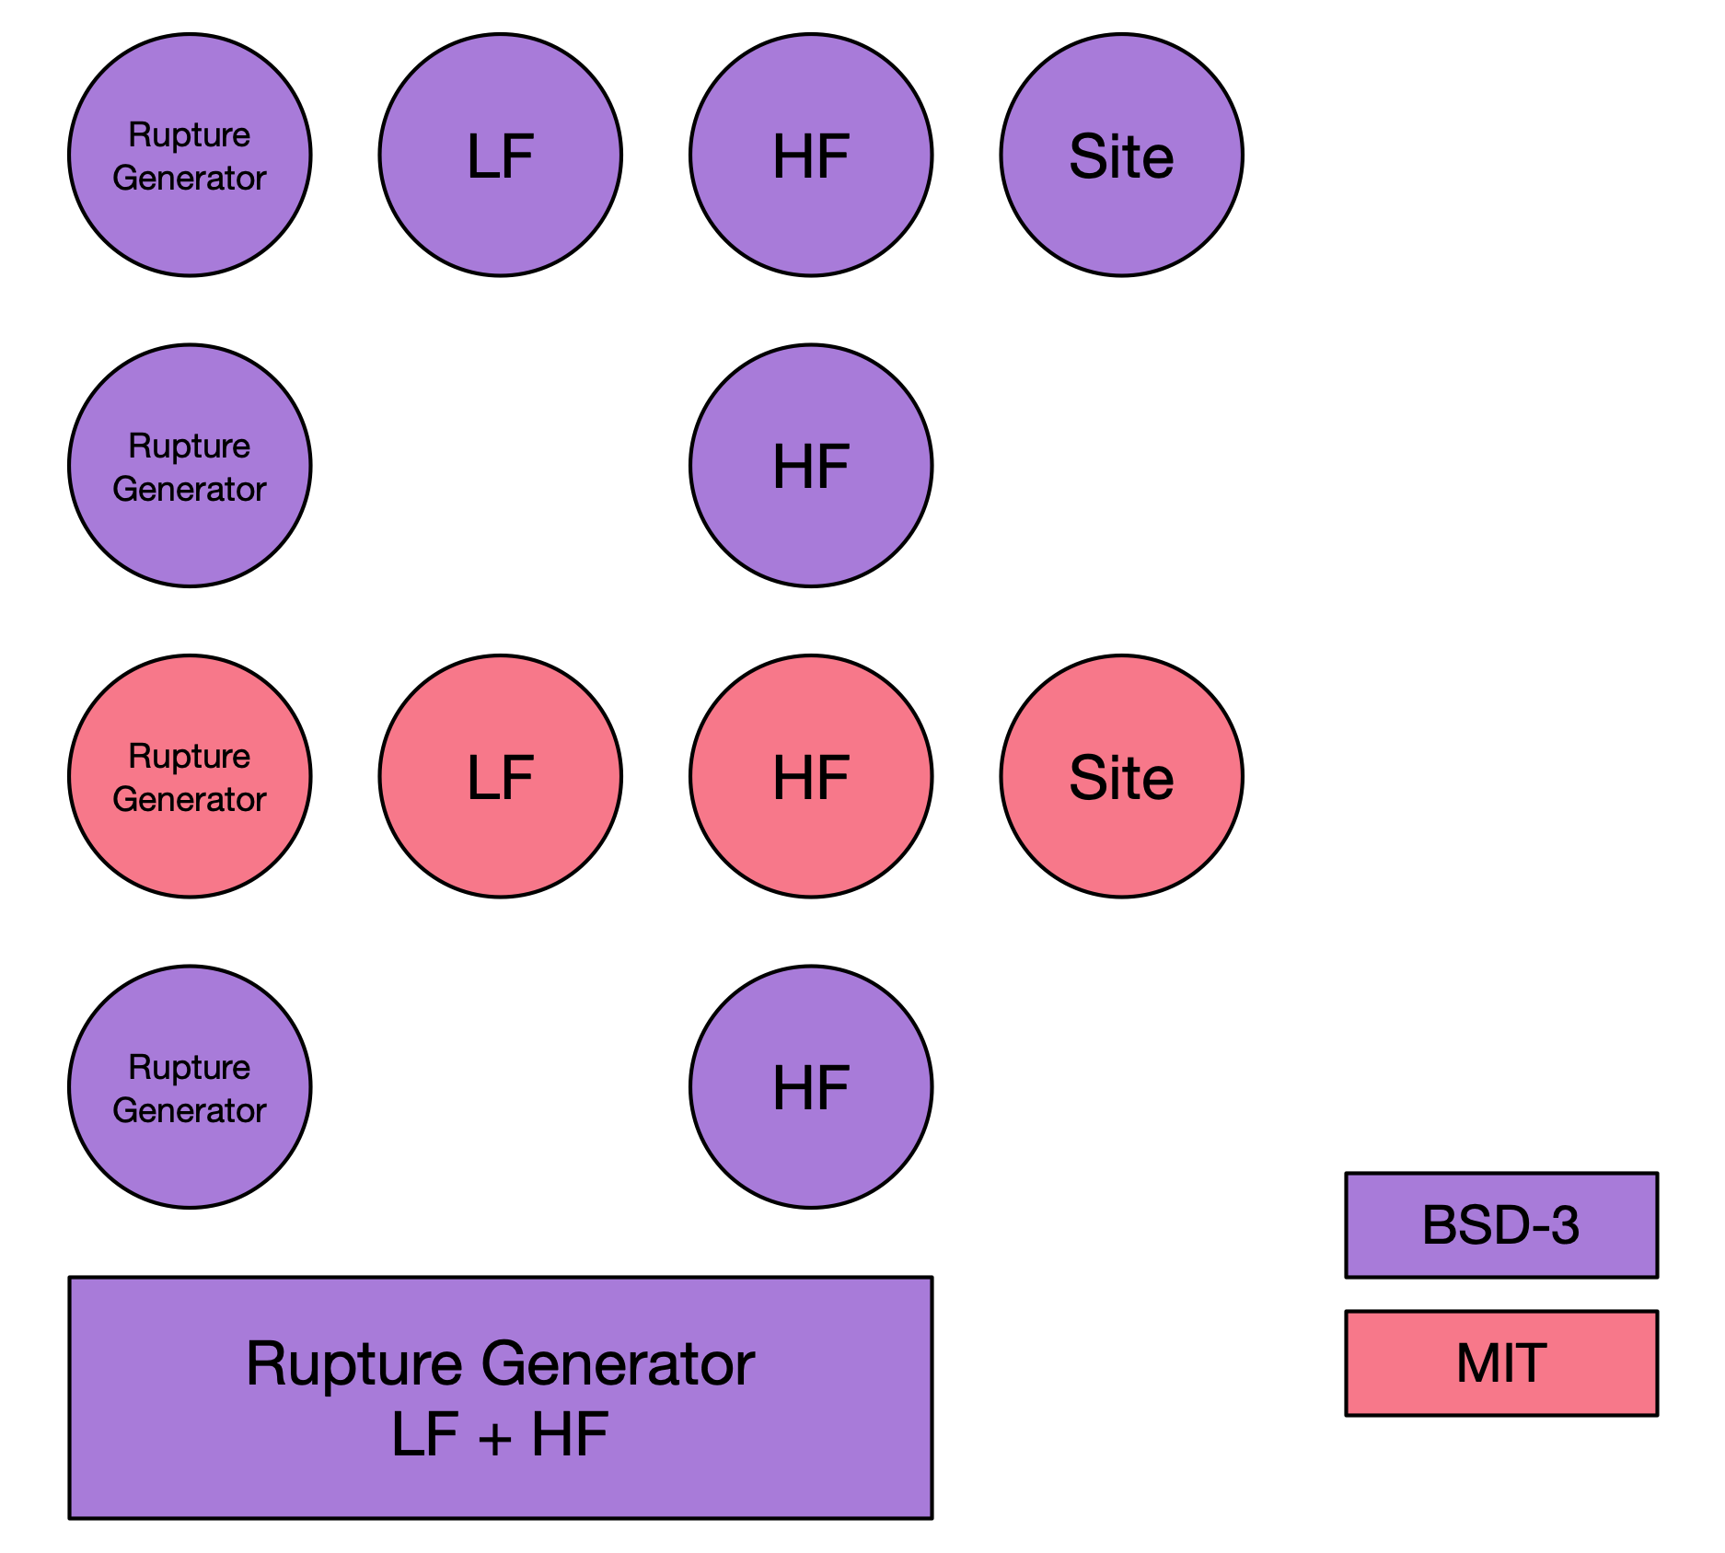
License - Simulation Methods
Graves and Pitarka (GP)
SDSU
UCSB
ExSIM
Irikura Recipe Method 1
Irikura Recipe Method 2
Song RMG

Slide 22
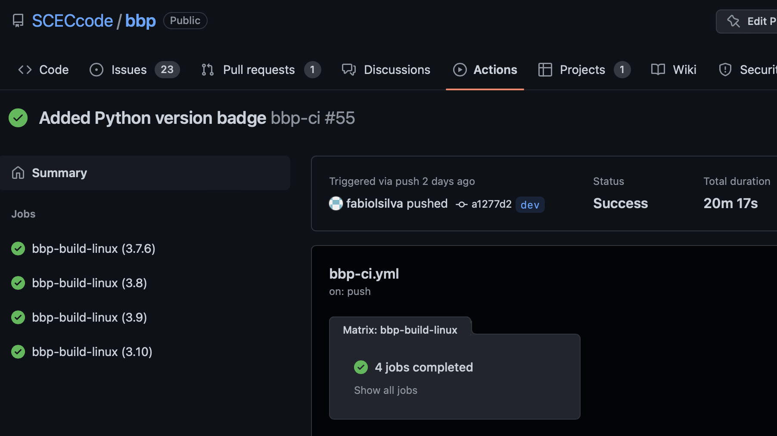
GitHub Continuous Integration (CI)
GitHub CI
  After each commit
  Try 41 unit tests
  Use Python versions
    3.7.6*
    3.8.12
    3.9.13
    3.10.5
  Run in parallel
    20 min runtime

Slide 23
Thanks!
https://github.com/SCECcode/bbp

