Slide 1

SCEC Broadband Ground Motion Simulation and Validation Developments
Philip Maechling
Fabio Silva
4 December 2023

Slide 2
Agenda
Overview of the SCEC Broadband Platform (BBP)
Overview of the SCEC Ground Motion Simulation Validation (GMSV)Toolkit
Development Directions

Slide 3
Agenda
Overview of the SCEC Broadband Platform (BBP)
Overview of the SCEC Ground Motion Simulation Validation (GMSV)Toolkit
Development Directions

Slide 4
Motivation for Development of Broadband Platform (BBP)
  Civil engineers (SCEC GMSV Technical Activity Group, PG&E, AECOM, others) wanted to study “hanging wall” effects on ground motions using ground motion simulation methods.
  Multiple ground motion simulations methods existed, and the engineers want to compare the results produced by alternative methods. This would help define the range of epistemic uncertainty for simulated ground motion methods.
  Engineers defined the specifications for the earthquake simulations to be run. Ground motion simulation methods were required to input common problem configuration, and output results in common format.
  Engineers defined methods for validating ground motion simulations including: (Part-A) comparisons of simulation results against recorded ground motions from historic earthquake, and (Part-B) and comparisons of simulation results against ground motion prediction equations.
  Engineer wanted open-source software, and a “neutral” third party to run the simulations to eliminate un-documented changes to simulations.
  The BBP software was collaboratively developed to meet these needs, and it was used in “hanging wall” studies, other studies, and later in SSHAC process for evaluation seismic safety of Diablo Canyon power plant. The SSHAC process was documented with a series of publications in SRL.

Slide 5
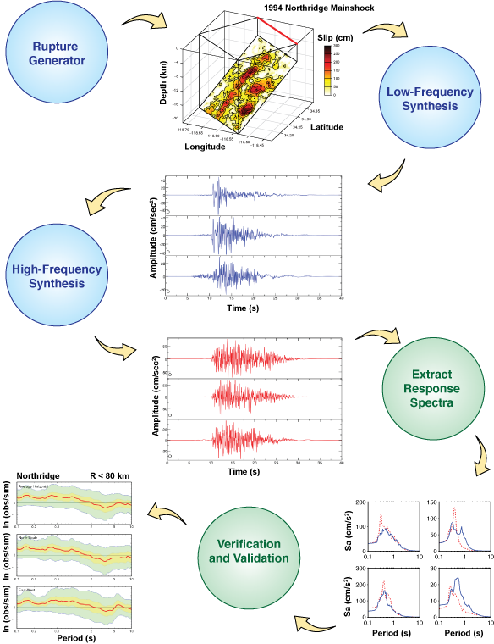
Broadband Platform Overview
The SCEC Broadband Platform…
  A collection of open-source scientific software that can calculate broadband ground motions at user-specified locations
    Historical and scenario earthquakes
  Integrates 7 different ground motion simulation methods
    Rupture generation
    Seismogram synthesis
    Site effects calculations
    Post-processing
    Visualization
  Supports common inputs and output data products
  Runs on Linux computers with GNU compilers and open-source libraries
  Features a simple command-line interface for interactive use and can be run on a laptop.

Slide 6
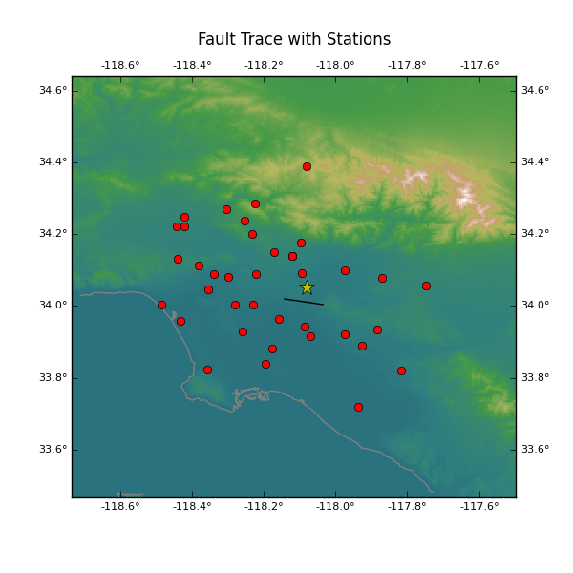
Part A Validation – Simulate Well Observed EQs
Validation simulations
  “validates” simulation methods against recorded data
  Uses historical event source description
  Includes locations where recorded data is available
User inputs
  Validation event
  Simulation method
  Validation metrics
BBP outputs
  Velocity and acceleration timeseries
  Per-station timeseries and PSA comparisons
  Goodness-of-Fit Plots
  Other validation metrics
  Plotting of results
Whittier Narrows (1987)

Slide 7
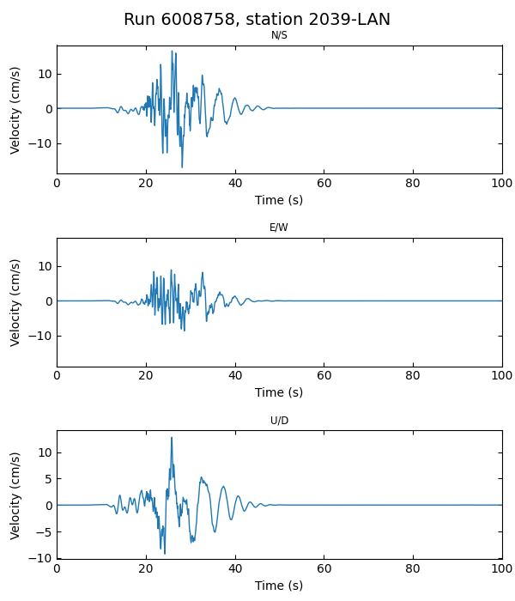
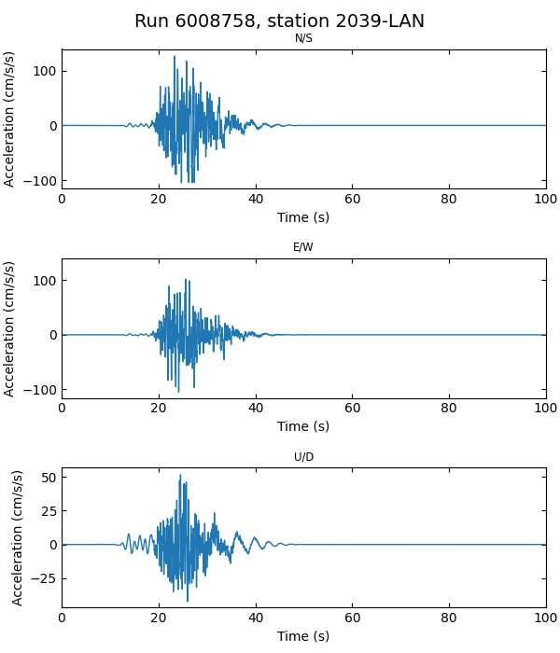
Plot Seismograms
Inputs
  Station list
  SRC file
  Vel/Acc Seismograms
  Plot vel (Y/N)
  Plot acc (Y/N)
Outputs
  3 comp velocity seismograms
  3 comp acceleration seismograms

Slide 8
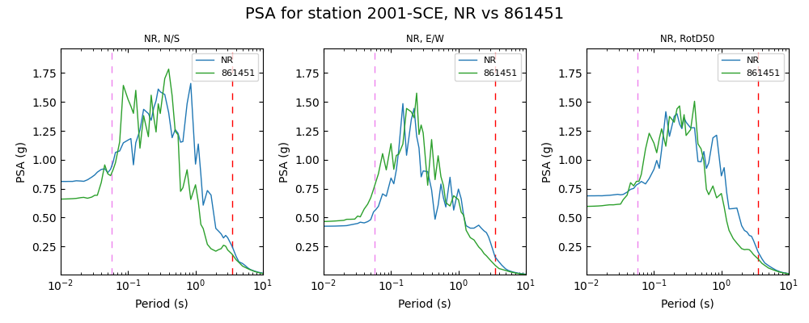
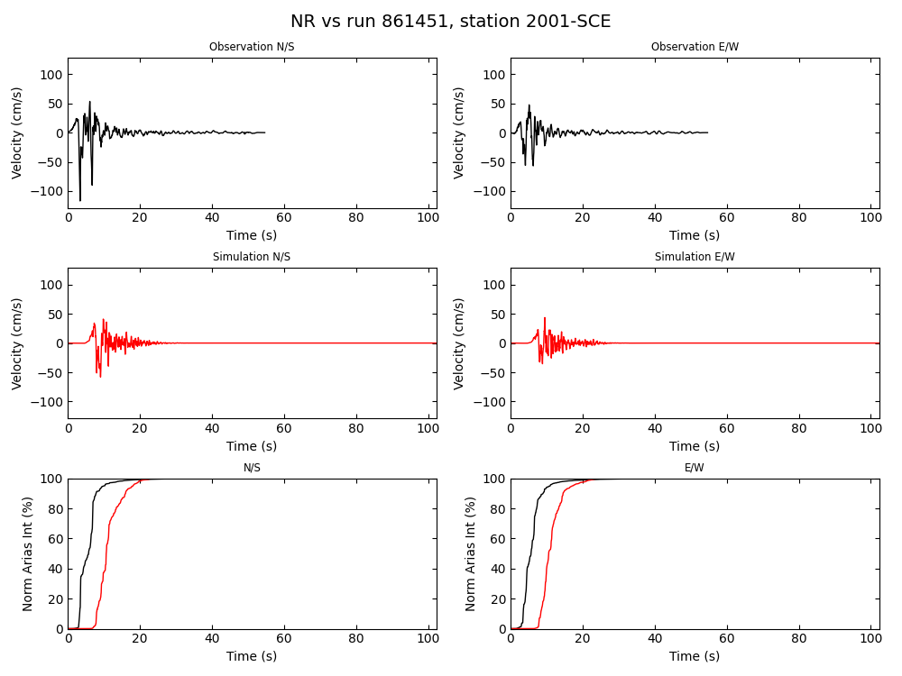
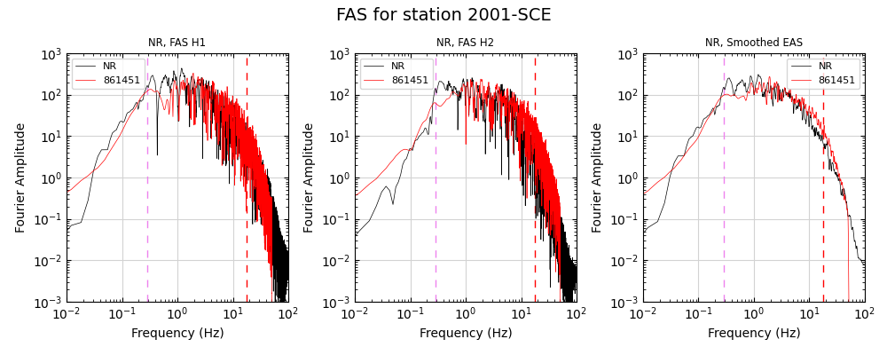
Validation Part A (Comparison Against Recorded Data)

Slide 9
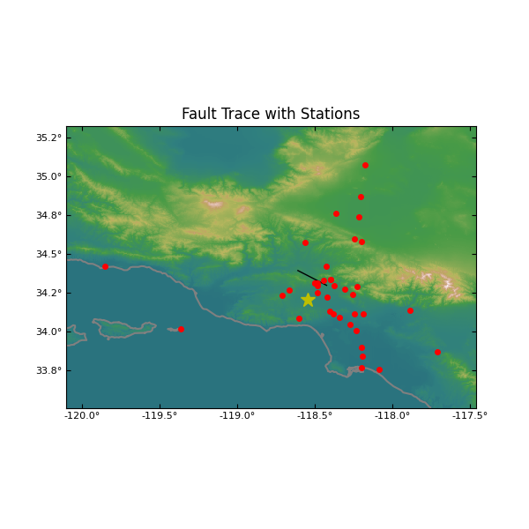
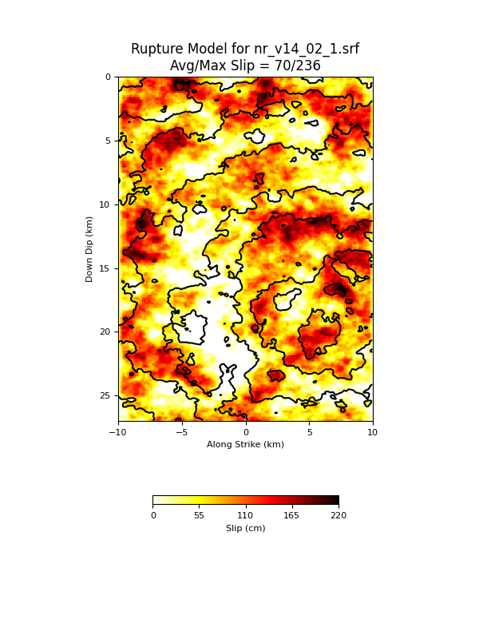
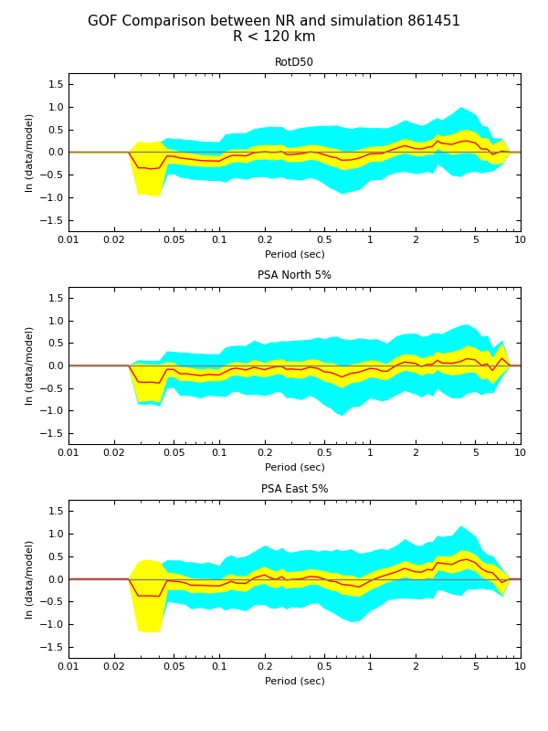
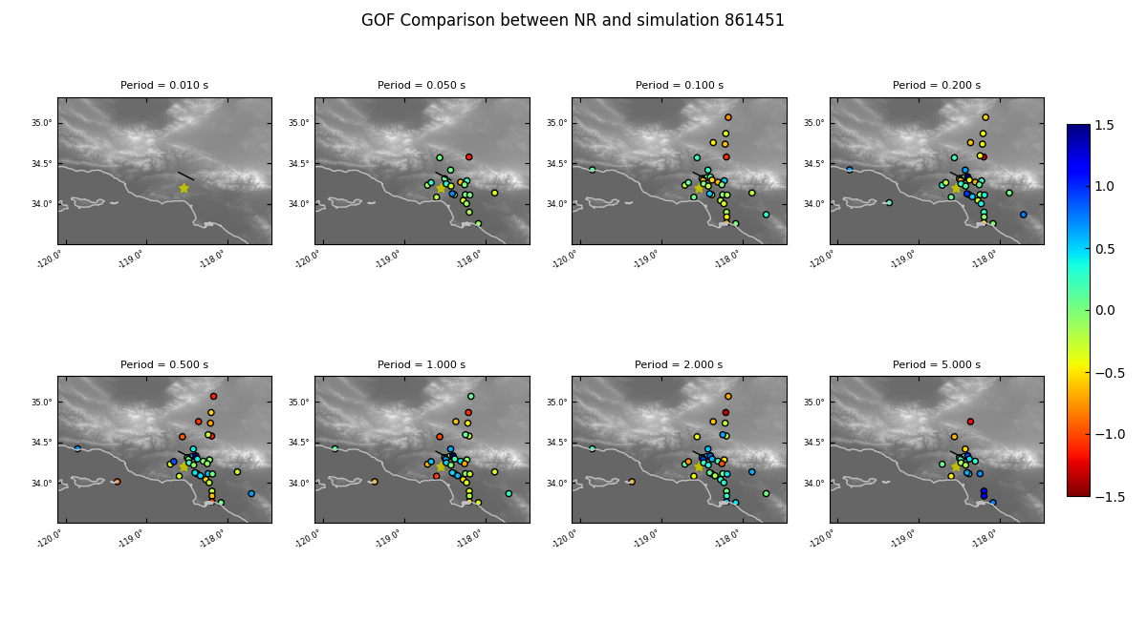
Validation Part A (Comparison Against Recorded Data)

Slide 10
Broadband Platform Validation Events
California
  Alum Rock Mw 5.45
  Chino Hills Mw 5.39
  Hector Mine Mw 7.13
  Landers Mw Mw 7.22*
  Loma Prieta Mw 6.94
  North Palm Springs Mw 6.12
  Northridge Mw 6.73
  Parkfield Mw 6.0
  Ridgecrest A Mw 6.47
  Ridgecrest B Mw 5.4
  Ridgecrest C Mw 7.08*
  San Simeon Mw 6.6*
  Whittier Narrows Mw 5.89
Japan
  Chuetsu-Oki Mw 6.69
  Iwate Mw 6.9
  Niigata Mw 6.65
  Tottori Mw 6.59
Italy
  L’Aquila Mw 6.29
Eastern North America
  Mineral Mw 5.68
  Riviere-du-Loup Mw 4.6
  Saguenay Mw 5.81
*Available as single or multi-segment ruptures
New validation events added to BBP 22.4
Includes: SRC, Site List, 1D Model, Vs30, Obs. Seismograms

Slide 11
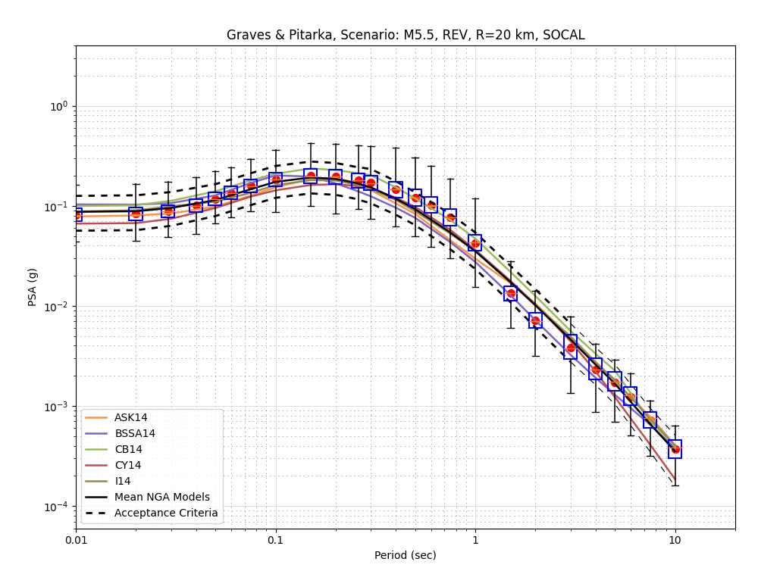
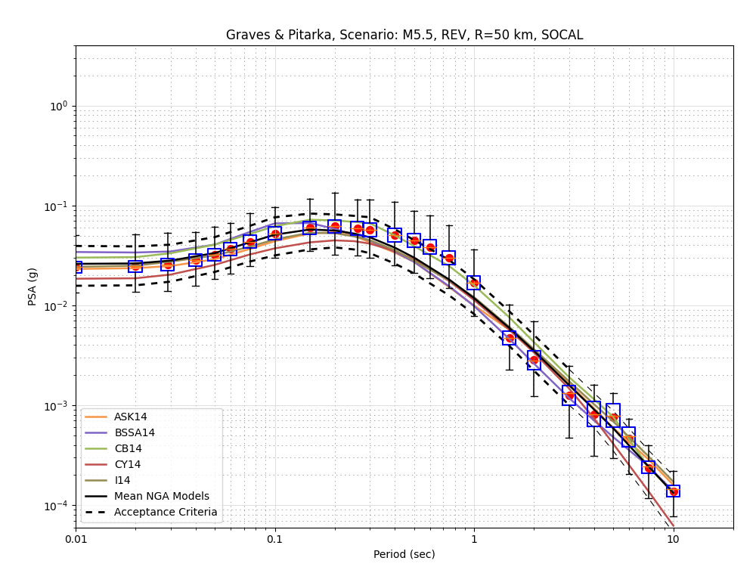
Validation Part B (Comparison Against GMPEs)

Slide 12
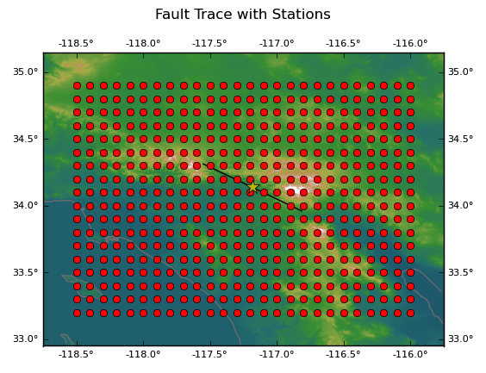
Broadband Platform Scenario Simulations
Scenario simulations
  Used to calculate ground motions for hypothetical events
  Users specify desired source description
  Users select locations of interest
User inputs
  Simulation region
  Simulation method
  Source description
  List of stations
BBP outputs
  Velocity and acceleration timeseries
  Per-station RotD50
  Station map

Slide 13
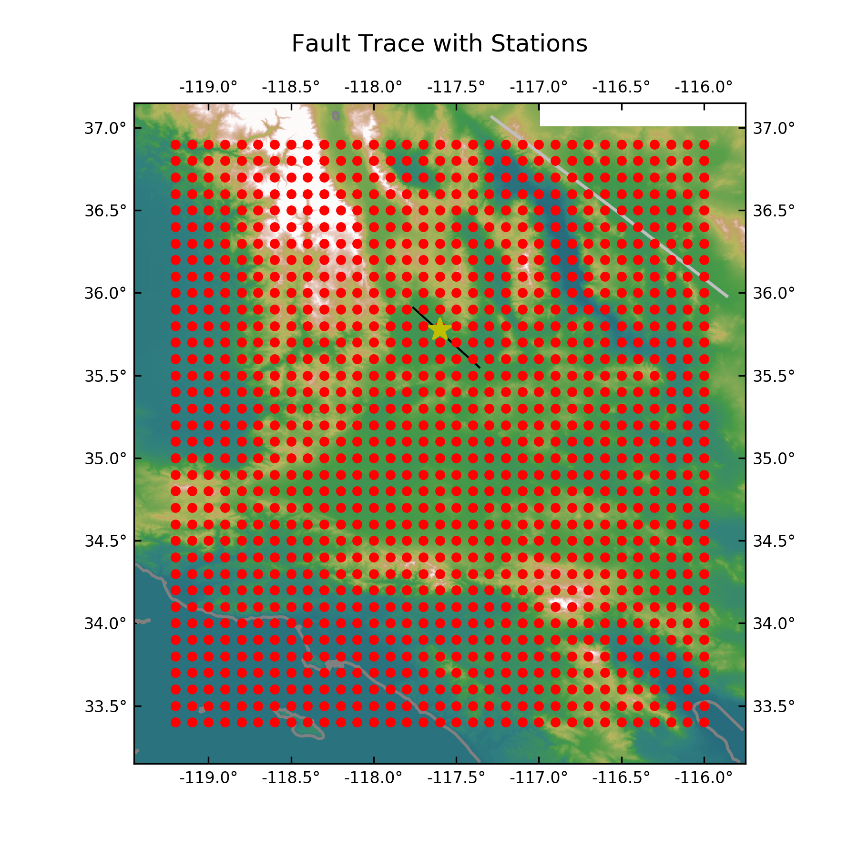
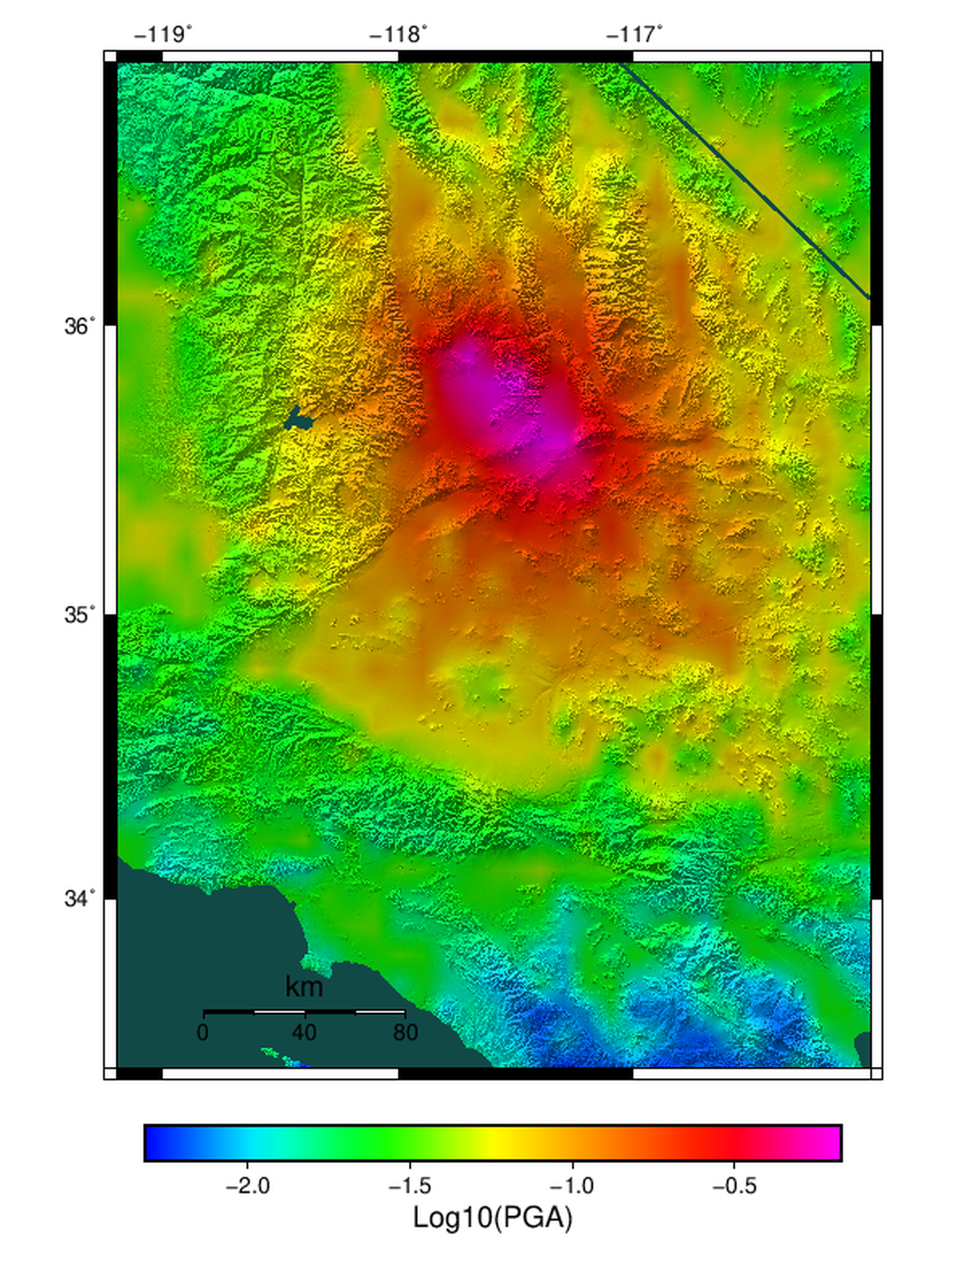
Scenario Simulations
Case Study: Creating shake intensity maps using simulated data: Ridgecrest C

Slide 14
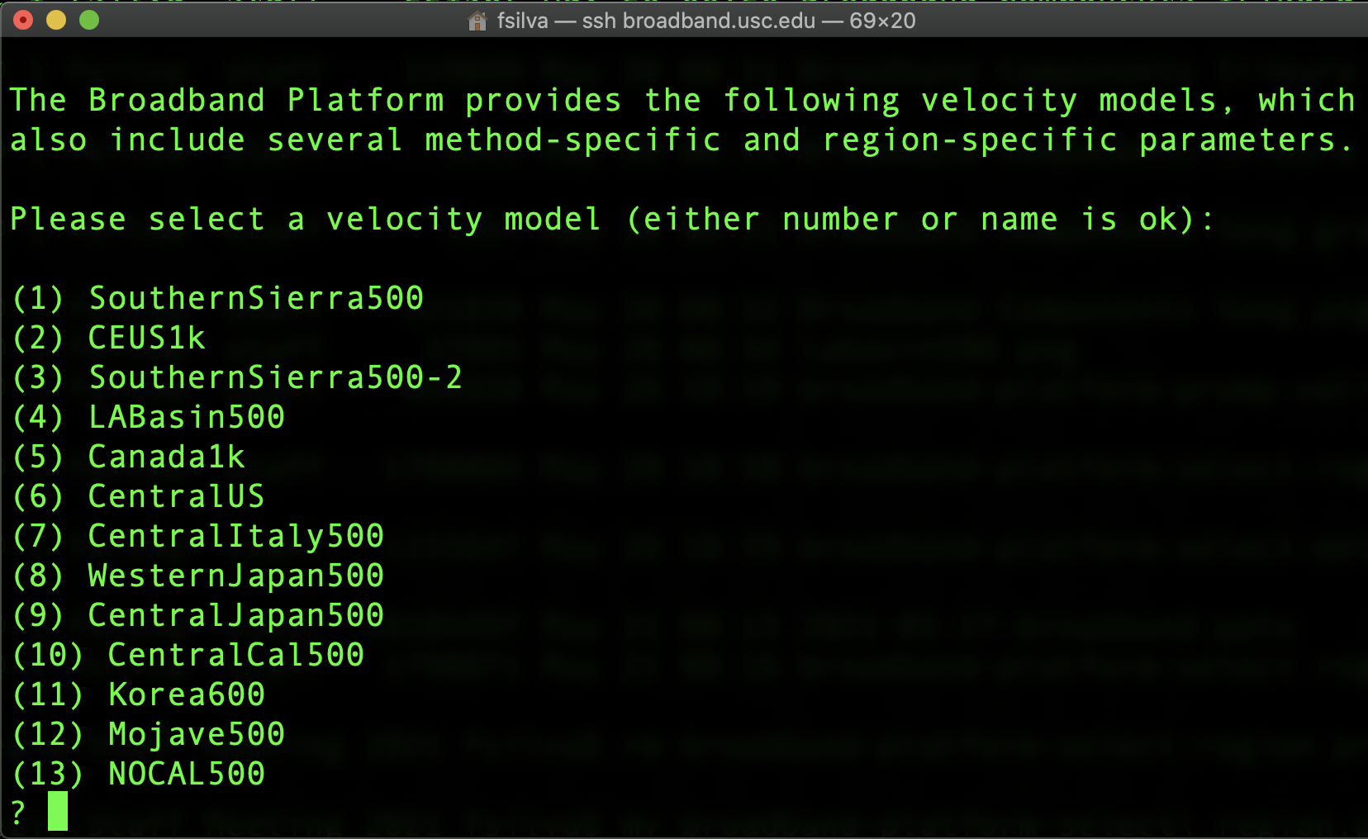
Broadband Platform Simulation Regions
  Velocity model
  Greens’ Functions
  Simulation Parameters
Broadband Platform California Regions

Slide 15
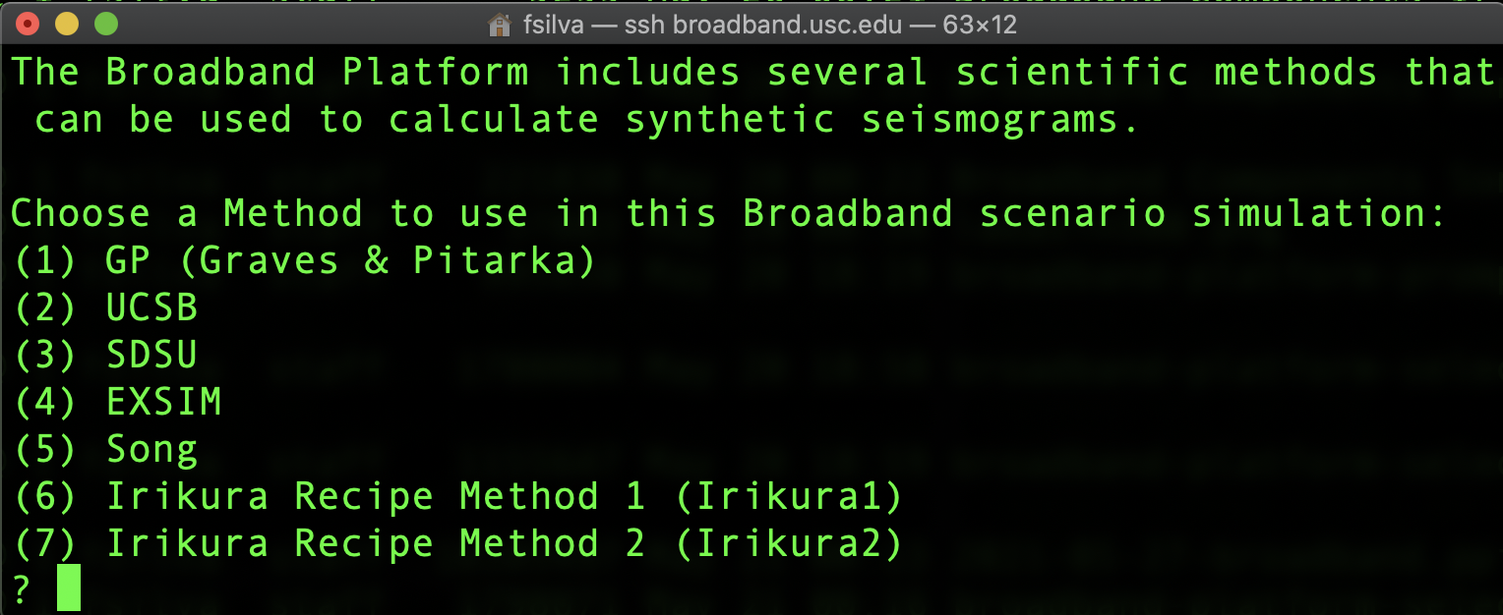
Simulation Methods
Users select one of 7 simulation methods
Also able to pick a site response module
  GP 2014 or SeismoSoil (Shi and Asimaki)

Slide 16
References for BBP Ground Motion Methods
Ground Motion Methods References : References for specific computational methods included in the Broadband Platform (v15.3.0 and later, including v16.5.0, v17.3.0, and v19.4.0) and for the validation procedures developed by the Broadband Platform include:
Anderson, J. G (2015) The Composite Source Model for Broadband Simulations of Strong Ground Motions Seismological Research Letters, January/February 2015, v. 86, p. 68-74, First published on December 17, 2014, doi:10.1785/0220140098
Atkinson, G. M., and Assatourians, K. (2015) Implementation and Validation of EXSIM (A Stochastic Finite‐Fault Ground‐Motion Simulation Algorithm) on the SCEC Broadband Platform Seismological Research Letters, January/February 2015, v. 86, p. 48-60, First published on December 17, 2014, doi:10.1785/0220140097
Crempien, J. G. F., and Archuleta, R. J. (2015) UCSB Method for Simulation of Broadband Ground Motion from Kinematic Earthquake Sources Seismological Research Letters, January/February 2015, v. 86, p. 61-67, First published on December 17, 2014, doi:10.1785/0220140103
Dreger, D. S., and Jordan, T. H. (2015) Introduction to the Focus Section on Validation of the SCEC Broadband Platform V14.3 Simulation Methods Seismological Research Letters, January/February 2015, v. 86, p. 15-16, doi:10.1785/0220140233
Graves, R., and Pitarka, A. (2015) Refinements to the Graves and Pitarka (2010) Broadband Ground‐Motion Simulation Method Seismological Research Letters, January/February 2015, v. 86, p. 75-80, First published on December 17, 2014, doi:10.1785/0220140101
Irikura, K., & Miyake, H. (2011). Recipe for Predicting Strong Ground Motion from Crustal Earthquake Scenarios. Pure and Applied Geophysics, 168(2011), 85–104. doi:10.1007/s00024- 010-0150-9
Olsen, K. B., and Takedatsu, R. (2015) The SDSU Broadband Ground‐Motion Generation Module BBtoolbox Version 1.5 Seismological Research Letters, January/February 2015, v. 86, p. 81-88, First published on December 17, 2014, doi:10.1785/0220140102
Pitarka, A., R. Graves, K. Irikura, H. Miyake, and A. Rodgers (2017). Performance of Irikura Recipe Rupture Model Generator in Earthquake Ground Motion Simulations with Graves and Pitarka Hybrid Approach, Pure and Applied Geophysics, 174(9), doi:10.1007/s00024-017-1504-3
Song, S.G. (2016) Developing a generalized pseudo-dynamic source model of Mw 6.5-7.0 to simulate strong ground motions, Geophysical Journal International, 204, 1254-1265. doi: 10.1093/gji/ggv521
Song, S.G., Dalguer, L.A. and Mai, P.M. (2014) Pseudo-dynamic source modeling with 1-point and 2-point statistics of earthquake source parameters, Geophysical Journal International, 196, 1770-1786. doi: 10.1093/gji/ggt479
Stewart, J. P., Boore, D.M., Seyhan, E., and Atkinson, G.M. (2016) NGA-West2 equations for predicting vertical-component PGA, PGV, and 5%-damped PSA from shallow crustal earthquakes. Earthq. Spectra, 32 (2): 1005–1031.

Slide 17
References for BBP Validation and Software
Ground Motion Simulation Validation Method Reference
The primary reference that describes the validation process developed by the Broadband Platform group to establish that the BBP platform software produces results are suitable for use in engineering applications is:
Goulet, C.A., Abrahamson, N.A., Somerville, P.G. and K, E. Wooddell (2015) The SCEC Broadband Platform Validation Exercise: Methodology for Code Validation in the Context of Seismic-Hazard Analyses, Seismol. Res. Lett., 86, no. 1, doi: 10.1785/0220140104
Results of Validation Study
The primary reference that describes the results of the validation process in 2014 is:
Dreger, D. S., Beroza, G.C., Day, S. M., Goulet, C. A., Jordan, T. H., Spudich, P. A., and Stewart, J. P. (2015). Validation of the SCEC Broadband Platform V14.3 Simulation Methods Using Pseudospectral Acceleration Data, Seismol. Res. Lett., 86, no. 1, doi:10.1785/0220140118.
Software Reference
The primary reference for the Broadband Platform software system (v15.3.0 and later) is:
Maechling, P. J., F. Silva, S. Callaghan, and T. H. Jordan (2015). SCEC Broadband Platform: System Architecture and Software Implementation, Seismol. Res. Lett., 86, no. 1, doi: 10.1785/0220140125.

Slide 18
Simulation Workflow
Based on user selections, Broadband Platform creates a simulation workflow
  Simulation and post-processing modules
Simulation inputs
  1D velocity model
  Source description
    SRC or SRF format
  Station list
    Lat/Lon
    Vs30 (for site response)
    Recorded data frequency range (for validation runs)
Post-processing inputs
  Recorded data

Slide 19
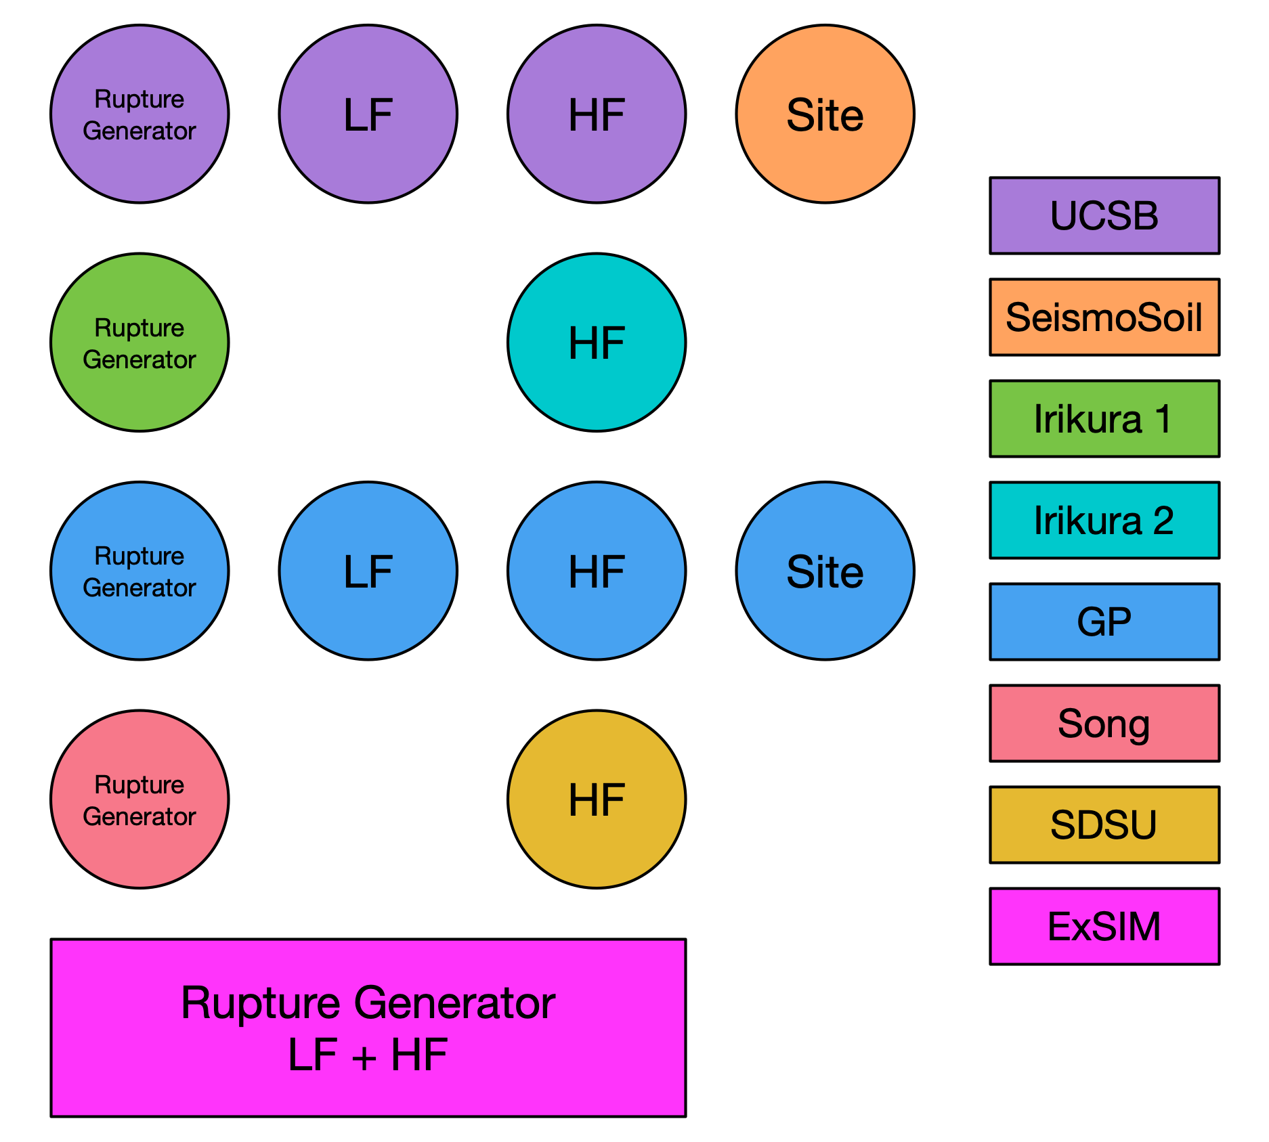
Simulation Methods
Graves and Pitarka (GP)
SDSU
UCSB
ExSIM
Irikura Recipe Method 1
Irikura Recipe Method 2
Song RMG

Slide 20
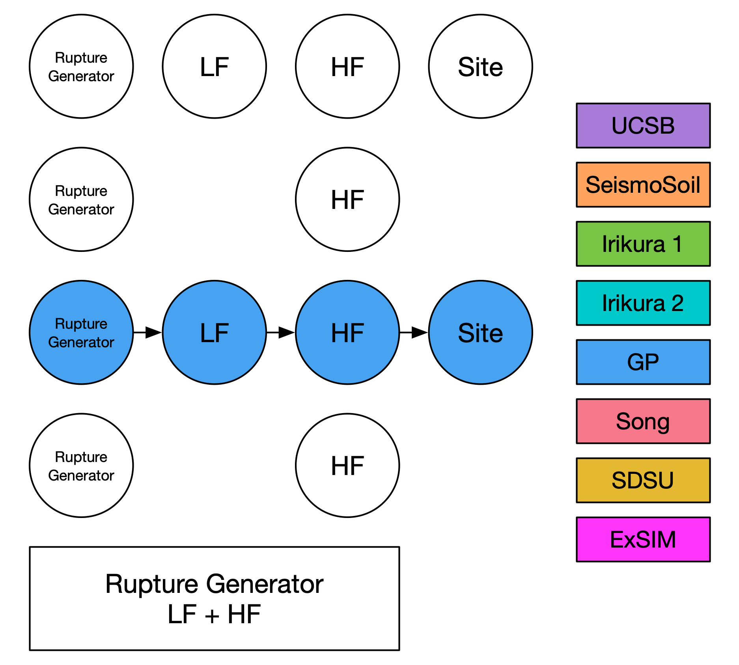
Simulation Methods
Graves and Pitarka (GP)
SDSU
UCSB
ExSIM
Irikura Recipe Method 1
Irikura Recipe Method 2
Song RMG

Slide 21
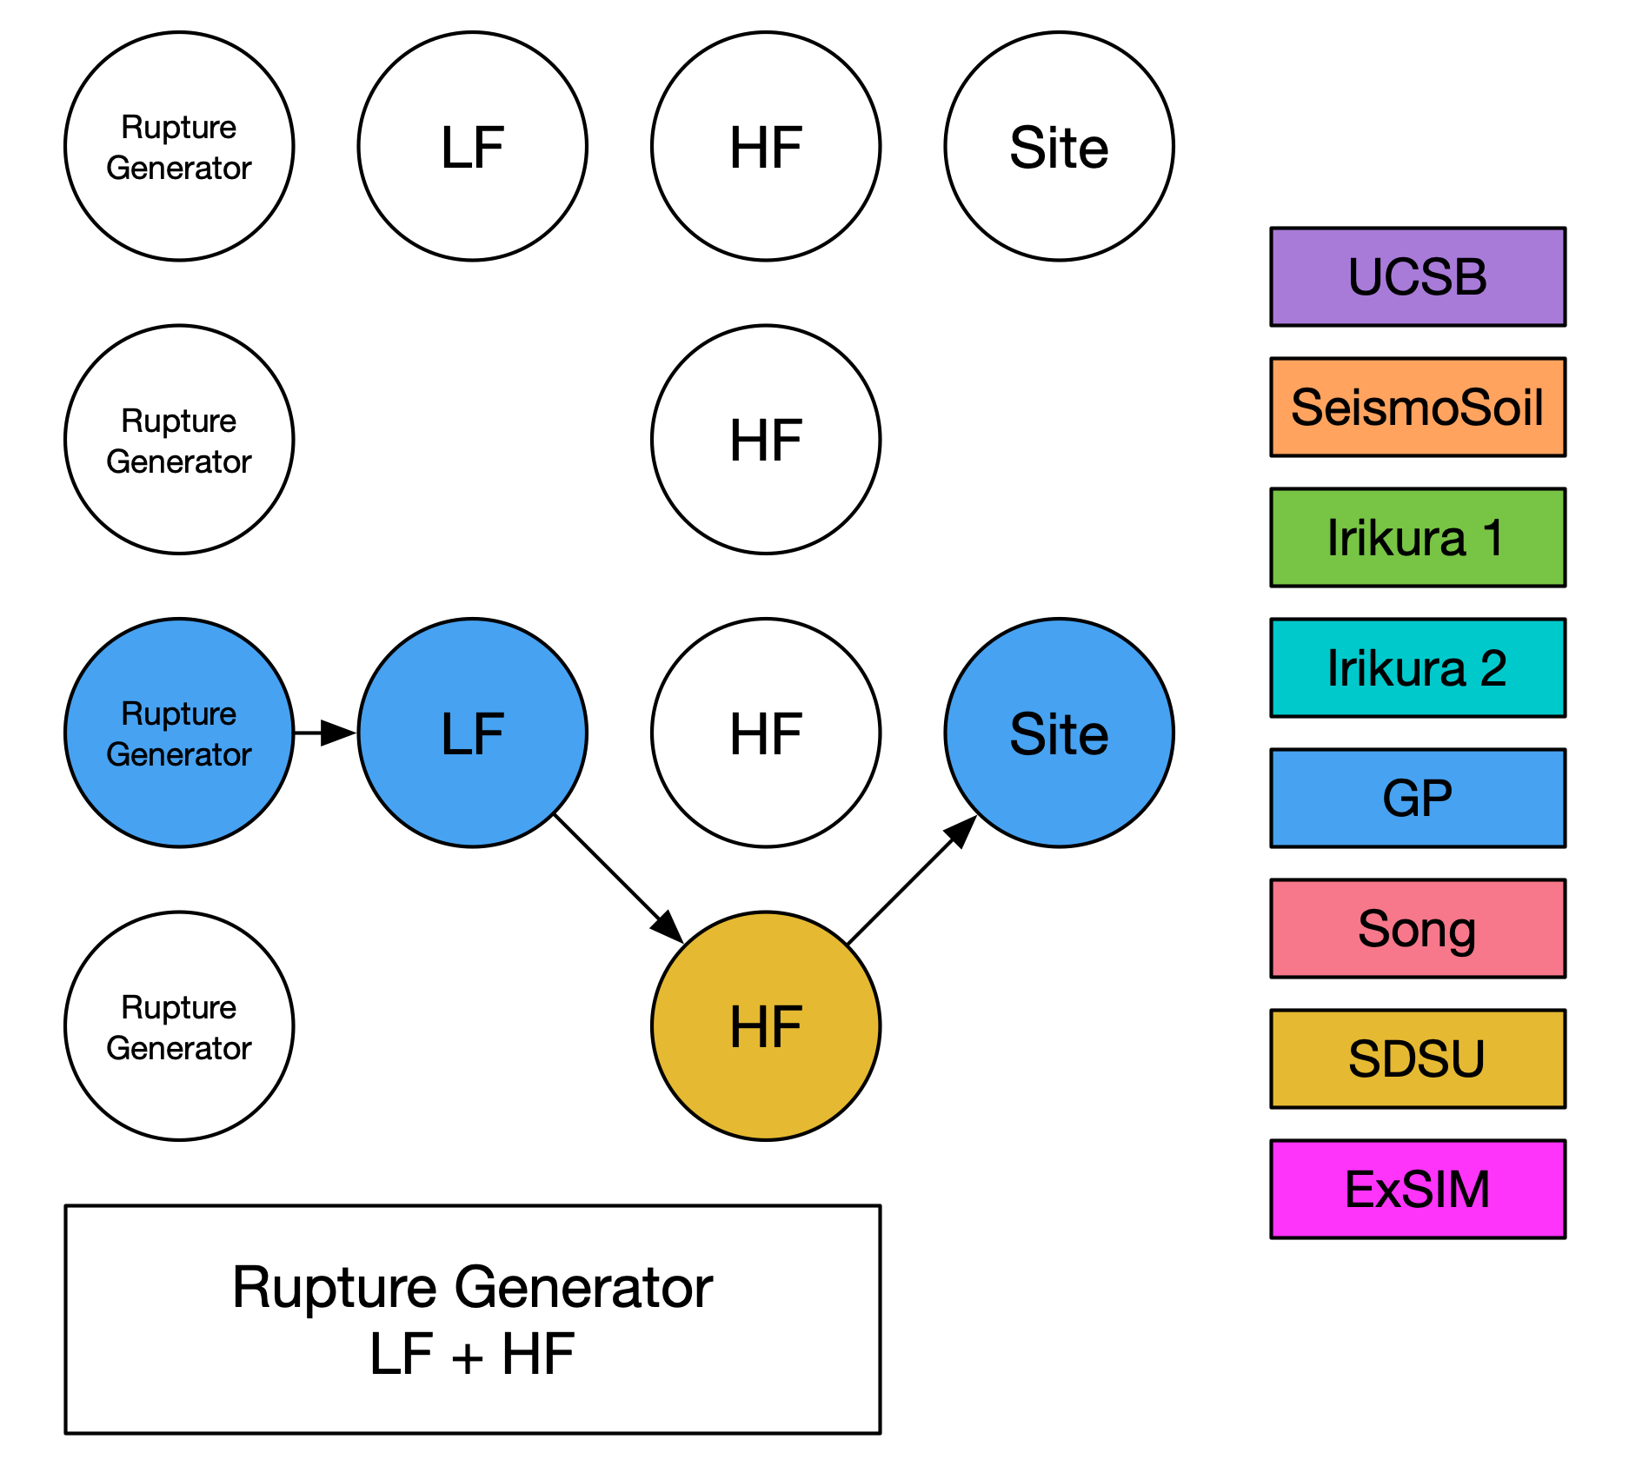
Simulation Methods
Graves and Pitarka (GP)
SDSU
UCSB
ExSIM
Irikura Recipe Method 1
Irikura Recipe Method 2
Song RMG

Slide 22
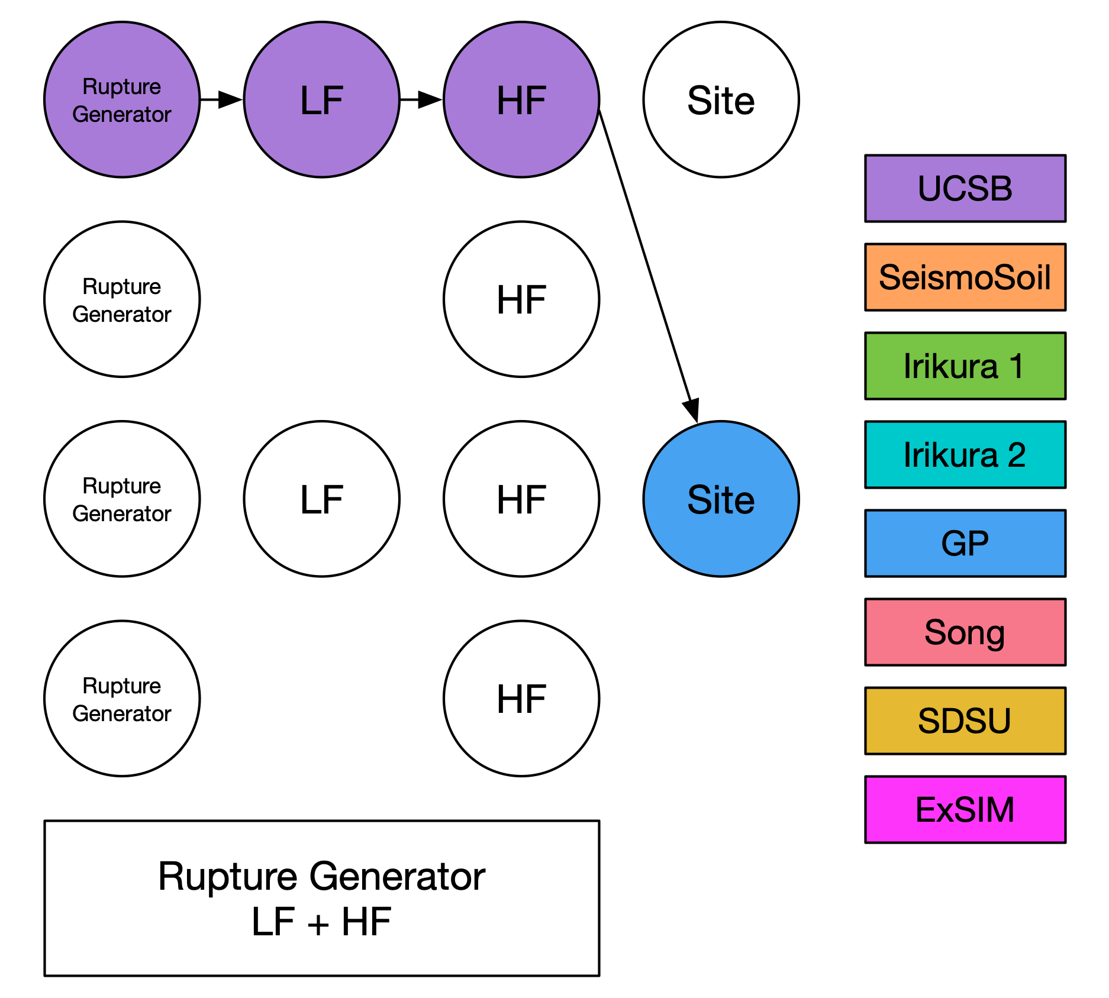
Simulation Methods
Graves and Pitarka (GP)
SDSU
UCSB
ExSIM
Irikura Recipe Method 1
Irikura Recipe Method 2
Song RMG

Slide 23
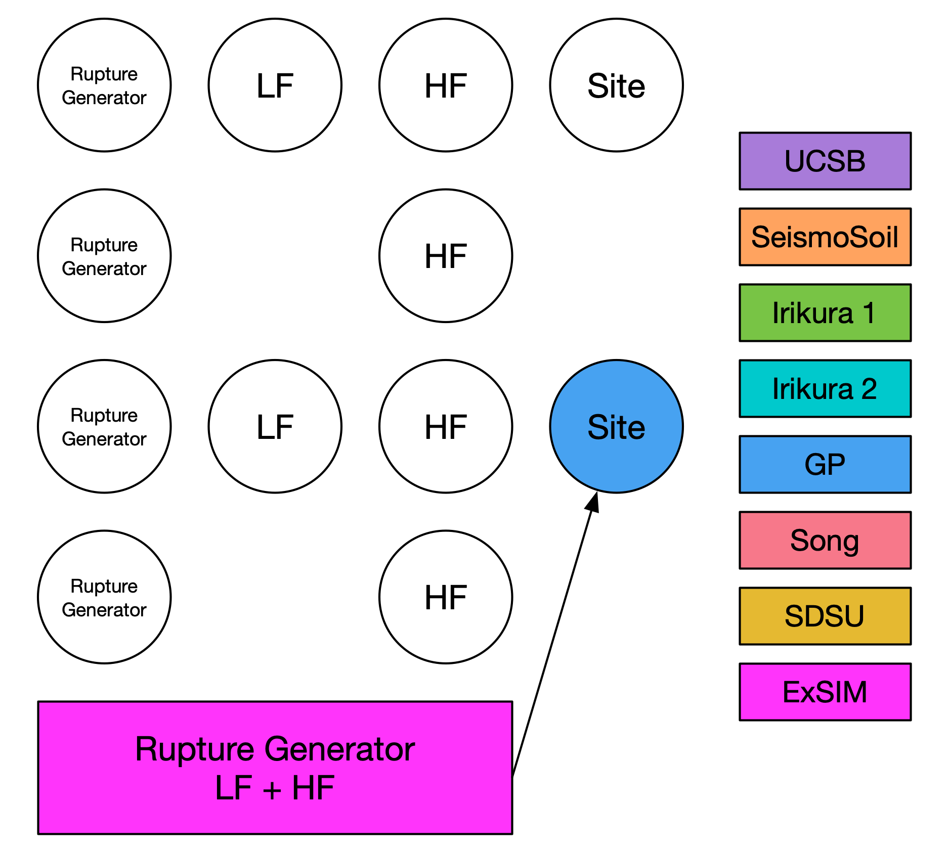
Simulation Methods
Graves and Pitarka (GP)
SDSU
UCSB
ExSIM
Irikura Recipe Method 1
Irikura Recipe Method 2
Song RMG

Slide 24
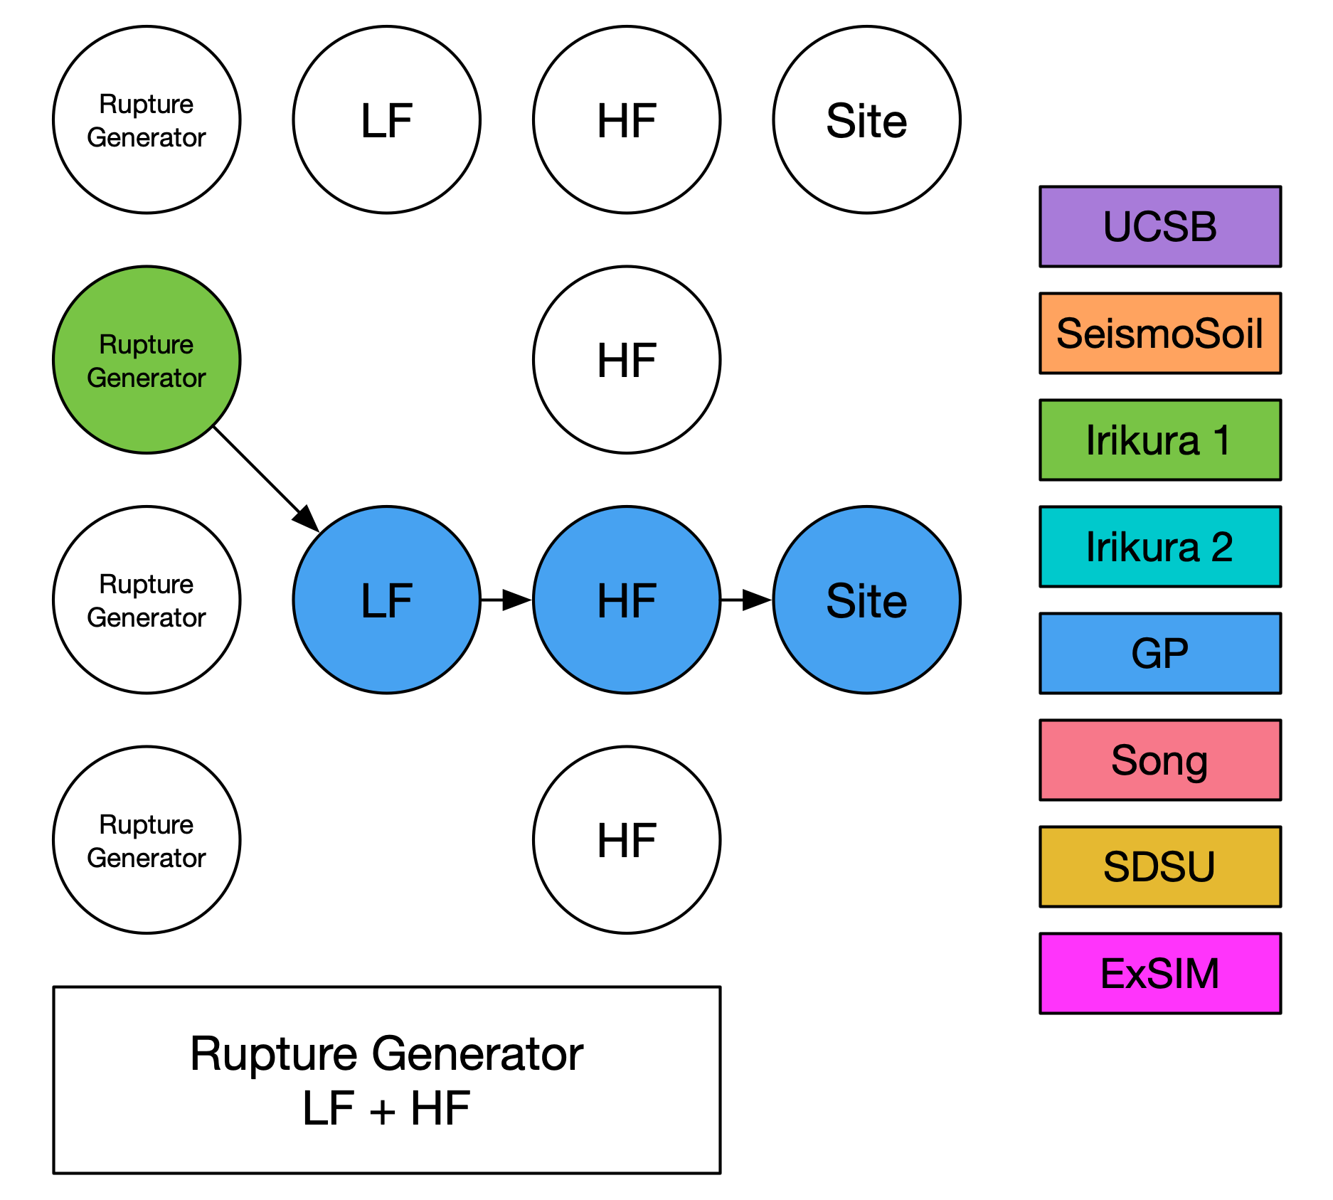
Simulation Methods
Graves and Pitarka (GP)
SDSU
UCSB
ExSIM
Irikura Recipe Method 1
Irikura Recipe Method 2
Song RMG

Slide 25
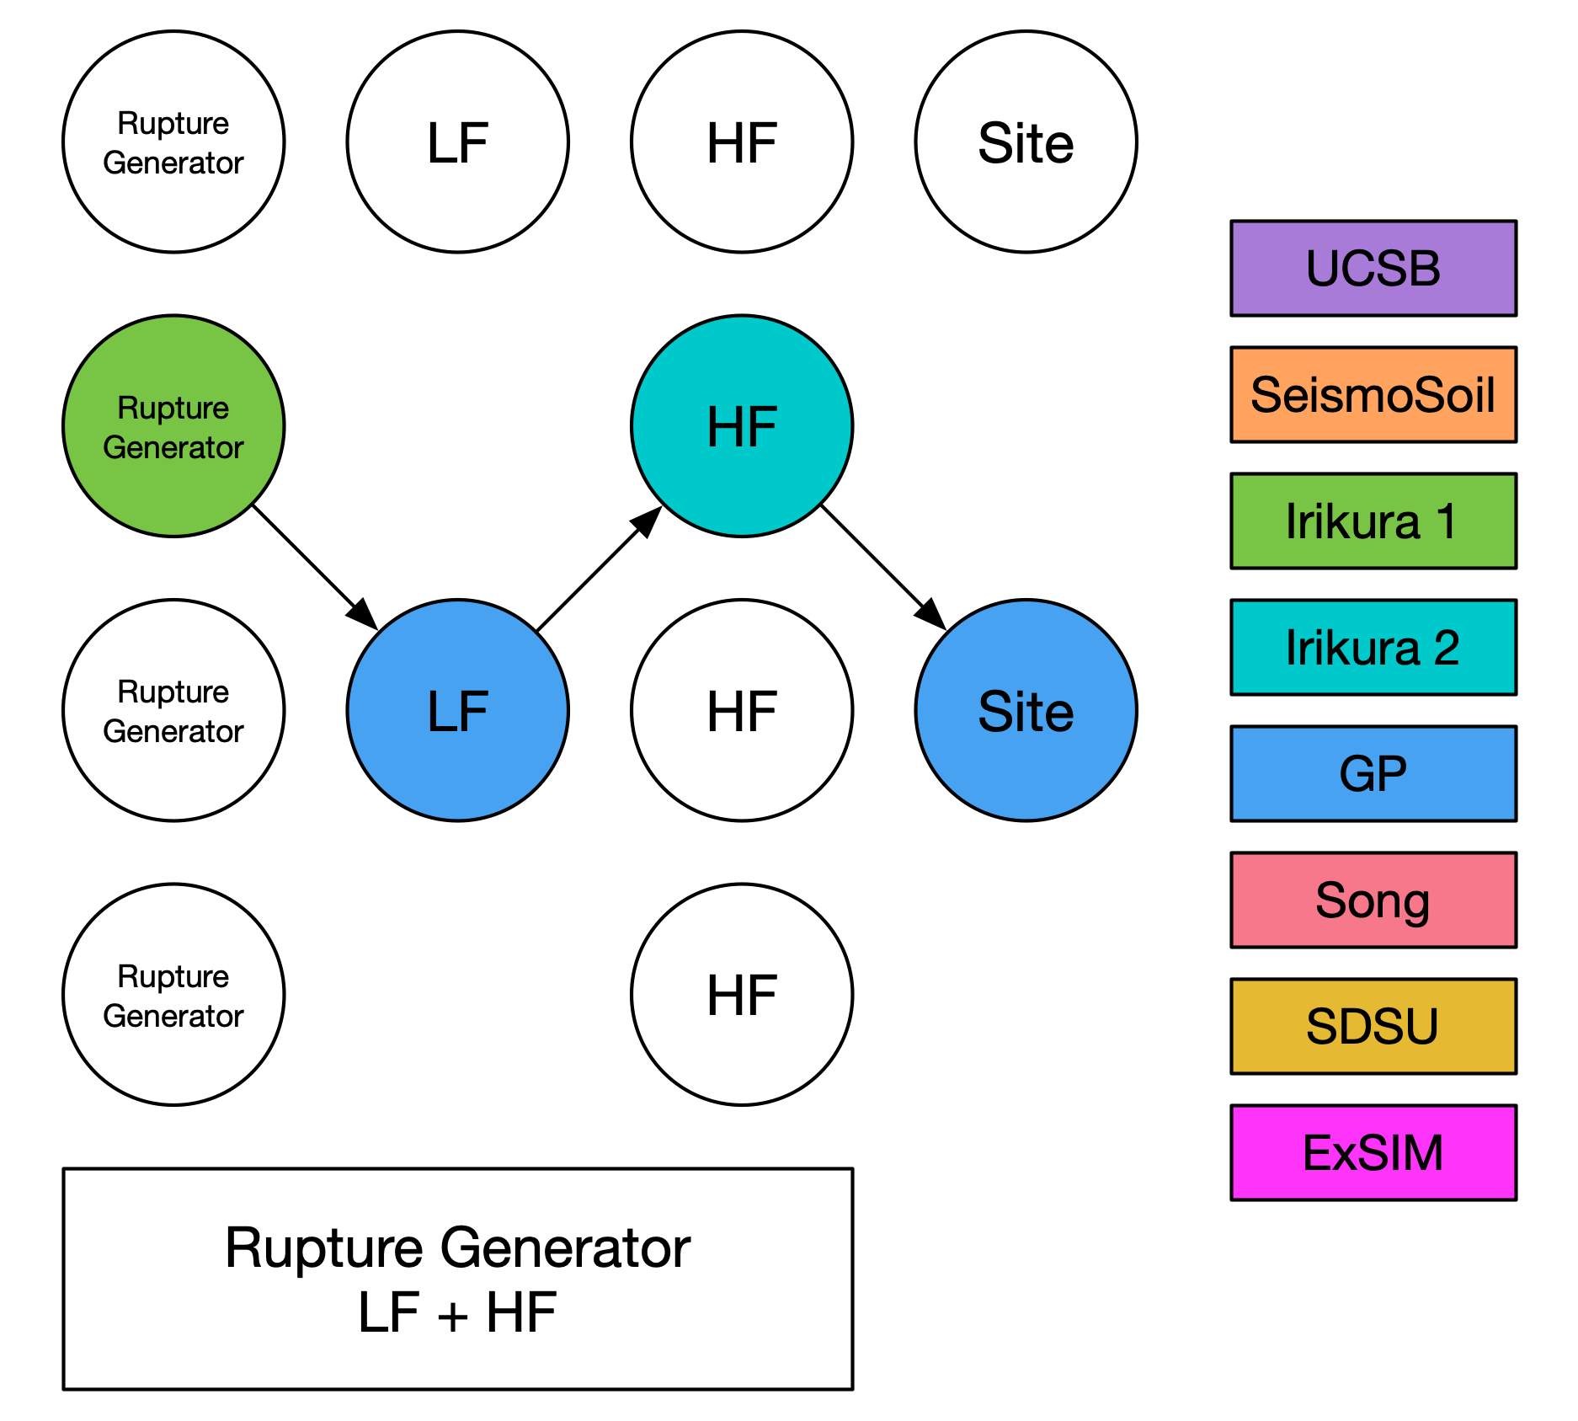
Simulation Methods
Graves and Pitarka (GP)
SDSU
UCSB
ExSIM
Irikura Recipe Method 1
Irikura Recipe Method 2
Song RMG

Slide 26
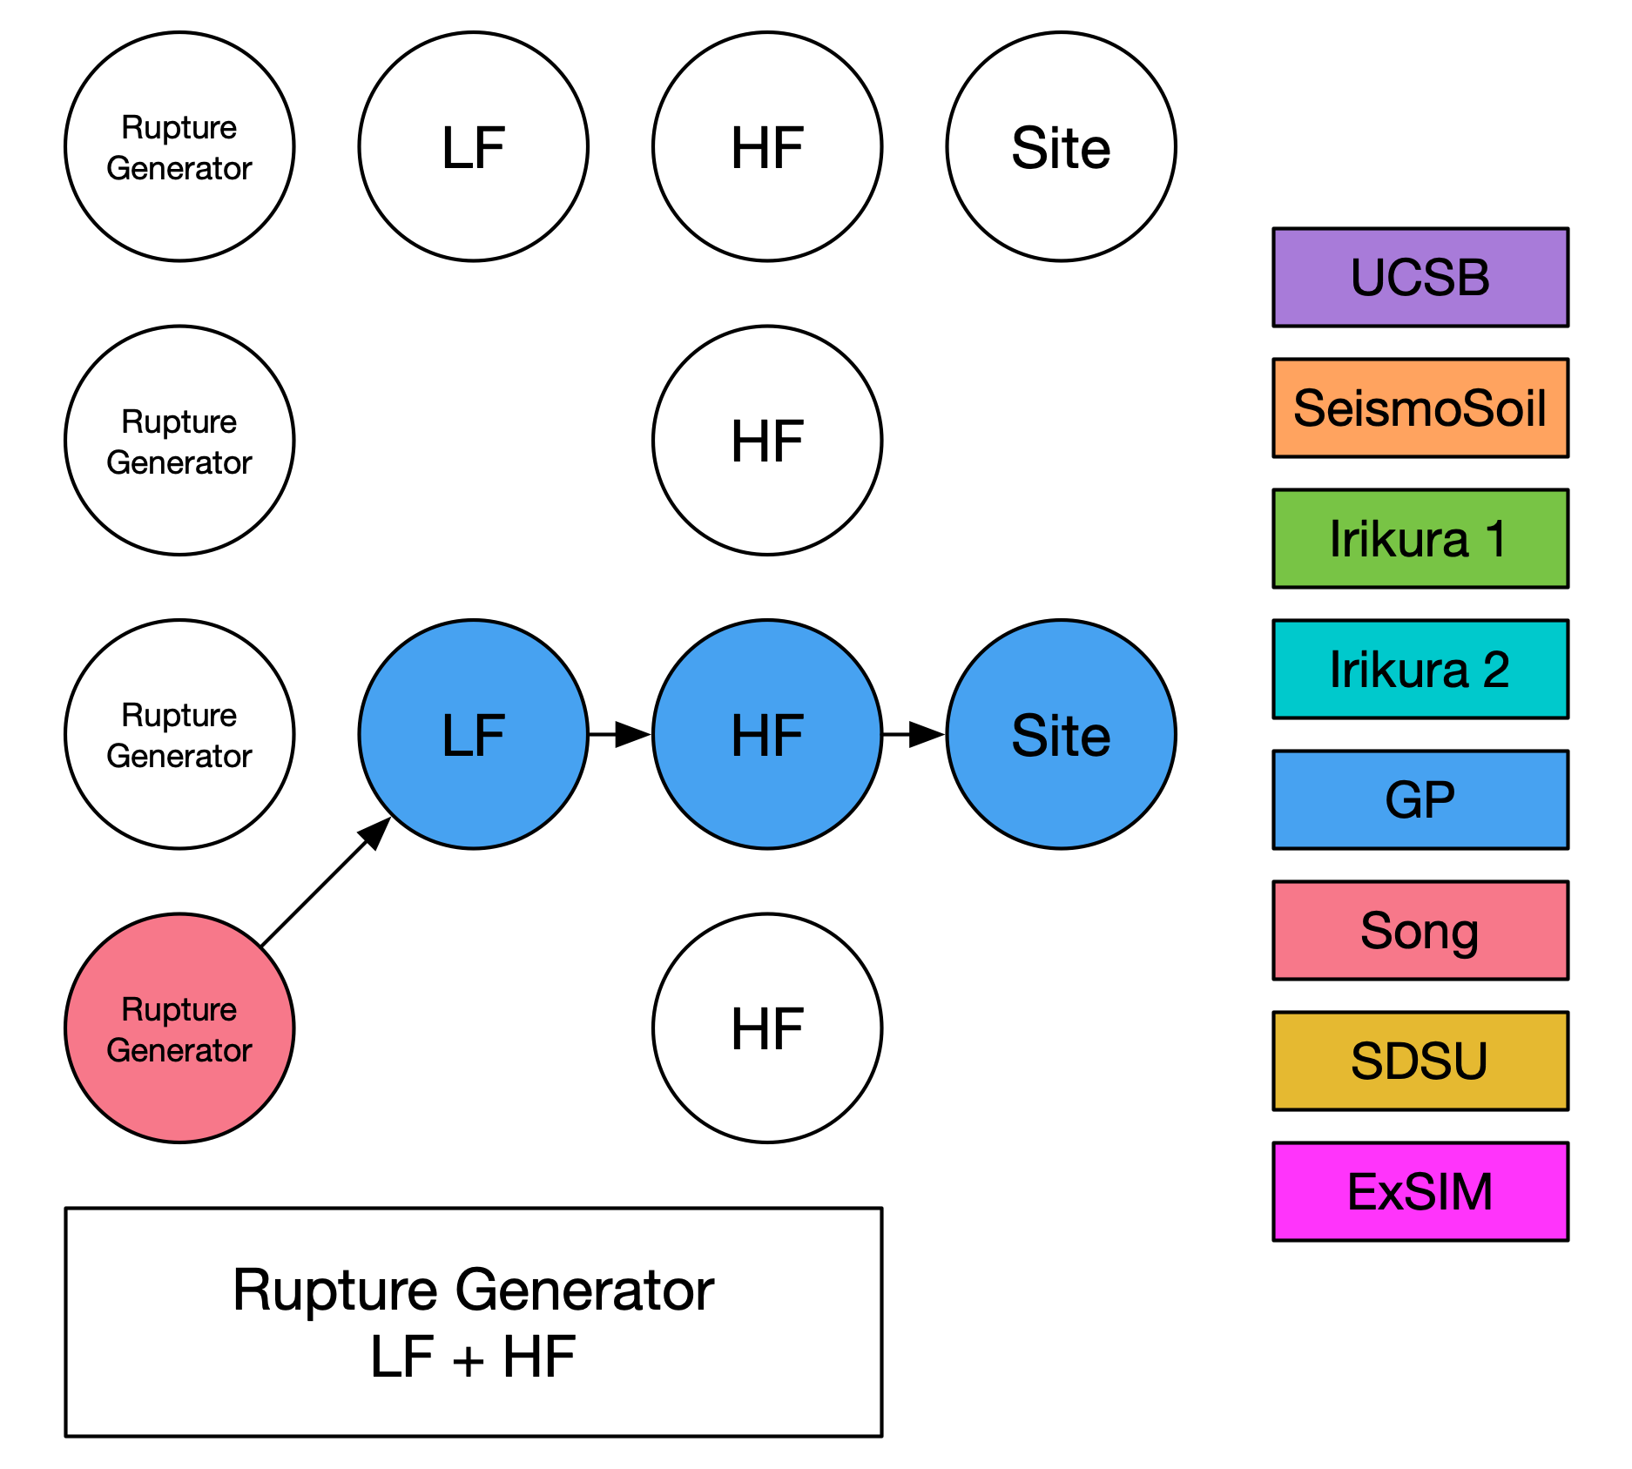
Simulation Methods
Graves and Pitarka (GP)
SDSU
UCSB
ExSIM
Irikura Recipe Method 1
Irikura Recipe Method 2
Song RMG

Slide 27
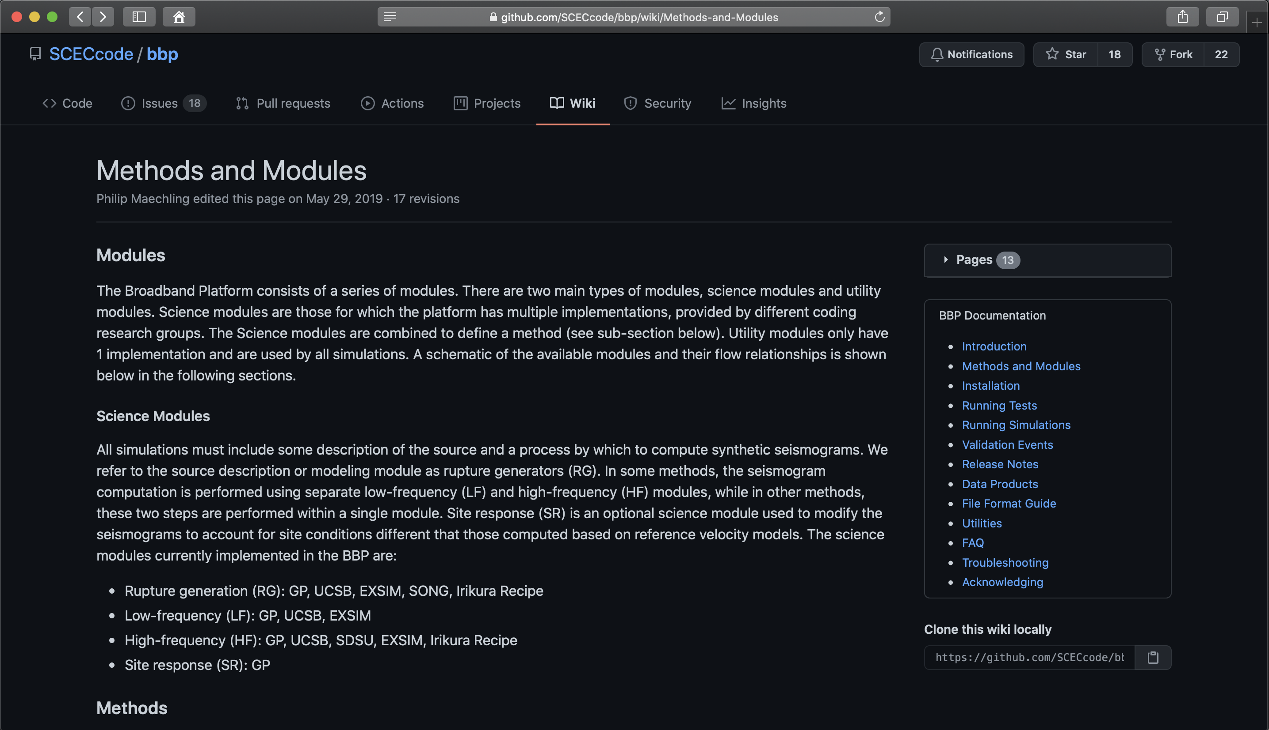
Simulation Methods
GitHub Documentation
Per model description
Modeler-provided model summary
Links to more detailed publications
https://github.com/SCECcode/bbp/wiki/Methods-and-Modules

Slide 28
Agenda
Overview of the SCEC Broadband Platform (BBP)
Overview of the SCEC Ground Motion Simulation Validation (GMSV)Toolkit
Development Directions

Slide 29
GMSV Toolkit: Goals and Background
Ground Motion Simulation Validation software Toolkit (SCEC Project 22091)
  Developed by Christine Goulet, Fabio Silva, and Phil Maechling
Motivation for GMSV Toolkit development:
  1. The BBP contains several well-verified Ground Motion Evaluation Methods. We can make those methods more easily accessible to researchers as a standalone software toolkit.
  2. Ground motion method developers and earthquake engineers need software tools for comparing seismograms and performing goodness of fit measurements.
          Compare simulated seismograms to observed seismograms (validation)
          Compare simulated to simulated (simulation method development)
          Compare simulated ground motions to Ground Motion Prediction Equations (GMPEs)

Slide 30
GMSV Toolkit: Goals and Background
GMSV Toolkit makes existing, well verified, and useful software available to a broad seismological and engineering community of researchers interested in ground motion simulations validation
Leverages over a decade of scientific, engineering, and software development work completed by dozens of SCEC contributors (BBP group, GMSV TAG, High-F, etc.)
Aggregates methods into a standalone package so that its full capabilities are accessible for the validation of any simulated seismogram set(s)
Simplifies the maintenance and use of codes with the various existing SCEC platforms (BBP, CyberShake, High-F) and validation activities

Slide 31
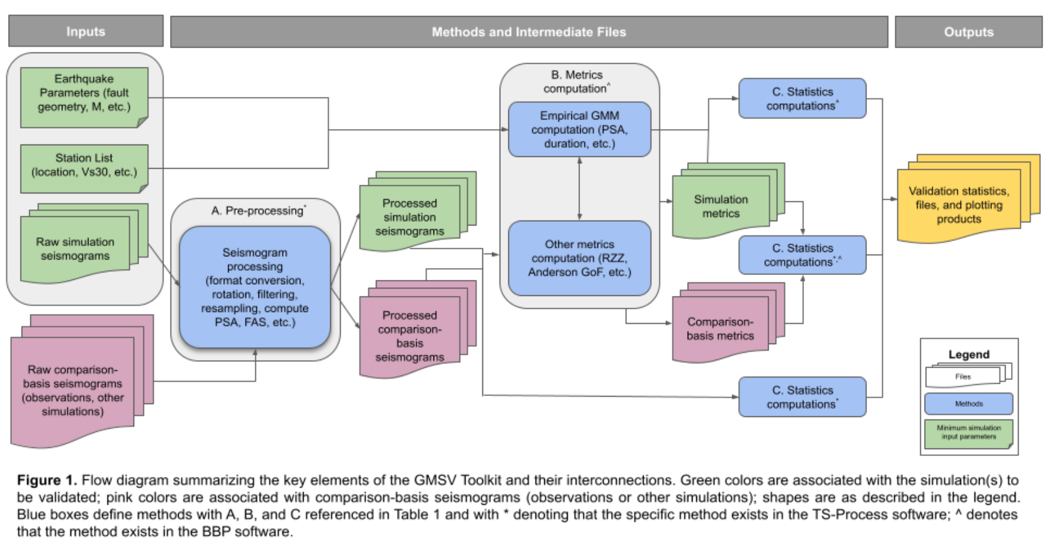
GMSV Toolkit Components
Seismogram pre-processing tools
  Timeseries format conversion (into BBP format)
    AWP, RWG, Hercules, PEER, SMC V1 and V2
  Resampling, rotation, variable band-pass filtering, baseline correction, etc.
Metrics computation
  Arias intensity and duration
  RotD50 PSA
  FAS (Fourier Amplitude Spectra) and SEAS (Smoothed Effective Amplitude Spectra)
  RZZ2015 metrics
  Directionality metrics (SA_{RotD100}/SA_{RotD50})
  GMM computations (NGA-West2), duration, inter-frequency correlation, and FAS/SEAS
Statistical computations and plots
  PSA and FAS GoF (including distance, Vs30, and map)
  Anderson GoF
  Seismogram comparison
  GMM GoF comparisons

Slide 32
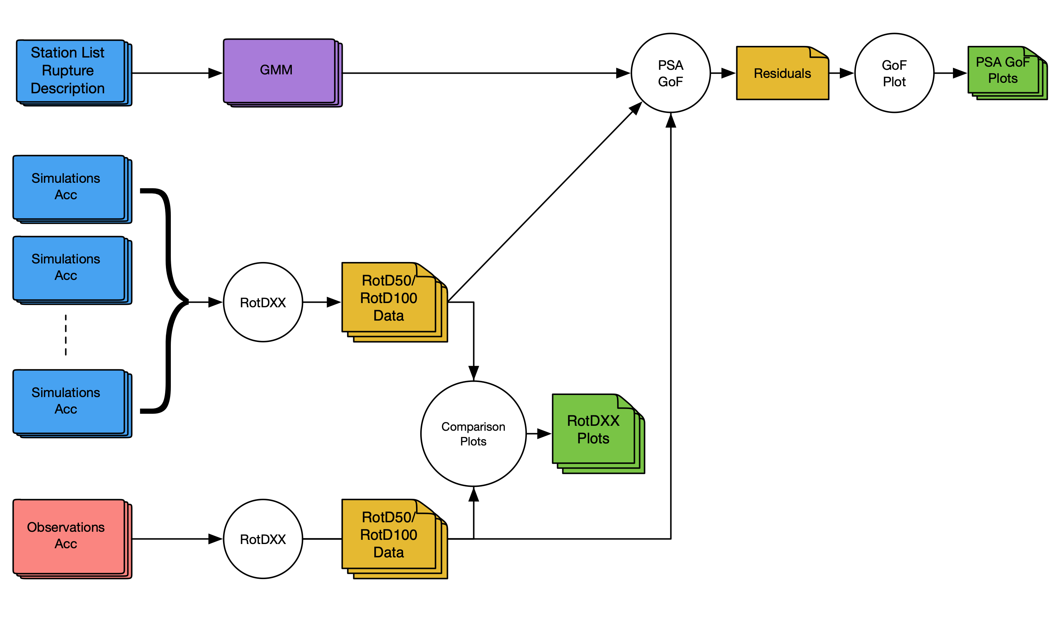
Pseudo-Spectral Acceleration (PSA) Validation Workflow
Pseudo-Spectral
Acceleration (PSA) Validation Codes
Metrics
  rotdxx.py
Statistics
  psa_gof.py
Plots
  plot_rotdxx.py
  plot_gof.py
  plot_dist_gof.py
  plot_map_gof.py
  plot_vs30_gof.py

Slide 33
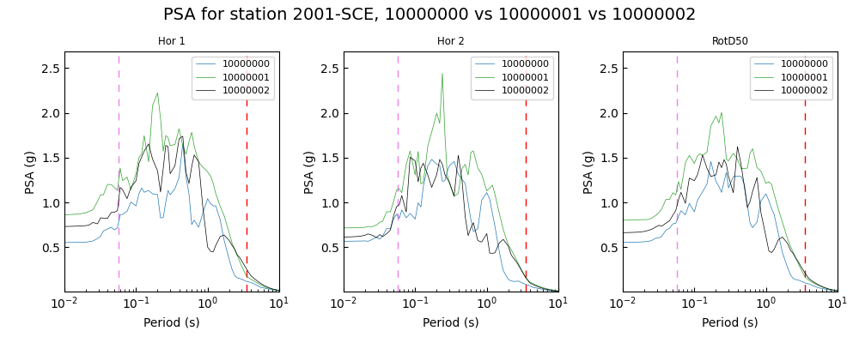
GMSV Toolkit Data Products (PSA)

Slide 34
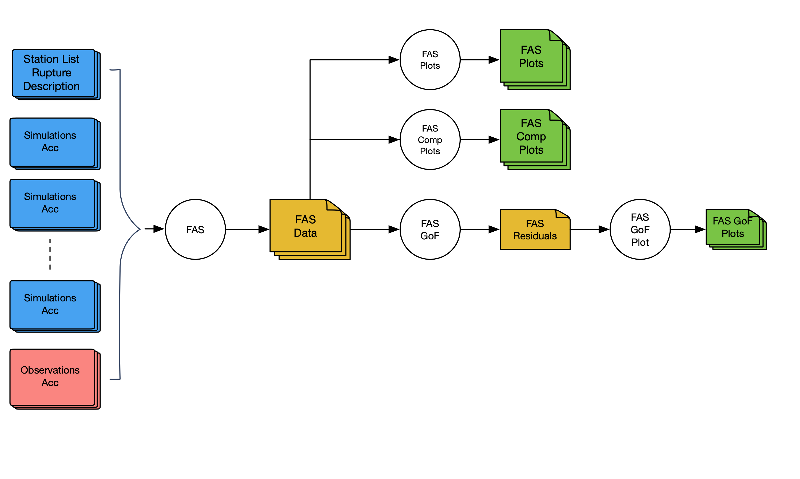
Fourier Amplitude Spectra (FAS) Validation Workflow
FAS Validation Codes
Metrics
  fas.py
Statistics
  fas_gof.py
Plots
  plot_fas.py
  plot_fas_comparison.py
  plot_fas_gof.py

Slide 35
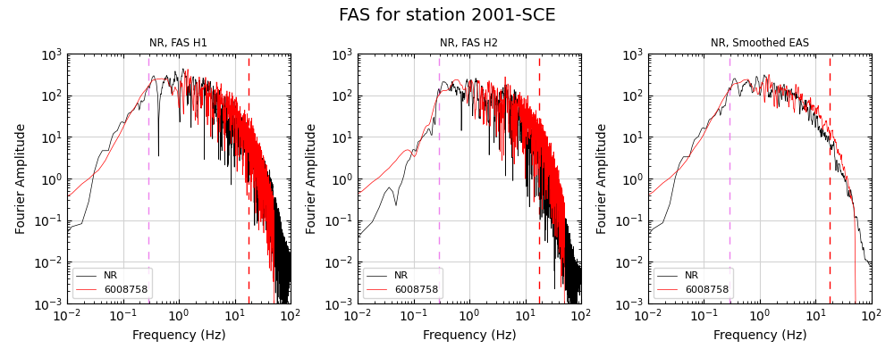
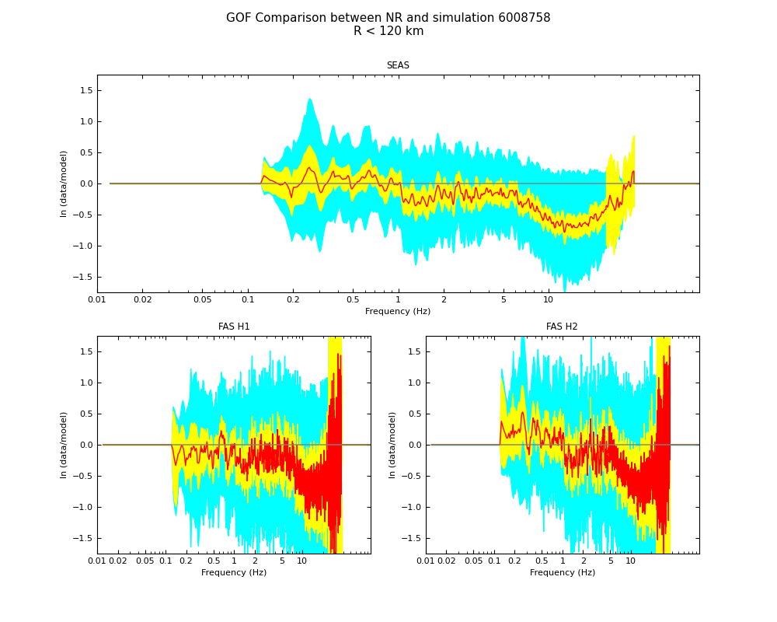
GMSV Toolkit Data Products (FAS)
Left: Per-station FAS comparison, Right: FAS GoF with 40 stations

Slide 36
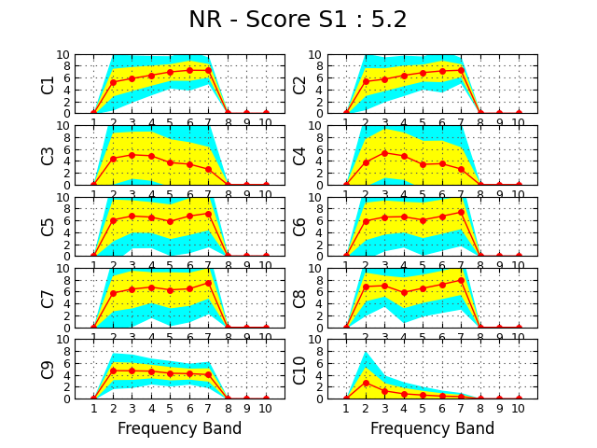
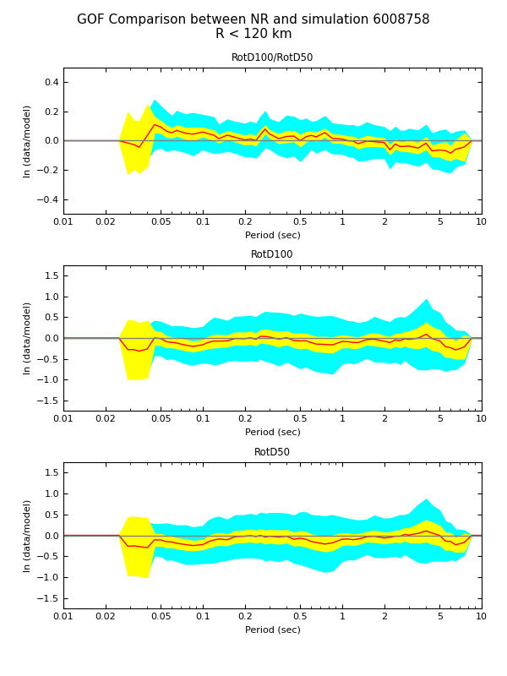
GMSV Toolkit Data Products
Left: Anderson GoF results across 40 stations, Right: RotD100/RotD50 GoF plot

Slide 37
Agenda
Overview of the SCEC Broadband Platform (BBP)
Overview of the SCEC Ground Motion Simulation Validation (GMSV)Toolkit
Development Directions

Slide 38
Broadband Platform and GMSV Toolkit
Future Development
Add additional validation events
  Coalinga (1983), Chi-Chi (1999), El Mayor-Cucapah (2010), Darfield (2010), Christchurch (2011), Kumamoto (2016), South Napa (2014), Turkey (2023), others…
Explore input parameter uncertainty and the impact on output
  Evaluate sensitivity of ground motions to source descriptions, different aspect ratios, rupture velocity, etc.
Create a 3D version of the Broadband Platform
  Integrated 3D ground motion methods into BBP to replace 1D ground motion methods
  Start by adding high frequencies to externally-produced 3D seismograms
Develop additional training materials for BBP and GMSV Toolkit
  Docker containers as a turn-key installation solution
  Jupyter notebooks with tutorials and examples

Slide 39
Questions / Comments?
https://github.com/SCECcode/bbp
https://github.com/SCECcode/gmsvtoolkit

