Slide 1
SCEC CVMs and the Unified Community Velocity Model (UCVM) Software
Philip Maechling (maechlin@usc.edu)
Mei-Hui Su (mei@usc.edu)
12/05/2023

Slide 2
Agenda
SCEC CVMs used in ground motion modeling
General Types of SCEC CVMs
UCVM Software

Slide 3
SCEC Seismic Velocity Models
Existing California Seismic velocity models:
are delivered in a variety of formats (on regular grids, rule-based software, custom software interfaces)
may use different projections:
may provide their own query interface.
Examples include:
CVM-S4 – provides btest-in (Fortran) software interface
CVM-H - provides vx and vx-lite (C-language) software interface
CCA06 - provides properties defined on 500m regular mesh
CenCal (USGS Bay Area Model) – provides properties defined in high and low resolution etree structures.

Slide 4
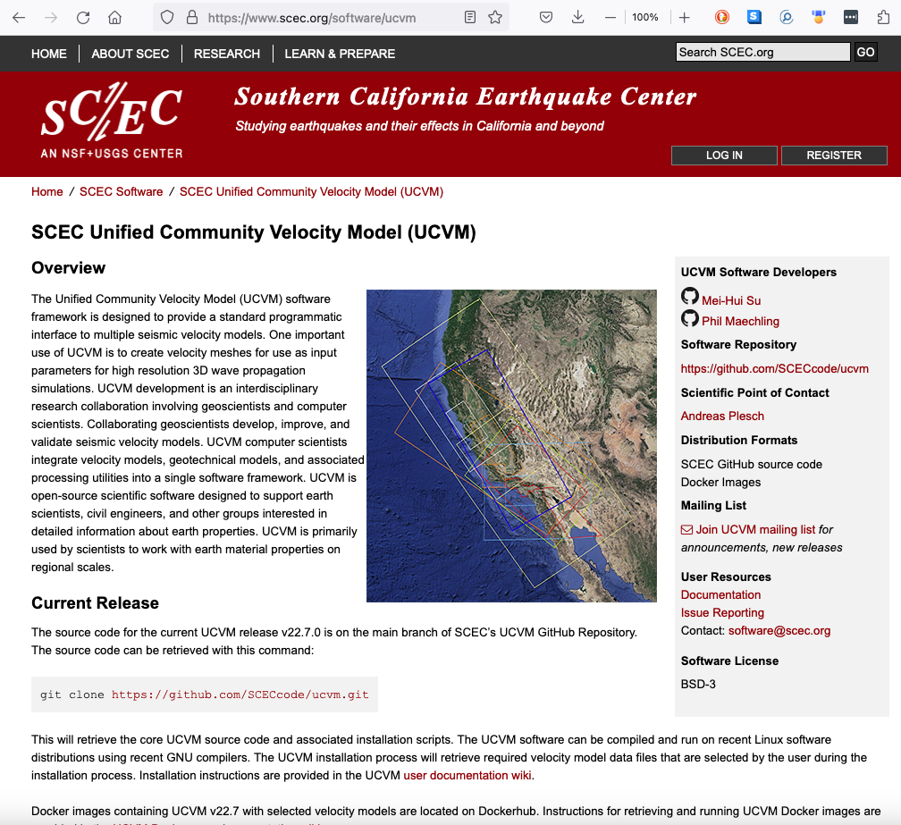
Unified Community Velocity Model (UCVM) Software Page
UCVM Software: https://scec.org/software/ucvm
SCEC’s UCVM software is not a velocity model.
It is a software package the provides access to multiple existing velocity models.
UCVM is open-source (Linux) software that provides access to multiple California (and Utah) velocity models.
UCVM is used to build large velocity meshes used to perform earthquake wave propagation simulations for California.
UCVM_Coverage_Regions_v22_7.kml

Slide 5
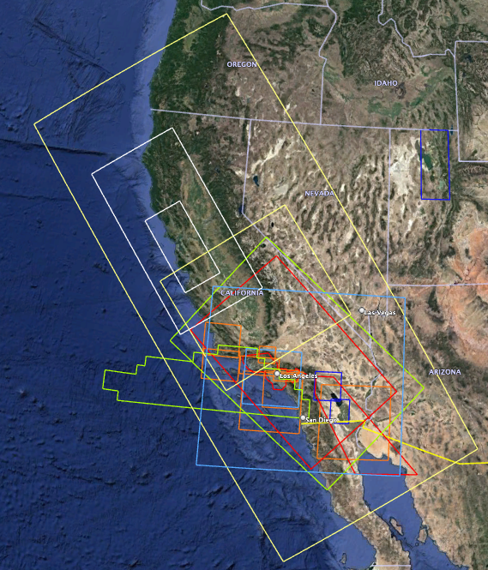
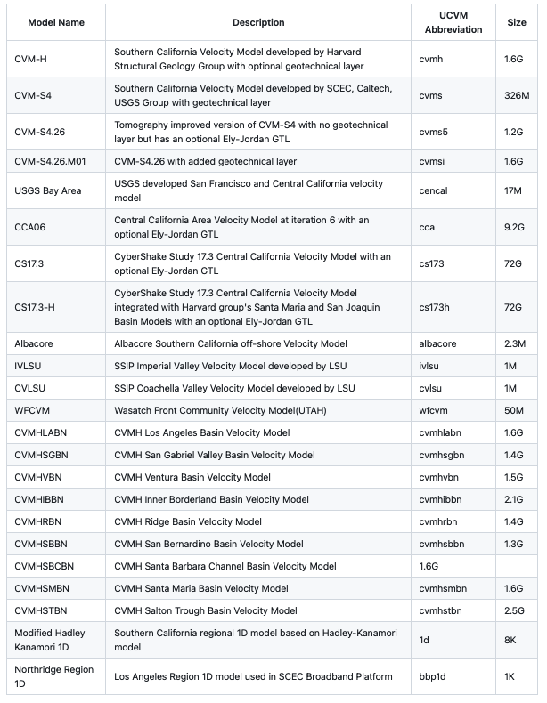

Slide 6
CVM-H
Shaw, J. H., A. Plesch, C. Tape, M. P. Suess, T. H. Jordan, G. Ely, E. Hauksson, J. Tromp, T. Tanimoto, R. Graves, K. Olsen, C. Nicholson, P. J. Maechling, C. Rivero, P. Lovely, C. M. Brankman, J. Munster (2015). Unified Structural Representation of the southern California crust and upper mantle. Earth and Planetary Science Letters. 415 1, doi: 10.1016/j.epsl.2015.01.016 SCEC Contribution 2004
CVM-S Model:
Magistrale, H, Day, S, Clayton, RW, Graves, RW (2000) The SCEC southern California reference three-dimensional seismic velocity model version 2. Bulletin of the Seismological Society of America 90(6B): S65–S76.
Kohler, MD, Magistrale, H, Clayton, RW (2003) Mantle heterogeneities and the SCEC reference three-dimensional seismic velocity model version 3. Bulletin of the Seismological Society of America 93(2): 757–774.
CVM-S4.26 and CVM-S4.26.M01
Lee, E.-J., P. Chen, T. H. Jordan, P. J. Maechling, M. A. M. Denolle, and G. C.Beroza (2014), Full 3-D tomography for crustal structure in Southern California based on the scattering-integral and the adjoint-waveﬁeld methods, J. Geophys. Res. Solid Earth, 119, doi:10.1002/2014JB011346. SCEC Contribution 6093
USGS Central California Model (cencal)
Brocher, Tom & Aagaard, Brad & Simpson, R. & Jachens, R.. (2006). The USGS 3D Seismic Velocity Model for Northern California. AGU Fall Meeting Abstracts. -1. 1266.
ALBACORE Model:
Bowden, D. C., Kohler, M. D., Tsai, V. C., & Weeraratne, D. S. (2016). Offshore southern California lithospheric velocity structure from noise cross-correlation functions. Journal of Geophysical Research, 121(5), 3415-3427. doi: 10.1002/2016JB012919.
Imperial Valley Model:
Persaud P., Y. Ma, J. M. Stock, J. Hole, G. Fuis and L. Han (2016), Fault zone characteristics and basin complexity in the southern Salton Trough, California , Geology, 44(9), p. 747-750, doi:10.1130/G38033.1.
Coachella Valley Model
Ajala, R., Persaud, P., Stock, J. M., Fuis, G. S., Hole, J. A., Goldman, M., & Scheirer, D. (2019). Three‐Dimensional Basin and Fault Structure From a Detailed Seismic Velocity Model of Coachella Valley, Southern California. Journal of Geophysical Research: Solid Earth,. doi: 10.1029/2018JB016260. https://agupubs.onlinelibrary.wiley.com/doi/abs/10.1029/2018JB016260
Wasatch Model:
Magistrale, H, Olsen, KB, Pechmann, JC (2008) Construction and verification of a Wasatch front community velocity model. Technical report no. HQGR.060012, 14 pp. Reston, VA: US Geological Survey.
Lin-Thurber Model
Lin, G., C. H. Thurber, H. Zhang, E. Hauksson, P. Shearer, F. Waldhauser, T. M. Brocher, and J. Hardebeck (2010), A California statewide three-dimensional seismic velocity model from both absolute and differential times. Bulletin of the Seismological Society of America, 100, 225-240. doi: 10.1785/0120090028. SCEC Contribution 1360
Ely/Jordan GTL
Ely, G., T. H. Jordan, P. Small, P. J. Maechling (2010), A Vs30-derived Near-surface Seismic Velocity Model Abstract S51A-1907, presented at 2010 Fall Meeting, AGU, San Francisco, Calif., 13-17 Dec.
Topography-based Vs30 Model
Wald, D. J., and T. I. Allen (2007), Topographic slope as a proxy for seismic site conditions and amplification, Bull. Seism. Soc. Am., 97 (5), 1379-1395, doi:10.1785/0120060267.
Wills California Vs30 Model
Wills, C. J., and K. B. Clahan (2006), Developing a map of geologically defined site-condition categories for California, Bull. Seism. Soc. Am., 96 (4A), 1483-1501, doi:10.1785/0120050179.
Thompson California Vs30 Model
Thompson, E.M. (2018), An Updated Vs30 Map for California with Geologic and Topographic Constraints (ver. 2.0, July 2022): U.S. Geological Survey data release, doi:10.5066/F7JQ108S.
CVM-H Basins
Plesch, A., C.H. Thurber, C. Tape, and J.H. Shaw (2021, 08), The SCEC CVM effort: new basin models, enhanced access and tomographic updates. Oral Presentation at 2021 SCEC Annual Meeting.
Digital Elevation Model
USGS NED 1 arcsec DEM
https://apps.nationalmap.gov/datasets/
https://cugir.library.cornell.edu/catalog/cugir-009096

Slide 7
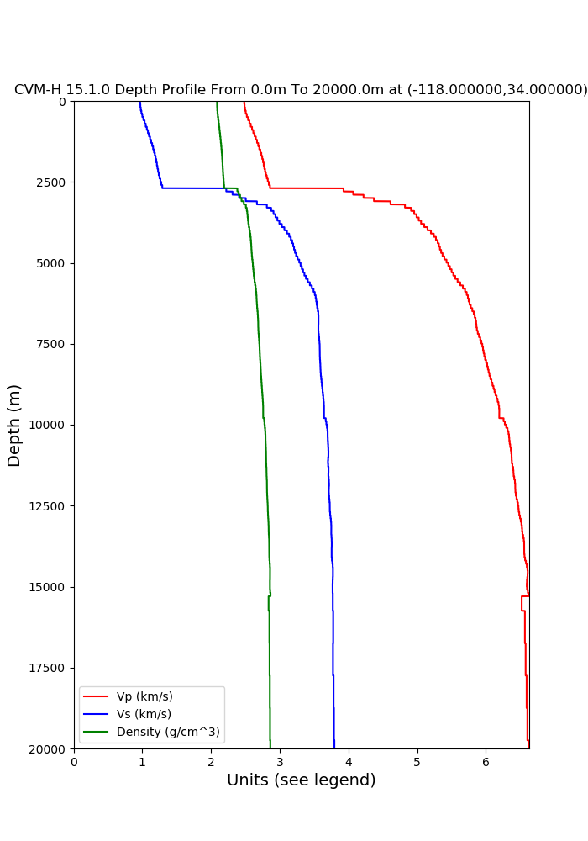
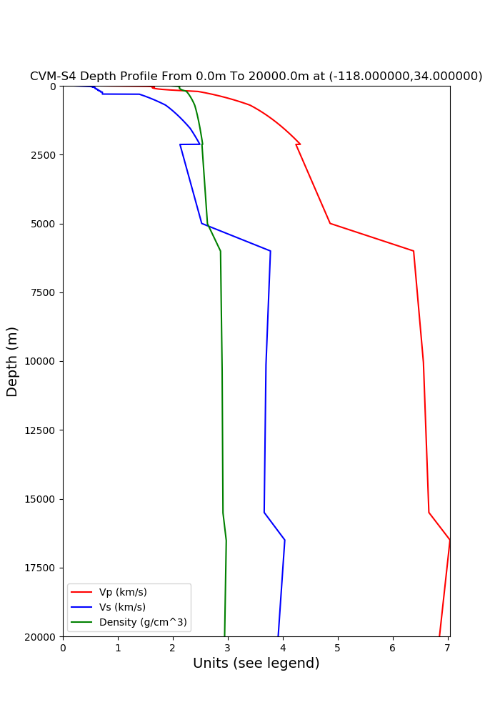
CVM-H versus CVM-S4
$cd /home/ucvm/ucvm194/utilities
$./plot_depth_profile.py -s 34.0,-118.0 -b 0 -e 20000 -d vp,vs,density -v 5 -c cvms -o whittier_cvms_profile.png

Slide 8
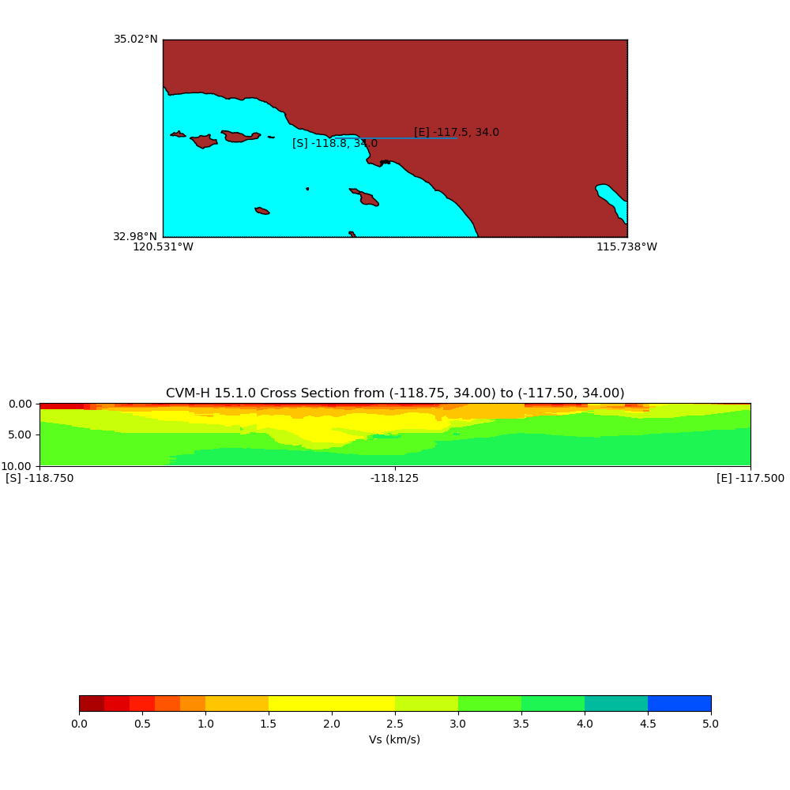
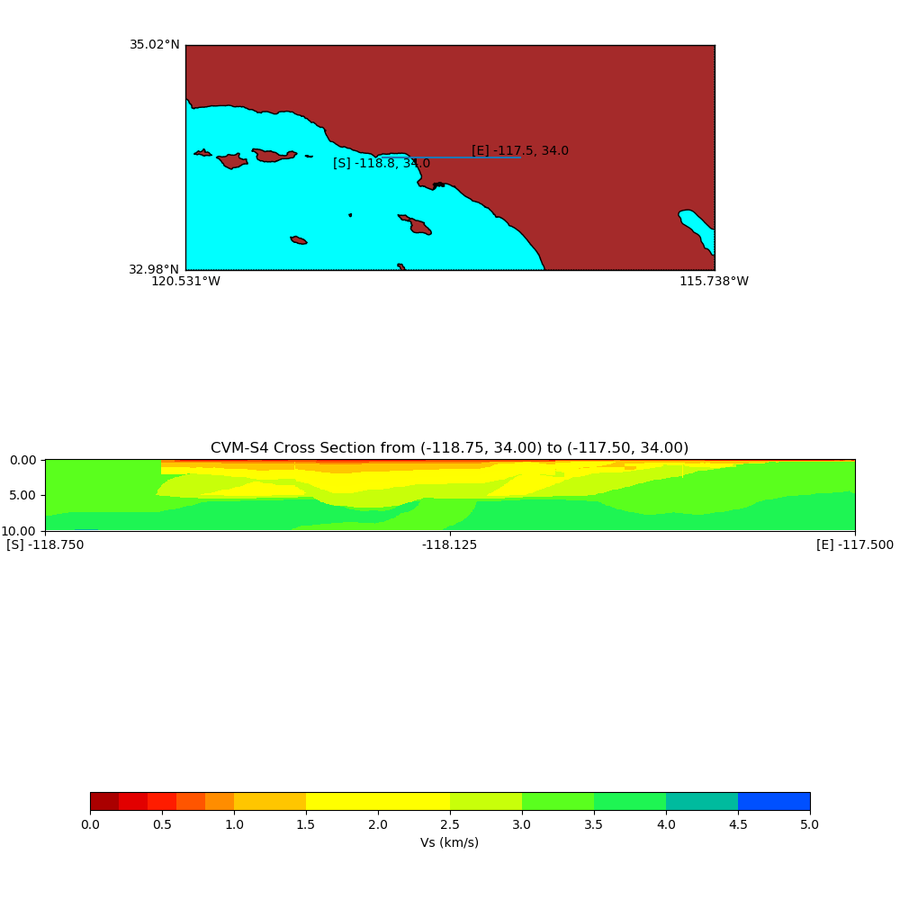
CVM-H versus CVM-S4
$cd /home/ucvm/ucvm194/utilities
$./plot_cross_section.py -b 34.0,-118.75 -u 34.0,-117.5 -h 100 -v 100 -d vs -c cvmh -s 0.0 -e 10000.0 –a d –o cvmh_cross_section.png

Slide 9
Comparison of CVM-H and CVM-S4 LA Basin Z1.0 and Z2.5 depths
Vs at 1km depth for CVM-H v15.1 (left), for CVM-S4 (left center)
Z2.5 depth for CVM-H (right center), and CVM-S4 (right)

Slide 10
Agenda
SCEC CVMs used in ground motion modeling
General Types of SCEC CVMs
UCVM Software

Slide 11
Standard Questions about CVMs
Model Coverage Volume
What are the model’s dimensions and resolution ?
Is the Model for a flat region or does is include topography?
What is the default projection for model ?
Model Properties
What material properties does the model provide ? Are any of the properties scaled from one another (standard are vp, vs, and density) ? What is the preferred formulas for populating vp and density if the model is vs only ?
Does the model make any special considerations for geotechnical layer (top 350m or so?).
What is the minimum Vs in the model ?
How is the moho represented in the model
Model Access and Storage
Is there an existing way to query the model for a given point (e.g if the user has a given lat/lon/depth, how do they get material properties at that point)
What values does the model provide to indicate No Data, or out of defined region
Does the model provide a background model below max depth, or outside defined region?
Does the model provide interpolation (e.g. trilinear interpolation) when users query the model?
Where are the existing model data files ?
Is there a publication describing the model?

Slide 12
General Types of SCEC CVM Types
1D Models
Hadley Kanamori, Northridge Region
Rule-based 3D SCEC Model
CVM-S
Unified Structure Representation 3D Model
CVM-H
Tomography Improved Models
CVM-S4.26, CVM-S4.26-M01, CCA06
Simulation-Specific Tiled Models
CS-17.3, CS-18.8
Basin Models and Dense Array Model
CVM-H Basins stand-alone, Coachella Valley, Imperial Valley
Geological Models
CenCal
8. Offshore Model from ocean bottoms sensors
ALBACORE
9. Models with Modified Geotechnical Layer
Ely-Jordan Method, SVM Method, Vs30 Taper Method

Slide 13
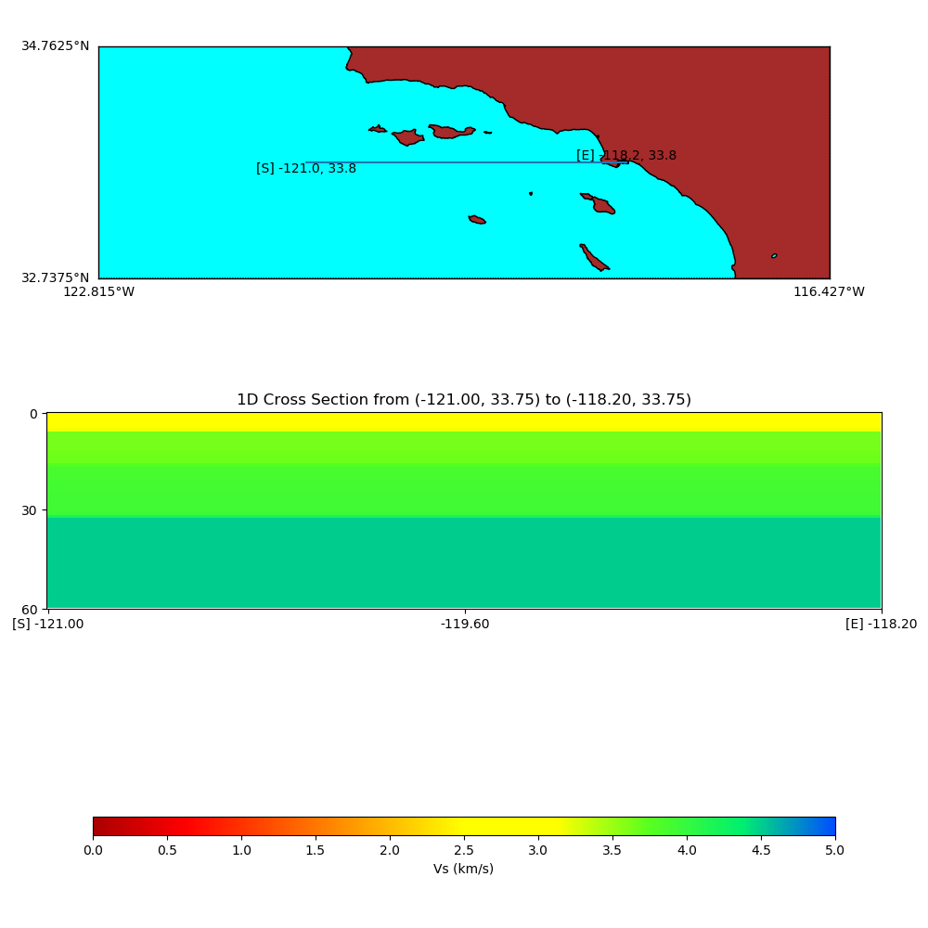
Modified Hadley-Kanamori Southern California 1D Model

Slide 14
General Types of SCEC CVM Types
1D Models
Hadley Kanamori, Northridge Region
Rule-based 3D SCEC Model
CVM-S
Unified Structure Representation 3D Model
CVM-H
Tomography Improved Models
CVM-S4.26, CVM-S4.26-M01, CCA06
Simulation-Specific Tiled Models
CS-17.3, CS-18.8
Basin Models and Dense Array Model
CVM-H Basins stand-alone, Coachella Valley, Imperial Valley
Geological Models
CenCal
8. Offshore Model from ocean bottoms sensors
ALBACORE
9. Models with Modified Geotechnical Layer
Ely-Jordan Method, SVM Method, Vs30 Taper Method

Slide 15
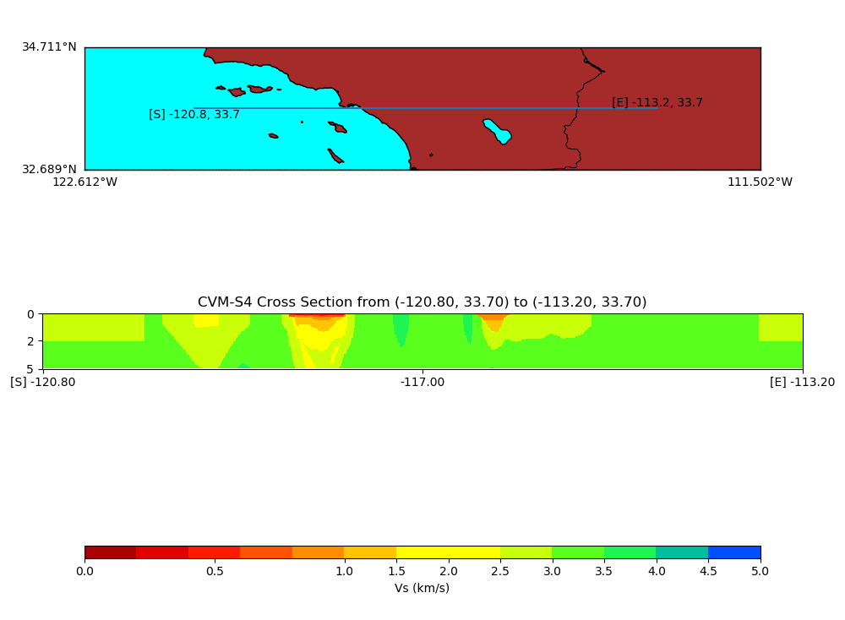
CVM-S4 (native gtl,bkg)

Slide 16
General Types of SCEC CVM Types
1D Models
Hadley Kanamori, Northridge Region
Rule-based 3D SCEC Model
CVM-S
Unified Structure Representation 3D Model
CVM-H
Tomography Improved Models
CVM-S4.26, CVM-S4.26-M01, CCA06
Simulation-Specific Tiled Models
CS-17.3, CS-18.8
Basin Models and Dense Array Model
CVM-H Basins stand-alone, Coachella Valley, Imperial Valley
Geological Models
CenCal
8. Offshore Model from ocean bottoms sensors
ALBACORE
9. Models with Modified Geotechnical Layer
Ely-Jordan Method, SVM Method, Vs30 Taper Method

Slide 17
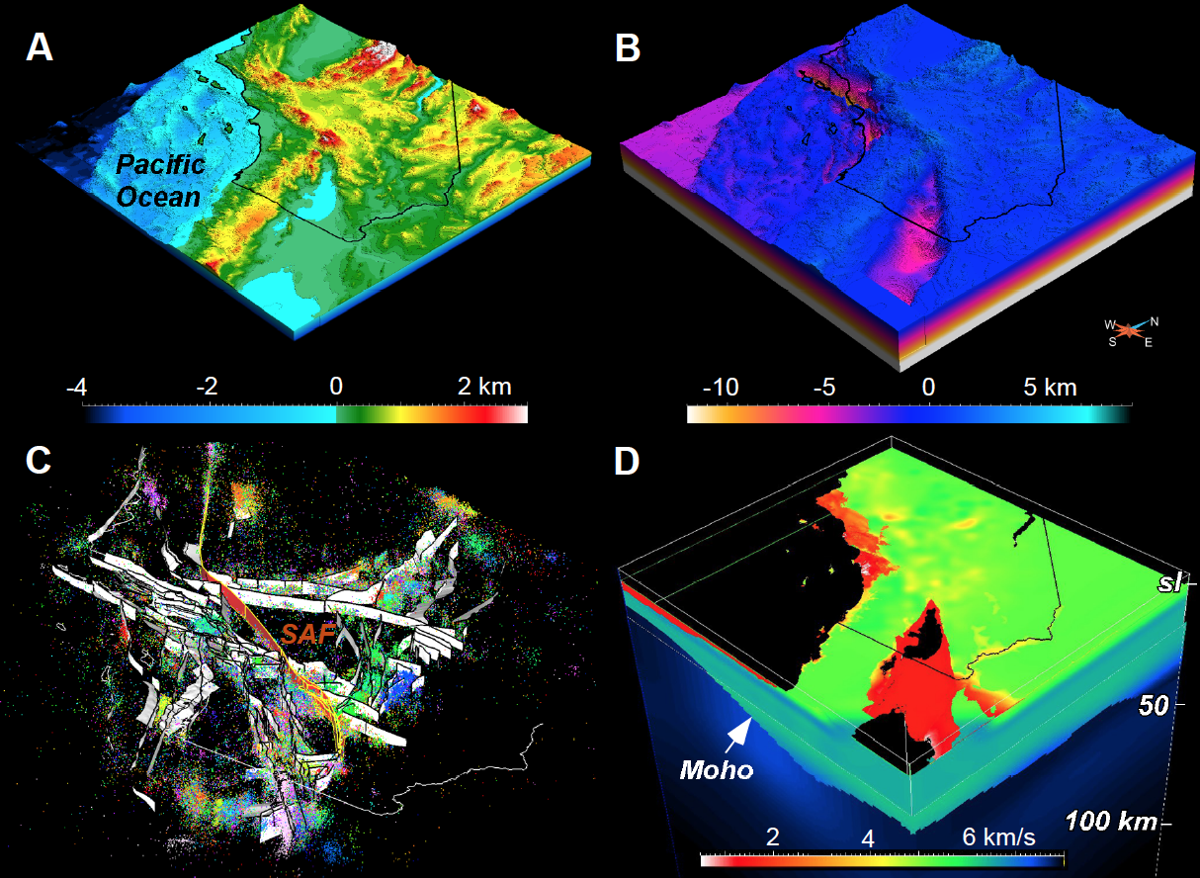
SCEC Unified Structural Representation (USR)
CFM
CVM-H
• An object-oriented, 3D description of crust and upper mantle velocity and fault structure in southern California
• The USR development workflow seeks to use the best available data and techniques to constrain velocity structurre, and to ensures internal consistency of model components

Slide 18
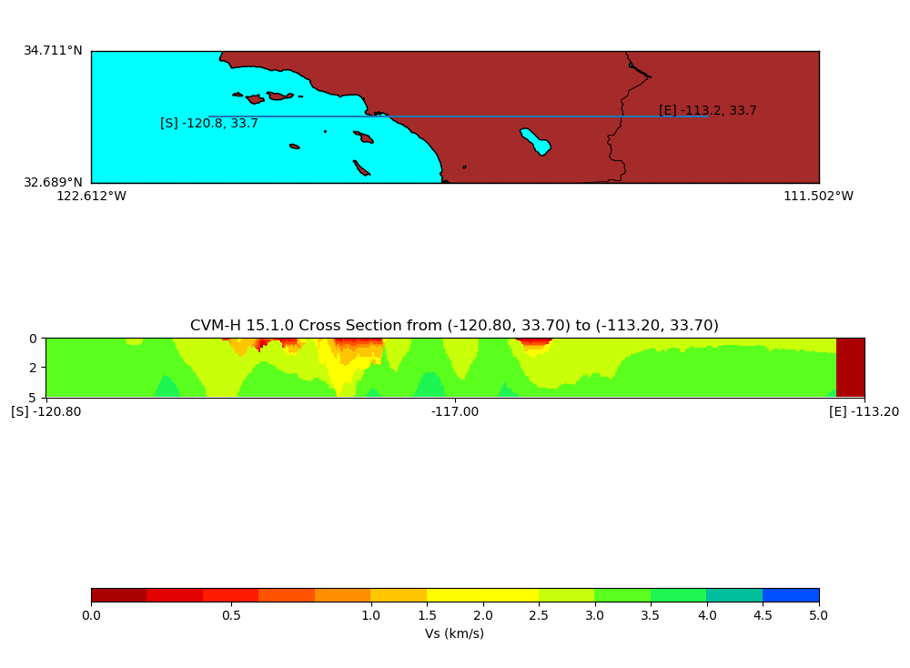
CVM-H 15.1 (native gtl, no bkg)

Slide 19
General Types of SCEC CVM Types
1D Models
Hadley Kanamori, Northridge Region
Rule-based 3D SCEC Model
CVM-S
Unified Structure Representation 3D Model
CVM-H
Tomography Improved Models
CVM-S4.26, CVM-S4.26-M01, CCA06
Simulation-Specific Tiled Models
CS-17.3, CS-18.8
Basin Models and Dense Array Model
CVM-H Basins stand-alone, Coachella Valley, Imperial Valley
Geological Models
CenCal
8. Offshore Model from ocean bottoms sensors
ALBACORE
9. Models with Modified Geotechnical Layer
Ely-Jordan Method, SVM Method, Vs30 Taper Method

Slide 20
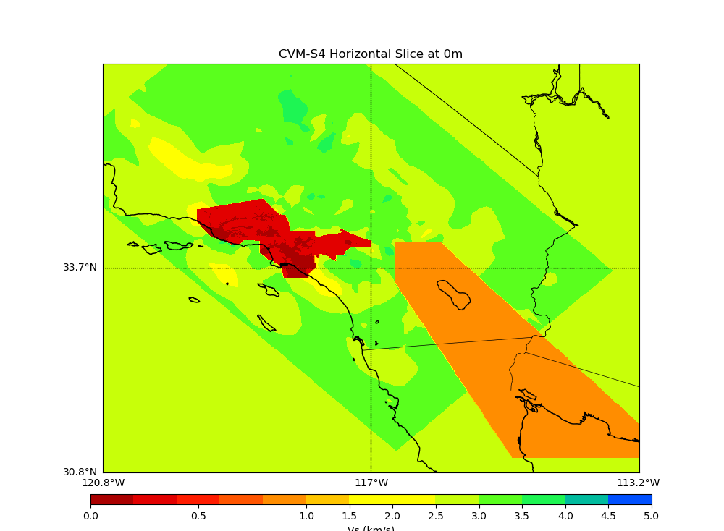
CVM-S4.26 (no gtl,no bkg)
Before - Tomography Starting Model
After – Tomography Improved Model

Slide 21
CVM-S4.26 (no gtl, no bkg)
Before - Tomography Starting Model
After – Tomography Improved Model

Slide 22
General Types of SCEC CVM Types
1D Models
Hadley Kanamori, Northridge Region
Rule-based 3D SCEC Model
CVM-S
Unified Structure Representation 3D Model
CVM-H
Tomography Improved Models
CVM-S4.26, CVM-S4.26-M01, CCA06
Simulation-Specific Tiled Models
CS-17.3, CS-18.8
Basin Models and Dense Array Model
CVM-H Basins stand-alone, Coachella Valley, Imperial Valley
Geological Models
CenCal
8. Offshore Model from ocean bottoms sensors
ALBACORE
9. Models with Modified Geotechnical Layer
Ely-Jordan Method, SVM Method, Vs30 Taper Method

Slide 23
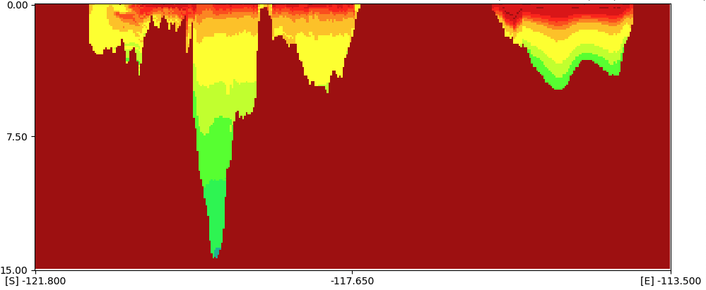
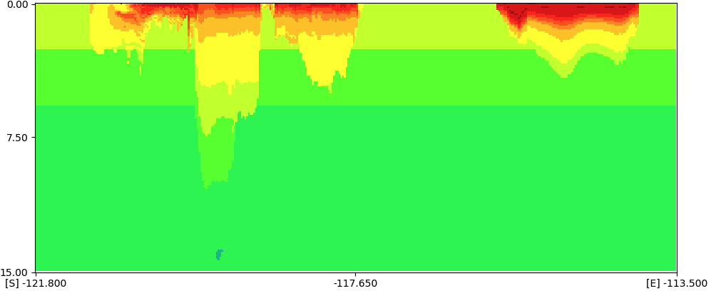
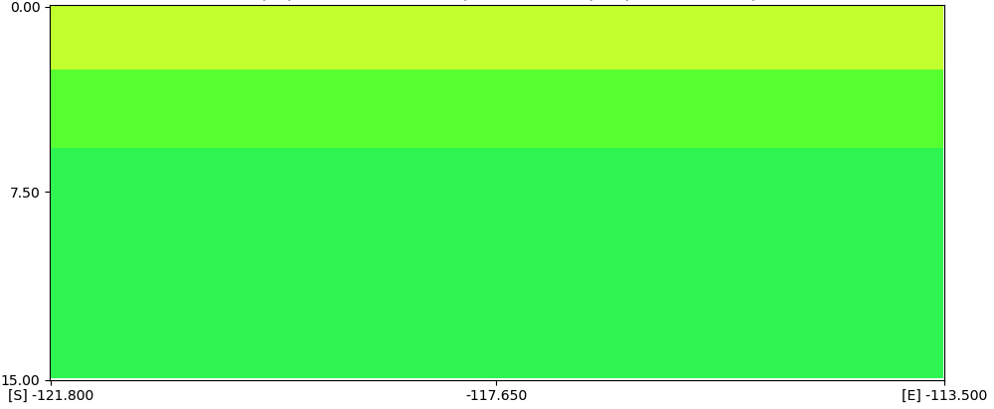
Combine Models using Tiling Method
UCVM queries each model in order and returns properties from first model that defines properties for a given point (e.g. Basin Mode, 1D)

Slide 24
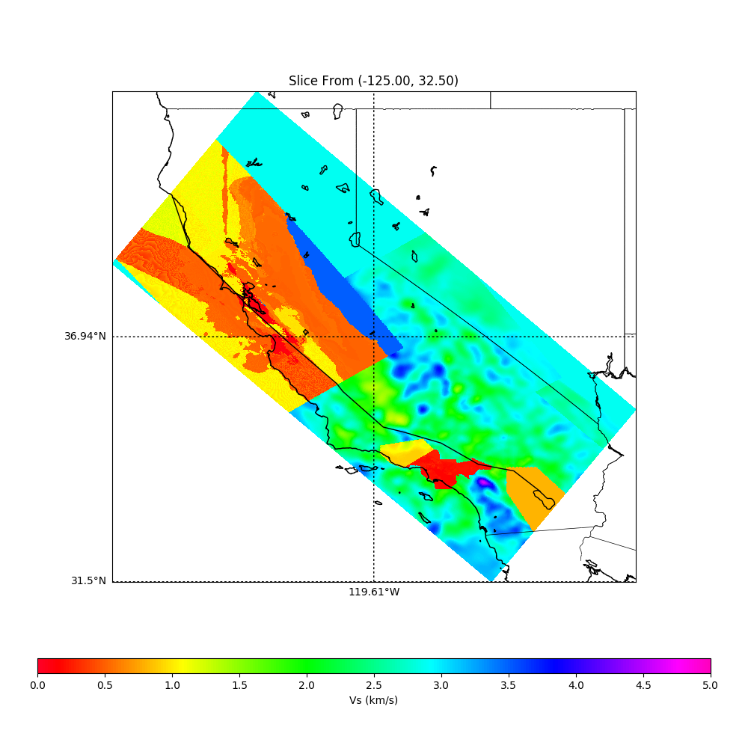
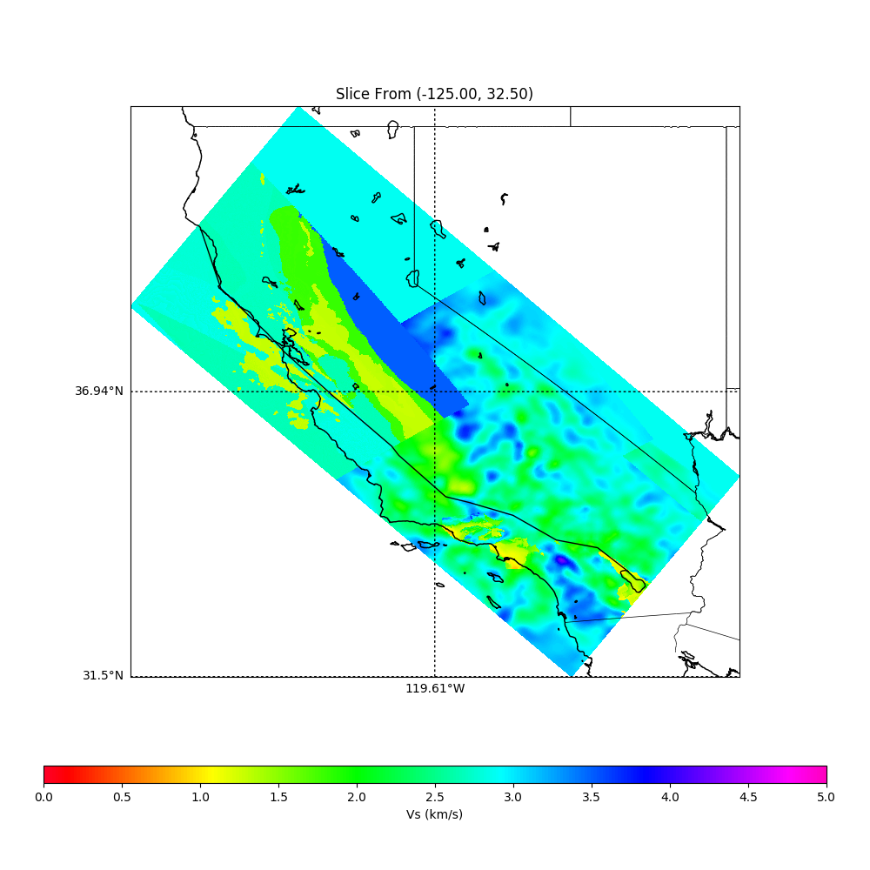
Example of Regional Model constructed by Tiling Models (0 depth (left), 1k depth (right))
UCVM queries each model in order and returns properties from first model that defines properties for a given point (e.g. CelCal,CCA06,CVM-S4.26M01,1D)

Slide 25
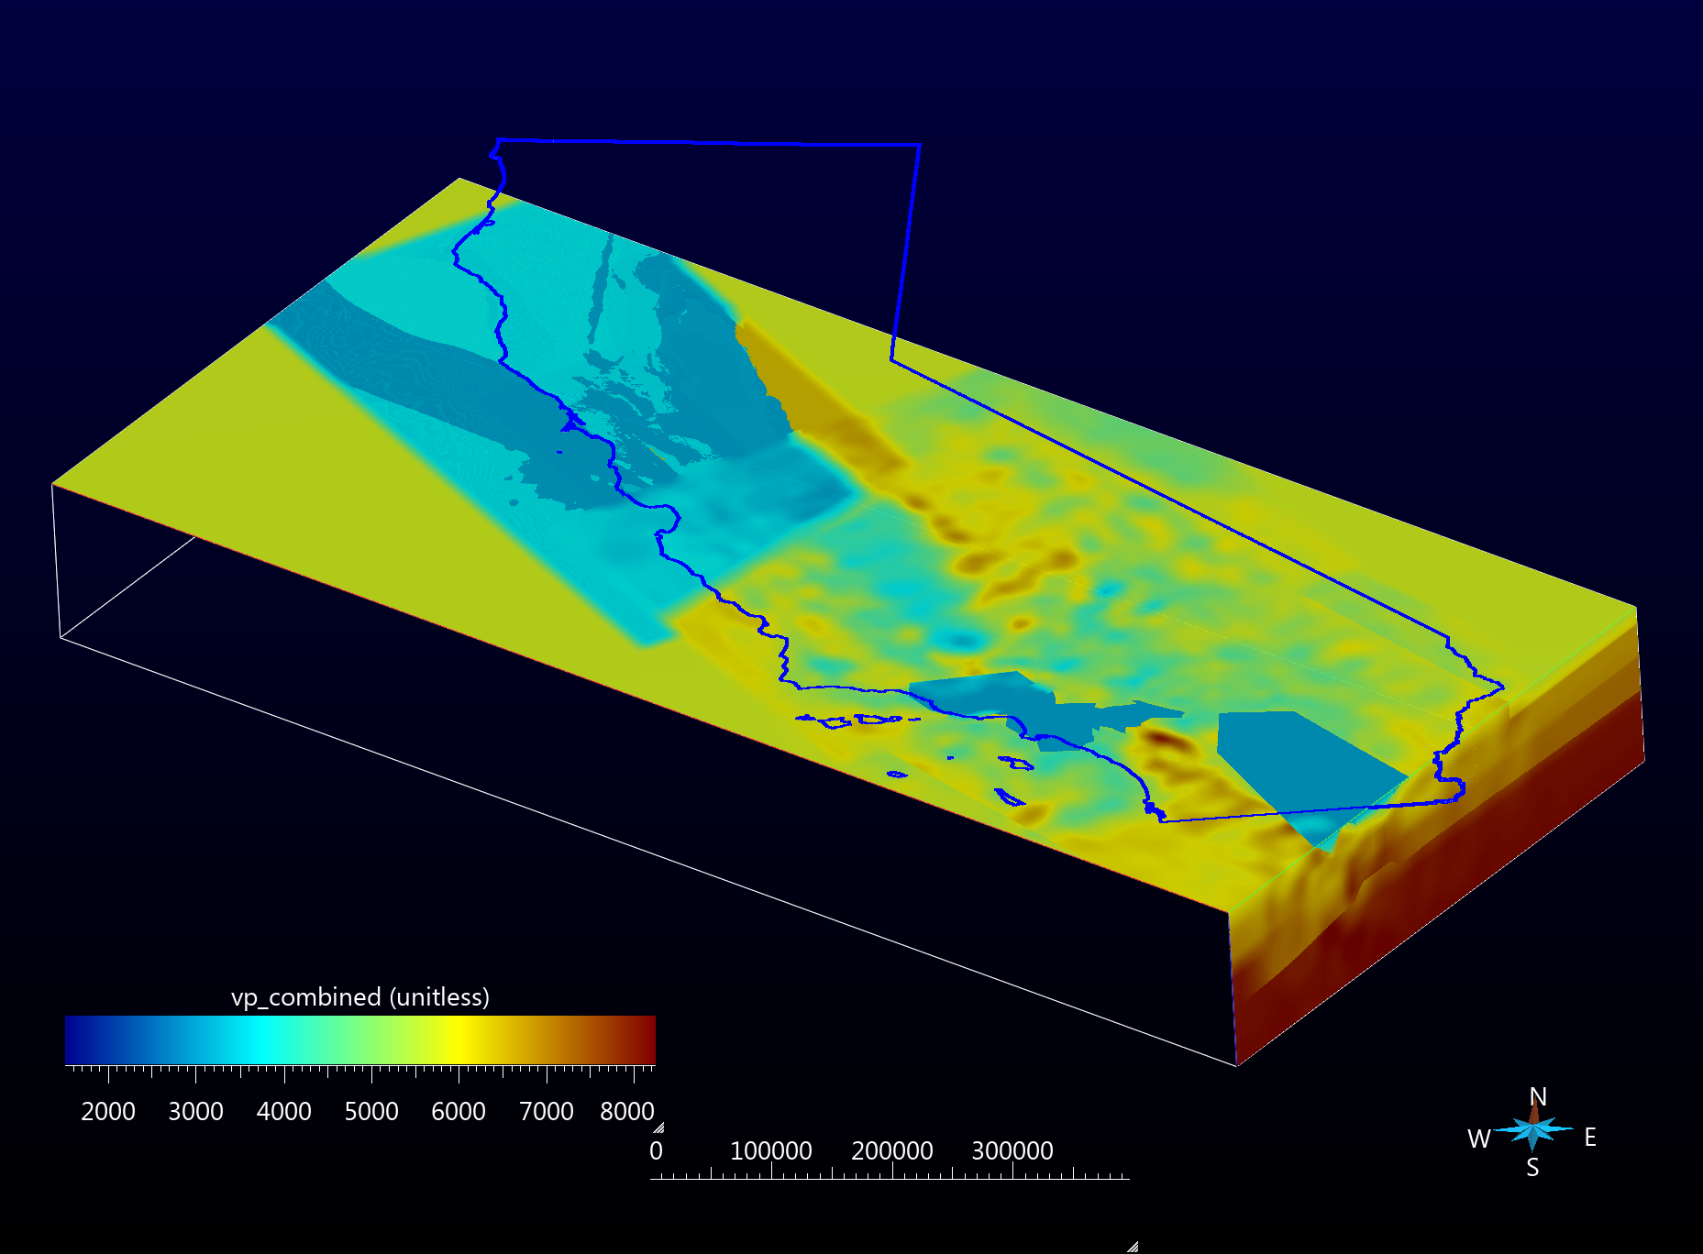
CyberShake Study CS17.3 mesh (cca06, bay area, cvm-s4.26.m01)
6960 x 3200 x 288 cells (6.4 billion cells)
175m x 175m x 175m resolution
origin at S corner at 548969, 3459243, 0 (UTM Z11, WGS84)
Regular grid in UTM space

Slide 26
General Types of SCEC CVM Types
1D Models
Hadley Kanamori, Northridge Region
Rule-based 3D SCEC Model
CVM-S
Unified Structure Representation 3D Model
CVM-H
Tomography Improved Models
CVM-S4.26, CVM-S4.26-M01, CCA06
Simulation-Specific Tiled Models
CS-17.3, CS-18.8
Basin Models and Dense Array Model
CVM-H Basins stand-alone, Coachella Valley, Imperial Valley
Geological Models
CenCal
8. Offshore Model from ocean bottoms sensors
ALBACORE
9. Models with Modified Geotechnical Layer
Ely-Jordan Method, SVM Method, Vs30 Taper Method

Slide 27
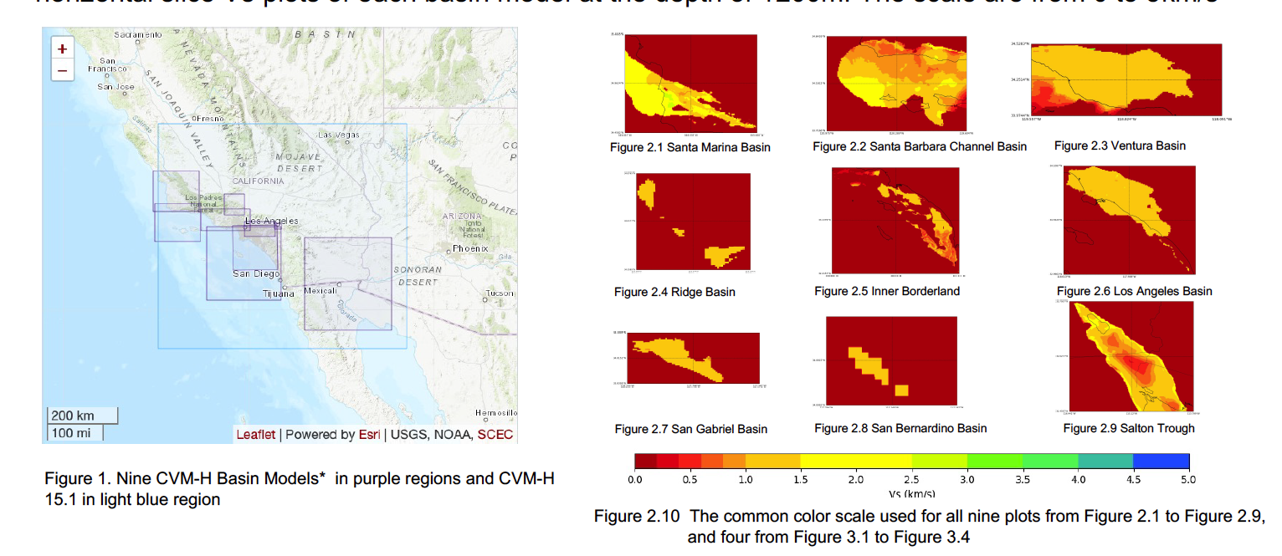
CVM-H Basin Models (max depth ~10km) Standalone

Slide 28
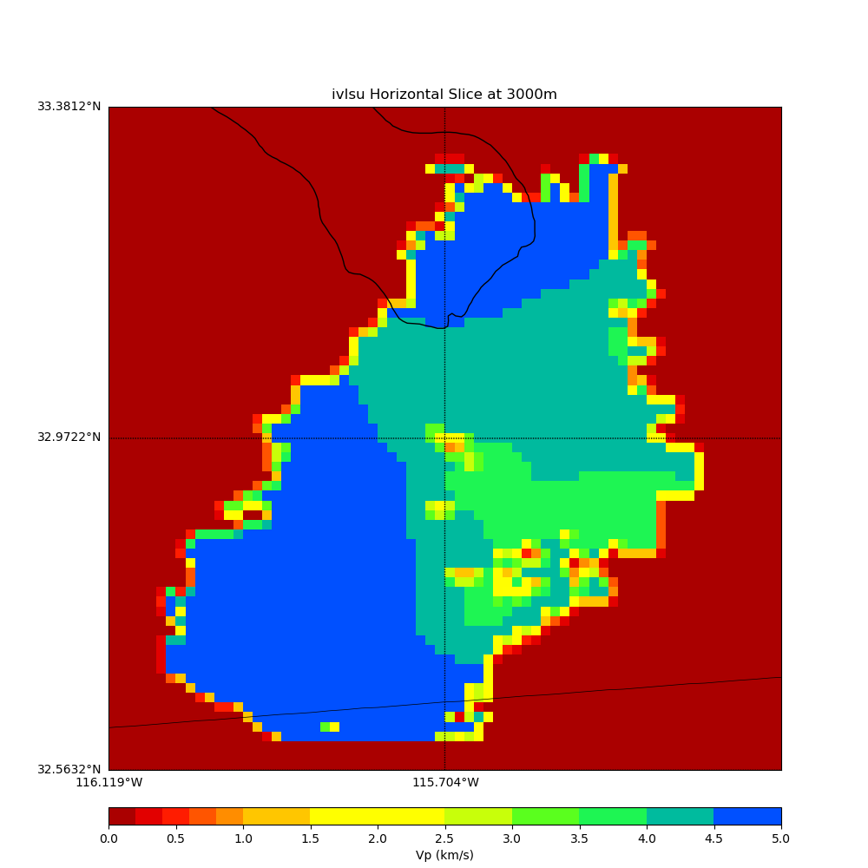
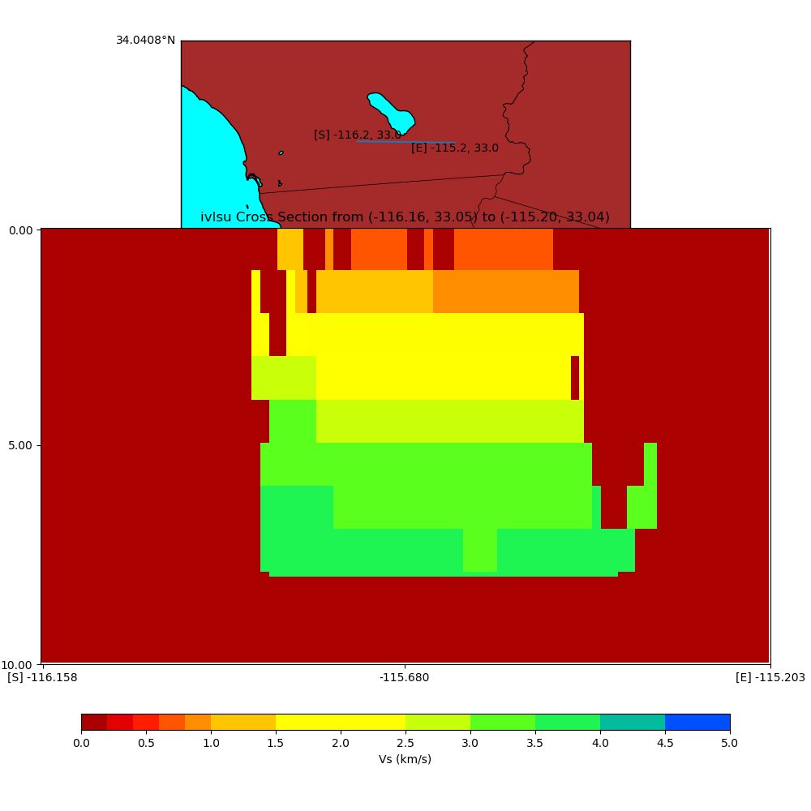
Dense Array Models
Includes:
Coachella Valley Velocity Model
Imperial Valley Velocity Model

Slide 29
General Types of SCEC CVM Types
1D Models
Hadley Kanamori, Northridge Region
Rule-based 3D SCEC Model
CVM-S
Unified Structure Representation 3D Model
CVM-H
Tomography Improved Models
CVM-S4.26, CVM-S4.26-M01, CCA06
Simulation-Specific Tiled Models
CS-17.3, CS-18.8
Basin Models and Dense Array Model
CVM-H Basins stand-alone, Coachella Valley, Imperial Valley
Geological Models
CenCal
8. Offshore Model from ocean bottoms sensors
ALBACORE
9. Models with Modified Geotechnical Layer
Ely-Jordan Method, SVM Method, Vs30 Taper Method

Slide 30
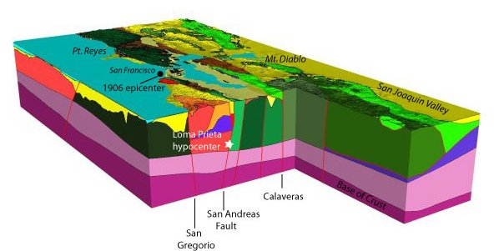
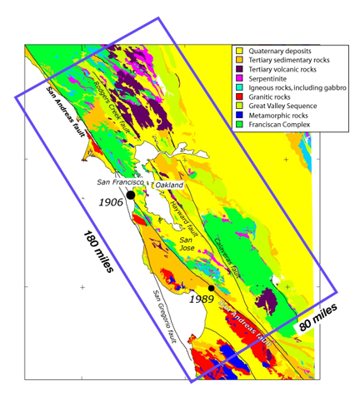
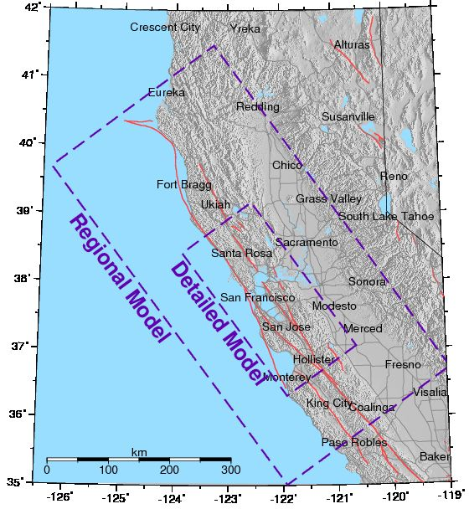
USGS CenCal 0.8.3 (and more recent SF Bay Area Model and
National Crustal Model) identify geological regions and associate Seismic Velocity Properties to each

Slide 31
General Types of SCEC CVM Types
1D Models
Hadley Kanamori, Northridge Region
Rule-based 3D SCEC Model
CVM-S
Unified Structure Representation 3D Model
CVM-H
Tomography Improved Models
CVM-S4.26, CVM-S4.26-M01, CCA06
Simulation-Specific Tiled Models
CS-17.3, CS-18.8
Basin Models and Dense Array Model
CVM-H Basins stand-alone, Coachella Valley, Imperial Valley
Geological Models
CenCal
8. Offshore Model from ocean bottoms sensors
ALBACORE
9. Models with Modified Geotechnical Layer
Ely-Jordan Method, SVM Method, Vs30 Taper Method

Slide 32
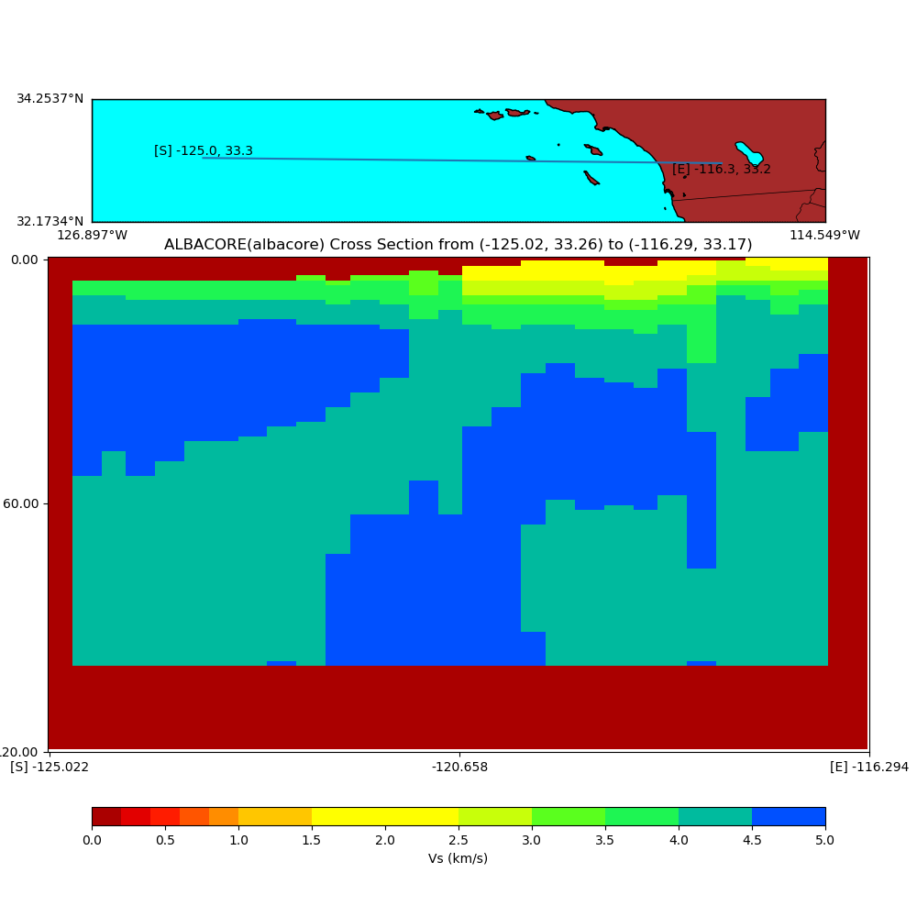
ALBACORE Off-shore model from Ocean Bottom Sensors

Slide 33
General Types of SCEC CVM Types
1D Models
Hadley Kanamori, Northridge Region
Rule-based 3D SCEC Model
CVM-S
Unified Structure Representation 3D Model
CVM-H
Tomography Improved Models
CVM-S4.26, CVM-S4.26-M01, CCA06
Simulation-Specific Tiled Models
CS-17.3, CS-18.8
Basin Models and Dense Array Model
CVM-H Basins stand-alone, Coachella Valley, Imperial Valley
Geological Models
CenCal
8. Offshore Model from ocean bottoms sensors
ALBACORE
9. Models with Modified Geotechnical Layer
Ely-Jordan Method, SVM Method, Vs30 Taper Method

Slide 34
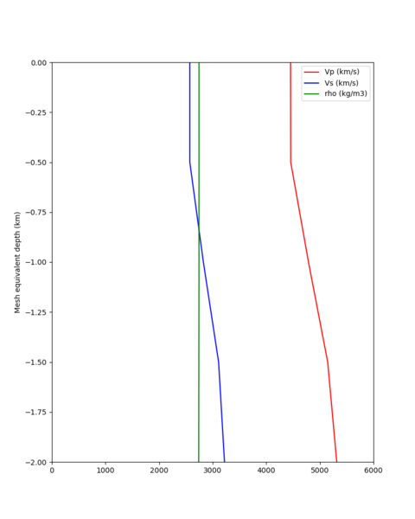
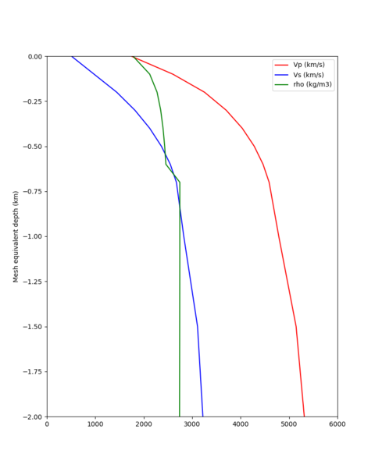
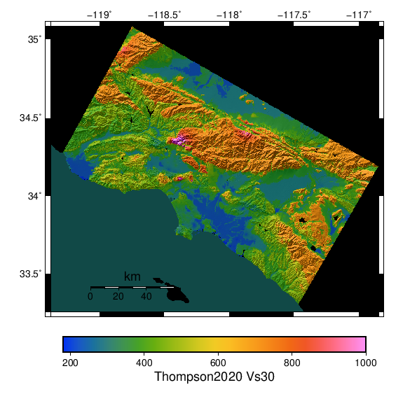
SCEC Developed techniques to add (or restore) low Vs near surface values by using Vs30 at surface merged into model in top 1000m
CVM-S4.26 Profile Near Palmdale
CVM-S4.26 Profile Near Palmdale with Vs30 Taper
California Vs30 Map

Slide 35
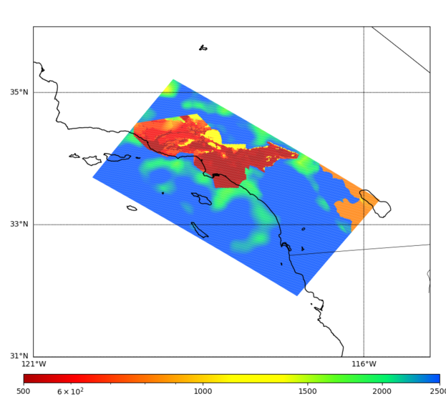
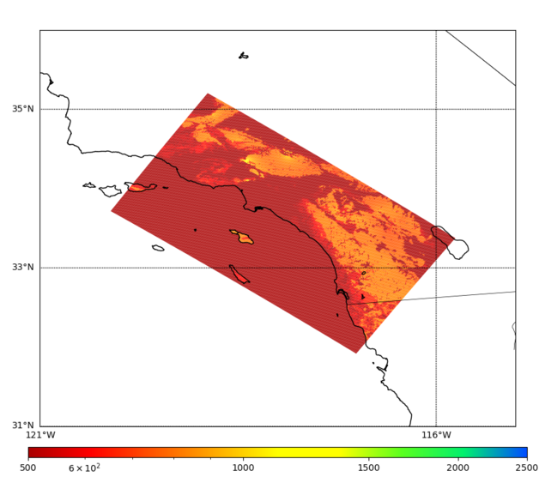
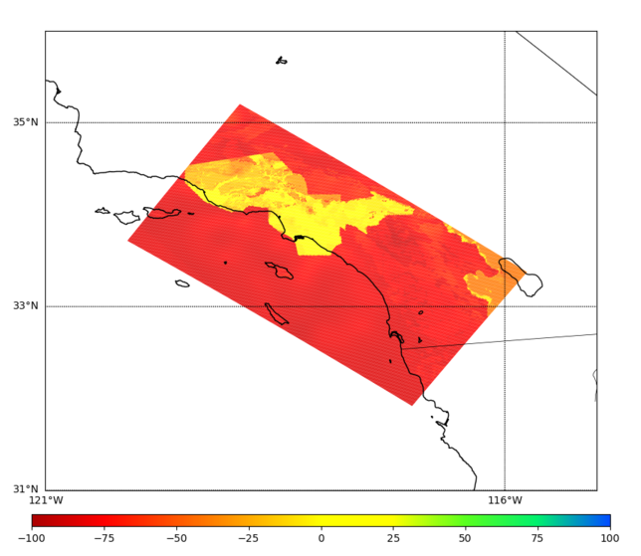
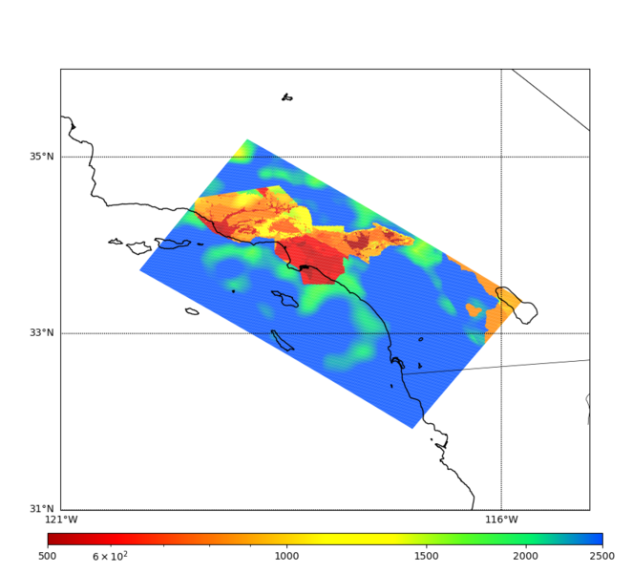
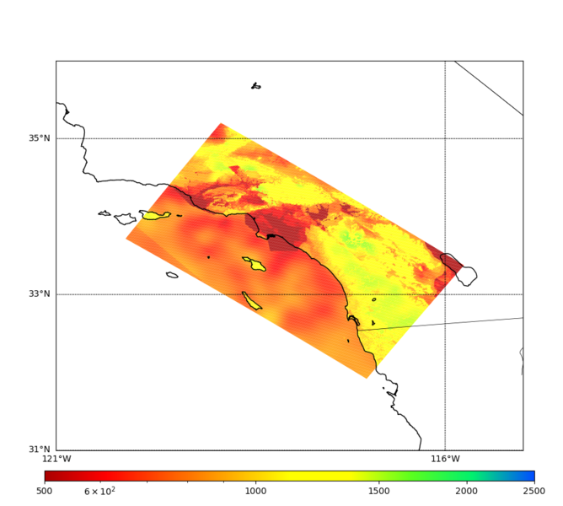
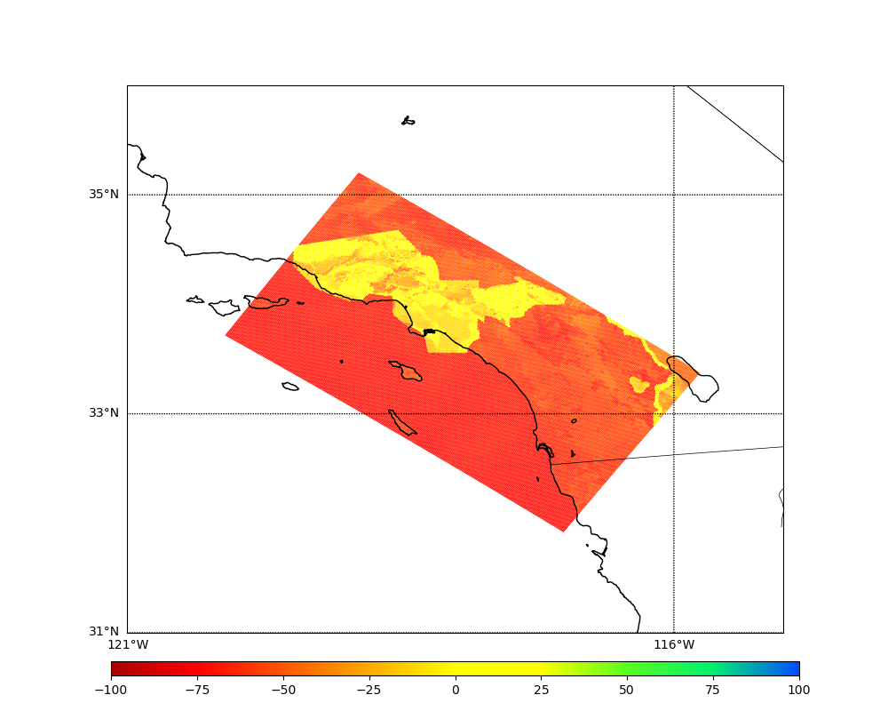
Vs at 0m (top) and 100m (bottom)
Vs at 100m
Vs from CVM-S4.26.M01 Vs from CVM-S4.26.M01 w/ Vs30 Taper % Differences

Slide 36
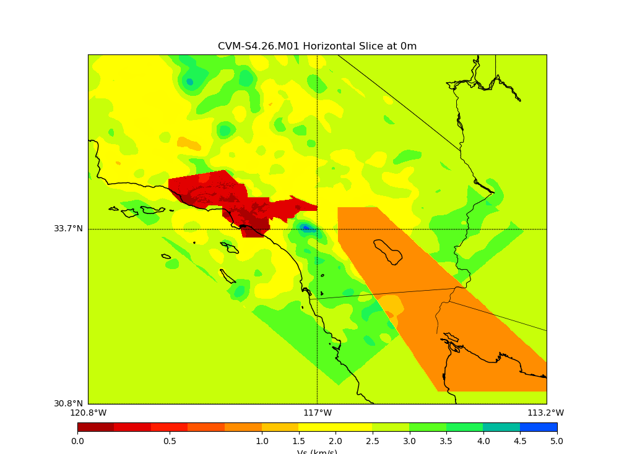
CVM-S4.26 (no gtl,no bkg)
CVM-S4.26-M01 (native gtl, bkg) – restored gtl

Slide 37
Agenda
SCEC CVMs used in ground motion modeling
General Types of SCEC CVMs
UCVM Software

Slide 38
Motivations for UCVM Development
Ground motion modelers want to compare ground motion simulations using alternative velocity models.
Goal was to create software tools for generating equivalent meshes from different velocity models (e.g. develop a standard way to query by depth for models that are query by elevation)
Additional capabilities added during 10+ years of development

Slide 39
Capabilities of UCVM software
UCVM is not needed to access several of these California models. Reasons to use UCVM include the following:
Provide standard query interface (lat,lon,depth) for models and common returned parameters (Vp,Vs,density)
Command line query and C API interface
Add/Remove topography as needed to match the velocity model (flat or topography) to the simulation velocity mesh (flat or topography)
Combine models using tiling (list order of models to be queried)
Modify near surface properties based on Vs30 values
Discretize region and define mesh points for cartesian meshes
Generate Hercules e-tree meshes
Perform parallel query (using MPI) to create large meshes (1 Billion+ points).

Slide 40
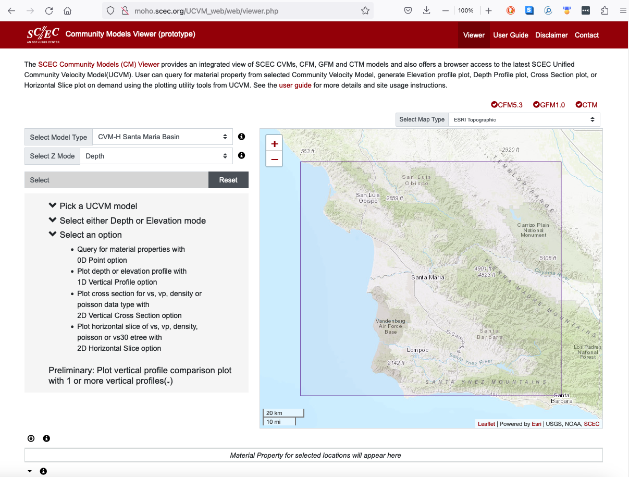
Community Velocity Model (CVM) Web Viewer
CVM Web Viewer: http://moho.scec.org/UCVM_web/web/viewer.php
The Community (Velocity) Model web viewer helps users visualize and download CVM data. It uses the Unified Community Velocity Model (UCVM) Software to access a collection of CVMs.
The Community Velocity Model Web Viewer overlays other SCEC community models including CFM and CTM onto the velocity models.

Slide 42
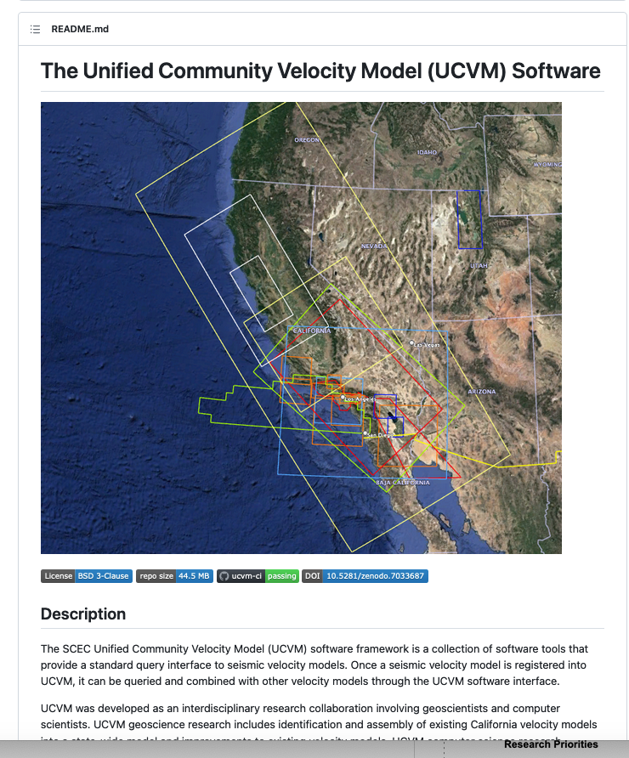
Unified Community Velocity Model (UCVM) Github Page
UCVM Github Repo: https://github.com/SCECcode/ucvm.git
UCVM is distributed as open-source software from the UCVM Github repository. New velocity models are integrated into UCVM on a regular basis. There are several ways to access the UCVM software.
UCVM is used by the SCEC CVM Web viewer. This site is recommended for users investigating the available CVMs.
Small or moderate users can access CVM models using a UCVM Docker image on Dockerhub.
Large-scale users, such as ground motion modelers running simulations on HPC systems, will want to retrieve and build UCVM.
Cite as: Small, P., Gill, D., Maechling, P. J., Taborda, R., Callaghan, S., Jordan, T. H., Ely, G. P., Olsen, K. B., & Goulet, C. A. (2017). The SCEC Unified Community Velocity Model Software Framework. Seismological Research Letters, 88(5). doi:10.1785/0220170082. SCEC Contribution 2067

Slide 43
Current ucvm query by depth specifies depth below ground level as a positive number. Negative depths are not valid because the query points would be in the air or in the water.
below ground level
above sea level

Slide 44
CVM-H and CenCal models query by elevation return Vp and Vs properties of water for points below sea level and above ground level using a bathymetry model.
5000m Elev

Slide 45
Interface | GMD Standard Query | GMD Squashing Query (5000m,surface=Topography_bathymetry)
PT1 | 400 | -600
PT2 | -1500 | -2500 (approx. due to interpolation)
PT3 | -7500 | -7500
PT4 | -1500 | -500 (approx. due to interpolation)
PT5 | -7500 | -7500
2000
Ground Level
Sea level
1000
0
Pt1
+400 asl
-1000
-2000
Pt2
-1500 bsl
Pt4
-1500 bsl
-3000
-4000
-5000
-6000
-7000
-8000
Pt3
-7500 bsl
Pt5
-7500 bsl

