Slide 1
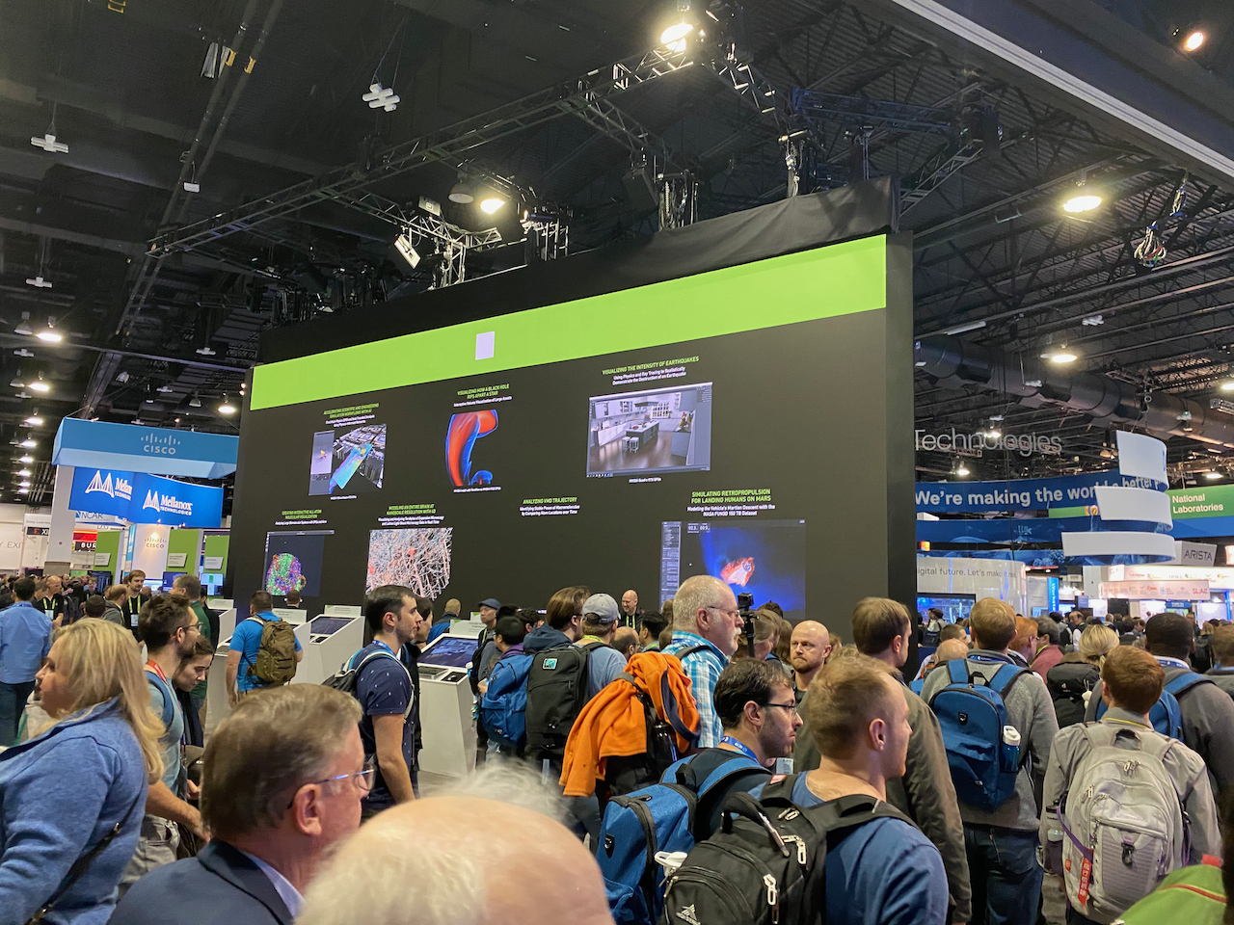
Visualizing the Intensity of Earthquakes
Using Physics and Ray Tracing to Realistically Demonstrate the Destruction of an Earthquake
Ground Motion Simulation Performed on OLCF Summit using NVIDIA Volta GPUs
Visualization Using NVIDIA Quatro RTX GPUs

Slide 2
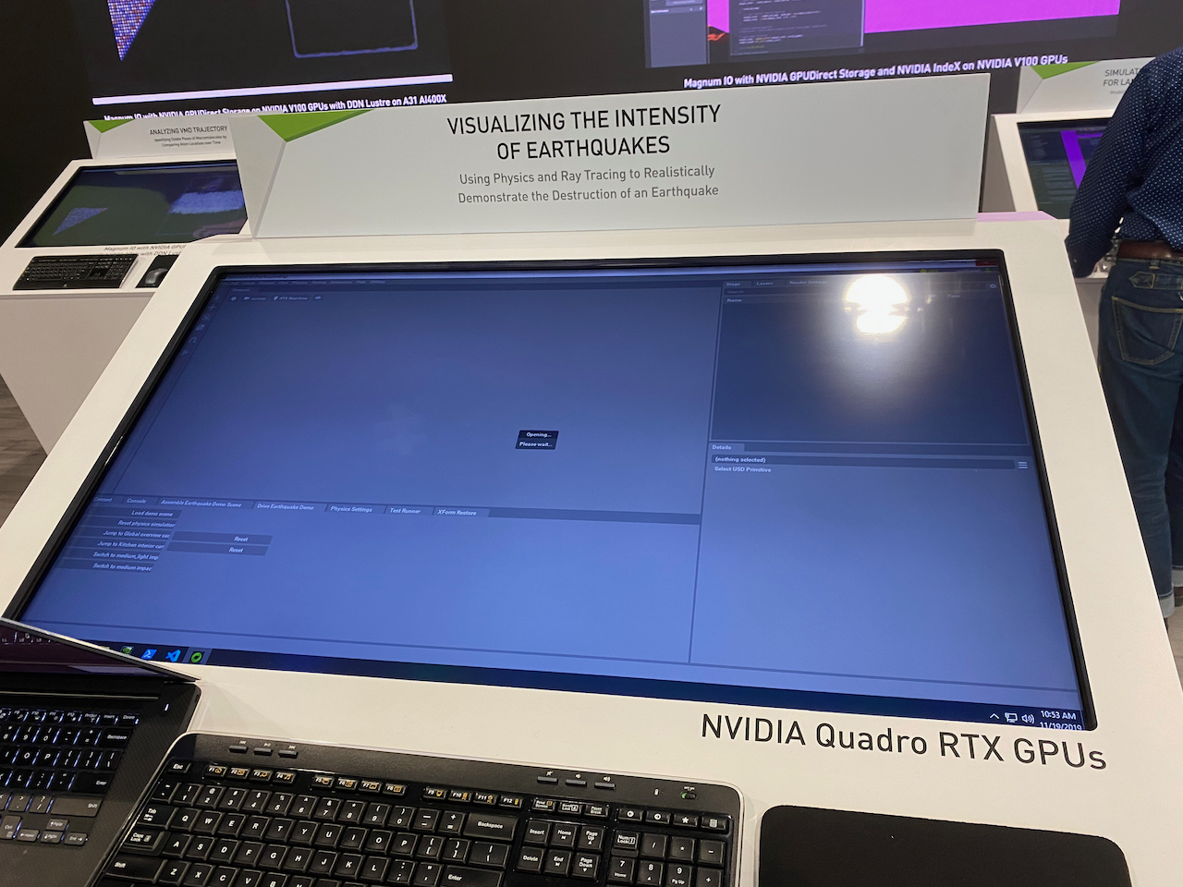
Visualizing the Intensity of Earthquakes
Using Physics and Ray Tracing to Realistically Demonstrate the Destruction of an Earthquake
Ground Motion Simulation Performed on OLCF Summit using NVIDIA Volta GPUs
Visualization Using NVIDIA Quatro RTX GPUs

Slide 3
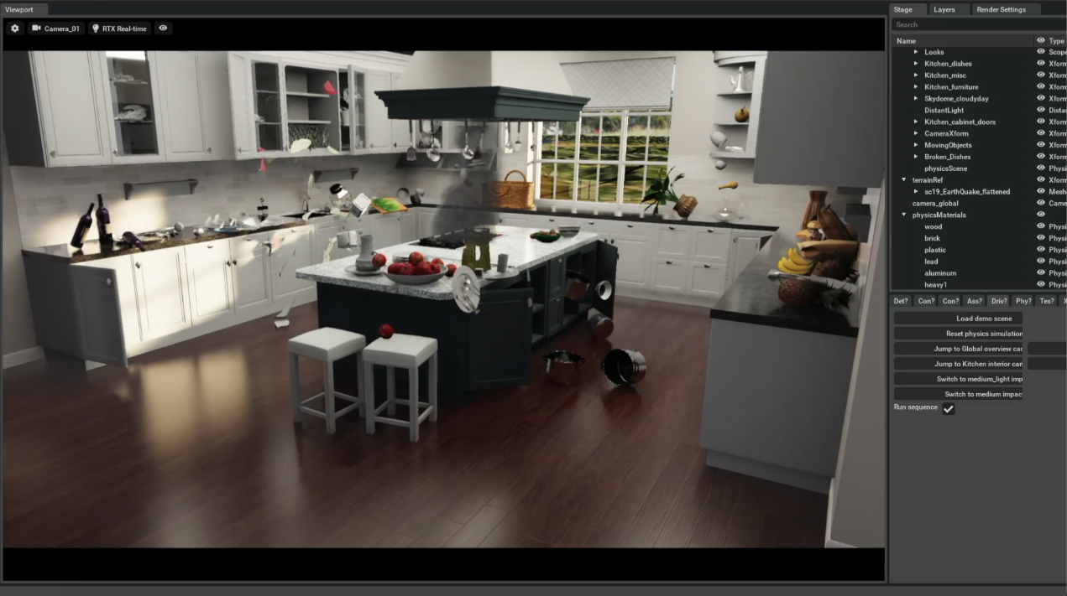
Visualizing the Intensity of Earthquakes
Using Physics and Ray Tracing to Realistically Demonstrate the Destruction of an Earthquake
NVIDIA showed an interactive earthquake intensity visualization system at their SC19 exhibit. They created this movie after the conference to show an example of what the interactive display showed. The display operator could input ground motions from a Cascadia M9.2 simulation that Daniel ran on Summit. The operator could also input Ridgecrest ground motions from the BBP that Fabio calculated.
Internal Review: http://hypocenter.usc.edu/research/viz/NVIDIA_SCEC_SC19.mov

Slide 4
NVIDIA:
Peter Messmer - Senior Manager HPC Visualization Development Technology at NVIDIA
Mathias Hummel - Scientific Visualization Software Engineer at NVIDIA
Jon Saposhnik - HPC Specialist at NVIDIA
San Diego State University (SDSU):
Daniel Roten – Computational Research Seismologist at SDSU
Kim Olsen – Professor in the Dept of Geological Sciences at SDSU
San Diego Supercomputer Center (SDSC):
Yifeng Cui – Director of the High Performance GeoComputing Laboratory at SDSC
Oak Ridge National Laboratory Leadership Computing Facility (OLCF) Summit:
Judith Hill – Computational Scientist and Group Leader for Scientific Computing Group at OLCF
Jack Wells – Director of Science for the National Center for Computational Sciences at OLCF
The Southern California Earthquake Center (SCEC):
Philip Maechling – Computer Scientist Sr. at SCEC
Jason Ballman – Communications Manager at SCEC
Mark Benthien – Director for Communication, Education, and Outreach at SCEC
Fabio Silva - Computer Scientist at SCEC

